Slide 1
An introduction to aLTmetrics
Sarah Goodier
May 2016

Slide 2
Who am I?
Currently:
Researcher and evaluation advisor on the Research on Open Educational Resources for Development (ROER4D) project
Work with altmetric tools to investigate the broader impact of ROER4D’s work
Previously:
Scholarly communications officer and researcher at the OpenUCT Initiative
Worked with altmetric tools to investigate the broader impact of both OpenUCT’s outputs and several UCT academics’ outputs

Slide 3
What we’ll be covering today:
A brief look at the research cycle and measuring impact using bibliometrics (focus on citations)
The rise of Altmetrics (What is it? What does it enable?)
What can you do with it? A free tool you can use

Slide 4
The Research Cycle
Conceptualisation
Data Collection
Findings
Engagement
Translation
Data Analysis

Slide 5
Traditional Scholarship
Student
Literature Reviews
Conceptual Frameworks
Bibliographies
Conceptualisation
Data Collection
Findings
Engagement
Translation
Data Analysis
Proposals
Notes
Recorded interviews
Lectures
Data sets
Presentations
Images
Reports
Audio records
Interviews
Community
Books
Conference papers
Journal articles
Technical papers
Scholar

Slide 6
Measuring impact
Student
Literature Reviews
Conceptual Frameworks
Bibliographies
Conceptualisation
Data Collection
Findings
Engagement
Translation
Data Analysis
Proposals
Notes
Recorded interviews
Lectures
Data sets
Presentations
Images
Reports
Audio records
Interviews
Community
Books
Conference papers
Journal articles
Technical papers
Bibliometrics: CITATIONS
Scholar

Slide 7
Traditional Impact Factor
Metrics that impute reputation and impact for the journal - based on how frequently articles published in that journal are cited in other published articles.
accrue to the journal
take time (as citing journal /paper has to be published)
Originated in 1960s (Garfield)
Beasley, Beyond the Impact Factor, Feb 2014

Slide 8
ISI or Web of Science impact factor
Published annually in the Journal Citation Reports (which lags by a year, i.e. the most recent JCR data is for 2014/15)
# of citations to articles in ABC Journal x during year # of articles published in ABC Journal x in past two years
1.0 means that, on average, the articles published in ABC Journal within the past two years have been cited one time
Beasley, Beyond the Impact Factor, Feb 2014

Slide 9
How the Impact Factor works
One article can make a huge difference to the IF for the whole journal
EG Shelx cited 32k, raised IF from 2 to 50
Measures only journal & year
Does not differentiate content cited
Subject areas vary enormously
Extensive criticism of the IF
Hardcastle 2013

Slide 10
Other Impact Measures: H-index: authors, not articles
“The H-index measures the maximum number of papers N you have, all of which have at least N citations. So if you have 3 papers with at least 3 citations, but you don’t have 4 papers with at least 4 citations then your H-index is 3.”
Bateman, A. (2012, October 19). Why I love the H-index

Slide 11
Citations
Citations are the norm but have been criticised for
Delays (citation latency)
Not measuring quality (cited because it is wrong, objectionable)
Measuring only one research output (research article)
Measuring only scholar-scholar (not scholar- society)
Easy to game
Nevertheless, they count
Especially for scholar-scholar

Slide 12
The rise of academic online services and social media¹
1997
Blogging
2001
Wikipedia
2003
LinkedIn
2005
YouTube
1999
Friends Reunited (UK)
2002
Friendster (US)
2004
Facebook, MySpace, Flickr, Podcasting
2006
Twitter
17 million faculty members and graduate students in the world²
http://www.uncp.edu/home/acurtis/NewMedia/SocialMedia/SocialMediaHistory.html
http://www.richardprice.io/post/12855561694/the-number-of-academics-and-graduate-students-in-the
From Pat Loria, Altmetrics as indicators of public impact, 2013

Slide 13
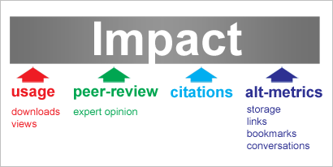
Broader measures of impact

Slide 15
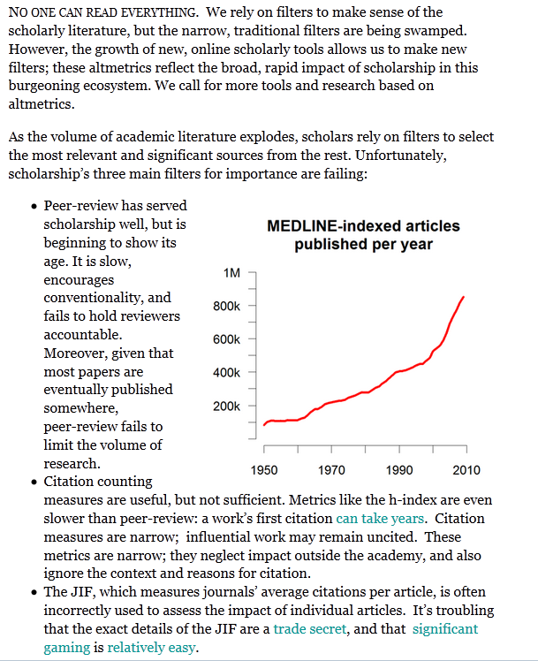
http://altmetrics.org/manifesto/

Slide 16
Defining Altmetrics
About new ways of measuring impact and influence of research
Social media
Scholar- community
as well as
Scholar- scholar
About new focus” (“non-traditional “outputs)
From journal article
All research “products”

Slide 17
Defining AltMetrics
Different definitions (a problem)
Goals
To be more timely than citations
To measure societal impact
To value all research products
Pinowar 2013
“Altmetrics is a good idea but bad name, we would like to propose “influmetrics”
Rousseau, R., & Ye, F.Y. (2013.
Source: S Haustein 2013

Slide 18
Rethinking Impact
New practices, new measures

Slide 19
Altmetrics
& online activity
Social media
Student
Social media
& online activity
Literature Reviews
Conceptual Frameworks
Bibliographies
Conceptualisation
Data Collection
Findings
Engagement
Translation
Data Analysis
Proposals
Notes
Recorded interviews
Lectures
Data sets
Presentations
Images
Reports
Audio records
Interviews
Books
& online activity
Conference papers
Journal articles
Technical papers
Community
Social media
Social media
& online activity
Scholar

Slide 20
New Practices
online reader / user behaviour
network interactions with content
online content management

Slide 21
How could you use this information?
Altmetrics explainer video: https://youtu.be/M6XawJ7-880

Slide 22
Issues
Ifs and buts

Slide 23
…a bias towards Journal articles

Slide 24
Meaning
What can you tell from the numbers? What does a metric say about quality of the work? What does it tell one about the researcher?
Better to ask: what does it mean to me?
Find and talk about NB narratives

Slide 25
Uneven
Disciplinary bias
30-40% of recent biomedical papers have Altmetric attention
Less than 10% of social sciences
Global geo bias
Tools have bias, data sources are those popular in USA and Europe
E Adie , 2013 Altmetric.com

Slide 26
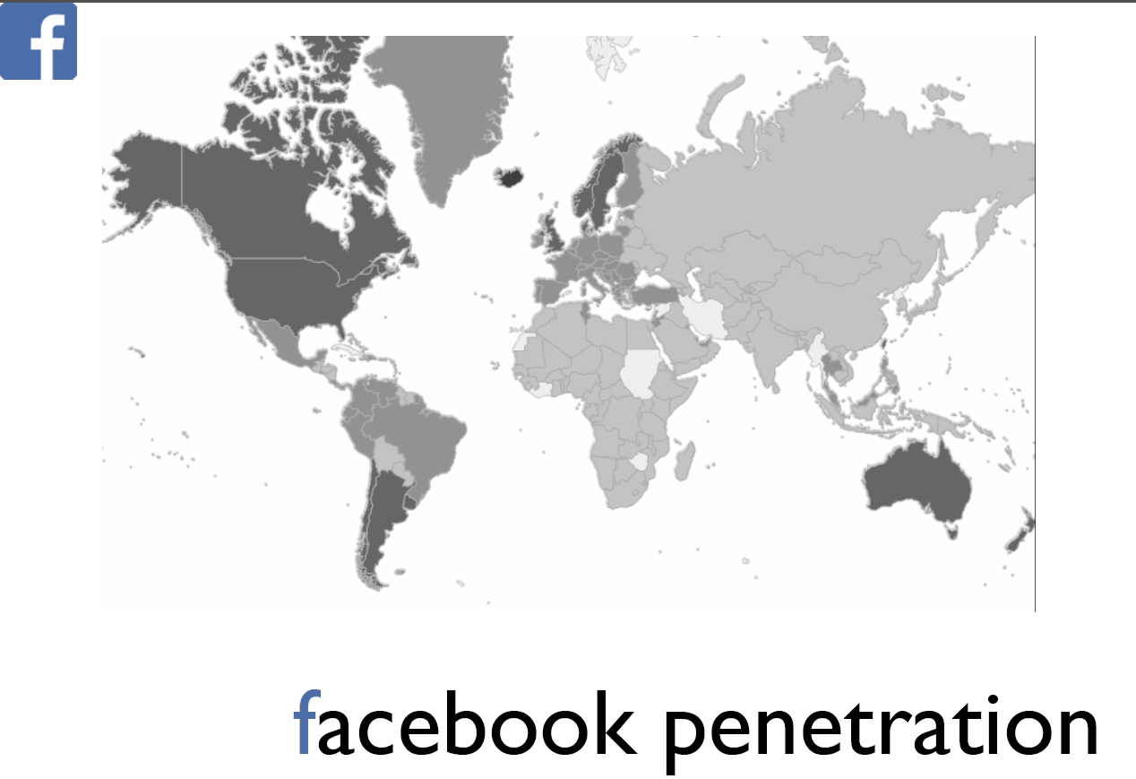
Global divides: social media tools
https://speakerdeck.com/jalperin/altmetrics-propagating-global-inequality

Slide 27
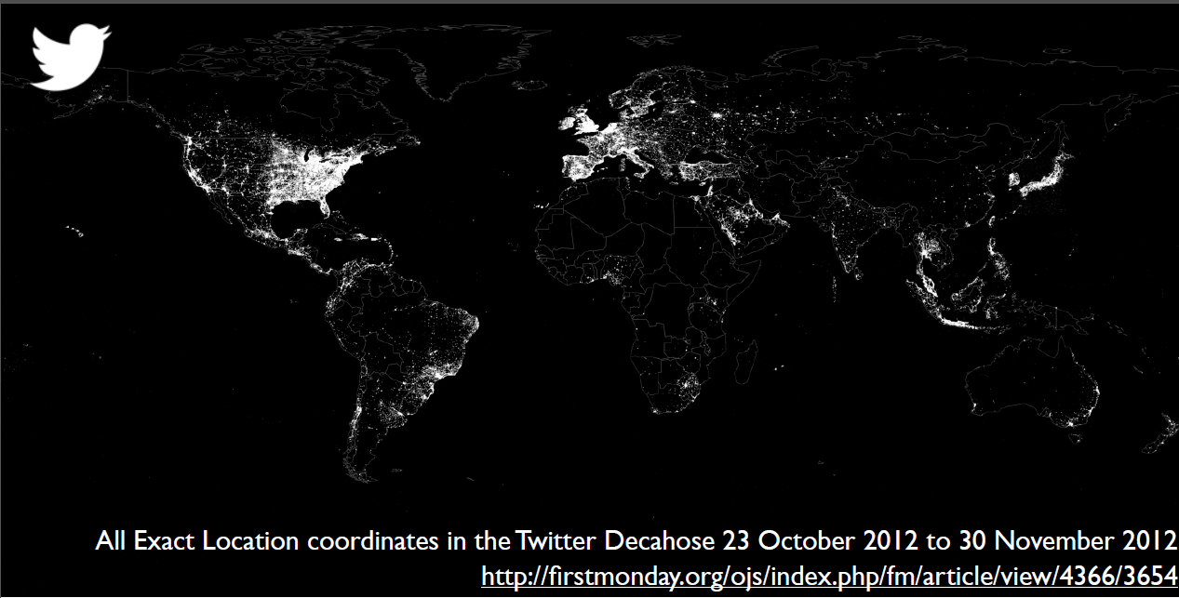
Global divides: social media tools
https://speakerdeck.com/jalperin/altmetrics-propagating-global-inequality

Slide 28
Nascent
Studies needed
to analyse who, why, how people use various platforms
Differences and biases ito disciplines, topics, output types & source, author age etc
Cannot determine audience by platform
Need studies to differentiate audiences and types/ levels of engagement
Need transparency in data aggregation
S Haustein, 2013

Slide 29
TOOLS

Slide 30
Altmetrics tools
Altmetric
An Elsevier product name
Adopted by Springer, Nature Publishing Group, Scopus, Biomed Central
Impact Story
Open source altmetric tool.
Draws on variety of social and scholarly data sources.
Plum Analytics
Owned by Ebsco, focuses on metrics for articles, chapters, datasets, presentations, source code.
PLOS
has developed its own (freely available) code for deriving metrics

Slide 31
A Free & Easy-to-use Tool
Bookmarklet

Slide 32
What is Altmetric.com?
“Altmetric tracks what people are saying about papers online on behalf of institutions, publishers, authors, libraries and institutions” http://www.altmetric.com/
The bookmarklet is “a simple browser tool that lets you instantly get article level metrics for any recent paper, for free”

Slide 33
The Bookmarklet

Slide 34
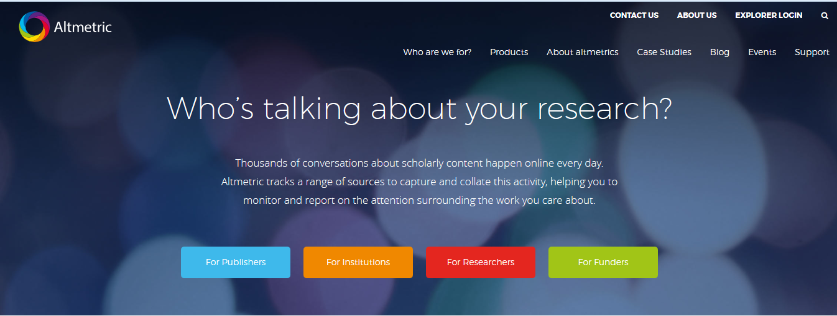
To get started: go to http://www.altmetric.com

Slide 35
Mouse over “Products”

Slide 36
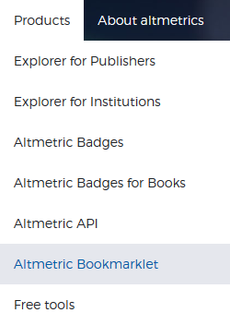
Click on “Bookmarklet”

Slide 37
The bookmarklet is available for the browsers: Chrome, Firefox and Safari

Slide 38
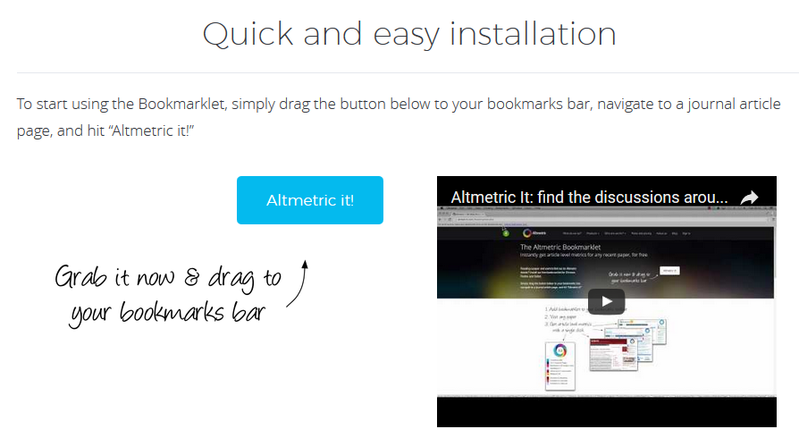
Very easy to install: just grab the “Altmetric it!” button and drag it to your bookmarks bar

Slide 39
Very easy to install: just grab the “Altmetric it!” button and drag it to your bookmarks bar

Slide 40
Once installed, the “Altmetric it!” button will appear in your bookmarks bar

Slide 41
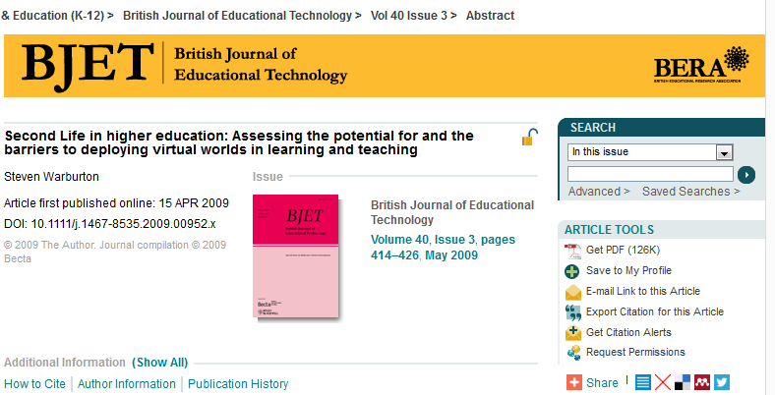
You can use the bookmarklet:
On any article that has a Digital Object Identifier (DOI)
e.g. doi: 10.1002/berj.3000

Slide 42
You can use the bookmarklet:
On any article that has a Digital Object Identifier (DOI)
e.g. doi: 10.1002/berj.3000
A DOI is:
“a unique alphanumeric string assigned to a digital object, such as an electronic journal, article, report, or thesis”
“a stable, persistent link to the full-text of an electronic item on the Internet”
DOIs don't change over time (URLs can), even if the item moves to a new location.
WHAT IS A DOI?
DOI
URL 1
URL 2
Information on DOIs from CrossRef: http://help.crossref.org/#what_is_a_doi

Slide 43
You can use the bookmarklet:
On any article that has a Digital Object Identifier (DOI) e.g. doi: 10.1002/berj.3000

Slide 44
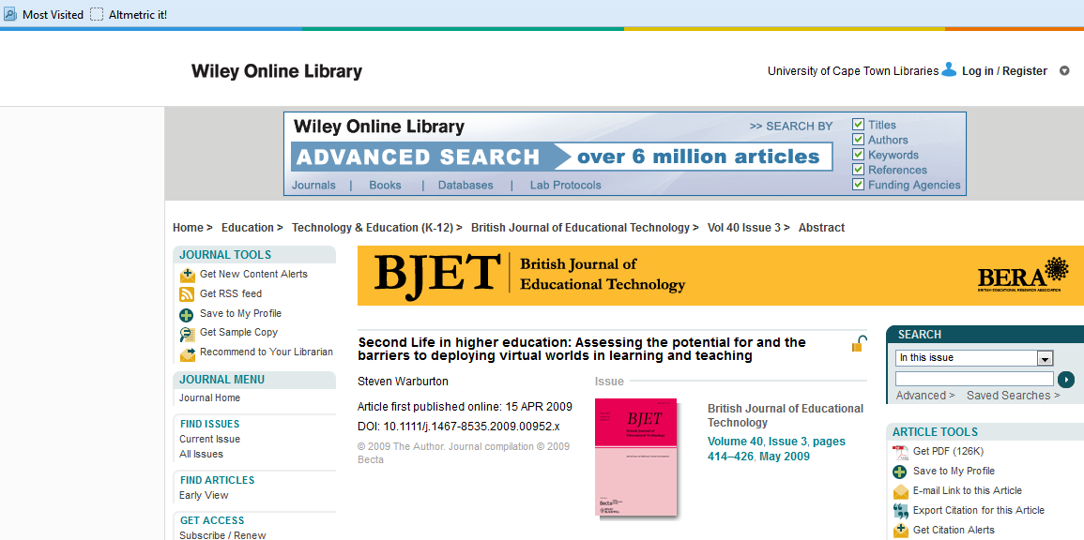
To use the bookmarklet: Navigate to any recent article

Slide 45
To use the bookmarlet: Click on the “Altmetric it!” button in your bookmarks bar

Slide 46
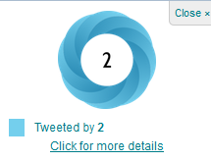
You will see the Altmetric.com results appear in the top right hand corner of your screen:

Slide 47
The Altmetric.com results:
The Altmetric donut
colour-coded according to which sources have mentioned the article

Slide 48
The Altmetric.com results:
The Altmetric score
Quantitative measure of attention for the paper
Considers:
Volume (how many people interact with it),
Sources (what medium its shared in)
Authors (who interacts with it)
of that attention

Slide 49
The Altmetric.com results:
Where the article is being shared/mentioned and how many times

Slide 50
The Altmetric.com results:
More details are available…

Slide 51
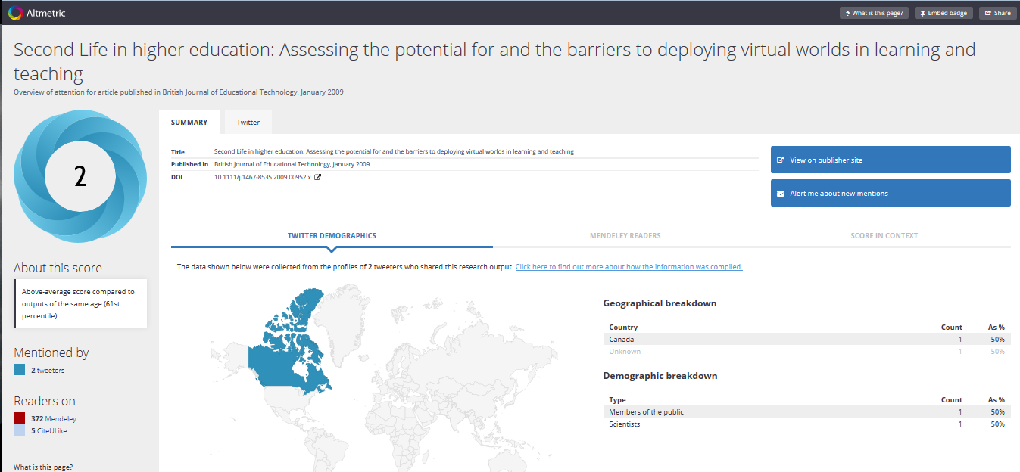
This includes: A summary Including demographic info of those interacting

Slide 52
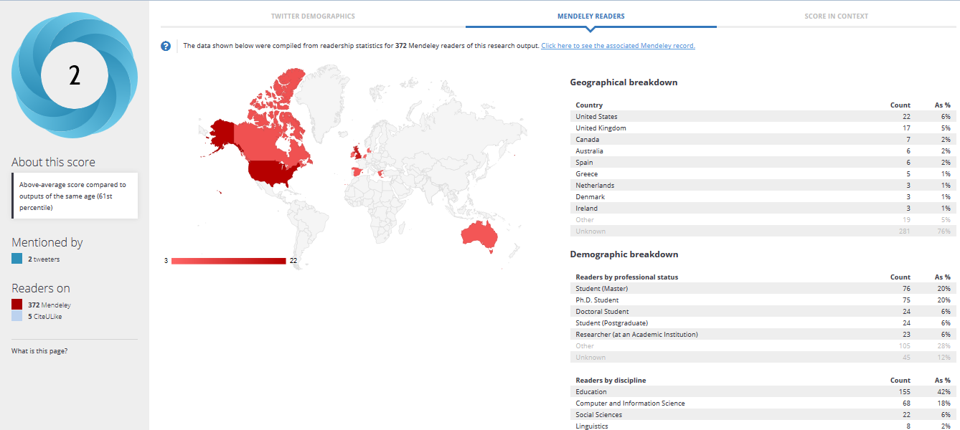
This includes: A summary Including demographic info of those interacting

Slide 53
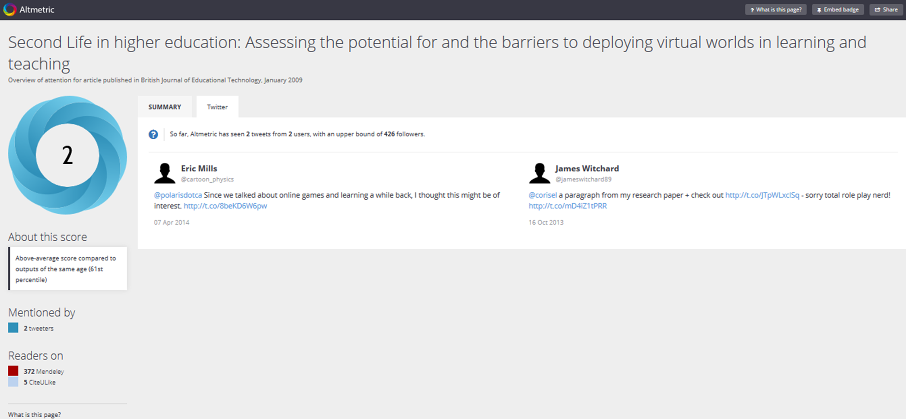
This includes: Tweets

Slide 54
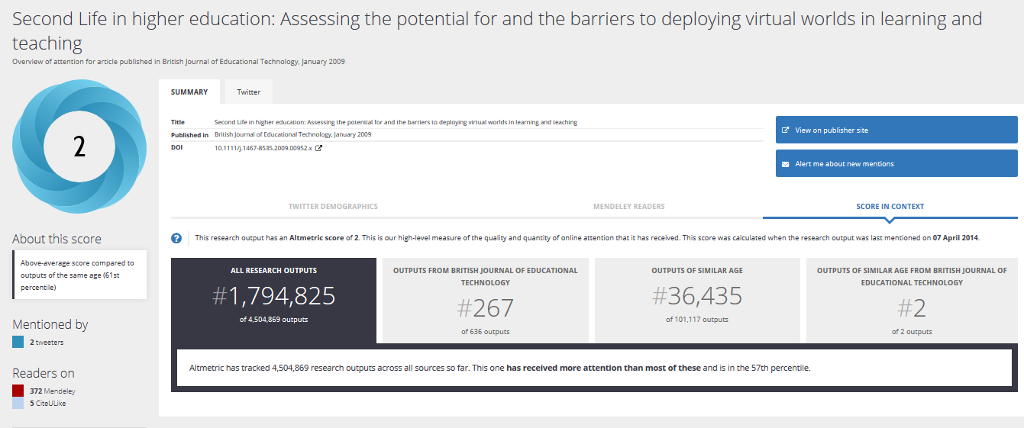
This includes: Some context of the Altmetric score

Slide 55
Nascent Field
Growing area of research

Slide 56
National Information Standards Organization (NISO) is looking into standards around Altmetrics;
Draft looking at Altmetrics Definitions and Use Cases was recently open for public comment
Watch this space!

Slide 57
How might these (alt)metrics be useful to you
in showing the reach and impact
of your work?

Slide 58
Thank you
Sarah Goodier
@SarahGoodier
sarah.goodier@uct.ac.za
Several slides modified from “altmetrics” presentation by Laura Czerniewicz (CC-BY-SA)

Slide 59
Some additional things to note:
Sources of the data measured fall into 4 major categories:
Social media
Online reference manager download counts
Publisher and PubMed Central download counts
Mainstream media data

Slide 60
For more information and to keep up to date with the latest on Altmetric.com and their bookmarklet:
See Altmetric.com’s blog post on their bookmarklet: http://altmetric.com/blog/getting-scholarly-conversations-instantly-altmetric-it/
Follow the blog: http://altmetric.com/blog/
Follow Altmetric.com on Twitter: @Altmetric

