Slide 1
Open Education @ UCT: Becoming an Open Educator
Glenda Cox (Centre for Innovation in Learning and Teaching) and Jill Claassen (Library)
University of Cape Town

Slide 2
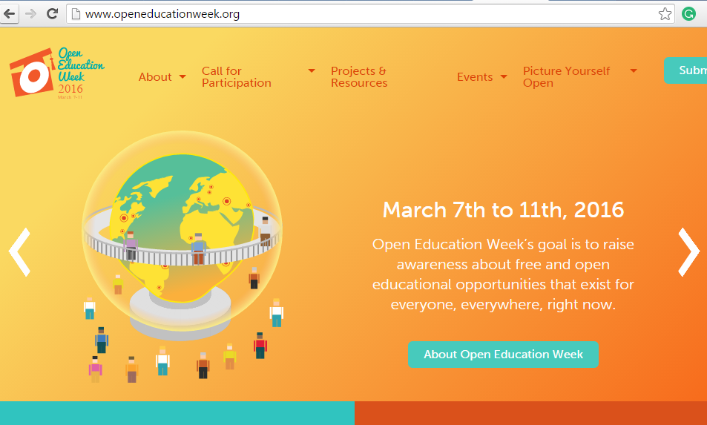

Slide 3
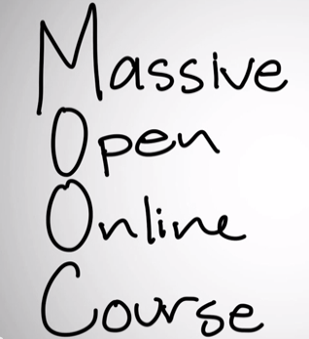
No cost
Degrees of openness depends on rights of the licence that the creator of content has granted to the user.
http://www.moddou.com/
Notes:
What is the meaning of “open” in education?
Open in the sense that there is access to education eg. The Open University in the UK. It is not free but anyone can sign up.
Open education and OER are taking this further to mean access and free
Massively open online courses (MOOCs) are accessible to everyone, not always free and many materials are copyrighted and closed

Slide 4
Open Content part of the “Open Movement”
Open Source Software
The Open Movement
Open Access
Open Society
Open Science
Open Licences
BY Cheryl Hodgkinson-Williams

Slide 5
Open Content / Open educational resources (OER) / Open Courseware are educational materials which are discoverable online and openly licensed that can be:
Shared freely and openly to be…
… redistribute and share again.
Shared
Redistributed
Used
… used by anyone to …
… adapt / repurpose/ improve under some type of license in order to …
Improved
Notes:
The key aspect of an OER is that it is both discoverable online – so that people can find it AND openly licensed - so that people can legally make use of it. OER includes texts, different forms of media, ideas, as well as documented teaching strategies/techniques or practices.
Advocates of openness would suggest that the value in OER is in its potential to support learning in many ways and in many contexts.

Slide 6
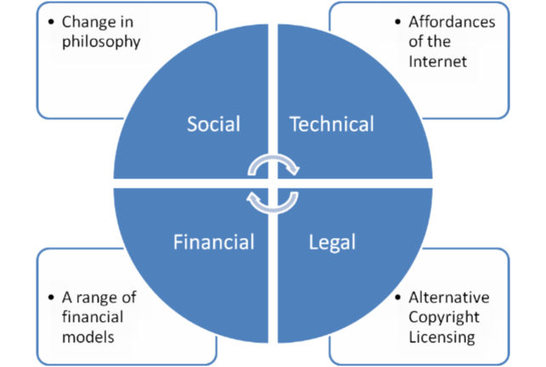
What are the enablers of Open Education?

Slide 7
In 2015 over 1 billion works were licenced under Creative Commons
Notes:
https://stateof.creativecommons.org/report/

Slide 8
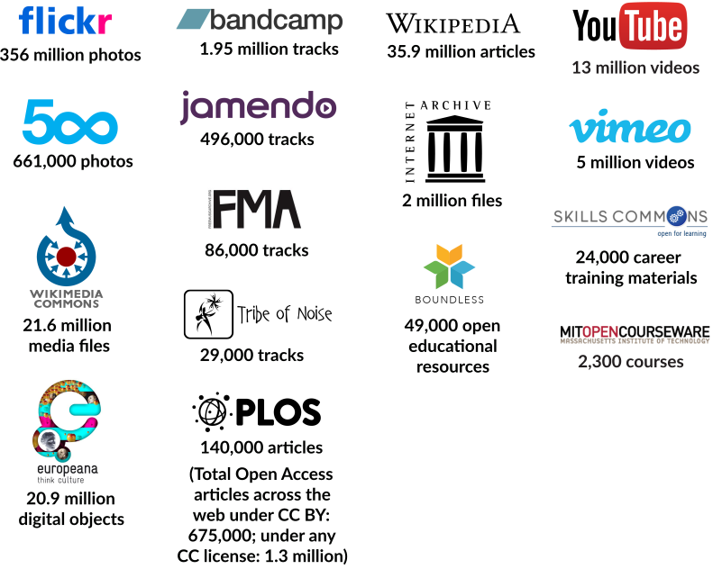
Notes:
https://stateof.creativecommons.org/

Slide 9
175 million visitors

Slide 10
Global Participation
http://www.oeconsortium.org/
Notes:
More than 250 institutions and afflilated organistations

Slide 11
Background to Open education @UCT

Slide 12
OER AT UCT

Slide 13
UCT signs Cape Town Open Education Declaration

Slide 15
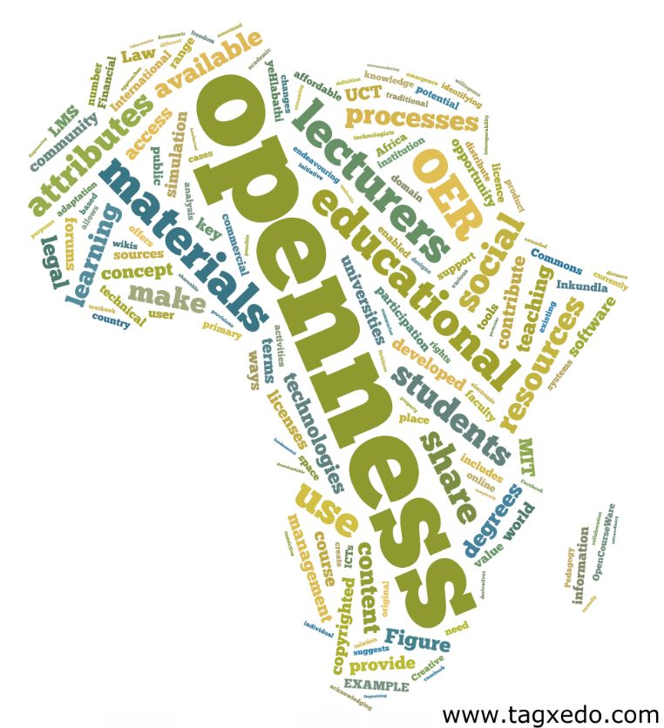
+200 000 visits
184 countries
UK: 6800
Germany: 1802
USA: 24 000
India: 7300
Philippines: 2400
Brazil:1750
Australia: 2152
South Africa
102 000
June 2014- before moving into OpenUCT

Slide 16
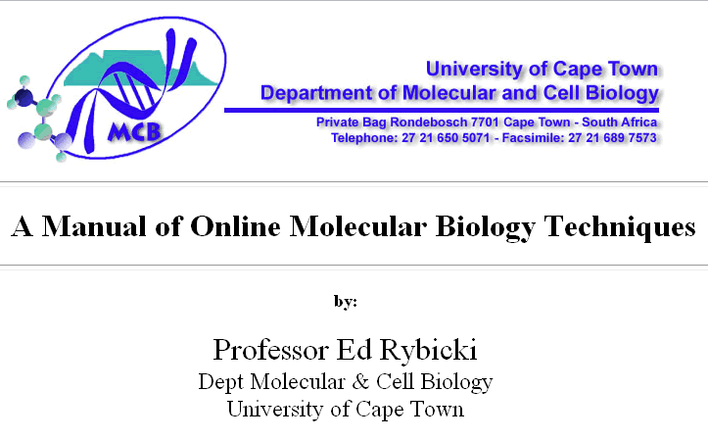
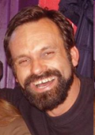
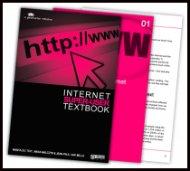
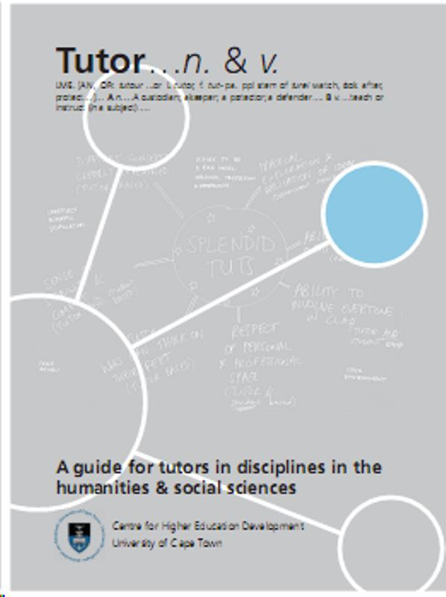
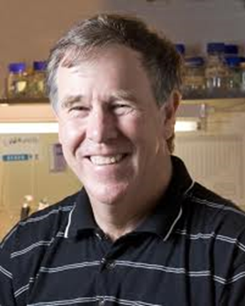
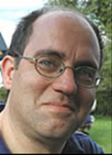
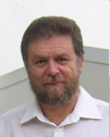
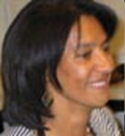
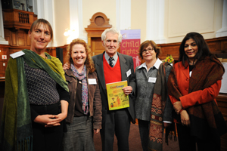
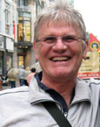
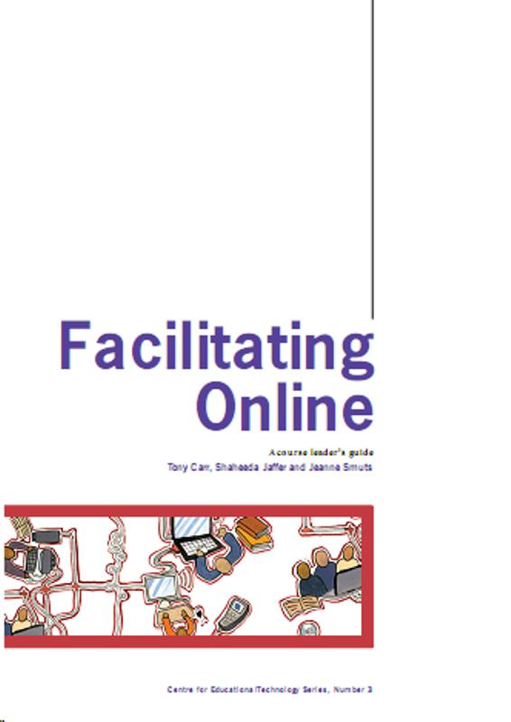
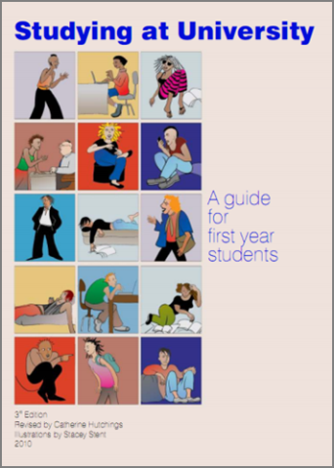
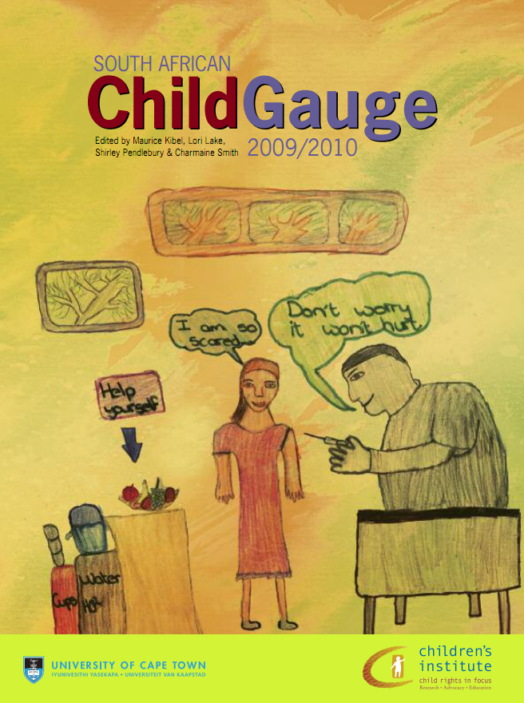
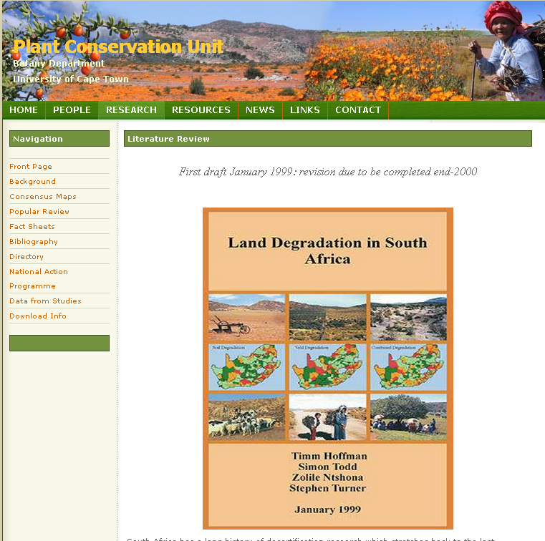
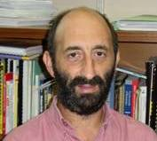
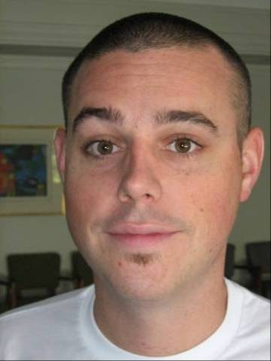

Slide 17
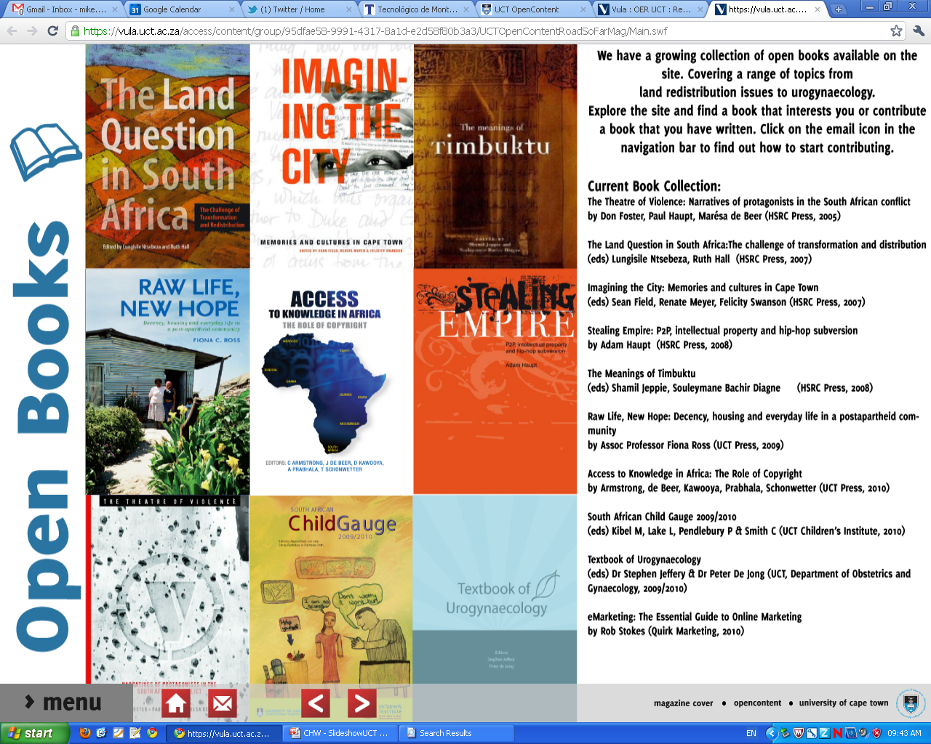

Slide 18
CILT
Open Educations Resources
CC awareness
LIBRARY
Open Access
IP LAW
Creative Commons legal Lead: Tobias Schonwetter
Support from RCIPS
Repository help and moderation

Slide 19
What does CILT offer:
OER grants for R10 000 next round 18 April
Workshops and seminars on all aspects of Open Education
Open education consortium Global Network with international recognition for open education
UCT MOOCs use materials that will become Open Educational Resources
Research: Research on OER for Development in the Global South. Post graduate studies in Open Education

Slide 20
OER grants for R10 000 next round 18 April
Faculties and areas | 2011-2015
Centre for Higher Education Development | 7
Commerce | 7
Engineering | 12
Health Science | 24
Humanities | 20
Science | 7
Law | 4
Library | 1
Vice Chancellor’s office | 1
Other (undefined) | 2
TOTAL | 85
Notes:
Update

Slide 21
Workshops and seminars on all aspects of Open Education

Slide 22
Open education consortium Global Network with international recognition for open education
Open education consortium Global Network with international recognition for open education

Slide 23
Award Winners
Open education consortium Global Network with international recognition for open education

Slide 24
Open education consortium Global Network with international recognition for open education

Slide 25
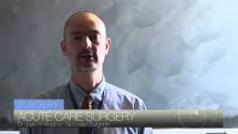
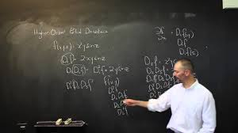
OCWC Educator award
Open education consortium Global Network with international recognition for open education
Over 200 000 views
Dr Juan Klopper (FHS)
“I’m honoured to announce that I have been awarded the Open CourseWare Consortium 2014 Award for the category Individual Educator for my work on open education.
Previous award winner, Walter Lewin, Physicist at MIT, has been an inspiration and hero of mine and to be a recipient of the same award, is a truly humbling experience for me” http://www.juanklopper.com/
Notes:
EDUCATOR AWARD The Educator award recognizes an educator who actively develops and/or uses open educational resources in creative and significant ways over a sustained period of time.

Slide 26
UCT MOOCs use materials that will become Open Educational Resources
UCT MOOCs use materials that will become Open Educational Resources

Slide 27
Research: Research on OER for Development in the Global South. Post graduate studies in Open Education

Slide 28
UCT Libraries’ role in UCT’s Open Educational Resources

Slide 29
UCT’s Open Access Policy, 2014
The Policy is committed to preserving “scholarly work of UCT scholars and to make this scholarship discoverable, visible and freely available online to anyone who seeks it".
The Policy encourages all forms of works of scholarship available, which includes:
essays, books, conference papers, reports, educational resources, presentations, scholarly multi-media material, audio-visual works and digital representations of pictorial and graphical materials.

Slide 30
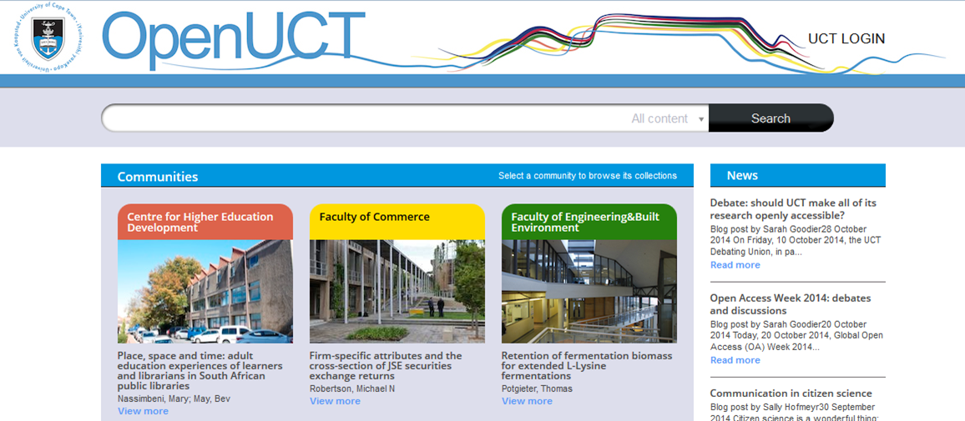
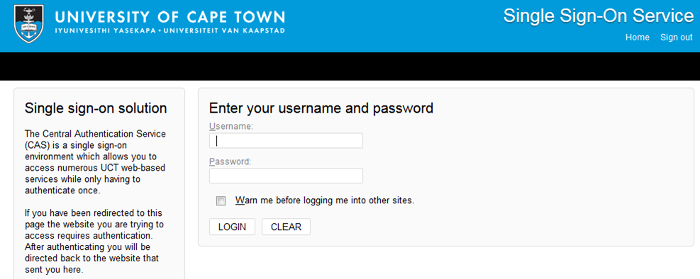
http://open.uct.ac.za/

Slide 31
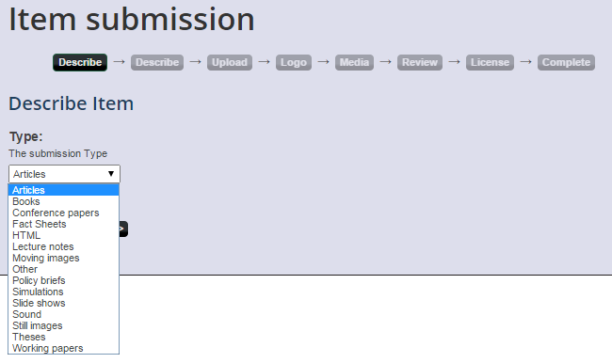
Choose a type of submission

Slide 32
Choose A Creative Commons License
The repository’s licensing options are found in the Rights dropdown list from the set of six Creative Commons licenses:

Slide 33
The distribution license
The submitter has to grant UCT a non-exclusive distribution license. By granting this license, the submitter gives OpenUCT the right to share the item further on their behalf and preserve it.
http://open.uct.ac.za/submission.html

Slide 34
The next steps: Moderation by Libraries
Check copyright
Check that teaching and learning material does not conflict with UCT’s IP Policy (e.g. multiple choice tests and examination questions, Syllabuses and curricula)
Thereafter make item available globally

Slide 35
2016 OpenUCT Statistics (T&L)
Activities and labs | 2 |  | Music score | 1
Assessments | 1 |  | Other | 83
Audio||Audio Lectures | 43 |  | Position paper | 6
Book | 4 |  | Poster | 3
Book chapter | 1 |  | Reading | 17
Book review | 1 |  | Recorded lecture | 23
Collection | 7 |  | Simulation | 12
Curriculum Standards | 1 |  | Slideshow | 26
Filmed lecture | 2 |  | Still image | 2
Graphic | 2 |  | Teaching & learning strategy | 3
Guide | 4 |  | Textbook | 21
Guidelines | 2 |  | Training manual | 1
Handbook | 1 |  | Training materials | 18
HTML | 17 |  | Video | 32
Interview | 11 |  | Video||Training materials | 15
Lecture notes | 29 |  | Web page | 16
Lesson plan | 16 |  | Web site | 16
Moving image | 3 |  | Wiki | 3
TOTAL: 445

Slide 36
2016 Stats of OpenUCT
Books and Chapters in Books | 56
Articles | 1695
Thesis | 11621
T&L | 445
Grey Literature | 1301
TOTAL: 15118

Slide 37
Webometrics ranking of OpenUCT
Attribution: Shireen Davis-Evans, UCT Libraries

Slide 38
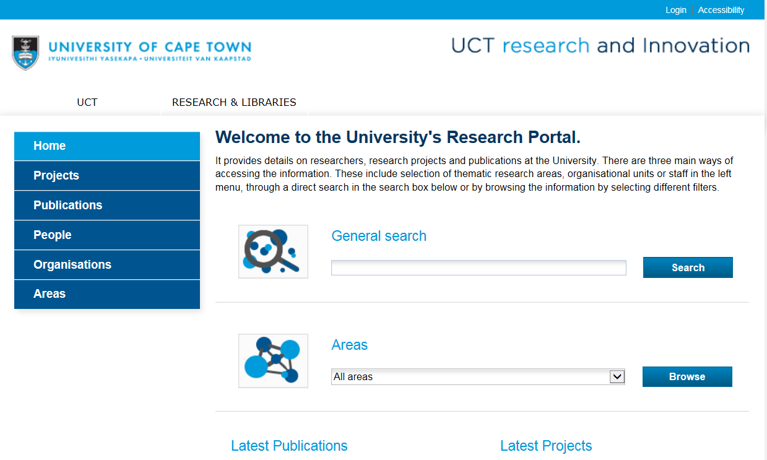
UCT’s eRA

Slide 39
You are invited to an Open Scholarship Symposium that will have international and national speakers present on open source, open access, OERs, open data and open publishing.
Details available at: http://www.openaccess.lib.uct.ac.za/open-access-symposium-2016

Slide 40
Why Now? And what can you do?

Slide 41
Why now for departments?
Increase institutional visibility, advancing competitiveness, attracting students and resources
Promote effective social responsiveness
Improve learning experience by selecting materials in pedagogically sound and innovative ways
Improve recruitment by helping the right students find the right programmes
Enhance teaching coherence across courses
Ensure better long-term archiving, curation and reuse of teaching materials
Attract alumni as life-long learners

Slide 42
Why now individually?
Profile teaching and pedagogical idea sharing
Create record of teaching for teaching portfolio
Foster connections between other colleagues, departments and even other universities (especially cross-disciplinary studies)
Increase impact of teaching materials
Extend use of teaching materials to high school learners and life-long learners
Individual
Notes:
Lets drill down and talk about what this means to us as academics in the information age.
Why is this important?
OER allows us to profile and highlight our teaching and pedagogical ideas online (in addition to research)
It creates a record of our teaching material and leads to the development of teaching portfolios – essentially building a teaching profile in addition to your research profiles
Having our material online may foster connections between other colleagues, departments and even other universities especially cross-disciplinary studies.
It can increase the impact of our teaching materials and help us attract the right students by giving them some idea of what we teach at UCT
It may also extend the use of teaching materials to high school and life-long learners

Slide 43
My online presence
Research project: Instruments and research data on Datafirst (https://www.datafirst.uct.ac.za/dataportal/index.php/catalog/central)
Articles in Open Access Journals
Open education resources: Slides in Slideshare: eg. Introduction to OER (+4000 views)
Slides and other materials in OpenUCT
Thesis in OpenUCT when examined later in the year
Twitter for communicating all of the above
Notes:
4452 views in one Slideshare on Openness

Slide 44
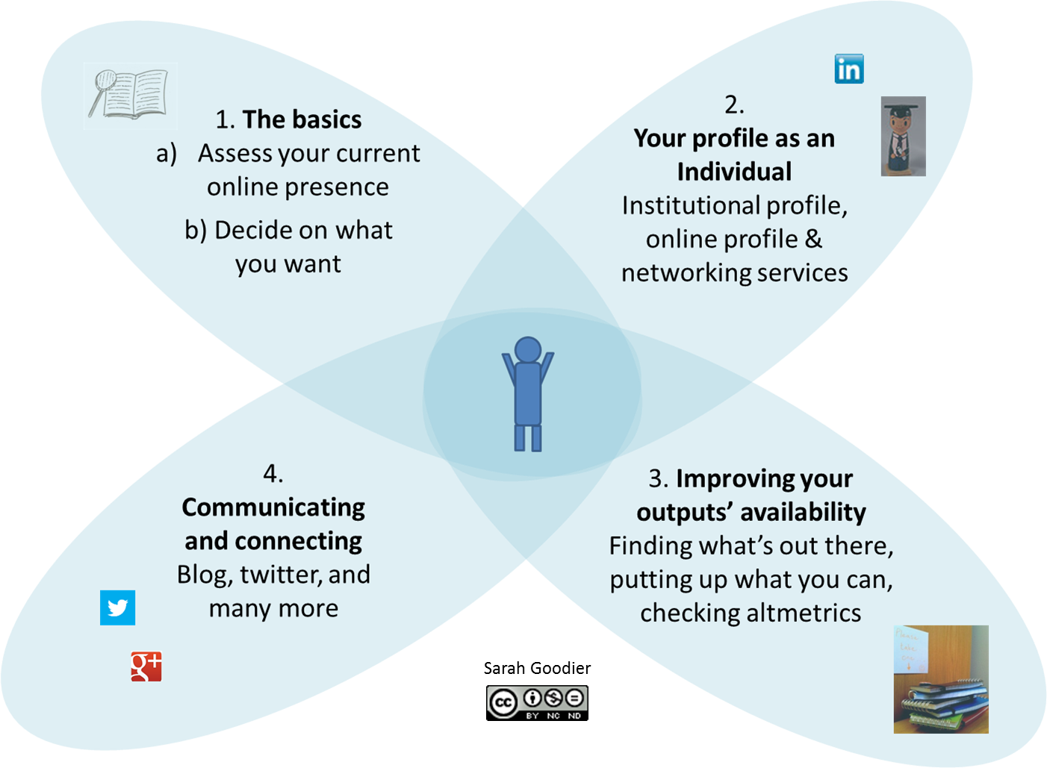
The process
Notes:
Magnifying glass image (top left) by Tall Chris available at http://www.flickr.com/photos/tallchris/14288135/ under CC BY 2.0 (http://creativecommons.org/licenses/by/2.0/deed.en)
Academic image (2nd from the top right) by Tim Ellis available at: http://www.flickr.com/photos/tim_ellis/2269499855/ under CC BY-NC 2.0 (http://creativecommons.org/licenses/by-nc/2.0/deed.en)

Slide 45
Creators and Contacts
Prepared by: Glenda Cox. Glenda.cox@uct.ac.za
And Jill Claassen. Jill.claassen@uct.ac.za
Some of the slides were created by Michael Paskevicius : mike.vicious@gmail.com
Other slides by Sarah Goodier, Cheryl Hodgkinson-Williams and Shireen Davis-Evans
OpenUCT repository
https://open.uct.ac.za/
CILT website
http://www.cilt.uct.ac.za/
Roer4D website:
http://roer4d.org/

Slide 46
Open Education @ UCT by Glenda Cox and Jill Claassen is licensed under a Creative Commons Attribution 4.0 International License

