Slide 1
CILT Seminar Framing E-assessment
31 May 2016
Laura Czerniewicz

Slide 2
This will focus on the contemporary affordances and challenges of assessing students and student work in the online learning environment.
The first part will focus on the overarching issues that are and should be of interest to us all:
The higher education environment and the need for e-learning policy
The extent to which policy can support and provide the enabling conditions for e-learning and e-assessment
Policy and the regulatory environment
The extent to which policy supports or interacts with contemporary online teaching and learning issues, such as the ‘unbundling’ of higher education teaching and learning and the offerings of private higher education online learning providers

Slide 3
Policy
“the allocation of goals, values and resources”
(Codd, 1988)
Notes:
Codd, J. (1988). The construction and deconstruction of education policy documents. Journal of educational policy. 3 (3), 235-48.

Slide 4
HE Traditionally: a single package
Time
Space
Content
Teaching & learning interaction
Assessment & certification

Slide 5
Disaggregation of HE
Time
Platform
Content
Teaching & learning interaction
Certification

Slide 6
Disaggregation
Time
Platform
Content
Teaching & learning interaction
Assessment & certification

Slide 7
Access to content
Analogue
Textbooks
Photocopying
Some photocopying
Legal
Illegal
E-Textbooks
Pirate sites
File sharing
Open Education Resources
Digital

Slide 8
Disaggregation
Time
Place
Content
Teaching & learning interaction
Certification

Slide 9
Disaggregation
Time
Platform
Content
Teaching & learning interaction
Certification

Slide 10
Learning platforms
Hill, P (6 Feb 2014) http://mfeldstein.com/resilient-higher-ed-lms-canvas/
Notes:
The Resilient Higher Ed LMS: Canvas is the only fully-established recent market entry
Posted on February 6, 2014 by Phil Hill http://mfeldstein.com/resilient-higher-ed-lms-canvas/
Hill, P (6 Feb 2014) http://mfeldstein.com/resilient-higher-ed-lms-canvas/

Slide 11
Changes in teaching & learning
Time
Place
Content
Teaching & learning interaction
Certification

Slide 12
Fully online
Online-intensive
Blended
(mixed mode): combines F2F and online
Forms of provision
Internet dependent
Internet supported
F2F only
On campus
Location of students
Remote

Slide 13
Disaggregation
Time
Platform
Content
Teaching & learning interaction
Certification

Slide 14
Certification: new forms
Badges- micro, granular certification
A form of formal(ised) recognition
for informal learning processes
for chunks of content
for competencies

Slide 15
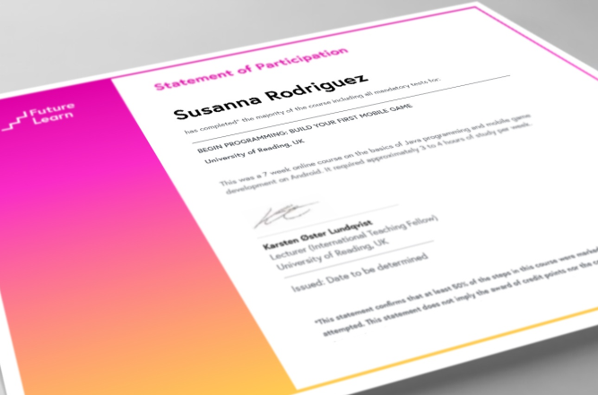
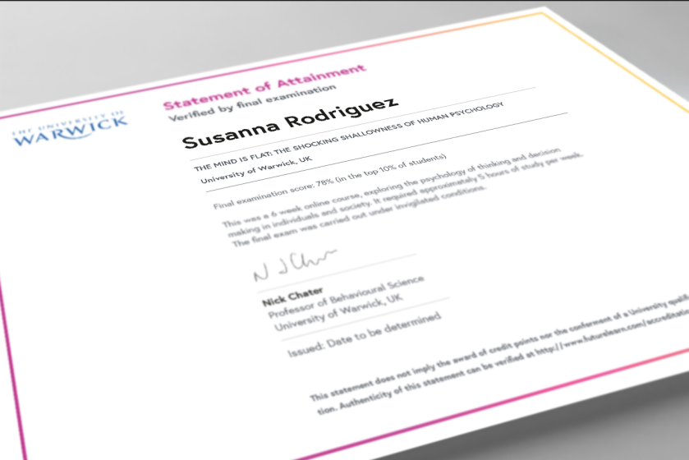
Certification: new forms
£ 24
£ 119
Pearson Vue Test Centre

Slide 16
Changing monetisation models
 | Traditional Complete package (fees) | Emergent models Individual elements
Fees | Yes | No
Content | May be free/included in fees/paid for | May be paid
Support | Free/included in fees | May be paid
Assessment | Free/included in fees | May be paid
Certification | Free/included in fees | Paid
Platform | May be licensed or free (student does not pay) | May be licensed or free

Slide 17
non university providers

Slide 18
FORMAL
SEMI-FORMAL
NON-FORMAL
curriculum innovation
CONVENTIONAL

Slide 19
conventional
flexible
FORMAL
Lectures & tutorials
Block release
Online courses
SEMI-FORMAL
Short courses
Professional development
courses
NON-FORMAL
Summer school

Slide 20
conventional
flexible
FORMAL
Lectures
Blended courses
Online courses
SEMI-FORMAL
Short courses
Professional development
courses
MOOC related variants
NON-FORMAL
Summer school

Slide 21
Forms of Provision
Multiple forms of provision conceptualised
Ad hoc
Up front
Within/ across levels
Implications for coherence across provision types
Quality oversight in different places
Assessment

Slide 22
Parallel offerings
Credibility and legitimacy of parallel offerings
Rise of acceptance of emerging forms of certification
Quality control of new forms of offerings and of certification

Slide 24
The Test- pedagogy - technology alignment
 | F2F | Blended | Fully on-line
Engagement | ✓ | ✓ | ✓
Mediation | ✓ | ✓ | ?
Alignment | x | ? | ?
Flexibility | X | ✓ | ?
Transformation | ✓ | ✓ | ?
Shay 2013

Slide 25
SA Policy environment
Notes:
White Paper for Post-School Education and Training, DHET, November 2013 http://www.che.ac.za/sites/default/files/publications/White%20Paper%20-
%20final%20for%20web.pdf
Policy for provision of distance education in South African universities in the context of an integrated post-school system, DHET, July 2014
http://www.gov.za/ss/documents/higher-education-act-policy-provision-distance-education-south- african-universities

Slide 26
DHET: provision
Notes:
Due to the increasing use of ICT, however, the continuum has been refined and isnow more usefully portrayed as a two dimensional figure which illustrates the increasing variation possible in designing learning programmes. So, for example, point A represents a distance programme that is offered using a variety of media but which does not involve use of the internet whereas point D represents a distance programme that is offered fully online for learners remote from the campus. Institutions will need to make strategic decisions about the most appropriate mode of provision and degree of ICT integration appropriate for particular learning needs and student cohorts. This may well change over time as illustrated by B. The grid also recognises that it is possible also to offer a largely online course in campus-based computer labs (point E) for both full-time and part-time students. The size of the circles might also approximate the scale of provision. Thus point C 8 No. 37811 GOVERNMENT GAZETTE, 7 JULY 2014 This gazette is also available free online at www.gpwonline.co.za Policy for the Provision of Distance Education in South African Universities represents a large scale programme in which economies of scale might be possible (requiring careful consideration of how large scale student support will be managed) whereas point A represents a small scale programme (in which costs per student for provision will likely be higher).

Slide 27
DHET: direction
“The DHET will also encourage all universities to expand online and blended learning as a way to offer niche programmes, especially at postgraduate level, to those who are unable to attend full-time programmes, either due to their employment status or their geographical distance from a campus” (DHET, 2014a, p. 51)

Slide 28
Modes of provision
Two modes of provision: F2F & Distance
Mode is determined by the proportion of face-to-face, on-campus learning activity
distance is defined as anything less than 30% of notional hours spent in face to face on campus learning activities for NQF 5-7 and anything less than 25% for NQF 8-10
For DE mode of provision subsidy is halved for NQF 5-8 qualifications

Slide 30
Discussion
What are the implications of global trends for teaching and assessment at UCT?
What are the implications of DHET frameworks for teaching and assessment
In the light of global trends?

