Slide 1
Section 6: Adaptation plans and practice
EGS 3021F: Vulnerability to Environmental Change
Gina Ziervogel (gina@csag.uct.ac.za)
December 2011
This work by Gina Ziervogel is licensed under a Creative Commons Attribution-NonCommercial-ShareAlike 3.0 Unported License.

Slide 2
Ethekwini Municipal Climate Protection Programme (MCPP) – Climate smart Durban
Phase 1: the Climatic Future for Durban Report (2006)
assessed the local impacts of climate change on the municipality and proposed possible responses;
Phase 2: a Headline Adaptation Strategy
key interventions required by the municipality to adapt to climate change
Phase 3: Urban Integrated Assessment Framework (in progress)
Simulate and evaluate strategic development in the city in the context of climate change
Phase 4: mainstreaming of climate change concerns into city planning and development.
climate neutrality as a goal for the 2010 FIFA Soccer World Cup
Climate Protection Branch within the Environmental Planning and Climate Protection Department.
(Roberts, undated)

Slide 3
eThekwini’s adaptation plans
Health
• Expand the existing malaria prevention programme.
• Secure sustainable energy and clean water sources for healthcare provision.
• Identify the sizes and distributions of key vulnerable groups in the population (e.g. children, the elderly, and immuno-compromised).
• Develop community-wide heat emergency plans.
• Initiate education campaigns about heat stress and environmental health problems associated with climate change.

Slide 4
eThekwini’s adaptation plans
Water & Sanitation
Increased use of water recycling methods (filtering processes to make used water drinkable or suitable for agriculture).
Promote water storage in cisterns and rainwater catchment tanks.
Reduce water losses from municipal water systems through better leak detection and flow and pressure controls.
Assess the effect reduced future water availability will have on new proposed developments in the city during municipal planning and development assessments.
Assess the effects that increased heat, storms, and sea level rise will have on water provision and sanitation infrastructure, and upgrade or relocate where necessary.

Slide 5
Summary
Adaptation action is starting to emerge
Needs leaders
Needs to integrate with development needs
Public awareness and support important

Slide 6
Climate variability and rural risk
Rural livelihoods are highly dependent on climate variability
Rainfall
Temperature
Direct impacts
Crop production
Livestock grazing
Water resources
Indirect impacts
Seasonal work
Household resources
Education
Health

Slide 7
Impact of climate variability on rural livelihoods (Ziervogel and Calder, 2005)
Livelihood assets | Prolonged drought | Delayed onset of rains
Economic | Crop failure, livestock death, deterioration of dwellings, erosion of savings | Shortage of water resources, later planting leads to lower yields, animals weak
Human | Increased labour migration, malnutrition, disease epidemics (cholera, dysentery, AIDS) due to poor sanitary conditions | Malnutrition, education suffers
Natural | Firewood depleted, poor pastures, limited water supply, dry soils, increased erosion, gathering of wild food | Firewood depleted, poor pastures, limited water supply, dry soils, increased erosion, gathering of wild food
Social | Kinship networks weaken as resources depleted, increased migration, increased conflict | Temporary exploitation of communal resources, minor claims not met

Slide 8
Consequences of more frequent or intense climate events
Different assets need to become more resilient
Individual responses
Agricultural strategies; livelihood diversification
Community response
Saving schemes; community access to intervention
Policy responses
Disincentives for water waste
Cultural change

Slide 9
Case study: Sekhukhune
(Source: Hugo Ahlenius, GRID-Arendal/UNEP)
Notes:
South Africa – Sekhukhune
ISRD node
FIVIMS

Slide 10
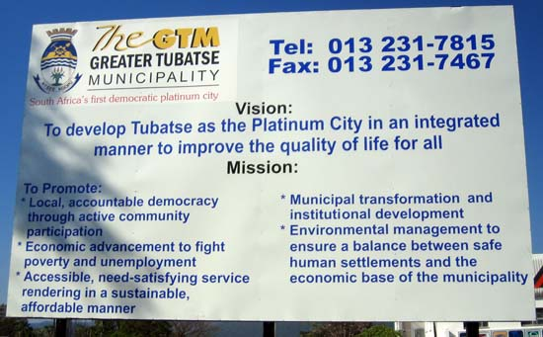
By Gina Ziervogel

Slide 11
Sekhukhune District Methodology
By Gina Ziervogel
Individual interviews; focus groups; social networks; storylines; video
Stated preference (SP) surveys
Villages
Workshop with
village
and municipality
Livelihood surveys
Municipal and
district level
Agent-based model
FIVIMS
Interviews
2 Feedback workshops

Slide 12
Climatic change is not something we can stop. Limpopo is a province of extremes, swinging between drought and flood.
But this new drier future is a whole new thing. ..We cannot just sit and wait for it to arrive. The government is proactively and aggressively driving new policies to stretch every drop of water we have as far as possible.
Premier of Limpopo, Mr. Moloto,
Mail and Guardian, 2006
By Gina Ziervogel
Notes:
Water stress key manifestations of climate variability and change
The water problem
more than a climate issue
to do with distribution and management

Slide 13
People ate homemade food made from sorghum and ingredients collected from the mountain so they were healthier and there was less disease around. Now people are eating sugar, beef and maize meal with chemicals added.
Sangoma from Ga-Selala
By Gina Ziervogel
Food makes people sick now because it contains chemical whereas before the grandmothers used to make food.
Comment during focus group in Mohlotsi

Slide 14
Climate/water/food and livelihoods
More money is available when it rains, because we get produce from our home garden and save on water bills.
Villager from Mohlotsi
We used to grow some food
but now we buy everything.
Villager from Mohlotsi
By Gina Ziervogel

Slide 15
Boiling Point by Leonie Joubert The Muti Queen
Identify
Key livelihood stressors
Impacted by climate
Not impacted by climate
Potential adaptation responses

Slide 16
Sekhukhune context
Population of > 1 million people
5 Municipalities
546 villages
> 90% in rural areas
Health facilities
good availability, poorly resourced
Limpopo HIV prevalence rate is 19.3%; Sek 13.4%
Water limited
Commercial and small-scale irrigation
Mining
Rapid development
Increase in mines; Burghersfort growing rapidly (along with crime, traffic accidents)
Tubatse set to be The Platinum City with 17 new platinum mines in next 10 years
Climate
High variability, Rainfall between 500 and 700mm/year
(Ziervogel et al, 2006)

Slide 17
Key stressors in Tubatse
 | Ga-Selala (village) | Greater Tubatse Municipality
Water | Domestic supply limited | Basic services need to be addressed
 | Irrigation is not feasible but desired | De Hoop dam will solve problems
 | Crops and home gardens suffer without access to water | Industry/mining/agriculture competing over water resources
Food security | High proportion of income spent on food | Grants are helping households to buy food
 | Nutrition not as good as past | Irrigation schemes being revitalised
 | High maize price | Non-food based community projects helping support households
Jobs | Few local jobs leading to high migration | Mines provide potential employment
 | Limited skills for local projects | Limited skills within district
 | Need to know right person to get jobs | Lack of people for government jobs
(Ziervogel et al, 2006)

Slide 18
Coping/adapting at household level
Coping strategies | Adaptation strategies
Eat less preferred food | Work elsewhere
Reduce number of meals a day | Engage in a village project
Limit portion size of meals | Contact district for support
Rely on piecework | Go on a training course at own cost
Borrow food | Try to access a grant
Eat elsewhere | Start/improve home garden
Purchase food on credit
(Ziervogel et al, 2006)

Slide 19
Water in Sekhukhune
By Gina Ziervogel
Water: central to development in the district
supply of basic services
water for agriculture
(commercial agriculture, small-scale market-oriented agriculture and subsistence)
water for expanding mining sector

Slide 20
Perceived strategies to respond to water stress
(Ziervogel et al, 2006)

Slide 21
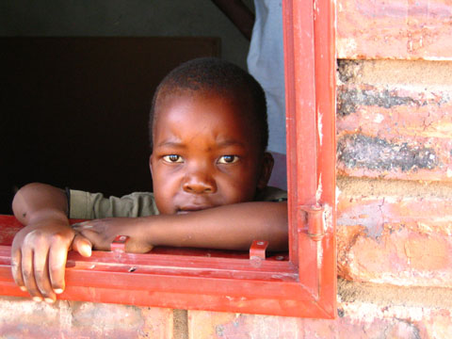
Need for adaptive strategies (linking water and livelihoods)
Access to water can impact livelihood security
Directly → agriculture and livestock, drinking and domestic use
Indirectly → mining, food prices
Yet, water decisions made
Around key district/provincial economic activities
Without considering impact of climate change
Often without exploring the impact on poverty and indirect factors
By Gina Ziervogel

Slide 22
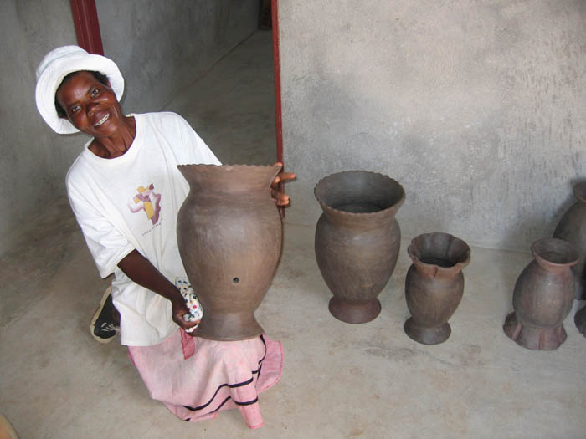
Potential options for adapting to climate change in Sekhukhune
Local projects
Efficient irrigation, conservation tillage
Rainwater harvesting
Small business development
Integrated in municipal and district planning
Supporting non-agricultural livelihood activities
Reassess infrastructure standards
Support from national level
Provisions for climate variability in water management plans
By Gina Ziervogel

Slide 23
Adaptation to multiple stresses (Ziervogel and Taylor 2008)
Acknowledge differing perceptions
Climate important for some but not others
Focus on key stressors and links to climate
Target municipal level as well as local level
Recognise the constraints at the municipal level
Give a voice to those most vulnerable
Integrated activities at the government level
Between sectors – livelihoods spans across sectors
Avoid maladaptation
Notes:
Target municipal level
Plan activities
Opportunity for integration
Limits to implementation
Improved communication
between government and people in the villages
people’s requests for assistance heard by government
Better integration of traditional leadership and local government structure
Integrated activities at the government level
departing from the sectoral approach
risk of maladaptation

Slide 24
Adaptation in South Africa

Slide 25
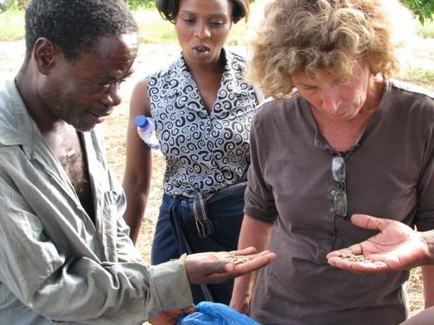
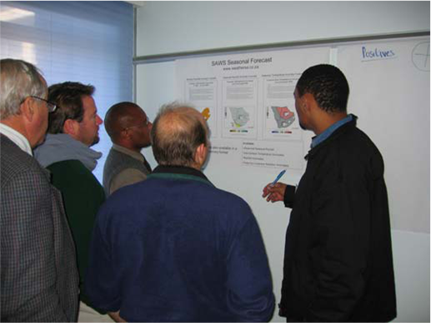
Adaptation should be a priority in SA
Highly variable climate
Intra-annual
Inter-annual
Numerous impacts from climate variability and change (Section 4)
By Gina Ziervogel
By Gina Ziervogel

Slide 26
Adaptation should be a priority in SA
High proportion of people exposed to climate risk
Urban areas
Concentration of people (and growing)
High risk
Strain on resources and services
(water, infrastructure, housing etc)
Rural areas strongly dependent on climate
High dependence on natural environment

Slide 27
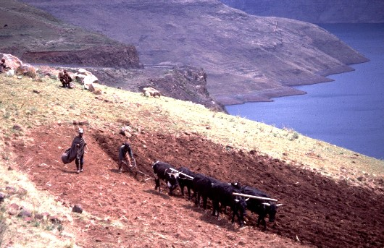
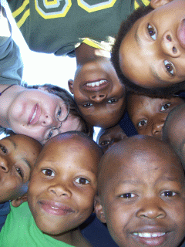
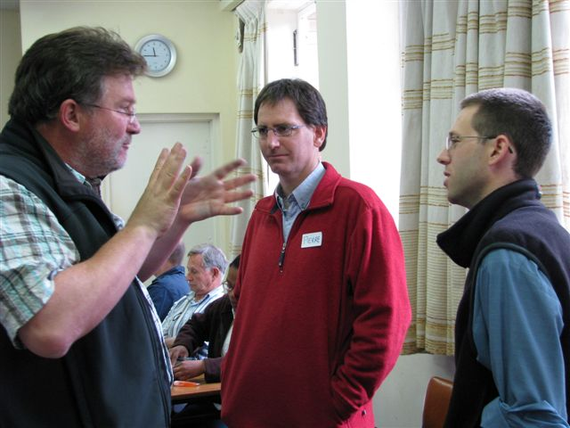
Adaptation should be a priority in SA
High sensitivity of many people and systems to climate change
Socio-economic factors
Political factors
Cultural factors
Low adaptive capacity
Information
Technology
Resources
Skills and capacity
By Gina Ziervogel
By Gina Ziervogel
By Gina Ziervogel

Slide 28
High vulnerability requires good adaptation
Adaptation at national level
Department of Science and Technology →
Global Change Grand Challenge
10 yr research plan
Interventions that support the implementation of the research plan
Areas for accelerated technology development and innovation
http://www.pmg.org.za/report/20090916-department-science-and-technology-briefing-global-change-grand-challe

Slide 29
Understanding a changing planet | Reducing the Human Footprint | Adapting the way we live | Innovation for Sustainability
Observation, monitoring and adaptive management. Dynamics of the oceans around southern Africa. Dynamics of the complex internal earth system. Linking the land, the air, and the sea. Improving model predictions at different scales. | Waste minimization methods and technologies Conserving biodiversity and ecosystems services Institutional integration to manage ecosystems and the services they offer | Preparing for rapid change and extreme events Planning for sustainable urban development in a South African context Water security for South Africa Food and fibre security for South Africa | Dynamics of transition at different scales - mechanisms of innovation and learning Resilience and capability Options for greening the developmental state
http://www.pmg.org.za/report/20090916-department-science-and-technology-briefing-global-change-grand-challe

Slide 30
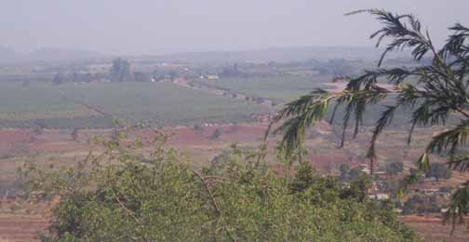
High vulnerability requires good adaptation
Adaptation at municipal level
eThekwini municipality
Municipal Climate Protection Programme (Durban climate smart lecture)
City of Cape Town
Sea level rise assessment
Climate change think tank (govt, academic, NGOs)
By Gina Ziervogel

Slide 31
High vulnerability requires good adaptation
Adaptation at community level: Urban and rural responses
Build adaptive capacity
Ensure access to information
Resources for responding
Meet local needs
Actors
Urban communities
NGOs
Local govt.
Examples
Rooibos tea farmers (Archer et al. 2008)
Related to water security in Sekhukhune (Ziervogel and Taylor 2008) (Muti Queen chapter in Joubert’s Boiling Point)

Slide 32
Buzz group
Do you think adaptation should be a priority in South Africa?
Provide reasons for your answer

Slide 33
References
Archer, E.R.M., Oettlé, N.M., Louw, R, Tadross, M.A. (2008) 'Farming on the Edge' in arid western South Africa: adapting to climate change in marginal environments. Geography. 93. 98-107.
Roberts, D., undated. A “Climate-Smart” Durban: local action for a resilient city. Presentation accessed at http://www.dbsa.org/Vulindlela/Presentations/Session7_Roberts.pdf
Ziervogel, G., Taylor, A., Takama, T., Thomalla, F. And Quinne, C. 2006. Adapting to climate, water and health stresses : insights from Sekhukhune, South Africa. Stockholm Environment Institute working paper.
Ziervogel, G. and Taylor, A., 2008. Feeling stressed –integrating climate adaptation with other priorities in South Africa. Environment: Science and Policy for Sustainable Development, 50(2): 32-41
All web links were checked in November 2011

