Slide 1
Section 1: Vulnerability Concepts
EGS 3021F: Vulnerability to Environmental Change section
Gina Ziervogel (gina@csag.uct.ac.za)
December 2011
This work by Gina Ziervogel is licensed under a Creative Commons Attribution-NonCommercial-ShareAlike 3.0 Unported License.

Slide 2
Risk and Vulnerability
Concepts
Risk
Vulnerability
Conceptual approaches
Origin
Risk/Hazard
Political economy/ecology
Ecological resilience

Slide 3
”Natural hazards are a part of life. But hazards only become disasters when people’s lives and livelihoods are swept away.”
(Kofi Annan’s message for the International Day of Disaster Reduction, 2003)
(http://www.unis.unvienna.org/unis/pressrels/2003/sgsm8909.html)

Slide 4
Linking environment and development
Sustainable development
interdependence of environment and development
(Kasperson et al., 2005:162)
Rio Declaration (1992) Principle 5
All States and all people shall cooperate in the essential task of eradicating poverty as an indispensable requirement for sustainable development, in order to decrease the disparities in standards of living and better meet the needs of the majority of the people of the world.
( http://www.unep.org/Documents.Multilingual/Default.asp?documentid=78&articleid=1163 )

Slide 5
Risk
Range of meanings and multiple dimensions
relate to safety, economic, environmental and social issues
Different meanings reflect the needs of particular decision-makers
Exposure to harm

Slide 6
Risk and probability
Probability Theory
dedicated to understanding whether events are random or happen by chance
Von Bortkiewicz (1868 - 1931)
first known application of probability theory
soldiers dying in Prussia from horse kicks random or due to negligence of soldiers
20 years data
conclusion = random; no disciplinary action required
(http://publish.uwo.ca/~jbaxter6/geog_152.html)

Slide 7
Risk definitions

Slide 8
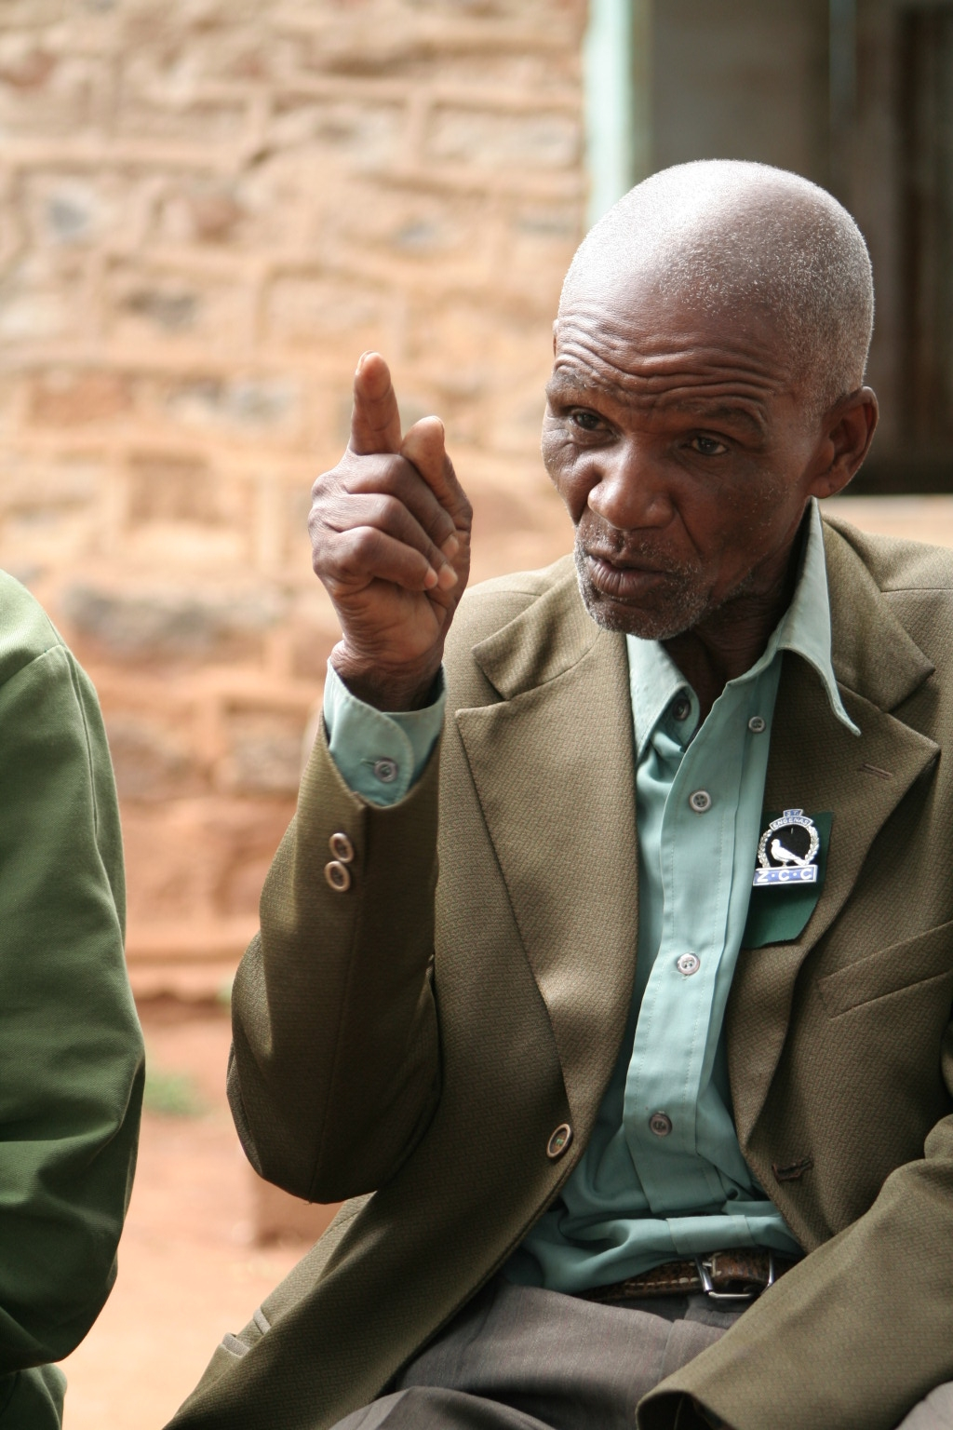
Vulnerability
What is vulnerability?
Susceptibility to loss
Shocks and stresses impact negatively
Understood by assessing the interaction of hazard/shock, impact and response
Vulnerability is dynamic
(Leichenko and O'Brien 2002)
Over space and time
Concatenation of stresses
By Gina Ziervogel

Slide 9
RISK SPACE
Risk is the overlay of hazard and vulnerability
Disasters are the realisation of risk
Both hazard and vulnerability are changing
HAZARD
VULNERABILITY

Slide 10
Vulnerability definition
Origin: vulnerable – power to wound
(OED online, accessed 8 November 2011)
Multiple definitions:
Your version
Numerous ‘academic’ versions:
VulnerabilityNet.org has 30 definitions
United Nations University — Institute for Environment and Human Security (UNU-EHS) – 39 definitions
Notes:
(hand out pieces of paper with definitions)

Slide 11
Vulnerability to food insecurity
High income
High production
Average income
Low production
A household on ‘new’ fruit farm; depending on the exchange rate for their profitability
No access to land;
3 family members work in non-farm services sector
Household 1
Household 2
Low income
High production
Low income
Low production
A mixed farm in remote, fertile rural area, producing all the hh needs
Pensioner in a close-knit community with large family supporting each other
Household 3
Household 4
Downing, T. E.

Slide 12
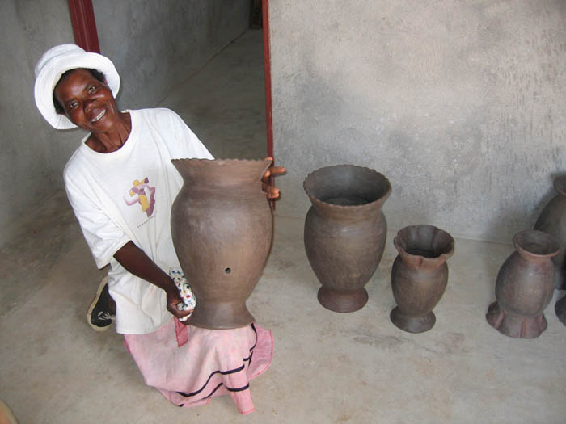
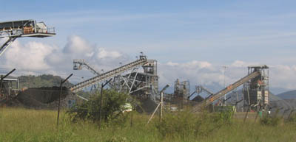
Sharma et al 2000
Sharma et al 2000
Sharma et al 2000
(Sharma et al, 2001)
By Gina Ziervogel
By Gina Ziervogel

Slide 13
Who/what is vulnerable?
livelihoods, sectors, ecosystems, regions
Vulnerable to what?
changes in market relations and access, removal of subsidies or tariffs, exposure to market risks and fluctuations, implications of greater competition
change in resource regimes, natural resource scarcity or degradation
changes in social dynamics, access to information, political affiliation, prejudices
Notes:
In terms of vulnerability and trade, there are certain livelihood impacts that need to be considered:
Removal of subsidies (e.g. removal of fertiliser subsidies may severely impact small farmers)
Rapid expansion in crops (to take advantage of market opportunities) may result in resource conflicts or degradation Differential effect of trade opportunities: some producers/traders better able to take advantage of new opportunities that others
Exposure to market risks – rapid rise or fall in prices in the absence of any buffer or safety net – market variability
Loss of assured market access, with increased competition
Commodification of biodiversity, or demand in particular natural resources, may result in loss of access to resources underpinning peoples’ livelihoods
Decline in demand for traditional or established goods and services with trade liberalisation

Slide 14
A wide range of vulnerabilities…
Stresses/threats:
Climate trends & hazards
Natural hazards
Environmental hazards
Health & disease
Socio-economic risks
Political & regulatory risks
Multiple stresses
Exposure unit:
Demographic group:
Women
Elderly
Scale:
Individual
Household
Community
Economic group:
-Livelihood
-Sector
Ecosystem
System
Consequences:
Loss of life
Loss of assets
Loss of livelihood
Psychological stress
Social stress
Social capital
Multiple attributes
Responses:
Operational
Strategic
Policy/ regulatory
Adaptive capacity
TIME: Season/Decade….Trends/forecasts…scenarios
Downing, T. E.

Slide 15
Difference between poverty & vulnerability
Poverty
“Well-being” of people as well as “enough” income
Measure of current status
Not hazard-specific
Vulnerability
Focus on social and economic obstacles
Forward-looking

Slide 16
Vulnerability approaches
Outcome vulnerability
A linear result of the projected impacts of climate change on a particular exposure unit, offset by adaptation measures
[Disaster literature]
Contextual vulnerability
A processual and multidimensional view of climate-society interactions, where climate variability and change are considered to occur in the context of political, institutional, economic and social structures and changes
[Vulnerability and adaptation literature]
(O’Brien et al, 2007)

Slide 17
Vulnerability is comprised of three dimensions:
exposure to stresses, perturbations, and shocks;
sensitivity, of people, places, and ecosystems, to the stress or perturbation, including their capacity to anticipate and cope with the stress; and
resilience of the exposed people, places, and ecosystems, that is their ability to recover from the stress and to buffer themselves against and adapt to future stresses and perturbations.
(Kasperson et al, 2005)
Notes:
Exposure to multiple and interacting stresses.
Sensitivity (social and environmental) to stresses. This is shaped by both socioeconomic and environmental/ecological conditions. These are, in turn, influenced by a range of factors as illustrated by the “balloons” and boxes at the top and bottom of Figure 2.1.
Resilience: the extent to which communities have coping (short-term) and adaptation (long-term) strategies that help them retain their basic properties under stress, recover from damage, and enact change to prevent future damage.

Slide 18
Recap
Risk
Hazard
Vulnerability
Dimensions
Approaches
Definitions

Slide 19
Conceptual frameworks
For Vulnerability Research

Slide 20
Disaster risk science approach

Slide 21
(Blaikie et al, 1994)

Slide 22
Vulnerability space
(Bohle et al, 1994)

Slide 23
Vulnerability to environmental change
(Kasperson et al, 2005: 147)
Notes:
The vulnerability analytical framework addresses three major dimensions of vulnerability:
Exposure to multiple and interacting stresses.
Sensitivity (social and environmental) to stresses. This is shaped by both socioeconomic and environmental/ecological conditions. These are, in turn, influenced by a range of factors as illustrated by the “balloons” and boxes at the top and bottom of the figure.
Resilience: the extent to which communities have coping (short-term) and adaptation (long-term) strategies that help them retain their basic properties under stress, recover from damage, and enact change to prevent future damage.
Including sensitivity and resilience in the vulnerability analytical framework ensures that not only is the external aspect of exposure to hazards identified, but also the internal capabilities groups use to resist or recover from damage.
The framework also illustrates the importance of considering the interactions among different levels of society. The framework includes the levels global, regional, and local (the different shades of grey.

Slide 24
Vulnerability affects who/what?
“Vulnerability is a characteristic of all people, ecosystems, and regions confronting environmental or socio-economic stresses and, although the level of vulnerability varies widely, it is generally higher among poorer people”
(Kasperson et al, 2001)
Buzz group:
When have you been vulnerable and why?

Slide 25
References
Blaikie, P., Cannon, T., Davis, I. and Wisner, B. 1994. At Risk: Natural Hazards, People’s Vulnerability, and Disasters. London: Routledge
Bohle, H. G., Downing, T. E. and Watts, M. J. 1994.Climate change and social vulnerability: Toward a sociology and geography of food insecurity. Global Environmental Change, 4(1): 37-48
Kasperson, R. E., Kasperson, J. X., and Dow, K. 2001. Vulnerability, equity, and global environmental change, in J. X. Kasperson and R. E. Kasperson (eds.), Global Environmental Risk, London: Earthscan
Kasperson, R. E., Archer, E., Caceres, D., Dow, K., Downing, T., Elmqvist, T., Folke, C., Han, G., Lyengar, K., Vogel, C., Wilson, K. and Ziervogel, G. 2005.Vulnerable people and places, in Hassan, R., Scholes, R. and Ash, N. (Eds) ,Ecosystems and Human-Well-being: Millennium Assessment Report: Current State and Trends. Washington DC: Island Press
Leichenko, R. M. and O’Brien K. L. 2002. The Dynamics of Rural Vulnerability to Global Change: The Case of Southern Africa. Mitigation and Adaptation Strategies for Global Change 7: 1–18
O’Brien, K., Eriksen, S., Nygaard, L. P. and Schjolden, A. 2007. Why different interpretations of vulnerability matter in climate change discourses. Climate Policy, 7: 73-88
Sharma, M., Burton, I., van Aalst, M.K., Dilley, M. and Acharya, G. 2001. Reducing Vulnerability to Environmental Variability. Environment Strategy. Background Paper. Washington, D.C.: The World Bank, 5
All web links were checked in November 2011

Slide 26
Acknowledgements
Some slide material from Tom Downing

