Slide 1
Fallingwater House (1935-1937)
Teaching Technology with Technology: A Project Conceptualised by Tom Sanya and Funded by the UCT Centre for Educational Technology
The construction of
Frank Lloyd Wright

Slide 2
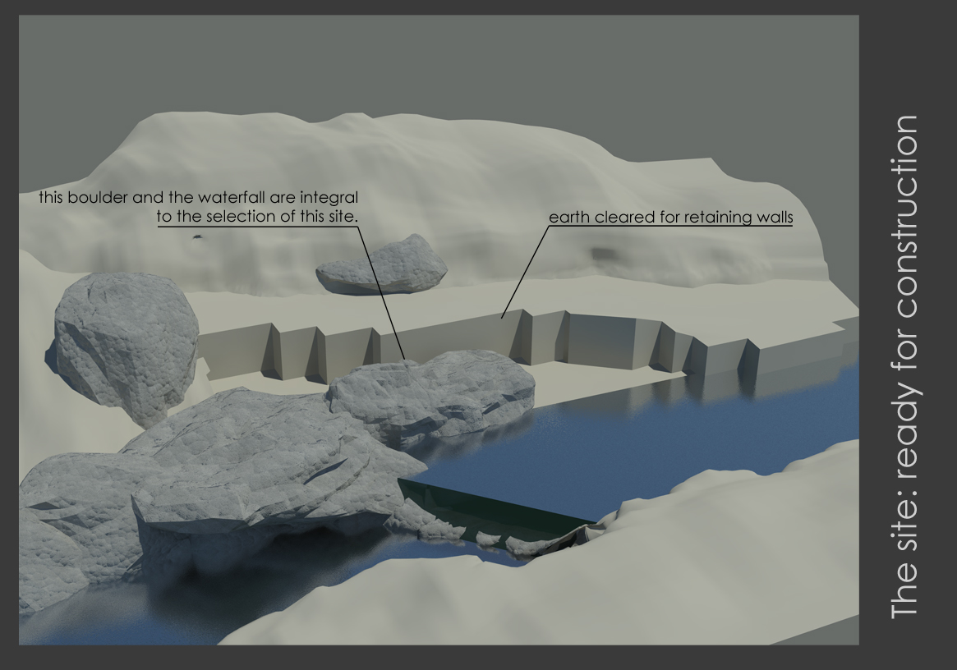

Slide 3
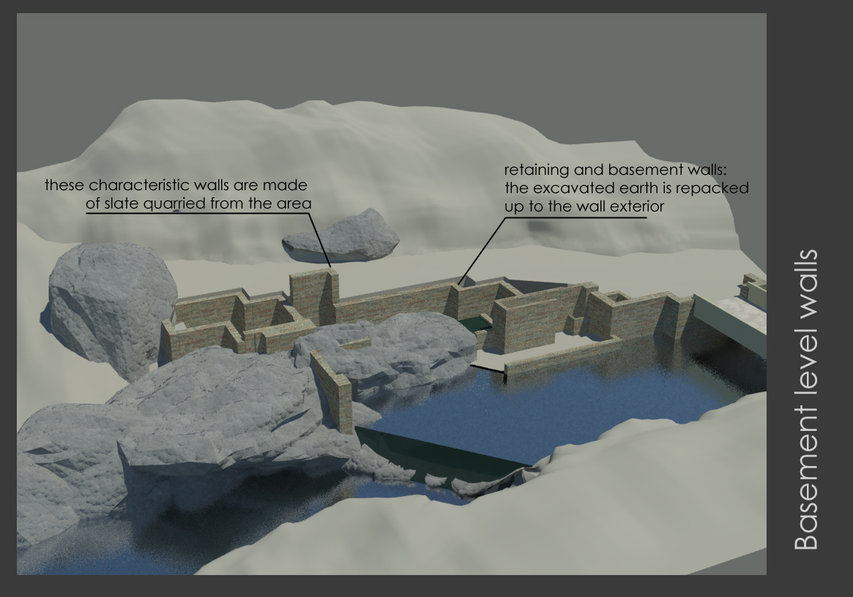

Slide 4
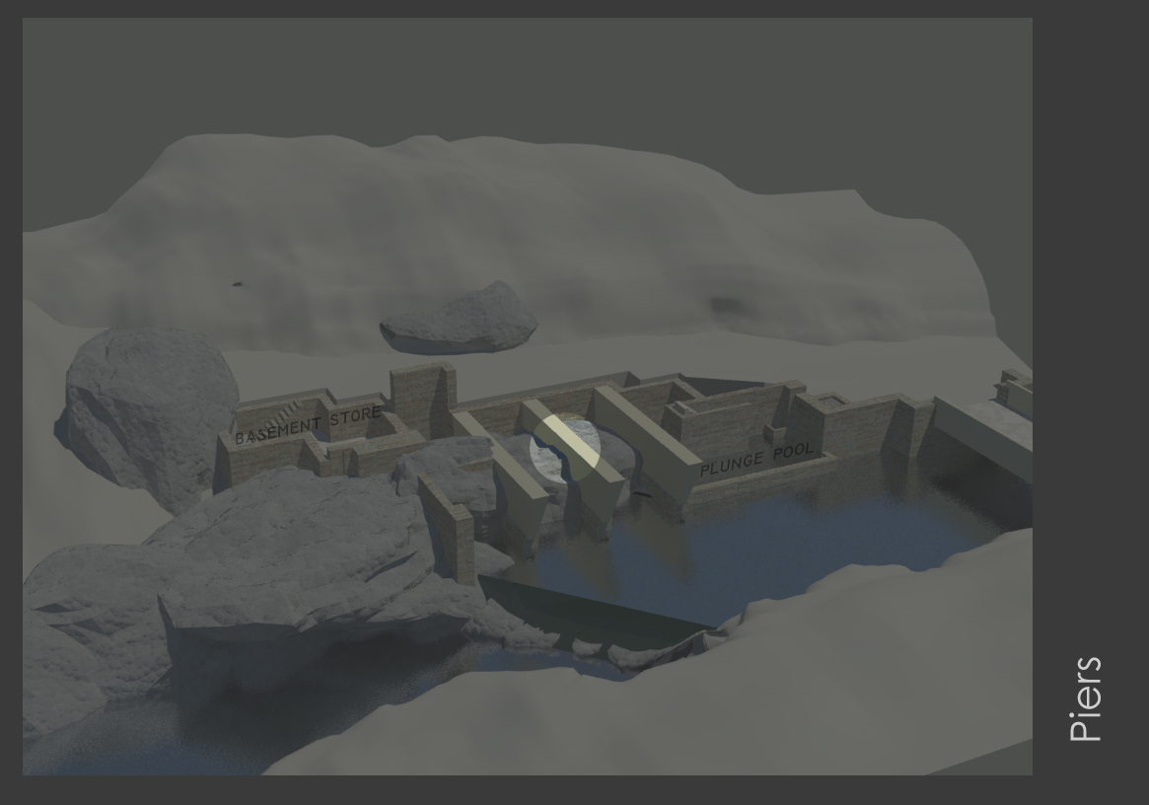

Slide 5
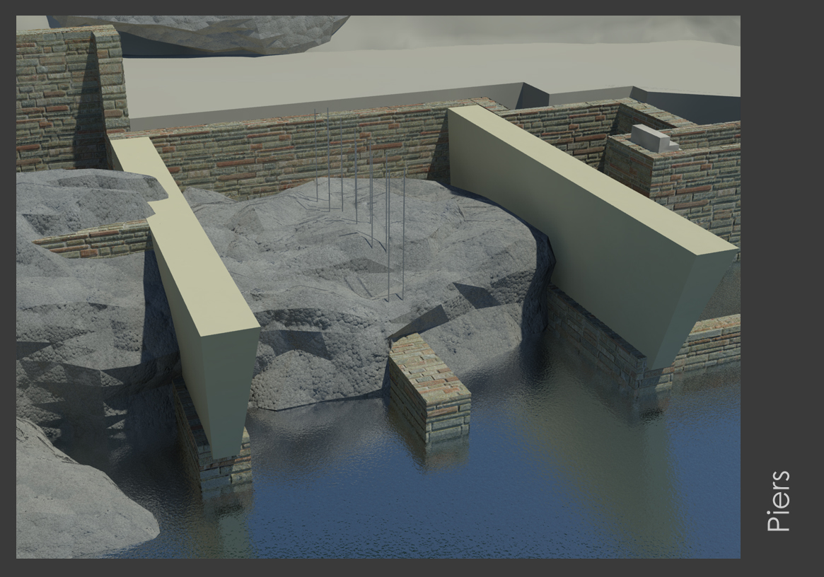

Slide 6
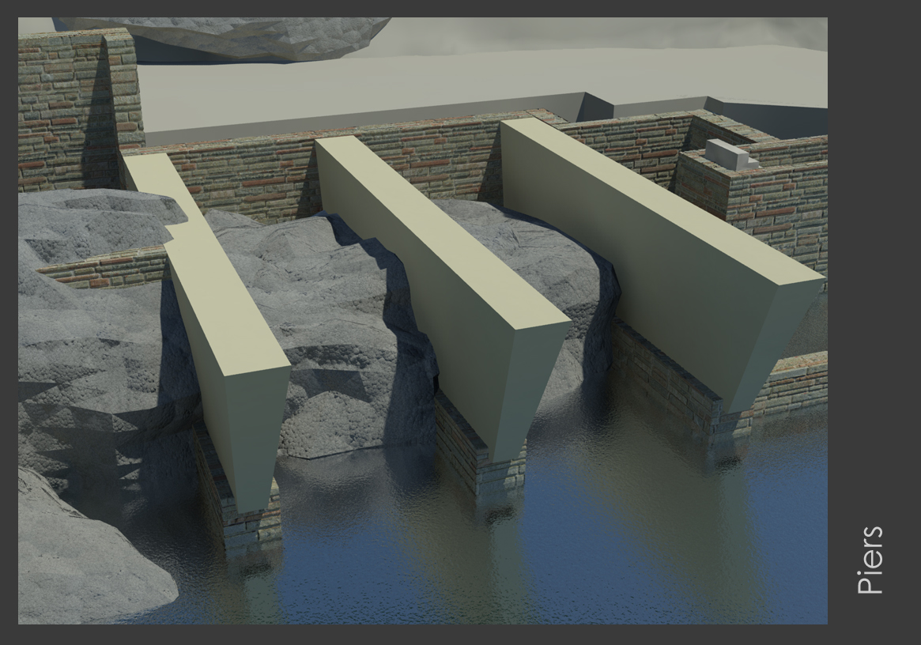

Slide 7
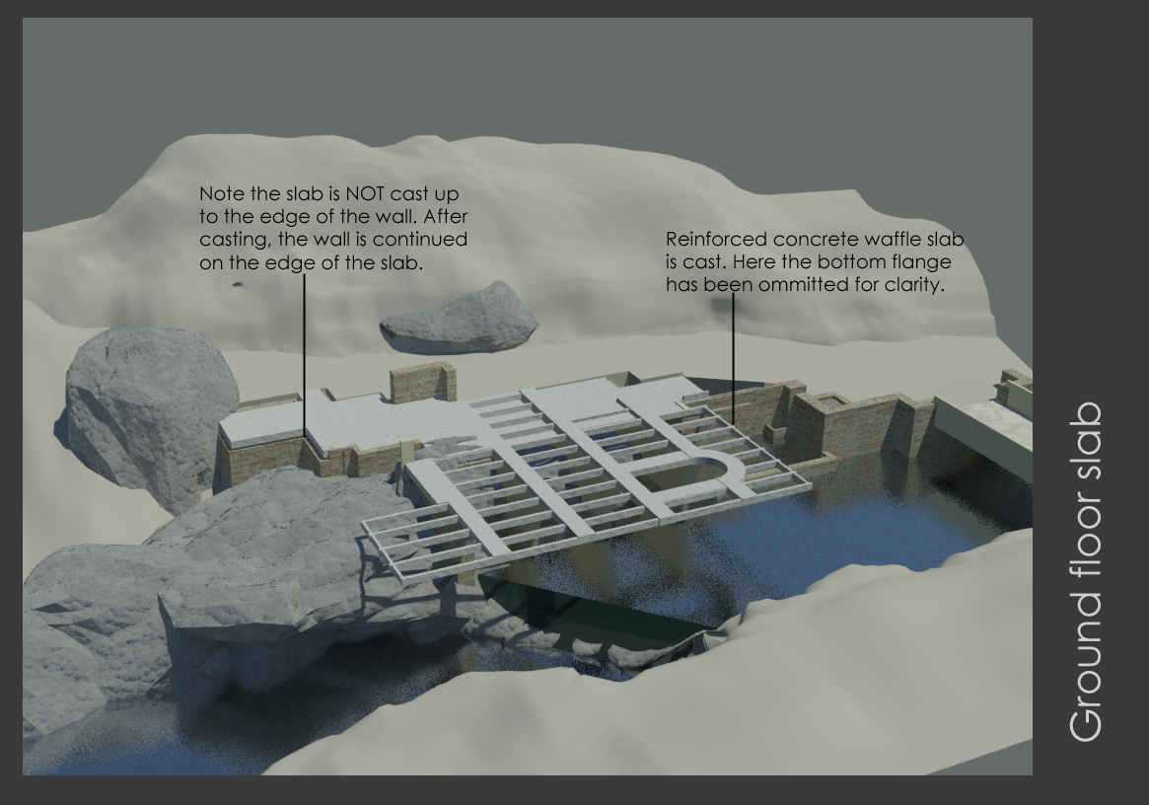

Slide 8
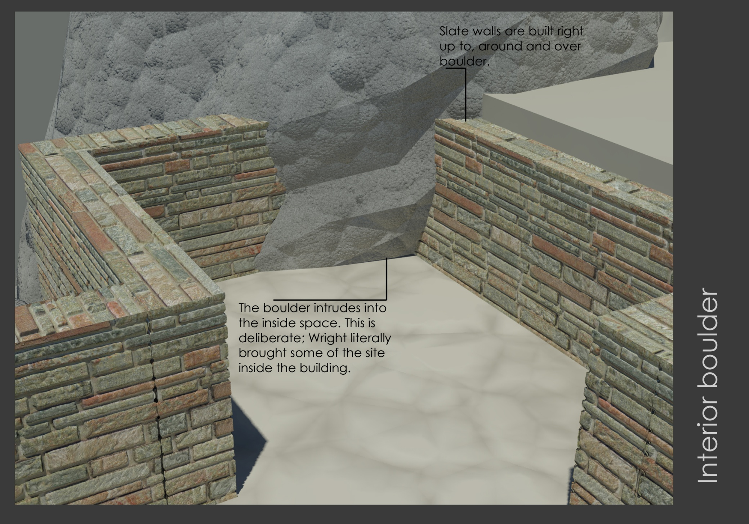

Slide 9
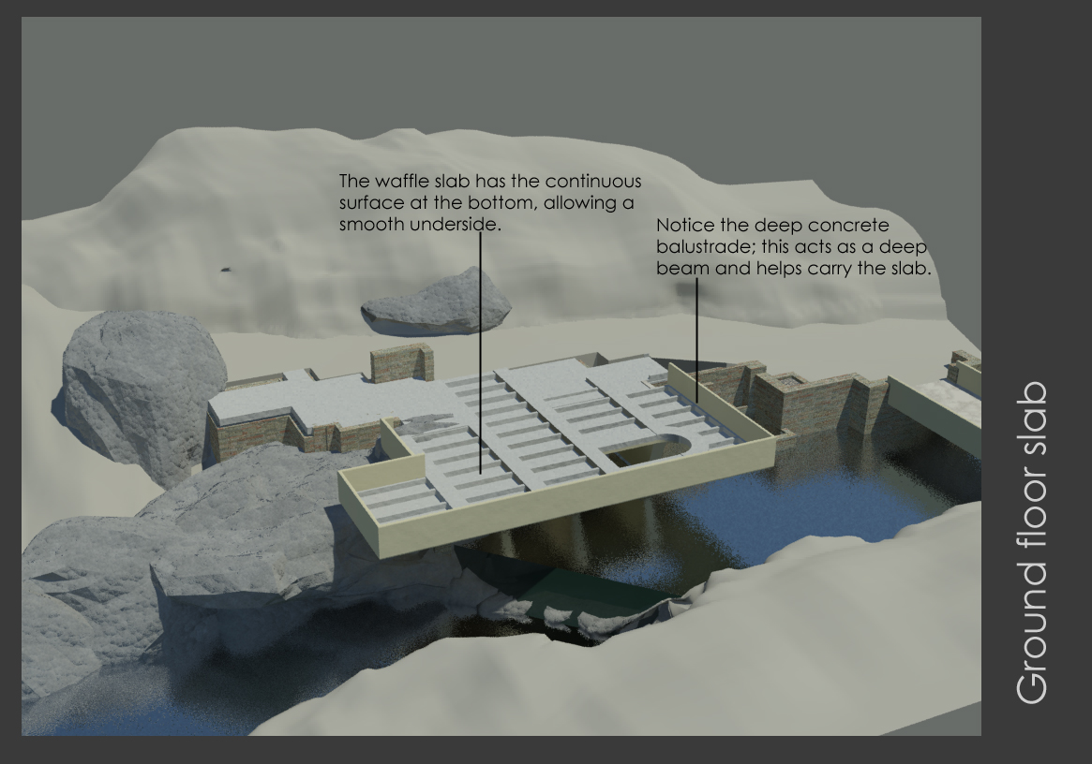

Slide 10
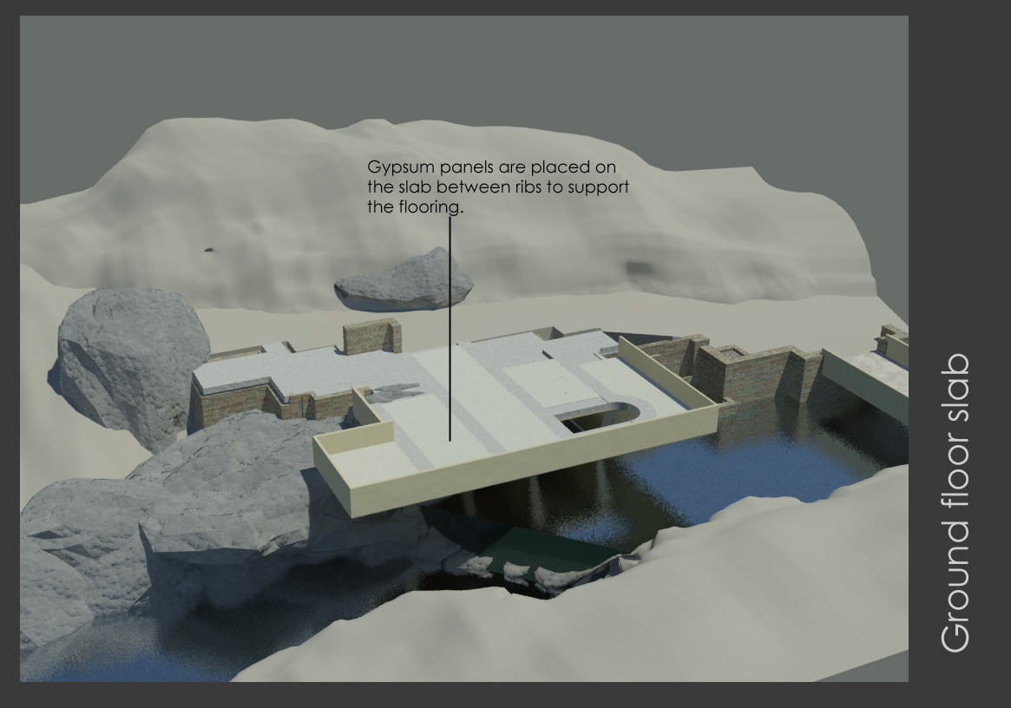

Slide 11
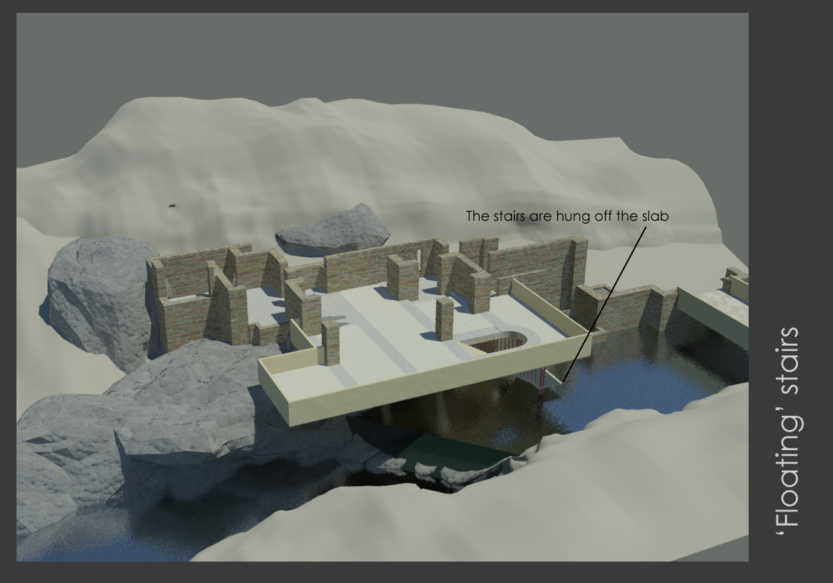

Slide 12
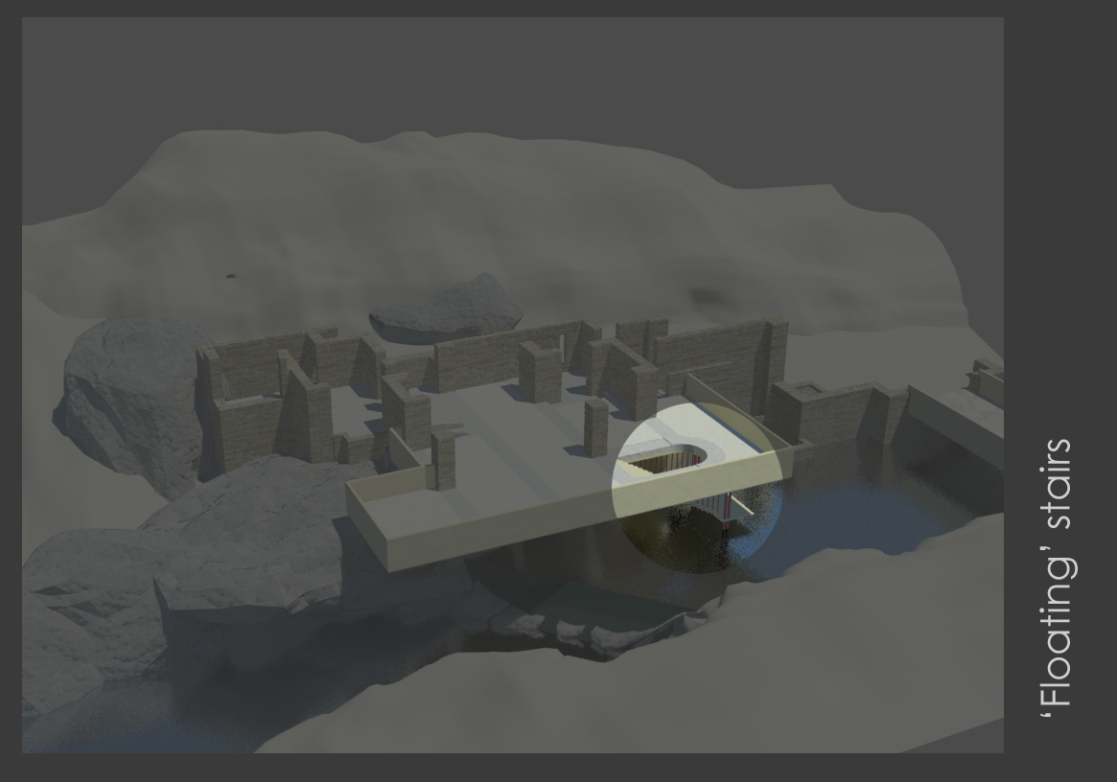

Slide 13
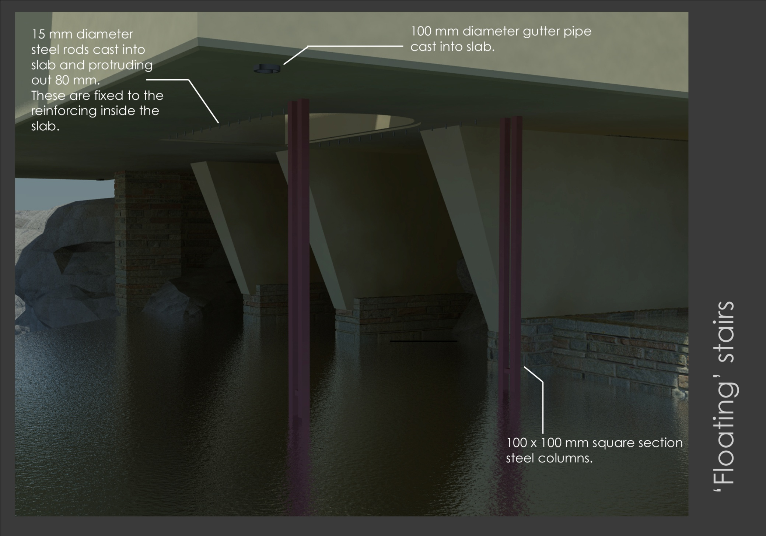

Slide 14
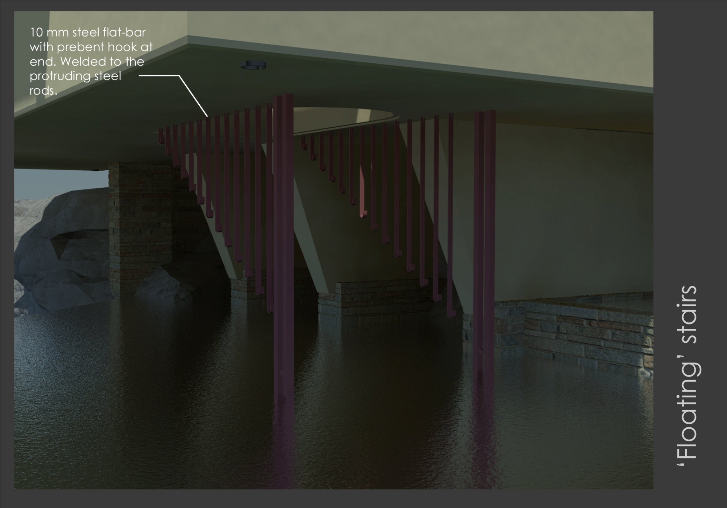

Slide 15
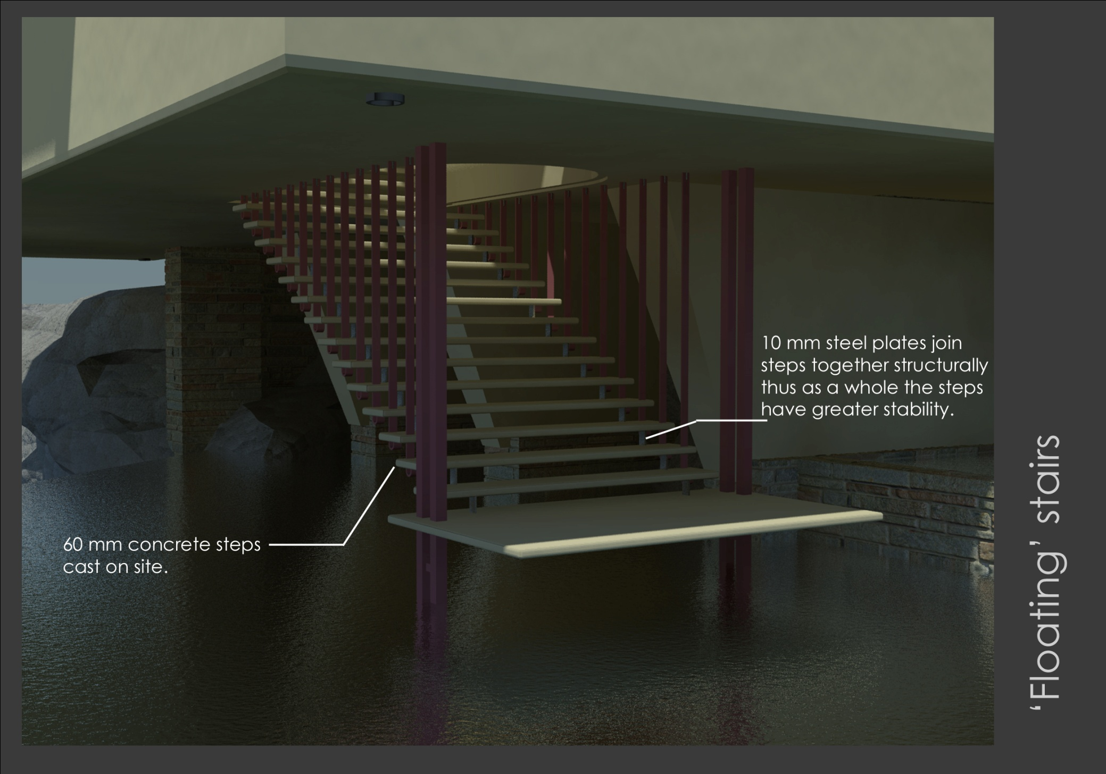

Slide 16
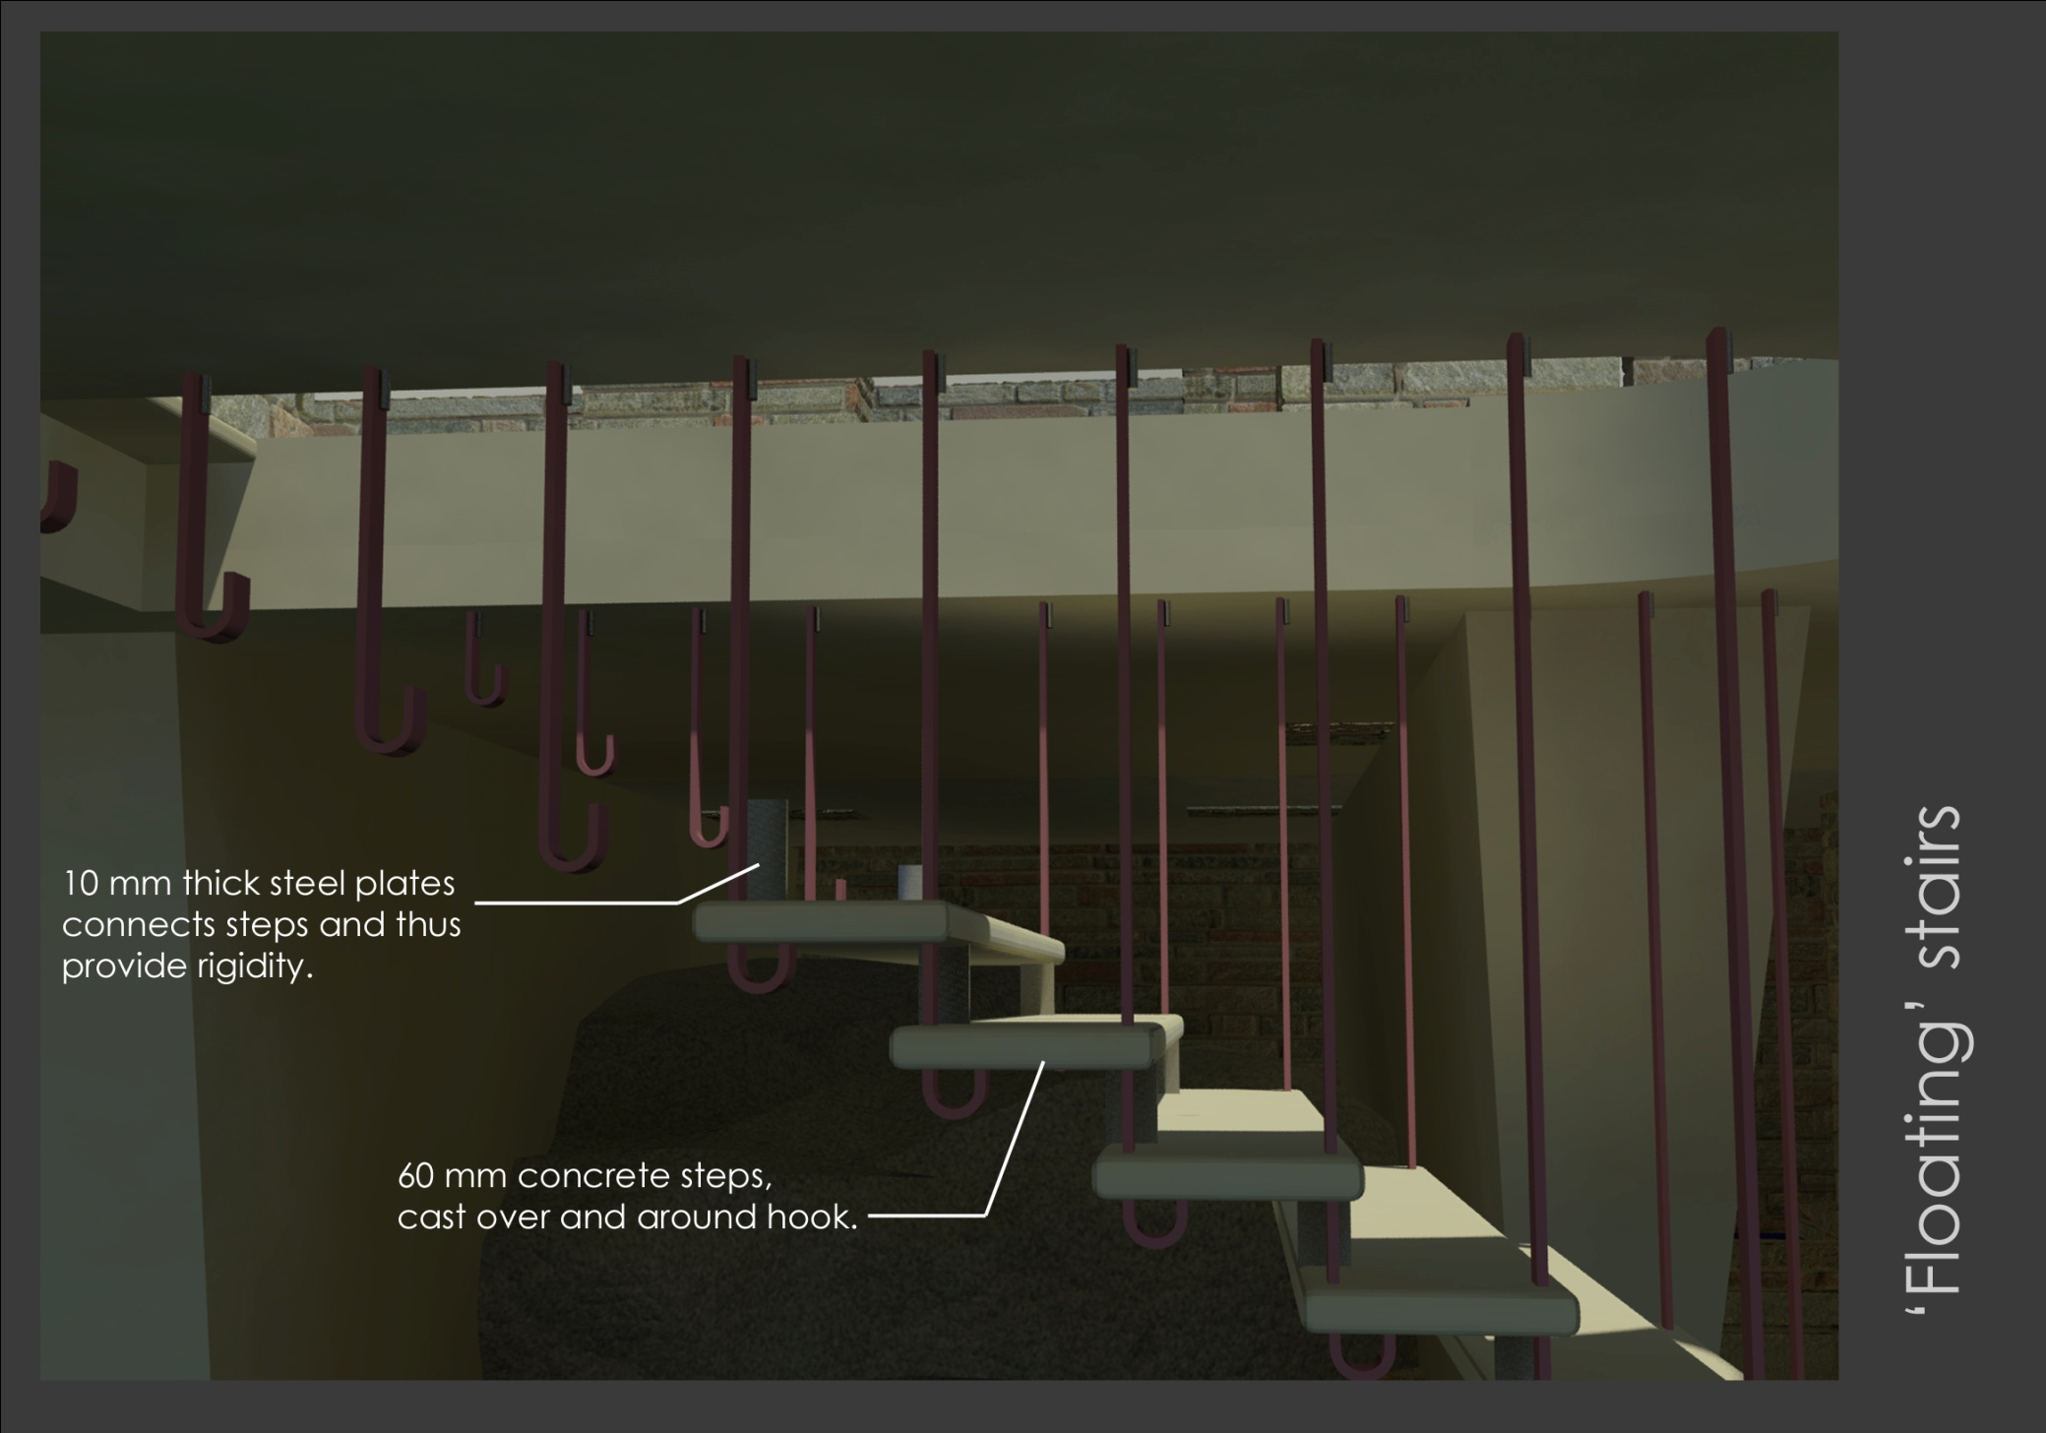

Slide 17
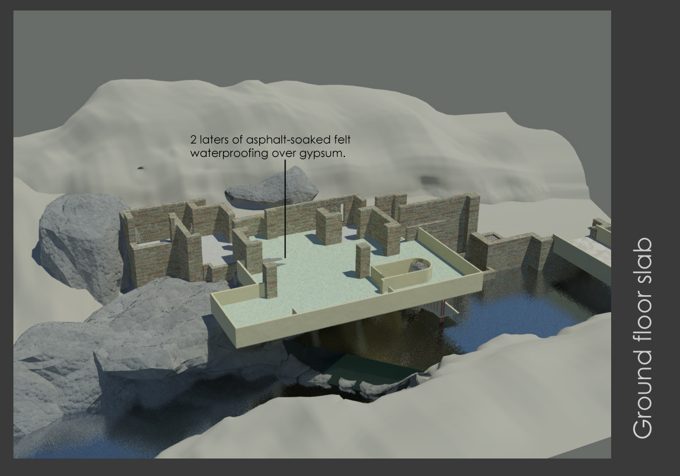

Slide 18
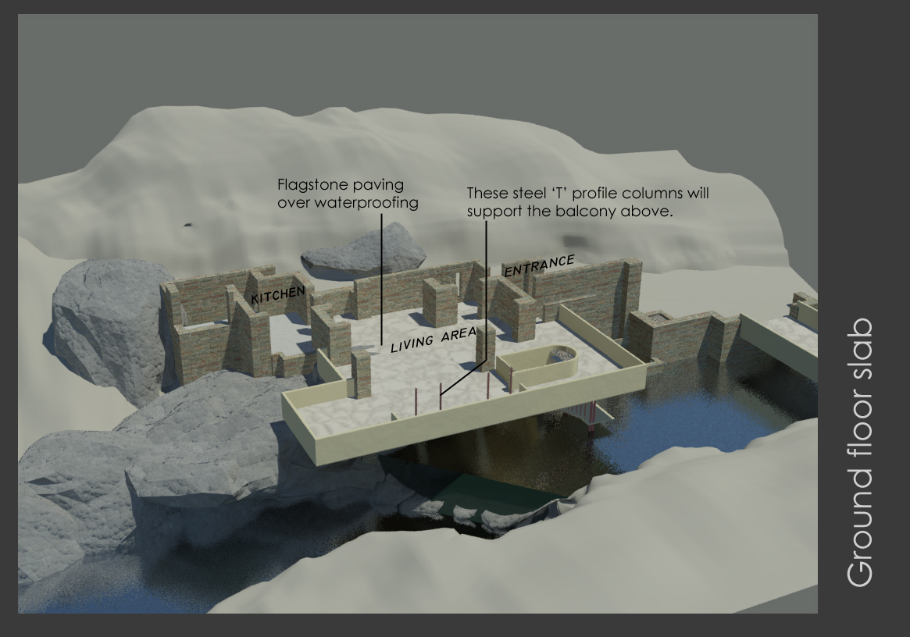

Slide 19
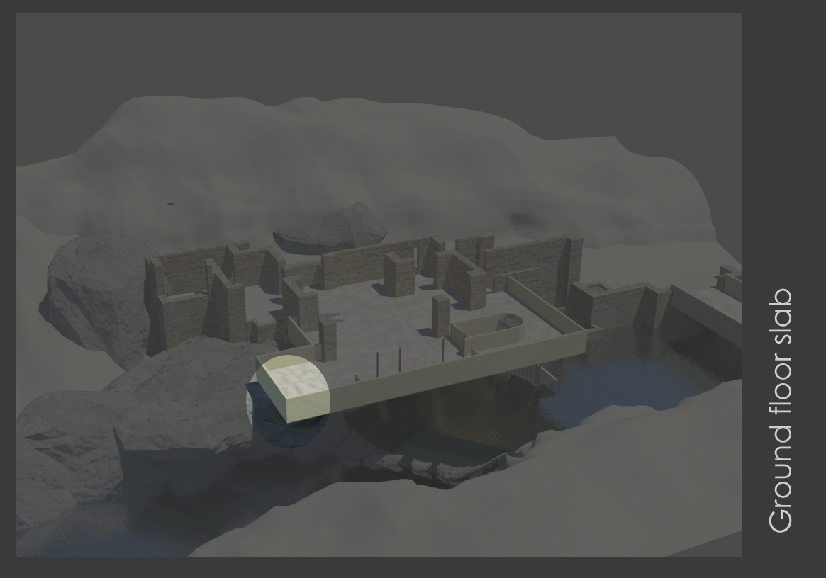

Slide 20
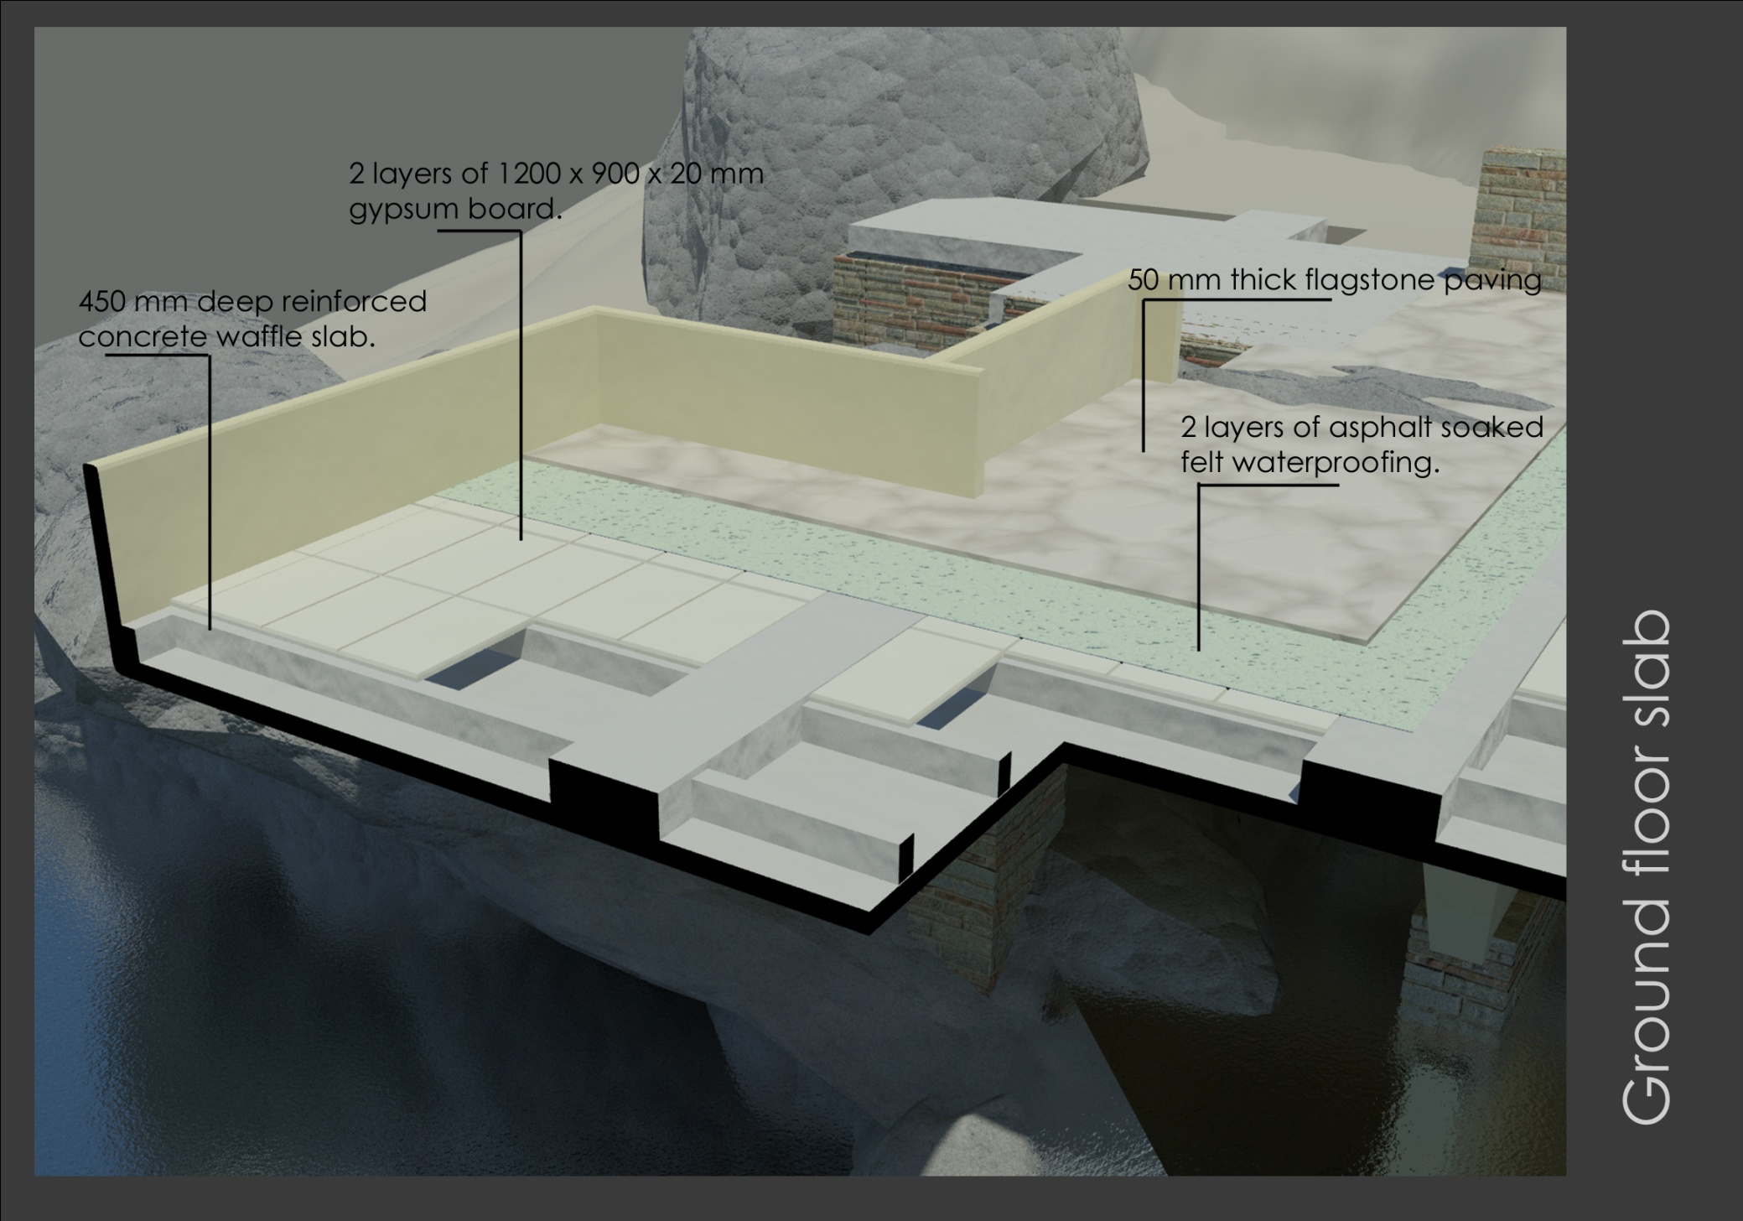

Slide 21
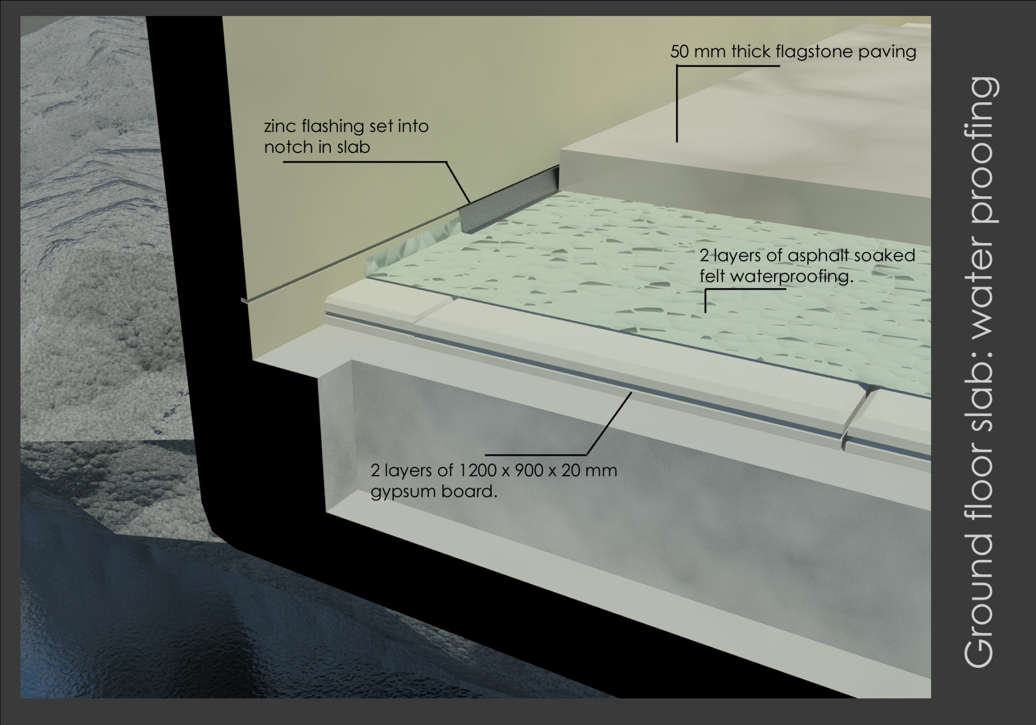

Slide 22
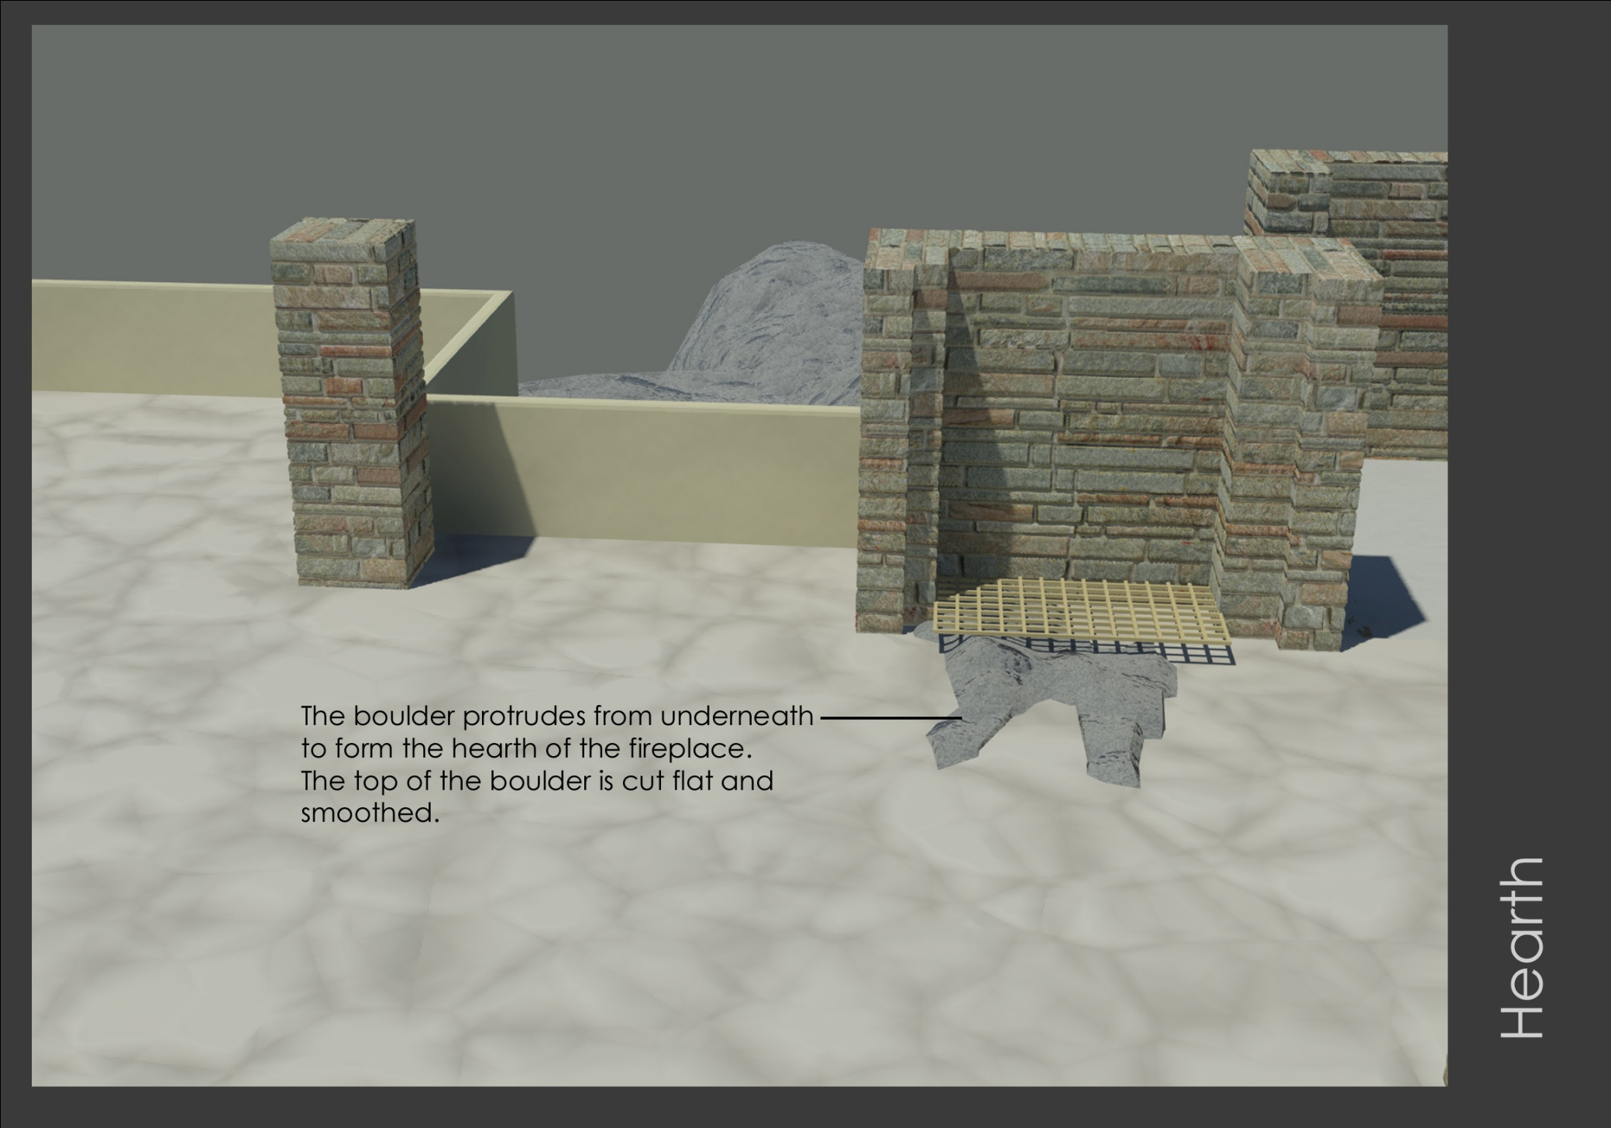

Slide 23
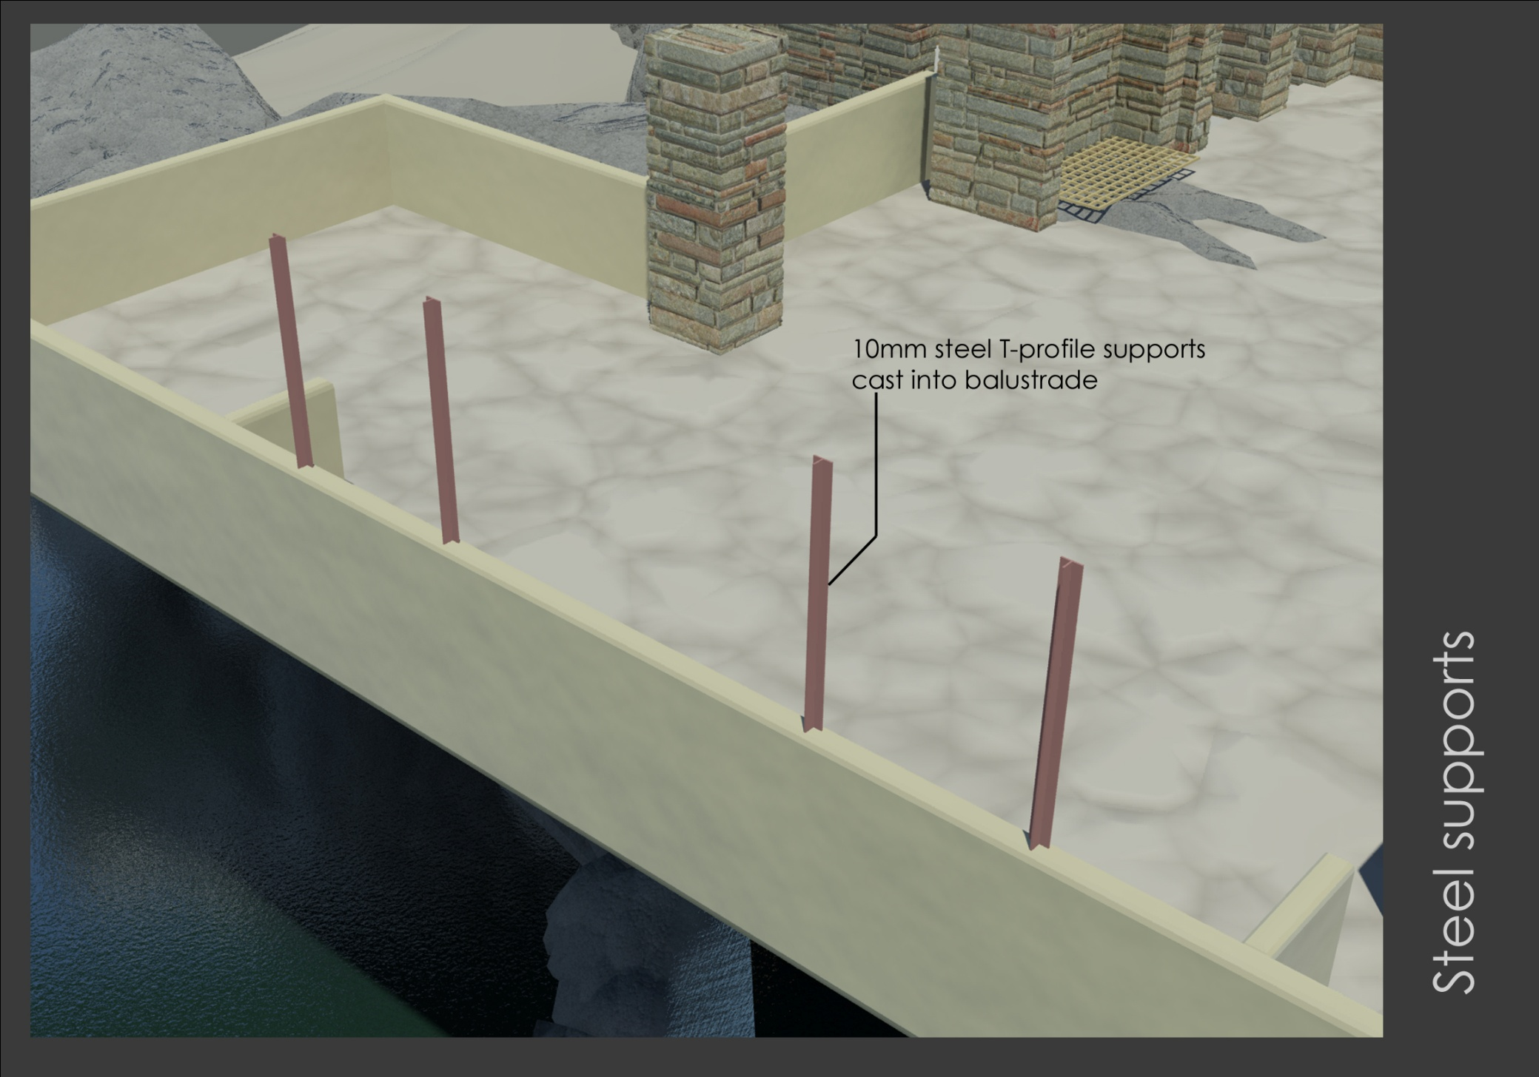

Slide 24
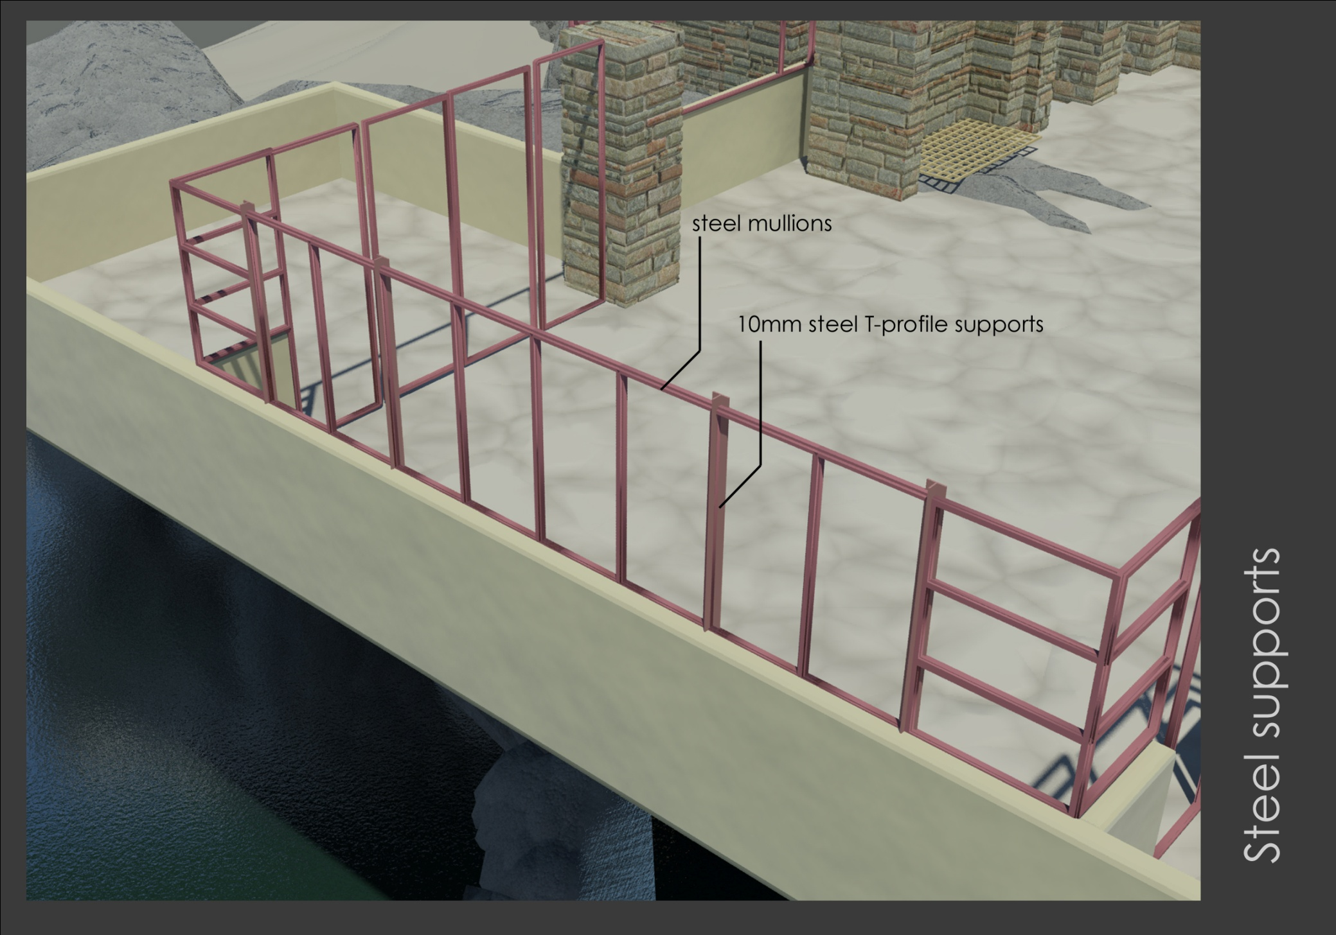

Slide 25
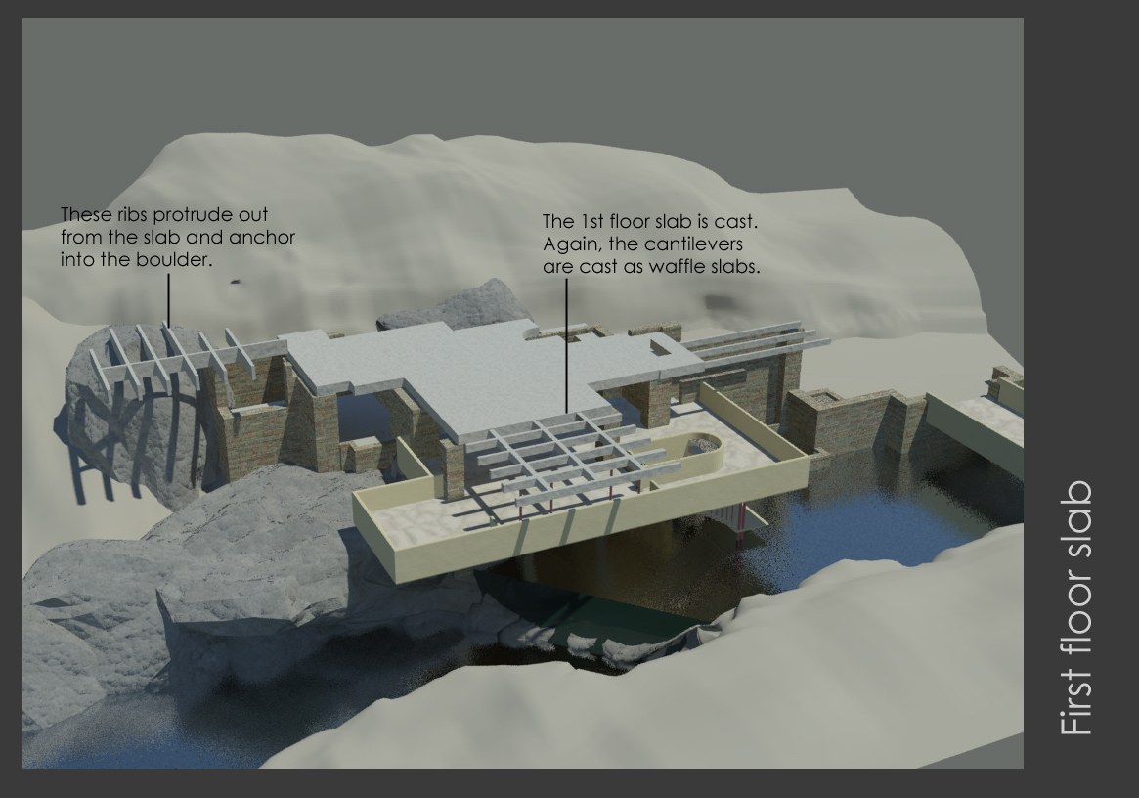

Slide 26
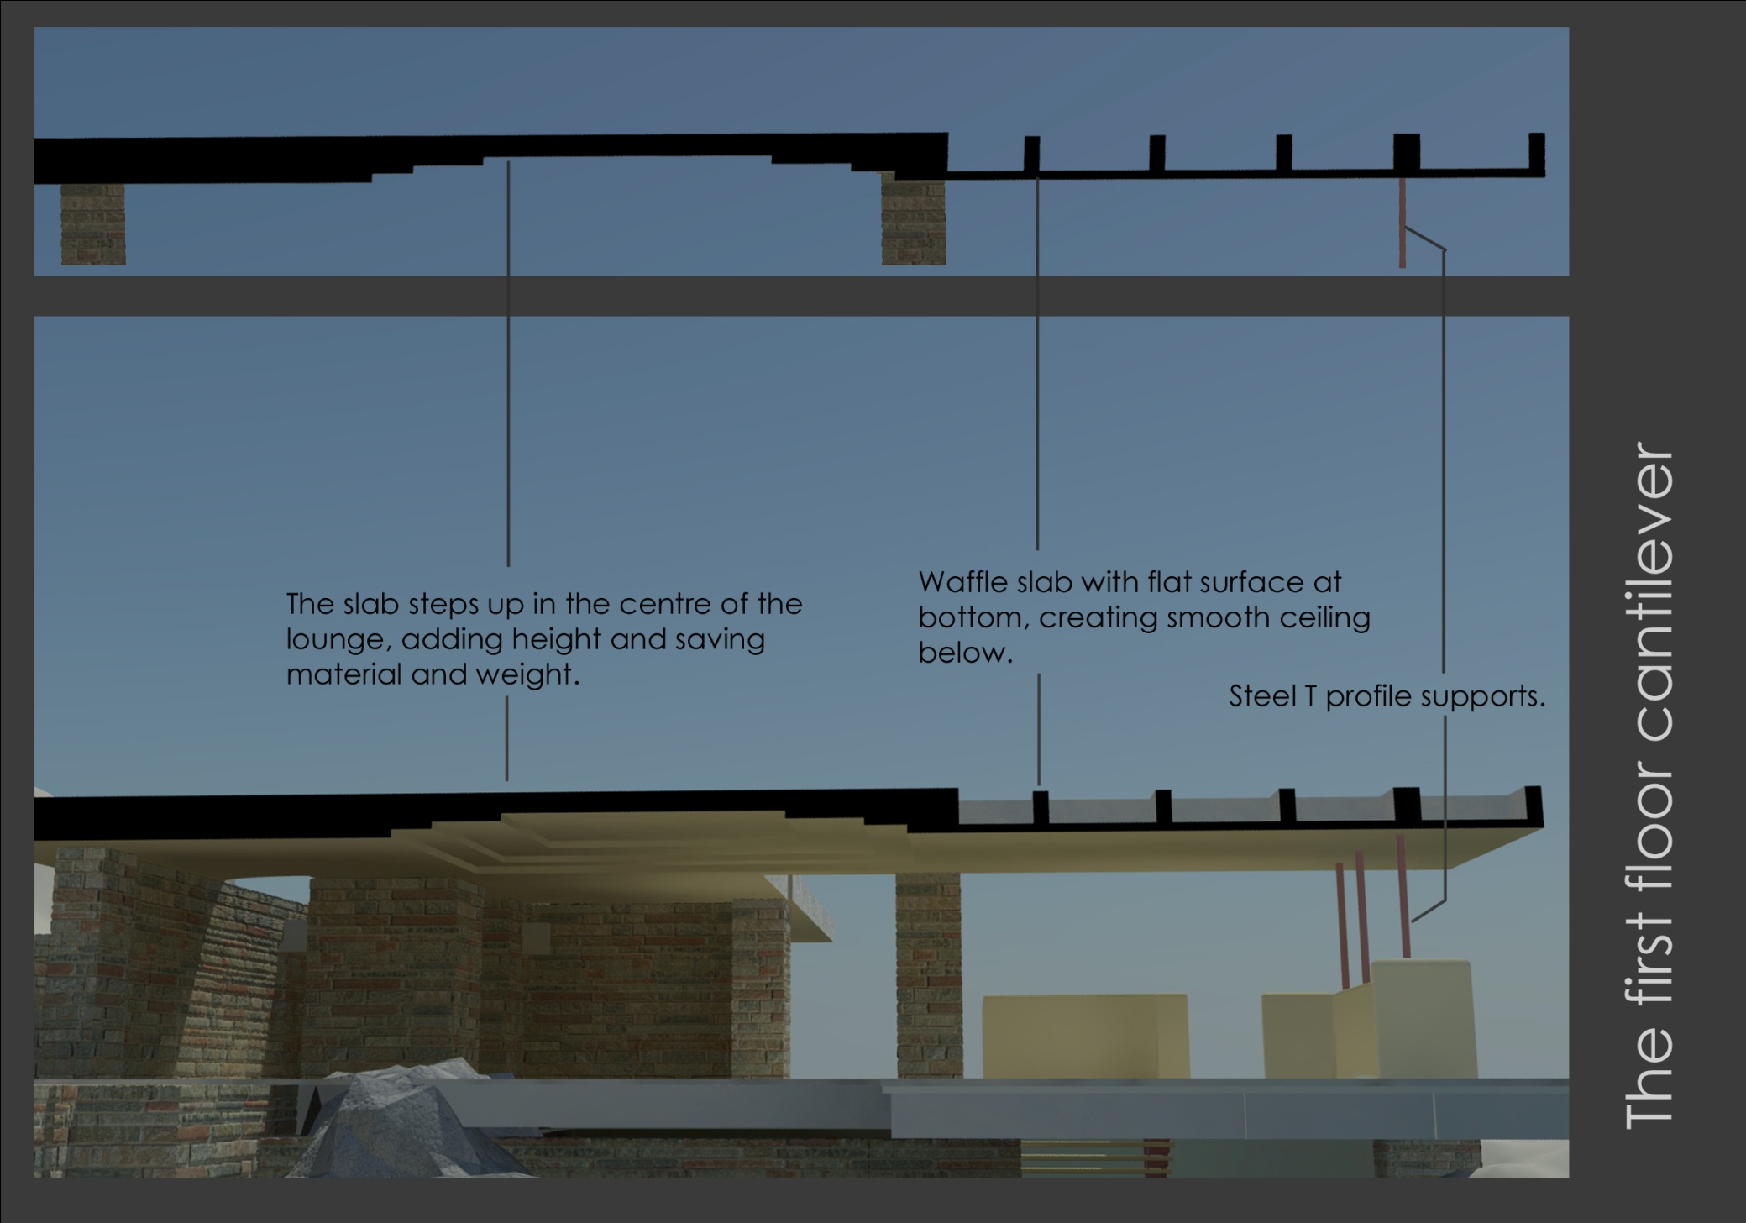

Slide 27
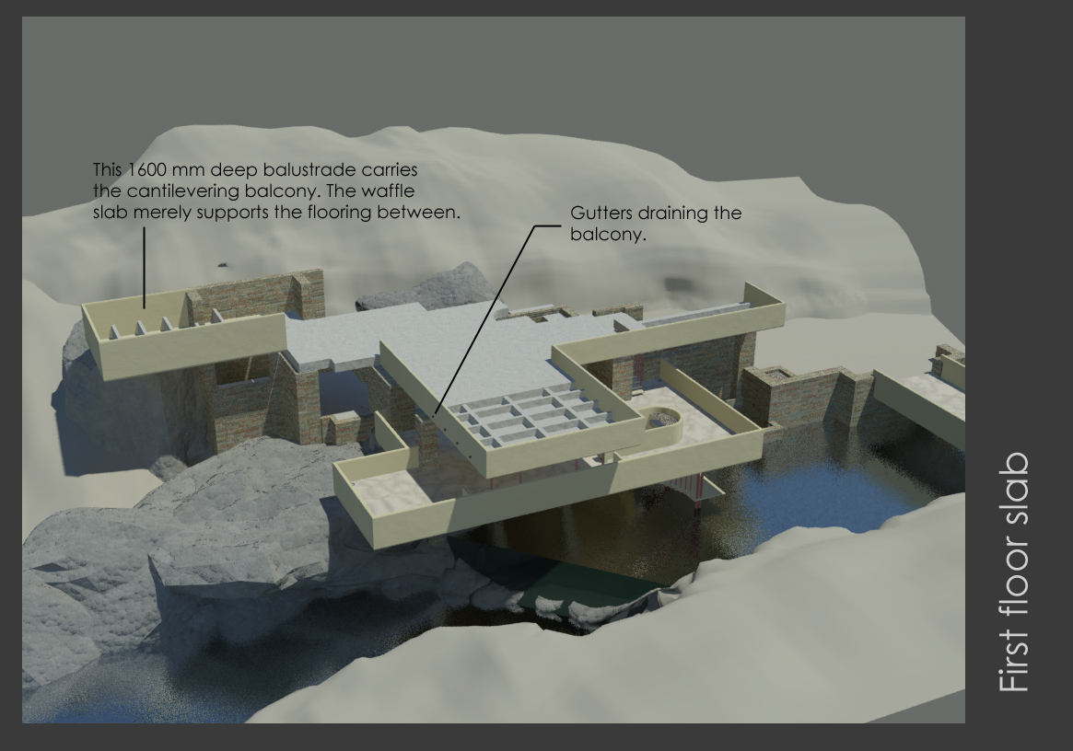

Slide 28
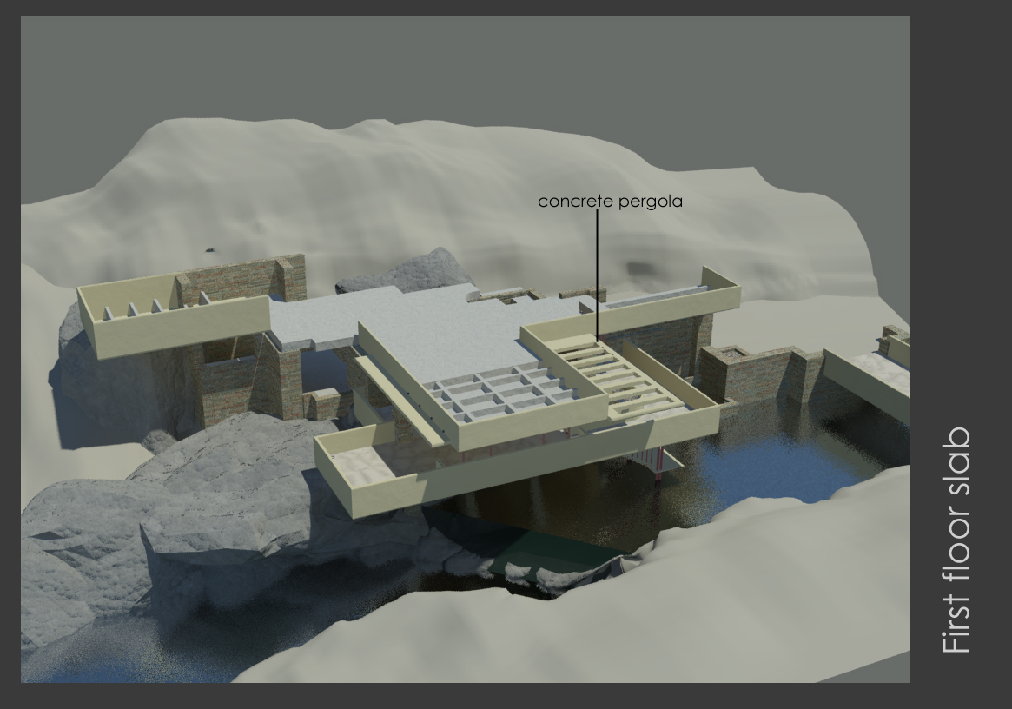

Slide 29
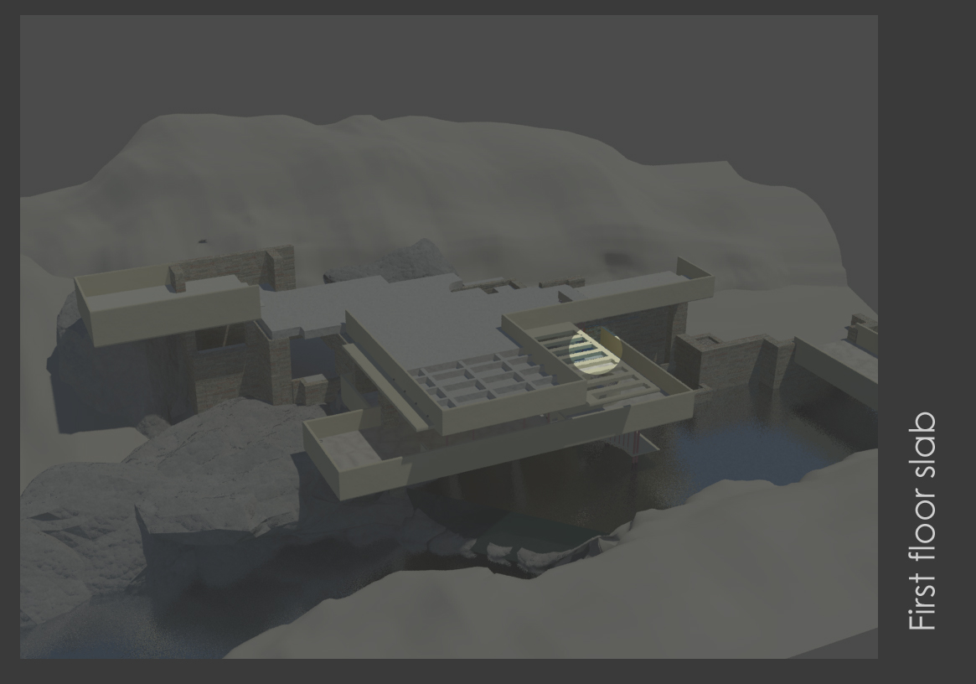

Slide 30
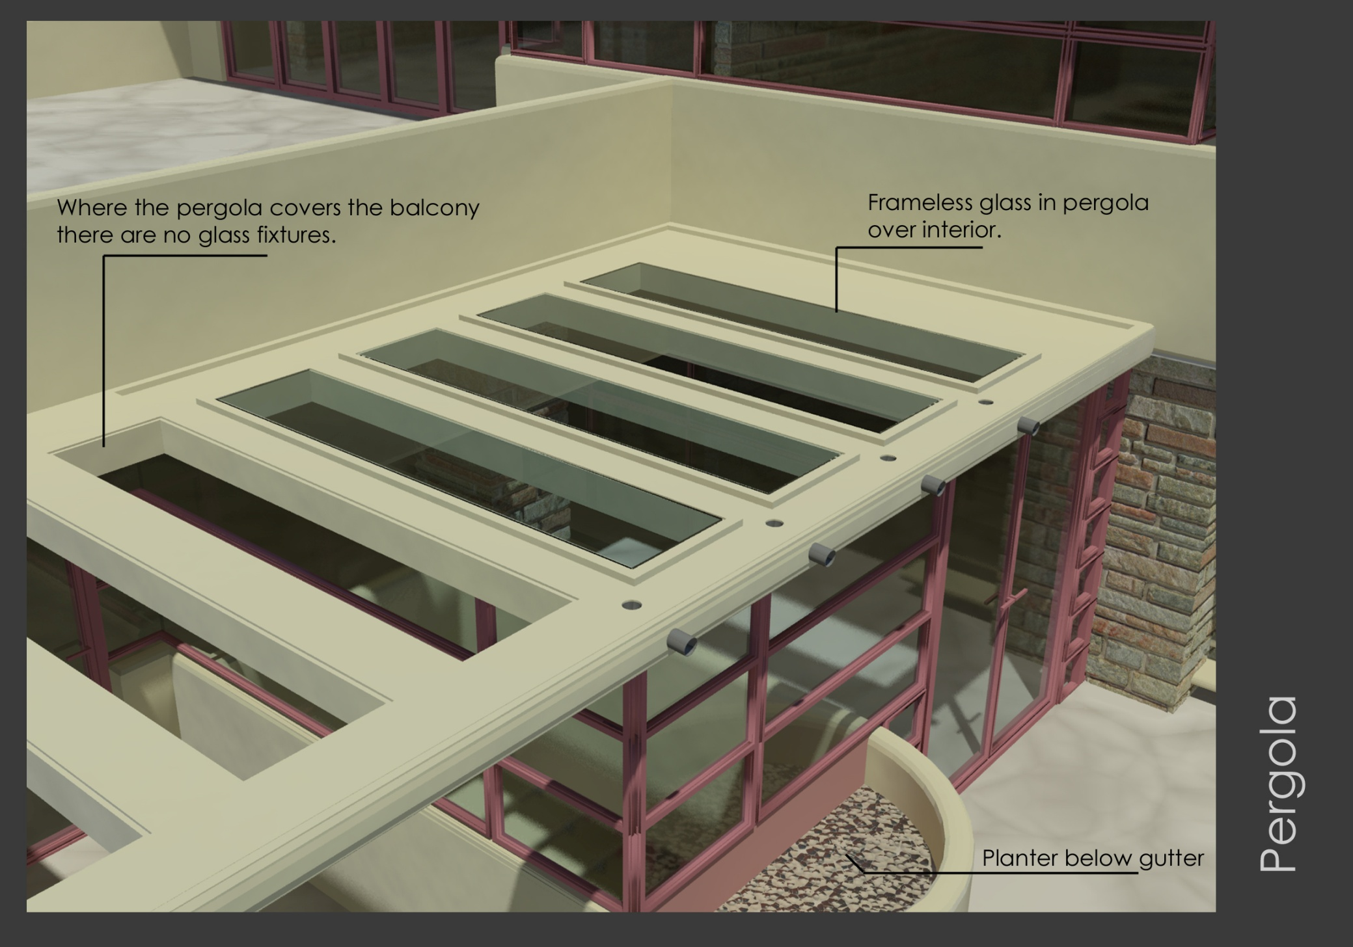

Slide 31
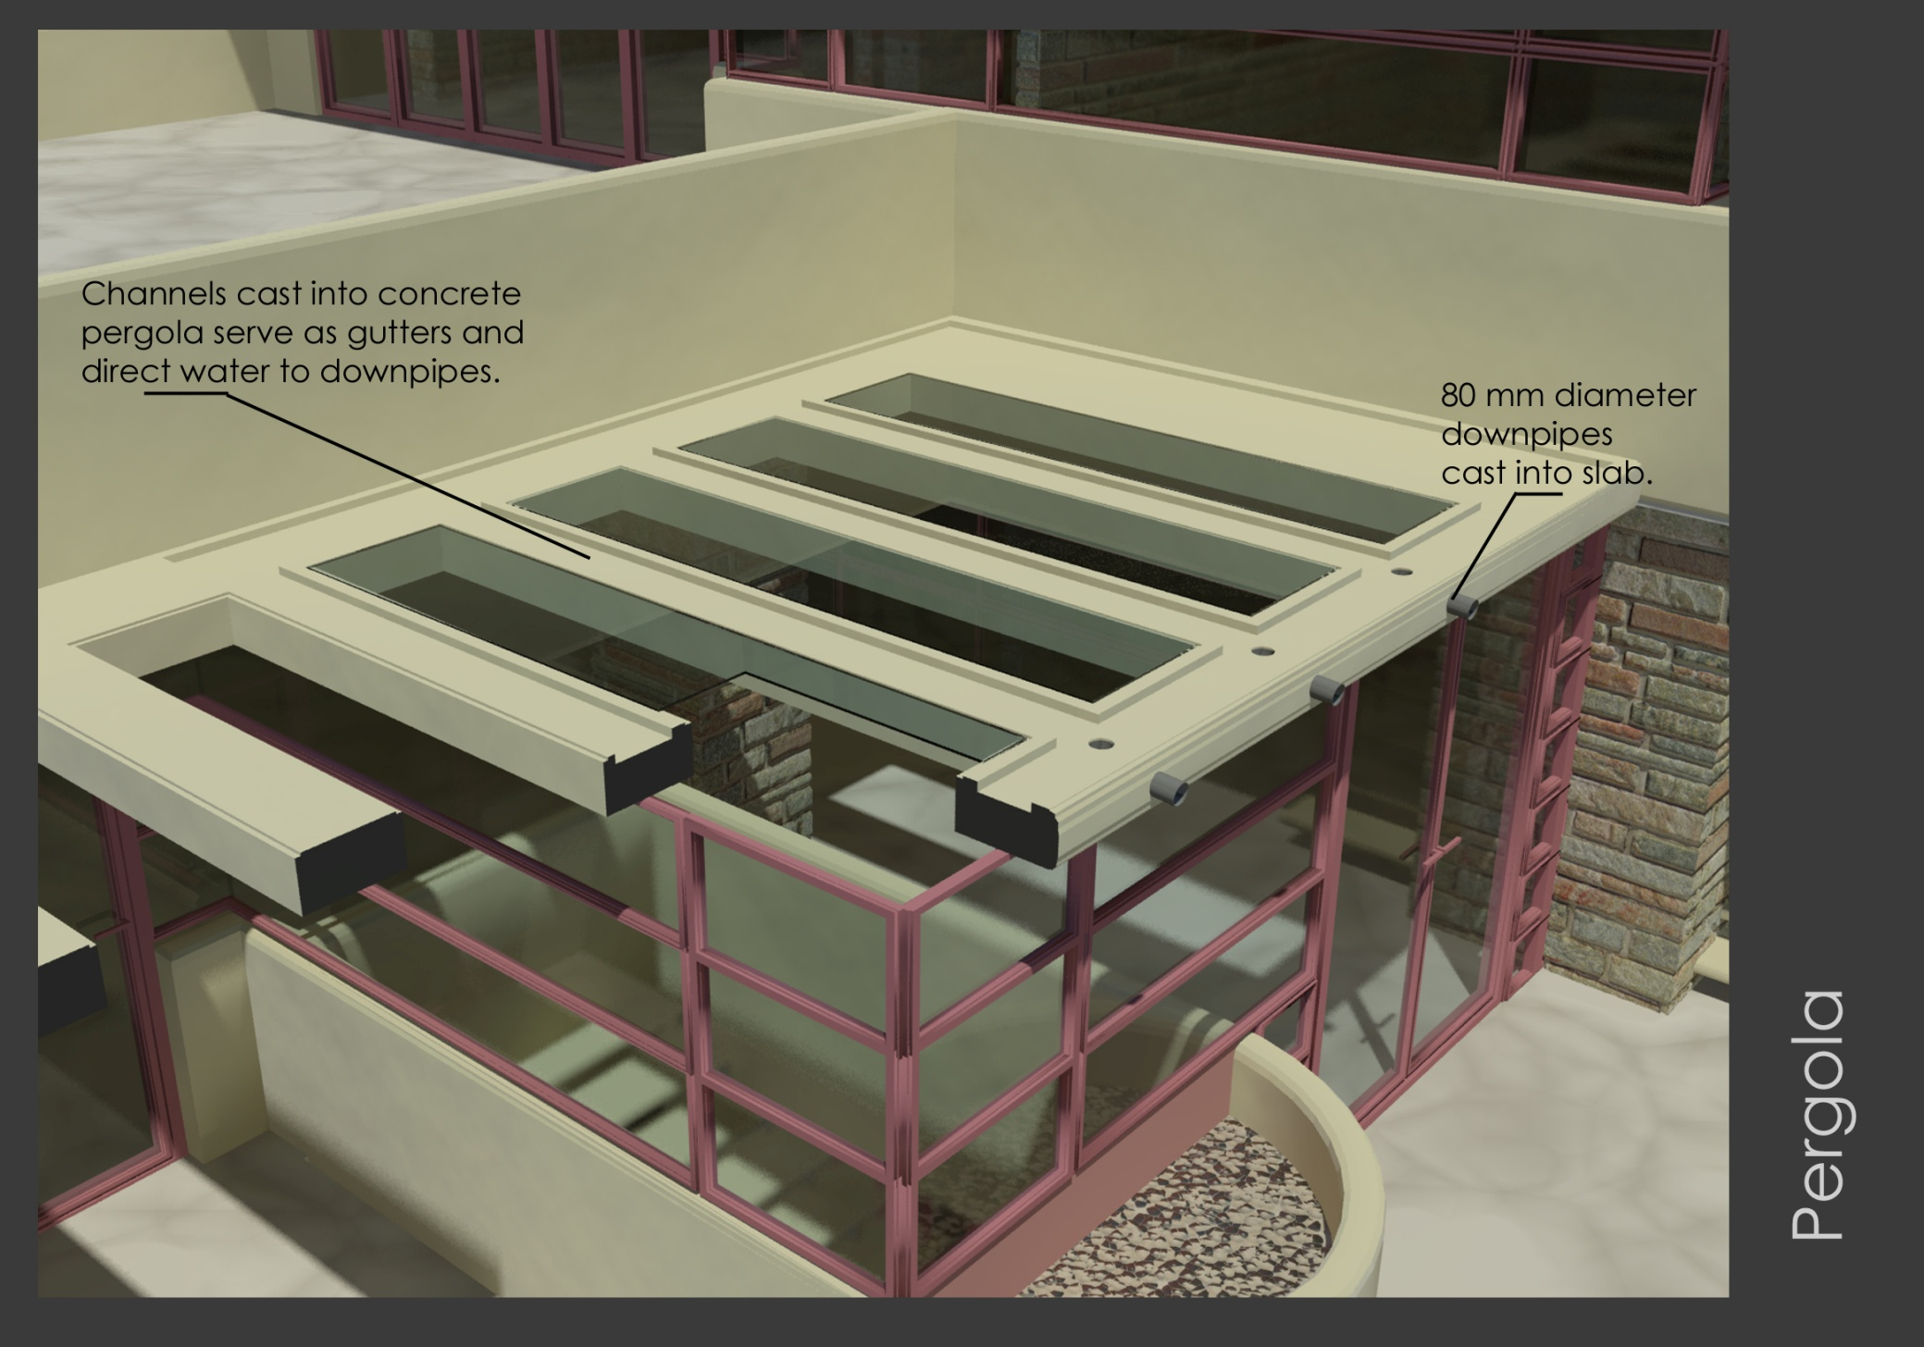

Slide 32
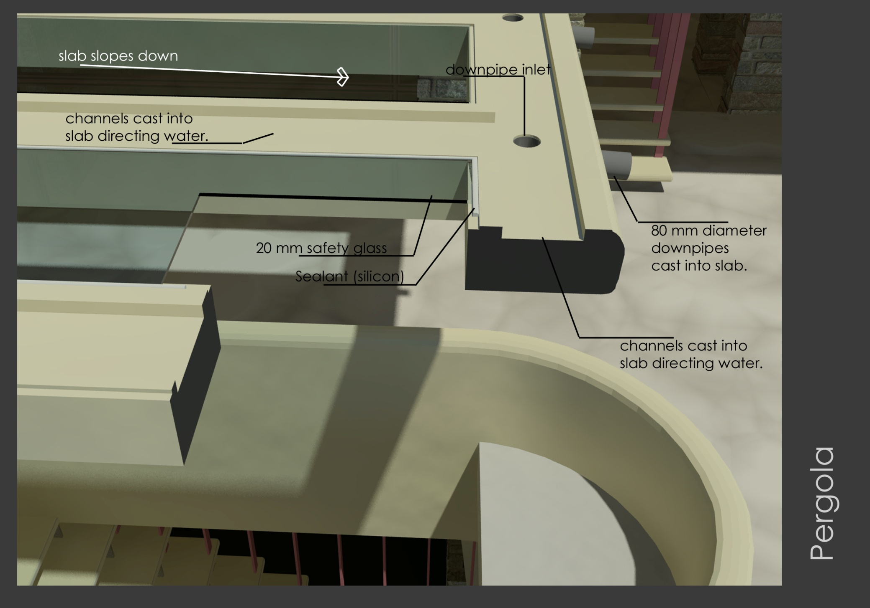

Slide 33
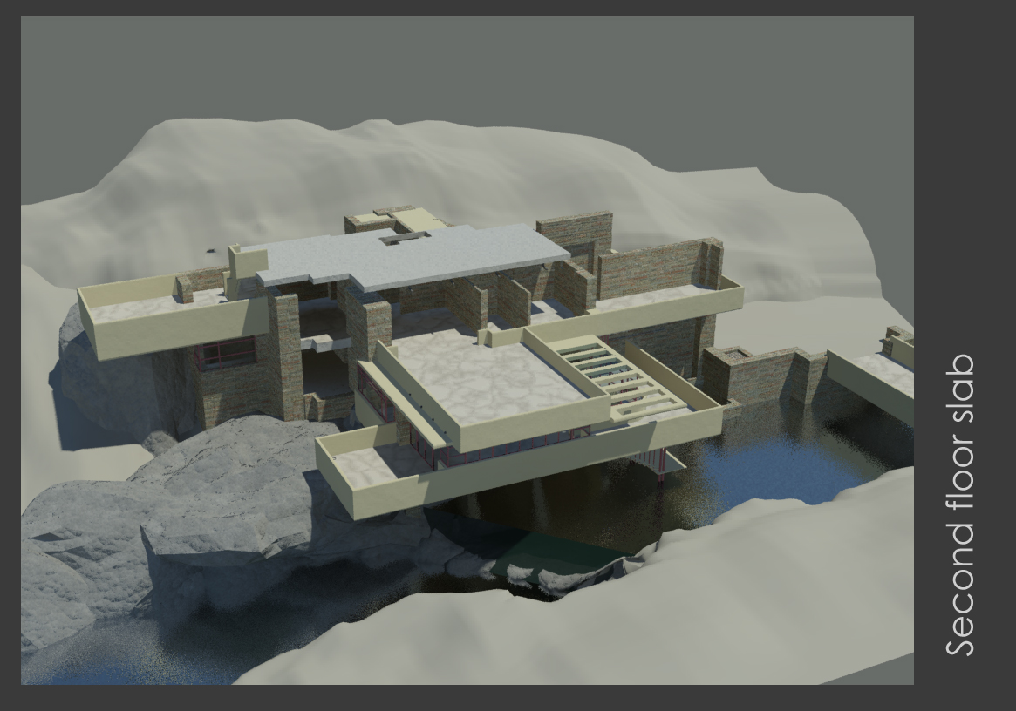

Slide 34
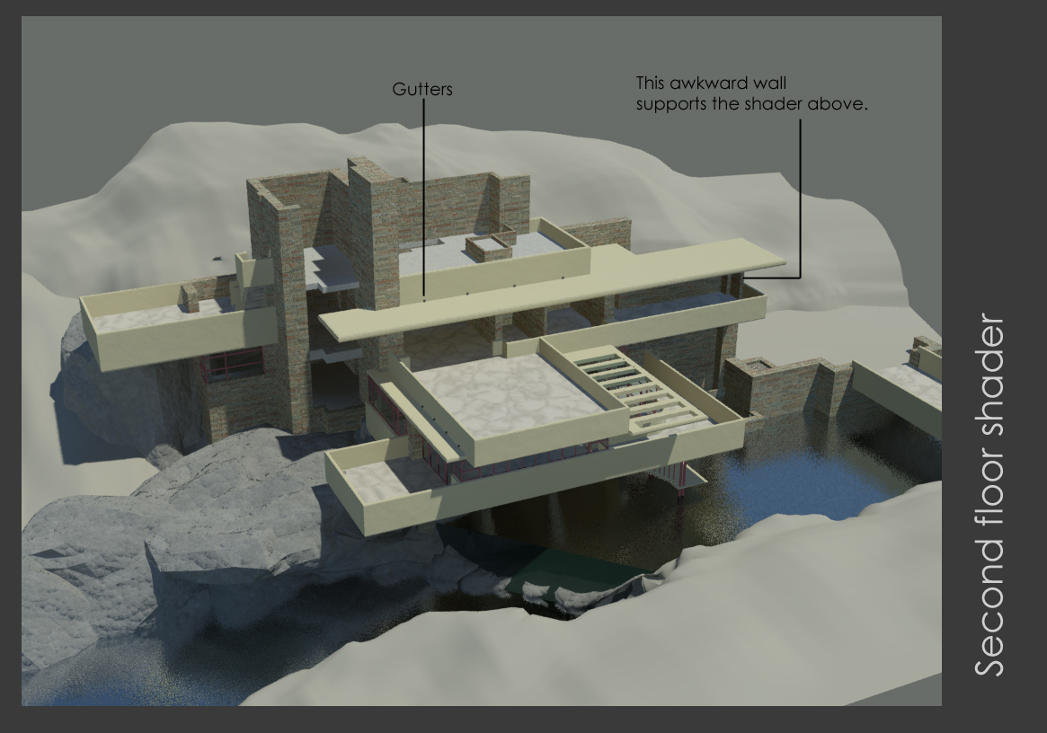

Slide 35
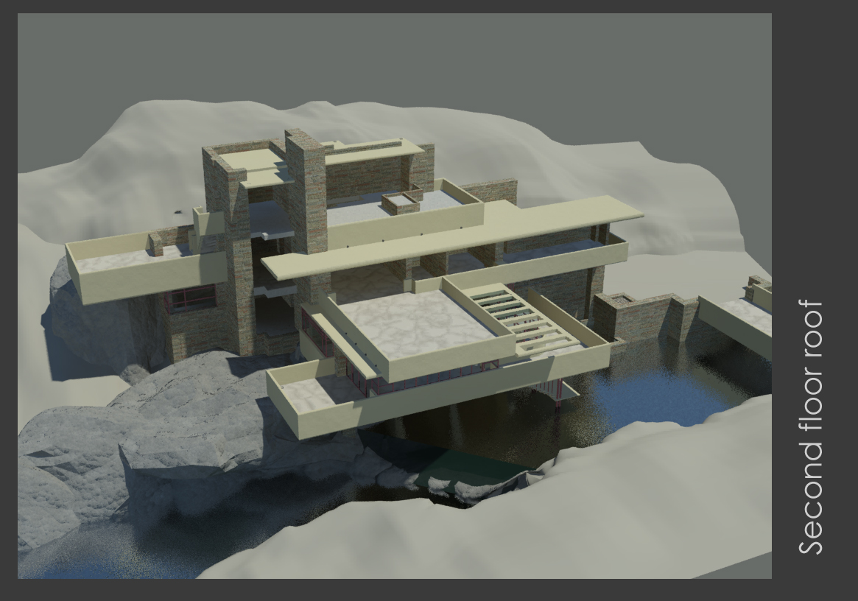

Slide 37
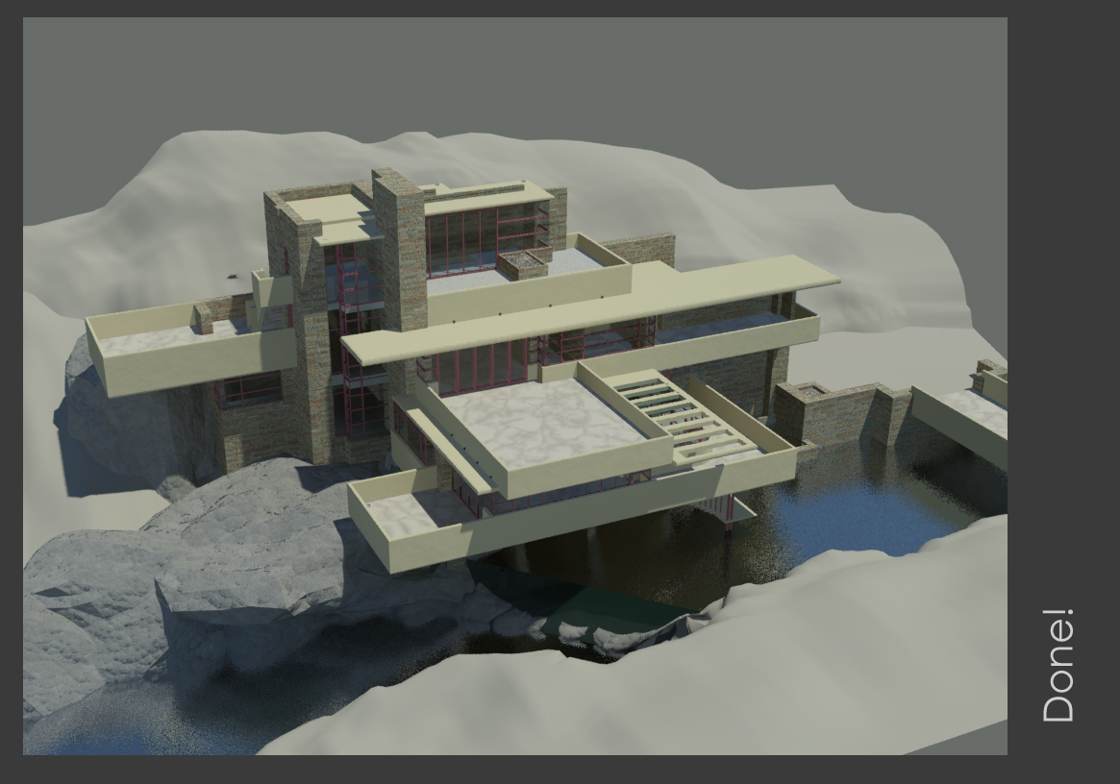

Slide 38
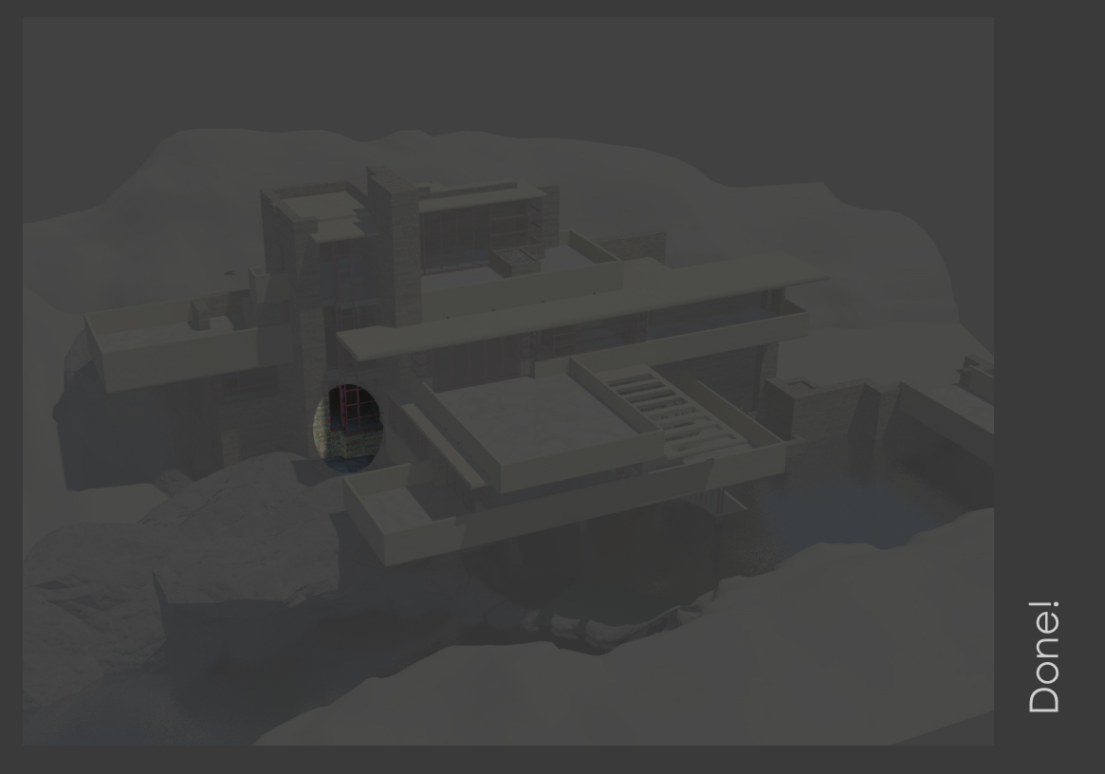

Slide 39
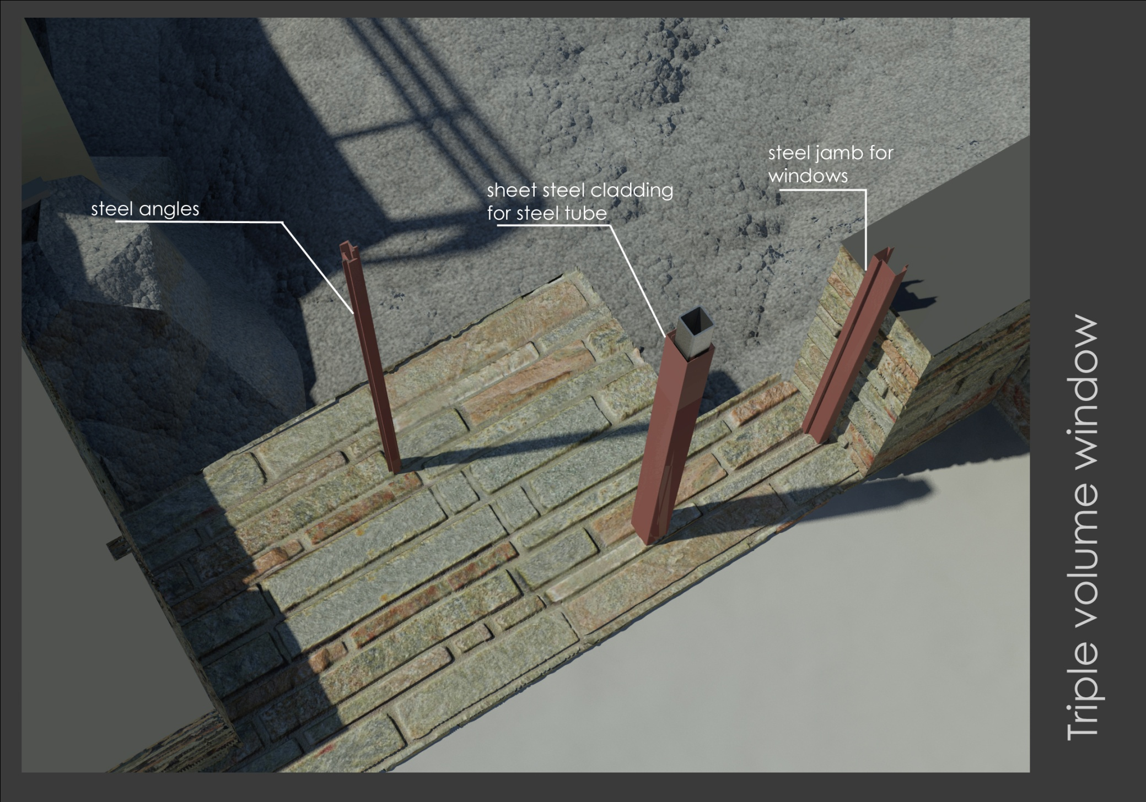

Slide 40
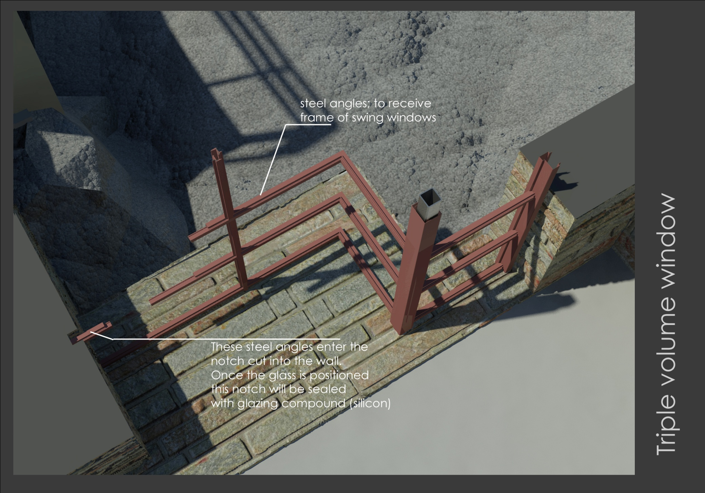

Slide 41
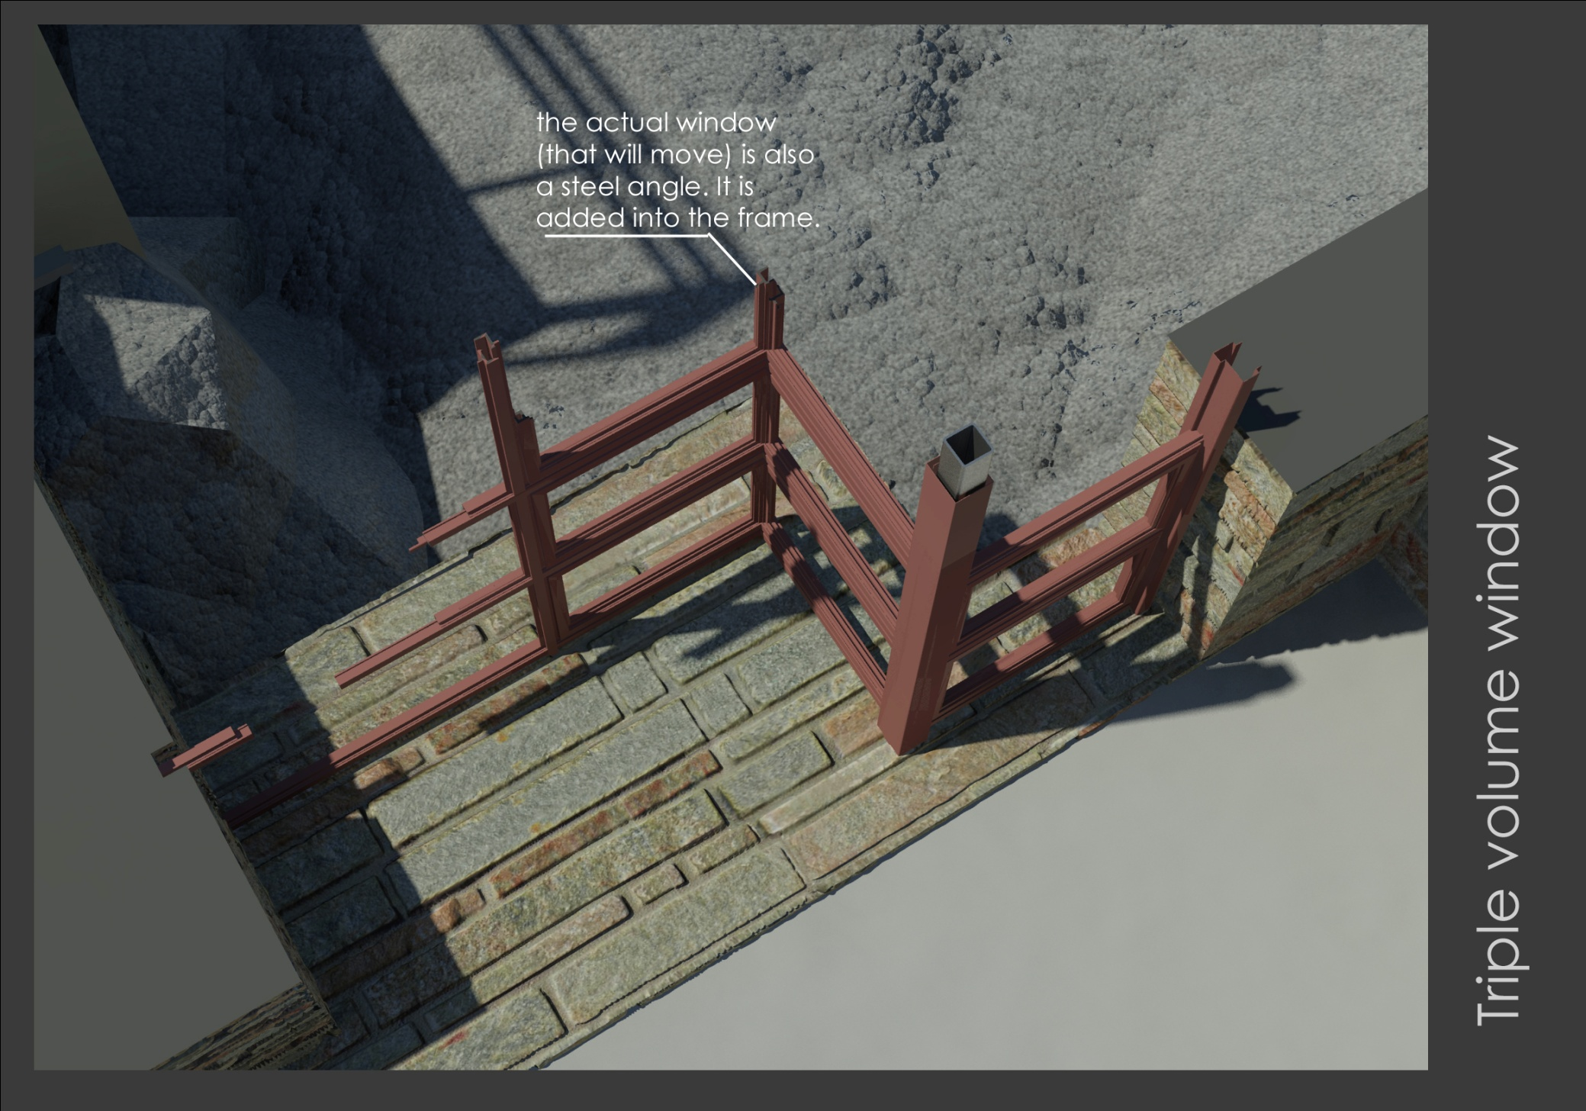

Slide 42
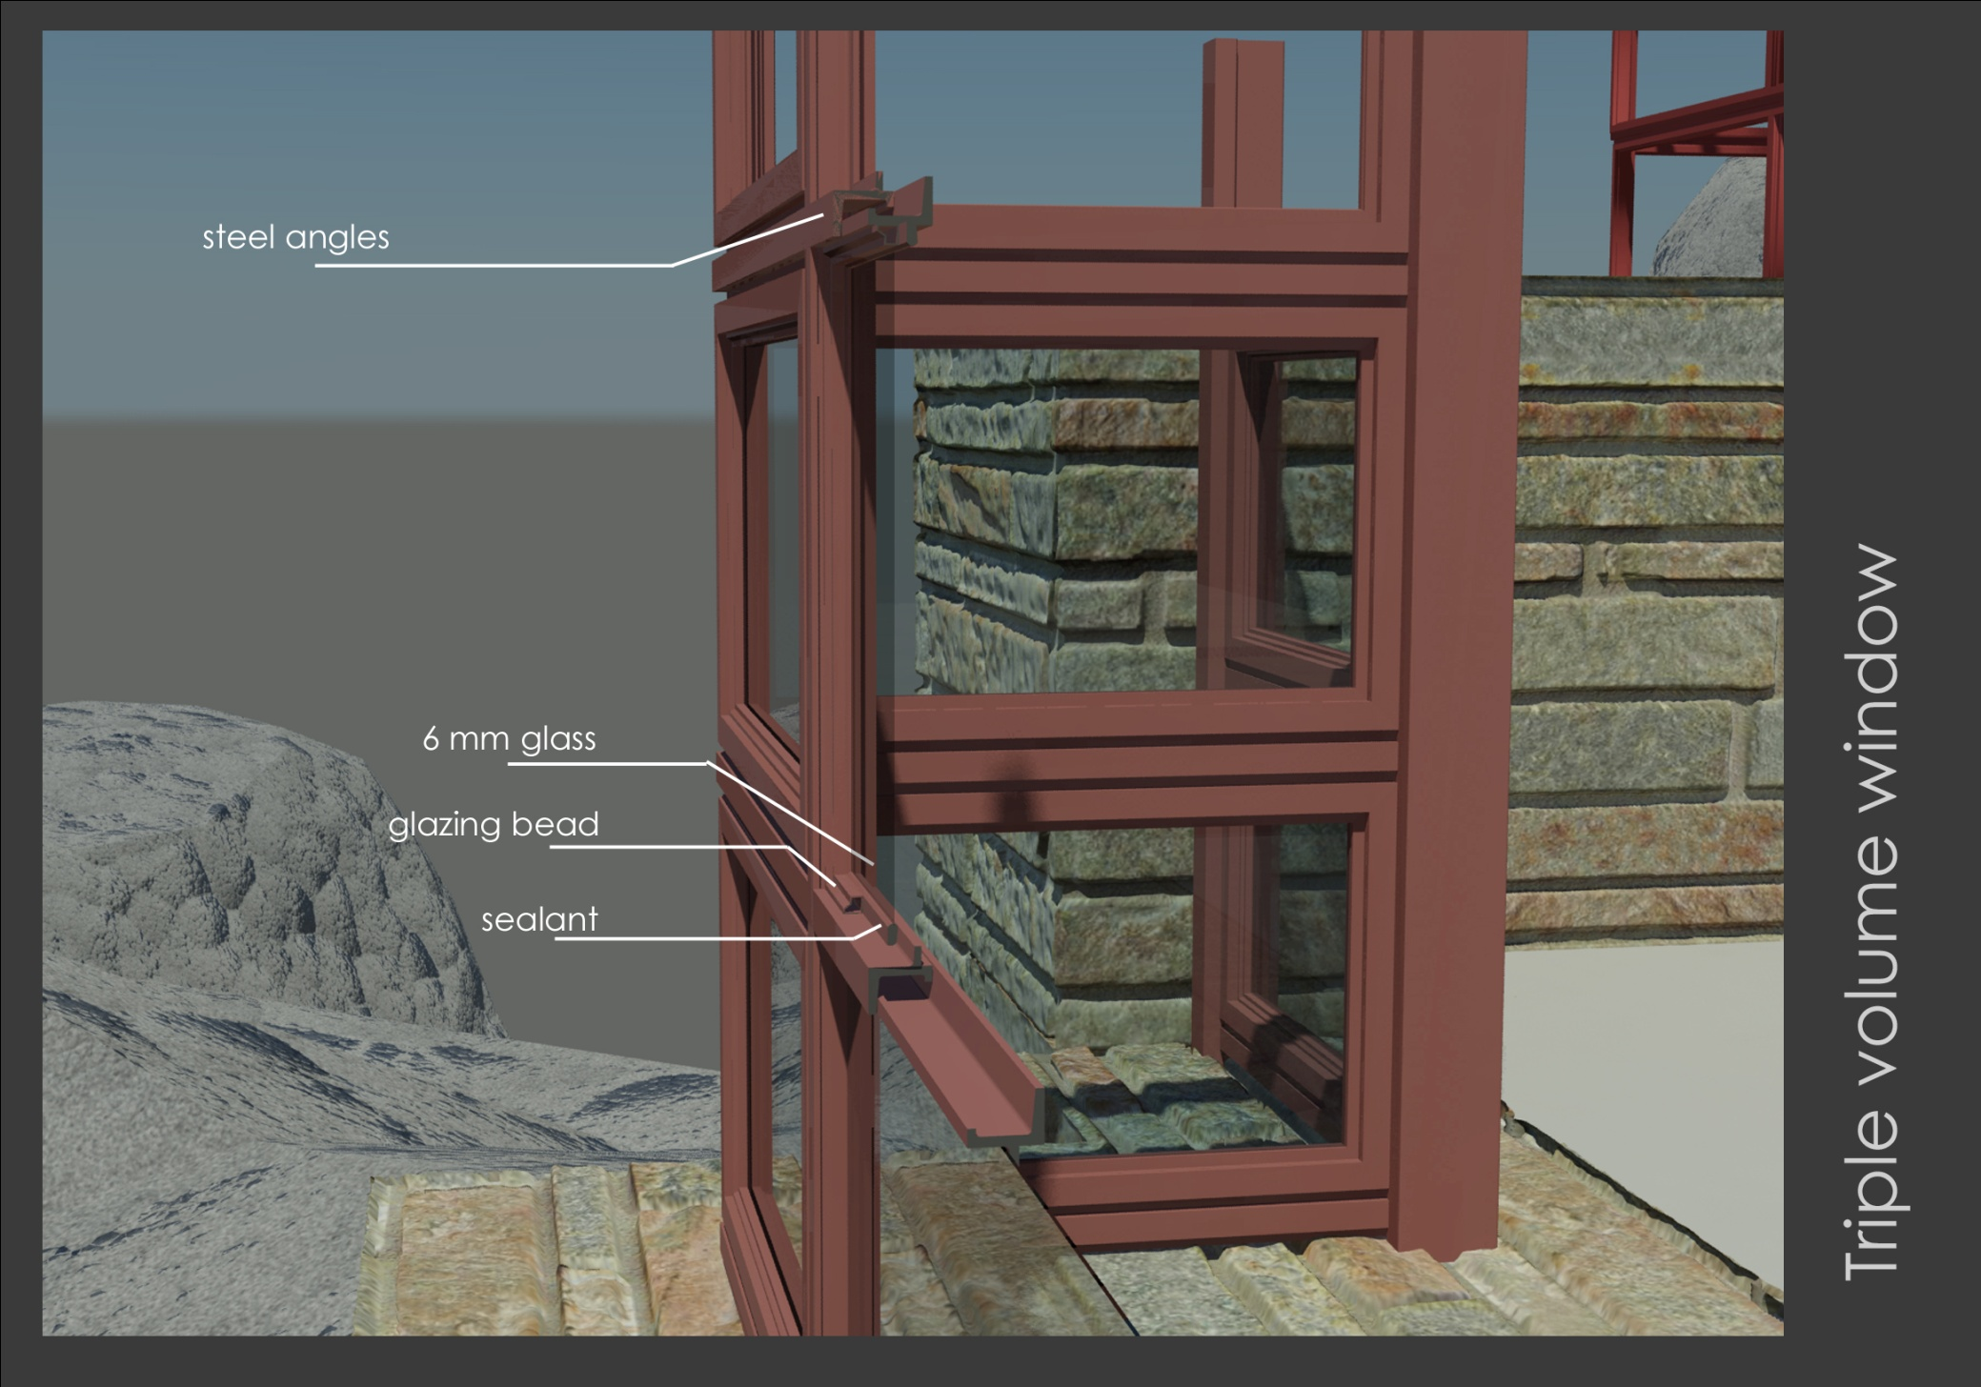

Slide 43
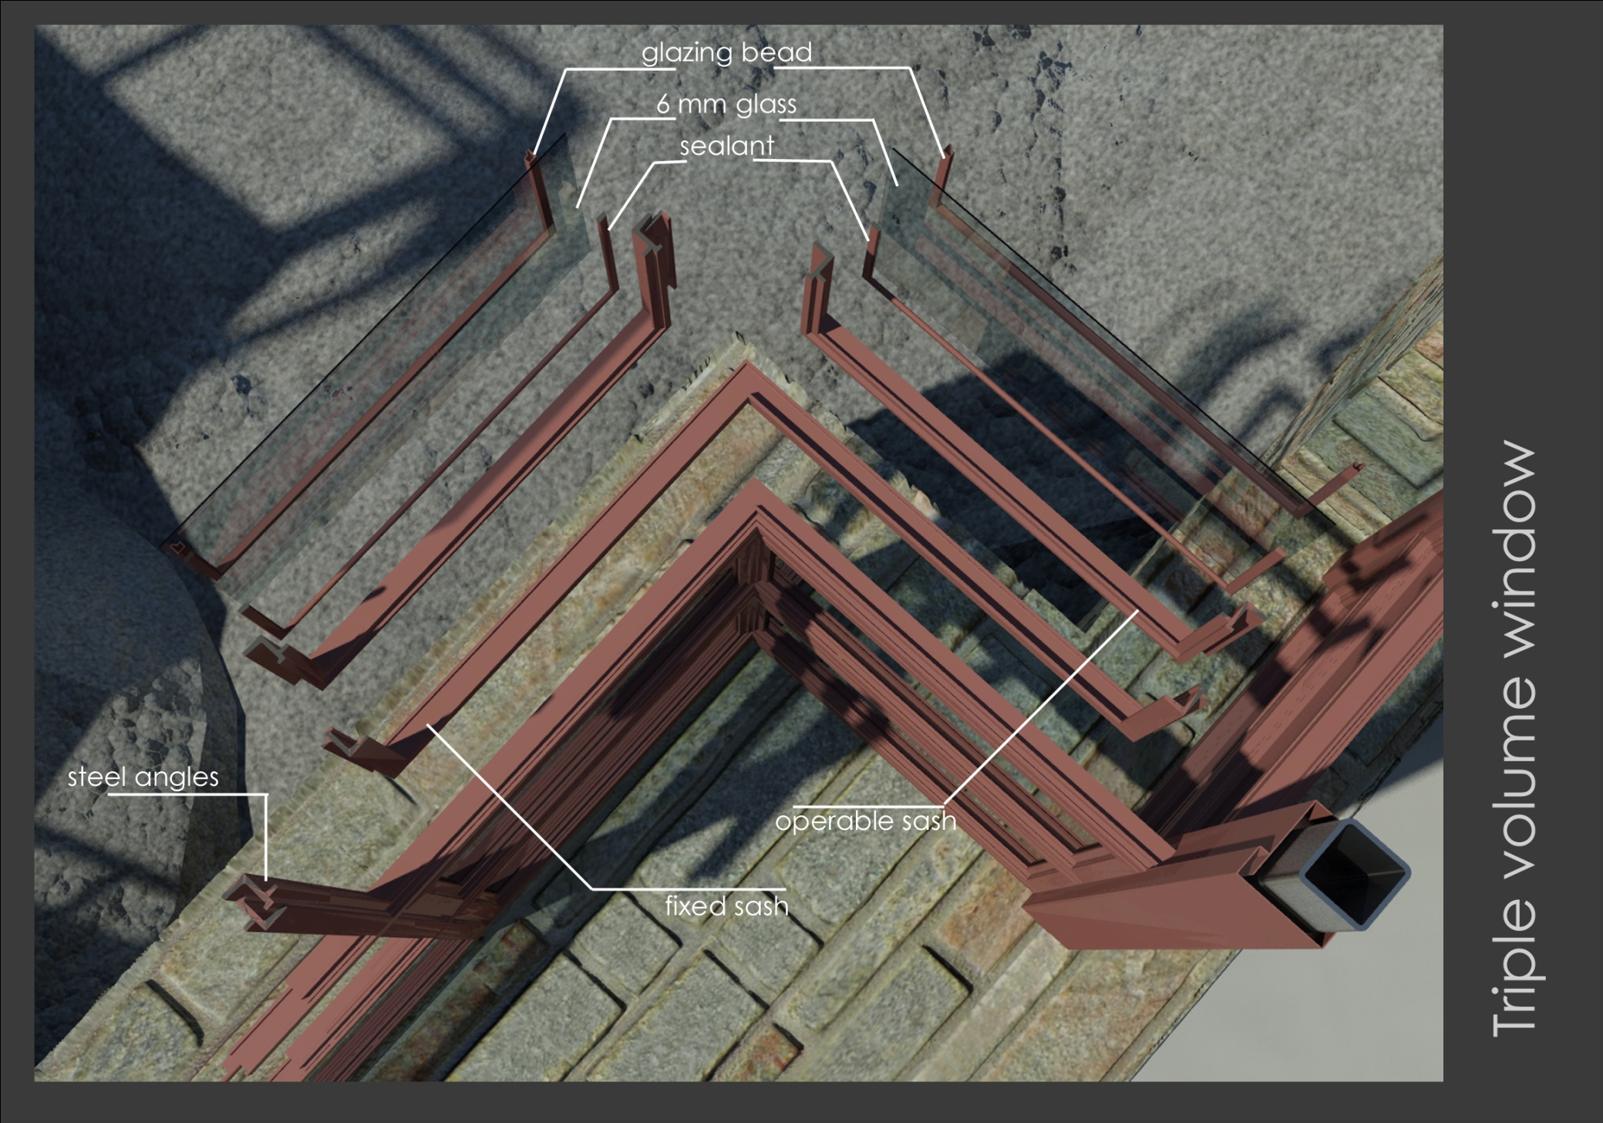

Slide 44
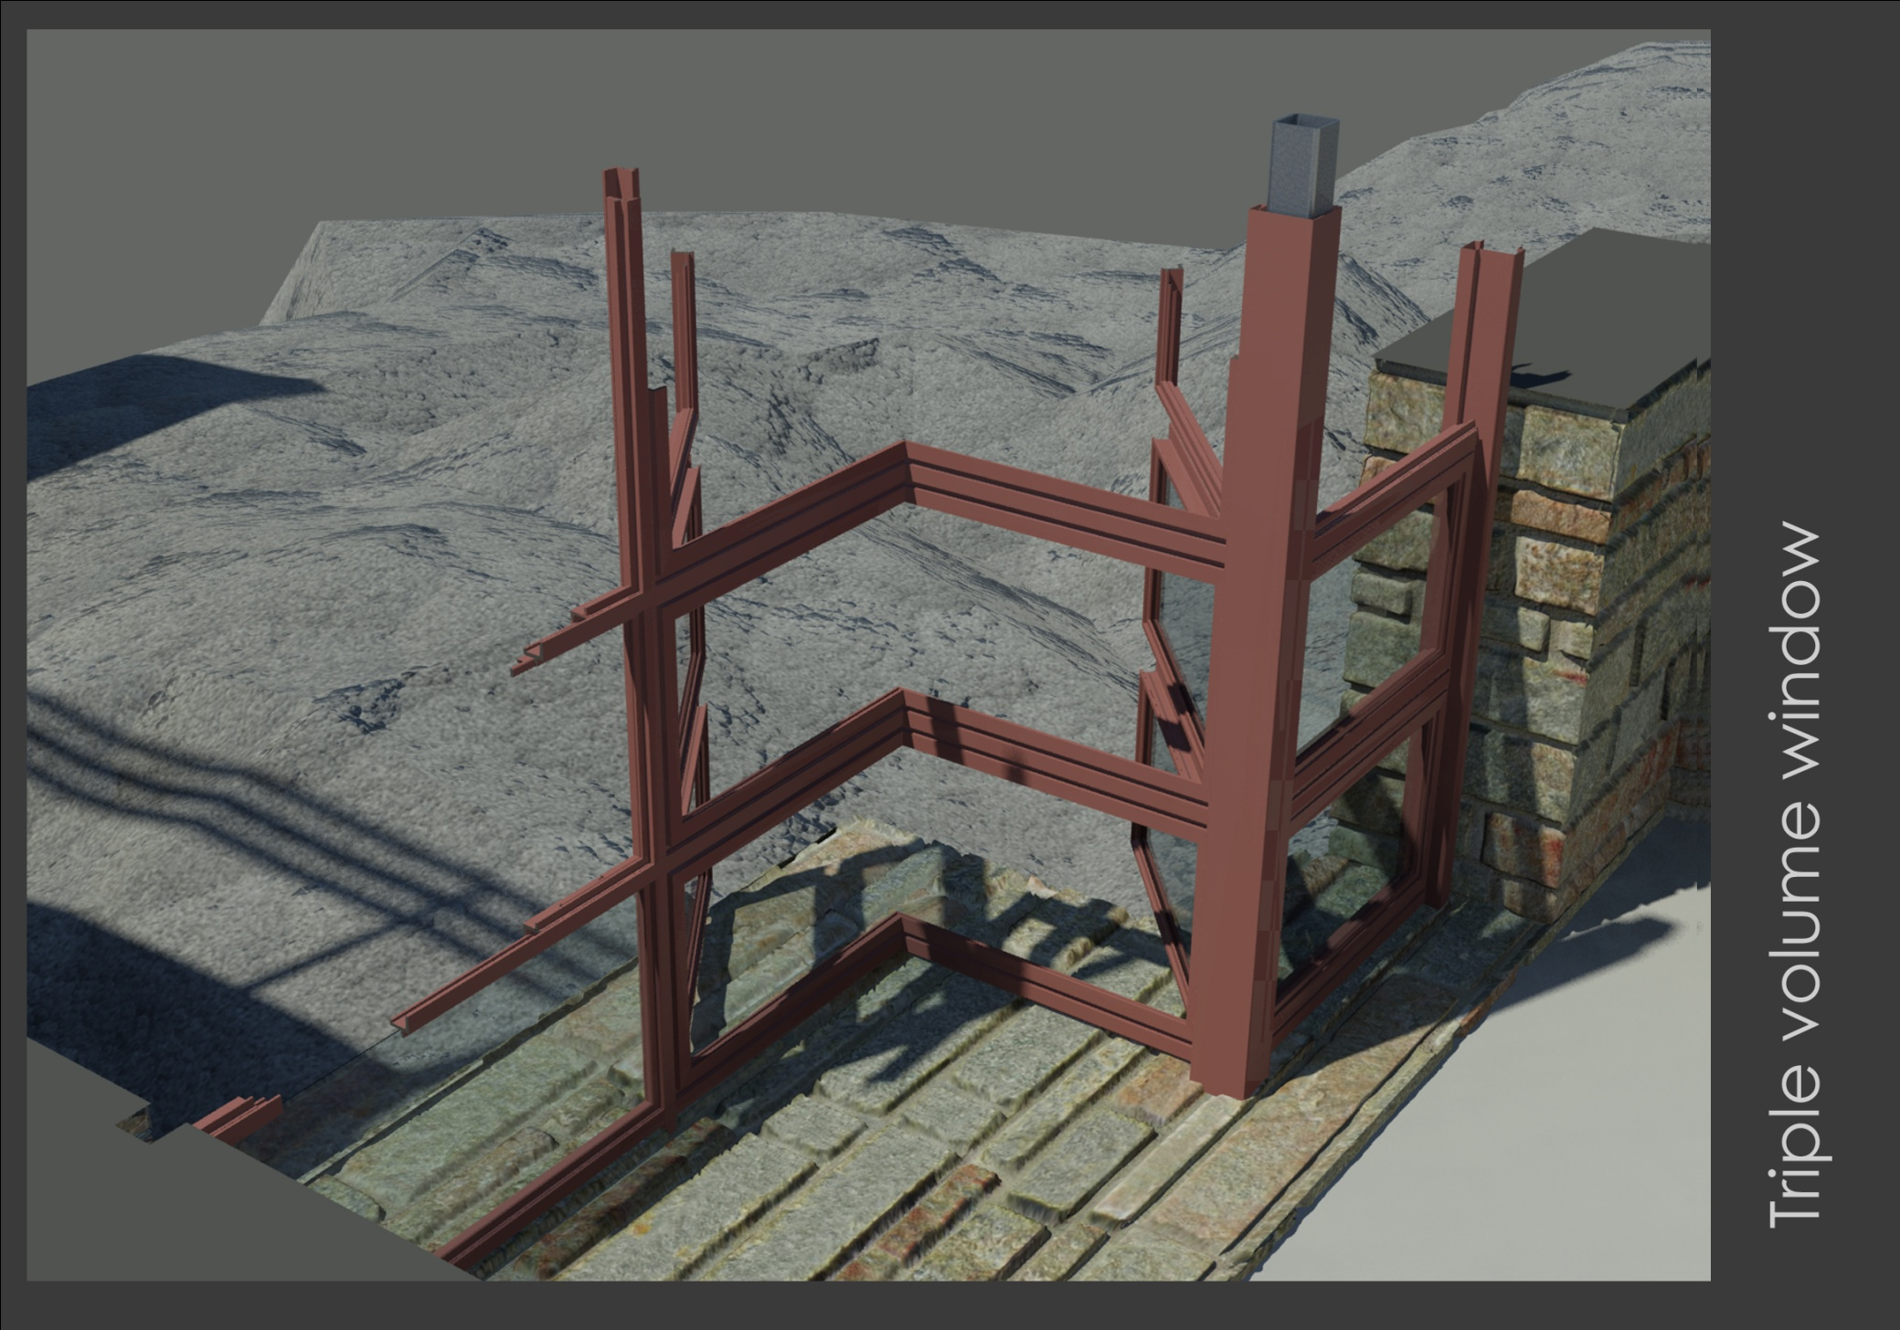

Slide 45
The Fallingwater House was beset by moisture and structural problems from right after construction.

Slide 46
Structural problems (as assessed in 2001)
Sagging cantilevers 7” – danger of failure
Cracked beams (structurally flawed)
Rusted stair reinforcements

Slide 47
Renovations (2001/2002)
Re-waterproofing
Post-tensioning of the cantilevers
Extra plates welded to T-mullions
Replacement of failed beams
Reconstruction of external staircase with stainless steel reinforcements
All done very sensitively to maintain architectural character
See: http://www.jstor.org/stable/40004684?seq=1

Slide 48
Up to 45 more interesting details (not shown in this presentation) were produced as part of this project Disclaimer: the veracity of information herein is not guaranteed. This is still a work in progress For your consideration: some sources refer to the floor slab as an inverted structural-T system (not waffle slab as is the case here). More information: Tom Sanya Leon Coetzee Sal Ahmad Kit Masu

Slide 50
Up to 45 more interesting details (not shown in this presentation) were produced as part of this project Disclaimer: veracity of information herein is not guaranteed. This is still a work in progress More information: Tom Sanya Leon Coetzee Sal Ahmad Kit Masu

