Slide 1
When is an intervention not in the child’s best interests?
Sharon Kling
Department of Paediatrics and Child Health Tygerberg Children’s Hospital and Stellenbosch University

Slide 2
Outline of Presentation
Standards for decision-making
The “best interests” standard
Guidelines for decision-making
Case studies
Conclusion

Slide 3
Standards for decision-making in health care
Subjective standard
Based on statements made by patient
Substituted judgment standard
Apply patient’s own values, beliefs, preferences
Best interests standard
Objective weighing of the benefits and burdens of proposed treatment alternatives

Slide 4
The Problem
When making decisions for children, we cannot estimate what their preferences would have been; no “substituted judgment” is possible
Therefore use the “best interests” standard

Slide 5
The Concept of Best Interests
“The highest net benefit among the available options that apply to any situation in which a decision has to be made regarding the health of the child.”
“The best interests standard protects another’s well-being by assessing risks and benefits of various treatments and alternatives to treatment, by considering pain and suffering, and by evaluating restoration or loss of functioning.”
It is therefore a quality-of-life criterion
Beauchamp & Childress 2001

Slide 6
Meaning of the Best Interests Standard
Criticism: unrealistic, too narrow, too focused on incompetent or incapacitated person’s interests
It does not require what is ideal but what is reasonable, given the available options
Should also take into account the needs and rights of others
Kopelman LM 1997 J Medicine Philos
Kopelman LM 2007 Childhood Obesity

Slide 7
Children
The “best interests of the child” refers to both those interests that are in the present and those that are in the future; the child has a “right to an open future” (Joel Feinberg)

Slide 8
Who makes decisions for children?
If children are autonomous and competent, they are able to make their own decisions related to health care
Proposed legislation places age of consent at > 12 years
If children are unable to make decisions for themselves, the parents/guardian make that decision
They are in the best position both legally and ethically

Slide 9
Parents’ decisions on children’s health care must be in close consultation with health workers
Decisions must be in best interests of the child; where health workers can rationally demonstrate that this interest is disregarded, they have the right and duty to protest and even to refuse

Slide 10
Is the treatment in the child’s best interests? Assess:
The amount of suffering and the potential for relief of that suffering
The severity of dysfunction and the potential for restoration of function
The expected duration of life
The potential for personal satisfaction and enjoyment of life
The possibility of developing a capacity for self-determination

Slide 11
Categories of Therapy
Clearly beneficial: continue therapy
Ambiguous or uncertain
Futile: discontinue life-supportive or burdensome therapy, institute palliative care

Slide 12
When may parents’ decisions be overridden?
When therapy is clearly beneficial, parents may not deny therapy (e.g., religious beliefs and blood transfusion)
Withholding life-sustaining therapy from handicapped infants where it is medically indicated (Baby Doe Rule – surgery for duodenal atresia withheld in baby with Trisomy 21)

Slide 13
Resolving difficult choices
Is the treatment medically indicated?
Respect for patient (parents’) autonomy
What is in the patient’s best interests?
Wishes of relatives secondary to patient’s own best interests
External factors
Impact of decisions on relatives
Resource allocation issues

Slide 14
What are the guidelines for decision-making?
First, do no harm (non-maleficence)!
Do not subject patients to treatment that cannot benefit them or that burden them
Over-treatment can harm patients
Do good (beneficence) in order to seek the best interests of the patient

Slide 15
When is an intervention not in the child’s best interests? Case studies

Slide 16
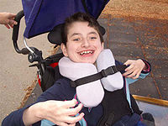
The Ashley Treatment
Story in Los Angeles Times 3 January 2007
Ashley X, aged 9 years (born 1997), from Seattle
Born with static encephalopathy – unable to walk, talk, eat, sit, roll over
Developmentally at 3 month level, no prospect of improvement
In 2004, Ashley’s parents and doctors at Seattle Children’s Hospital devised the “Ashley Treatment”

Slide 17
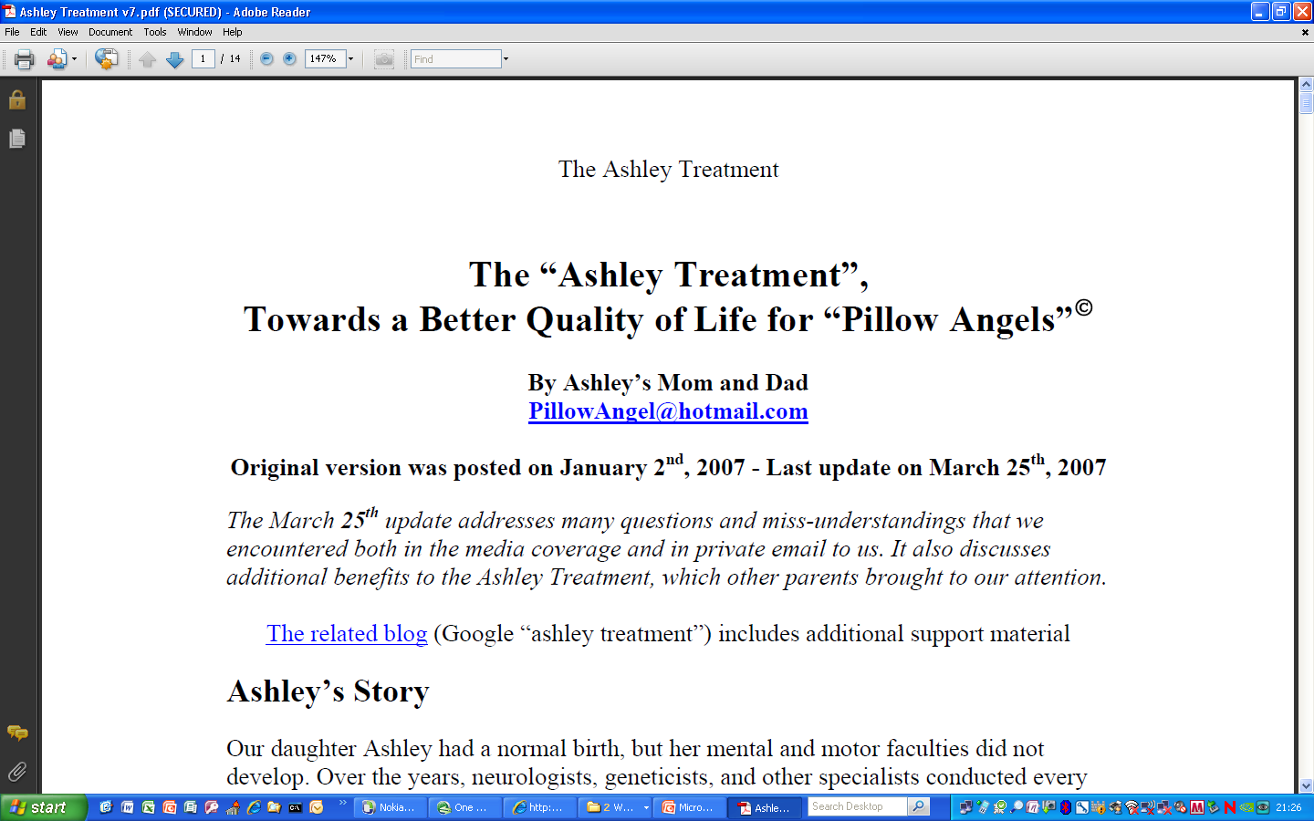

Slide 18
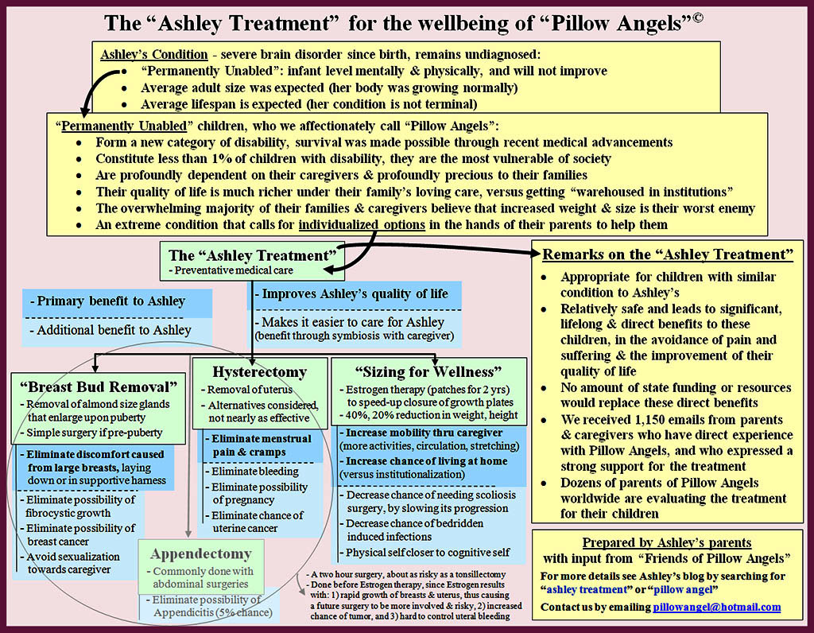

Slide 19
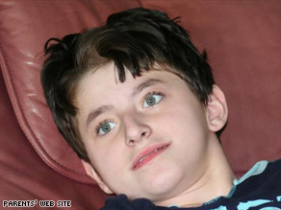
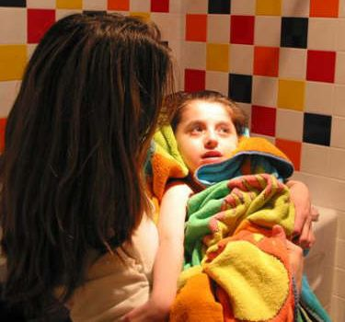

Slide 20
The Ashley Treatment 2
The “Ashley Treatment”:
High dose oestrogen therapy to stunt her growth
Hysterectomy to “prevent menstrual discomfort”
Removal of breast buds to limit breast growth
To “improve our daughter’s quality of life and not to convenience her caregivers”
Were these treatments in Ashley’s best interests?
Was she treated with dignity and respect?
Would these interventions improve her quality of life?

Slide 21
The Ashley Treatment: Parents’Arguments
Keeping Ashley small will make it easier to carry her around and care for her
Surgery will allow her to avoid menstrual cycle, eliminate possibility of pregnancy and uterine cancer, and avoid large breasts that may cause discomfort and avoid breast cancer
“The oestrogen treatment is not what is grotesque here. Rather, it is the prospect of having a full-grown and fertile woman endowed with the mind of a baby.” (Dvorsky)

Slide 22
The Ashley Treatment: Ethical Evaluation
Morally not necessarily wrong to promote interests of caregivers, but “it is disturbing to think of a scenario in which severely disabled institutionalised children are subjected to mass surgery and growth-stunting to make the staff’s work easier.”
Impinges on human rights and dignity
We have a duty to care for people like Ashley
Lack of resources influences her care

Slide 23
Newborn scenario
Baby Bella is born at 28 weeks’ gestation, weighing 950g
She is ventilated soon after birth for hyaline membrane disease and responds well, but then develops necrotising enterocolitis
She is taken to theatre. The majority of her small bowel is necrotic and has to be resected, leaving her with insufficient residual bowel for enteral feeding
The treating team feel that it will be in her best interests to have life-supportive therapy withdrawn, but the parents wish everything to be done for her

Slide 24
Bella continued
MRI done – shows severe hypoxic ischaemic changes which suggest that she will be significantly intellectually and physically impaired
Does this change the approach regarding withdrawal of life-supportive therapy?
Justification: concept of “interests” meaningless if disability is severe; may increase burden of life or decrease benefits of life

Slide 25
Two Cases of SMA
Re C: 16 month old, SMA type 1, ventilated before court hearing. Doctors felt it was not in her best interests to continue ventilation. Parents did not want ventilation withdrawn. Ruling: “it is in the best interests of C that she be taken off the ventilation and that it should not be reimposed or restored.”
An NHS Trust v MB: 2 year old SMA type 1: Court ruled it was in the best interests of M to continue to be ventilated.

Slide 26
SMA: Why the difference?
Re C intermittent ventilation vs M continuous ventilation
Confusion over terminology of intermittent positive pressure ventilation
Possible change in treatment since case of C in 1998 and M in 2006
Different subjective interpretations of situations and best interests test by judges
Also other scandals in UK at the time

Slide 27
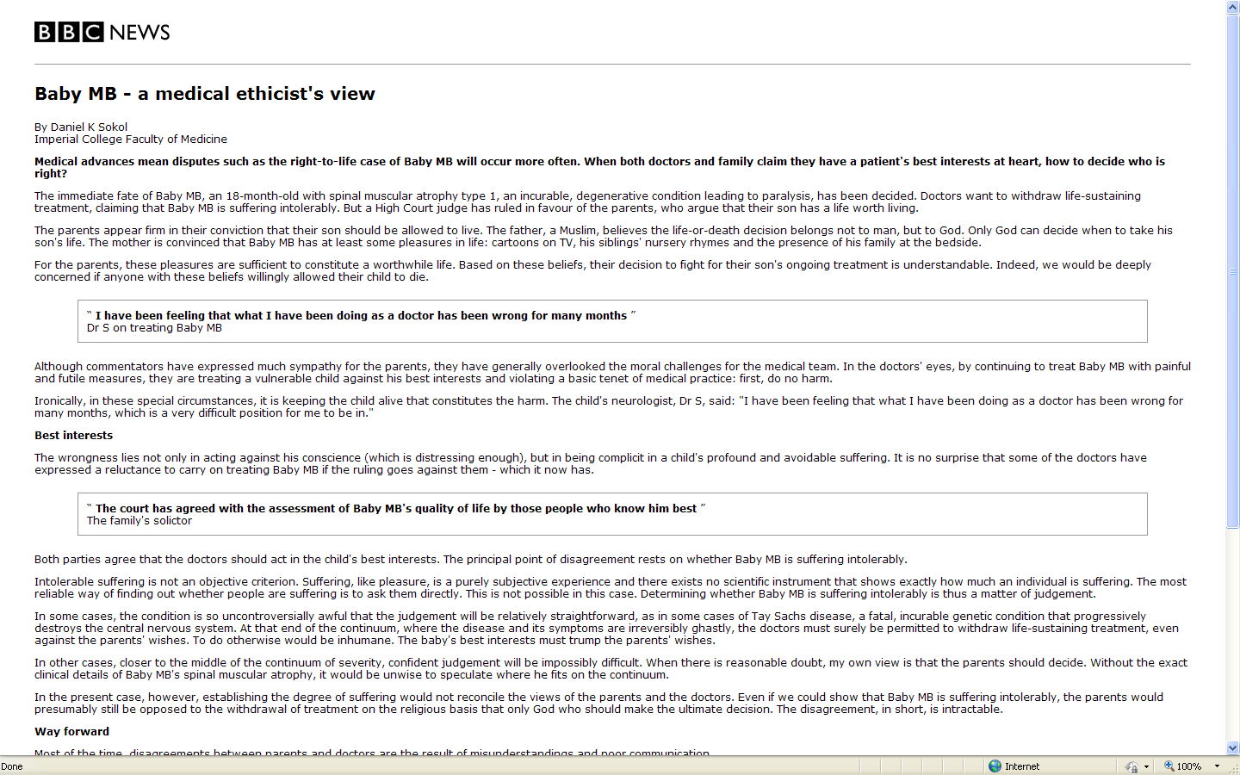

Slide 28
Medical advances mean disputes such as the right-to-life case of Baby MB will occur more often. When both doctors and family claim they have a patient’s best interests at heart, how to decide who is right?

Slide 29
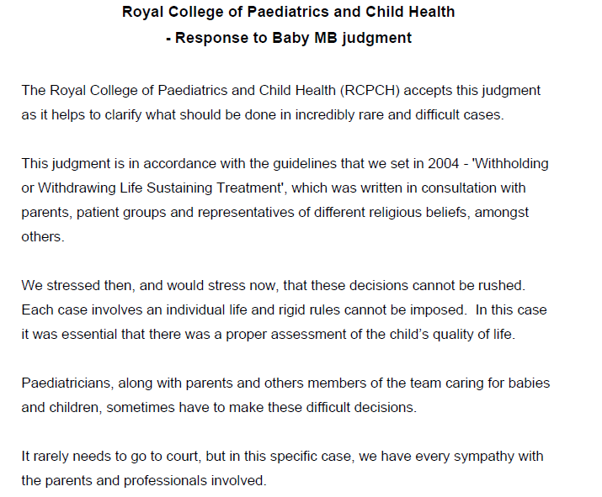

Slide 30
Is dying in the child’s best interests?
Can it be in a child’s best interests to die?
Cf 11-year-old with C2 transection
If decision results in death, it also results in permanent loss of all interests along with loss of life!
Quality of life should be included, but would have to be interpreted in context of the family

Slide 31
Conclusion
“Best interests” is a beneficence standard
Applies to individual patient as well as to others
If strictly applied can be very narrow and restrictive
It does not require what is ideal but what is reasonable

Slide 32
Conclusion 2
An intervention is not in a child’s best interests when the burden outweighs the benefit, when pain and suffering are unremitting without hope of cure or restoration of function, and when there is no hope of a future of overall benefit
Wilkinson D JME 2006;32:454-9
Sometimes even life-limiting decisions can be in a child’s best interests
Maxim: First do no harm!

Slide 33
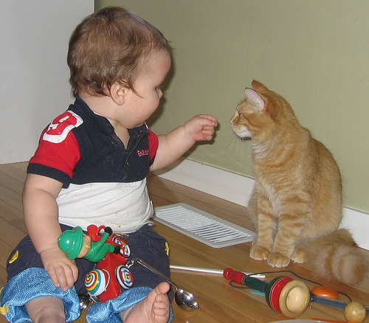
Thank you

