Slide 1
Who should get the bed – Allocating scarce resources
Andrew C Argent
Red Cross War Memorial Children’s Hospital and
University of Cape Town

Slide 2
introduction
there are never enough resources for everything
more resources can be made available by efficient and effective utilization of those resources
if resources for a specific activity are limited, then it is appropriate to argue the case for reallocation of resources
we still have to make decisions about how to allocate resources that are in limited supply
Notes:
Of course the fundamental problem is an imbalance between resources and need. And we must accept that there will never be enough resources to cover the needs in health care.
The only rational way to reconcile this is to ration.
Rationing has to be fair and just if it is to meet ethical and human rights imperatives.
Before discussing what I understand by fair rationing, lets look at what rationing is and what it is not.

Slide 3
what good do we aim to achieve in PICU?
what resources are available?
how do we optimize utilization of those resources?
increased efficiency may increase the effective resources available
what value can a PICU admission offer?
to the child
to the hospital
to the referring Dr / team
opportunity for major surgery
effective palliative care
removal of “high impact” patient from non-PICU area
life

Slide 4
intensive care in South Africa
how many units?
> 400
how many beds?
> 2000
where are the beds?
private: state ~ 2 : 1
who has access?
<4% of beds allocated to paediatrics alone
~10% of beds allocated to neonates alone
there is more money spent on intensive care in the private sector, than there is on the entire state health service …

Slide 5
who runs these units?
medical staff
vast majority are “open units”
<5% have an intensivist as a medical director
4 units in the country have a paediatric intensivist as director
nursing staff
>30% of nurses are agency staff
there are <30 paediatric ICU trained nurses in the country

Slide 6
PICU in South Africa
Region | Intensivist | Beds available | Patients per annum
W Cape | Yes | 24 | 1900
Gauteng | Yes | 8 + | 570
Pretoria | Yes | 6 + | ? 400
Free State | Yes | 11 | 300
KZN / Natal | Yes | 5 | 500
N Cape | No | 4
E Cape | No | ?
virtually NO beds in private sector
Notes:
Western Cape:
In Cape Town there are approximately 26 intensive care beds for children available at the Red Cross War Memorial Children’s Hospital (26 beds available physically, but only 18 in use because of staff shortages) and the Tygerberg Children’s Hospital (The children are cared for by paediatric intensivists at Red Cross on a 24 hour basis while at Tygerberg intensivists care for the children during the day and care after hours is shared with general paediatricians). Combined patient turnover is approximately 2000 patients per annum (many of these come from other areas including the Eastern Cape). The Red Cross unit is multidisciplinary and children from all disciplines at all ages under 14 are admitted. At Tygerberg children with surgical problems go to adult ICU if > 4 years of age.
Children in George may have short periods of ventilation in an adult ICU before transferal to one of the Cape Town hospitals.
Free State:
In Bethlehem there are 4 intensive beds that are predominantly used by adults and occasionally by children. There are no resident paediatric intensive care staff.
In Bloemfontein there are 11 beds in the 2 academic hospitals, 2 of these are high care and the rest are paediatric ICU. Annual turnover approximately 300 patients. Unit director full time (no formal paediatric ICU training).
Surgical and medical patients admitted to this unit. Post operative cardiac patients are cared for in the adult cardiothoracic unit.
Northern Cape:
Kimberley has 4 paediatric ICU beds under supervision of paediatrician with no paediatric ICU qualification. Is assisted by medical officers with little or no paediatric training.
Eastern Cape:
Children are cared for in the adult ICU at Frere Hospital under the care of paediatricians.
Children are admitted to the neonatal ICU at Cecilia Makiwane Hospital under the care of the paediatricians.
There are paediatric intensive care beds at Livingstone hospital where children are cared for by medical officers under the direction of a paediatrician with no formal paediatric ICU training.
There is no paediatric ICU at Umtata General Hospital.
Children from the Eastern Cape (particularly East London) are referred to the Cape Town hospitals for major surgical procedures and for management of complex paediatric problems.
Gauteng:
Chris Hani Baragwanath has paediatric ICU patients in a combined adult and paediatric ICU. The unit is directed by a trained paediatric intensivist and there are full time paediatric intensivists. Annual patient turnover approximately 250 patients.
Children are also cared for in the neonatal intensive care unit at the Johannesburg hospital. Annual turnover approximately 120 patients per annum.
Children undergoing cardiac surgery at the Johannesburg hospital are cared for by the adult cardiothoracic intensive care unit.
There is a neonatal intensive care unit at Coronation hospital that manages children occasionally.
Pretoria:
Children at Medunsa are cared for in the adult intensive care unit.
Children at the Pretoria academic hospital are cared for in a paediatric intensive care unit (approximately 6 beds)
Kalafong hospital has NICU that admits some children.
KwaZulu Natal:
There is a paediatric ICU (5 ICU beds and 5 high care beds) at the Albert Luthuli hospital (at the new hospital there is physical provision for 14 ICU beds and 26 high care beds). Annual throughput approximately 500 patients). At present cardiothoracic and neurosurgical patients go to Wentworth hospital (2 cardiothoracic beds for children and neurosurgical beds are shared with adult ICU).
Children in the paediatric intensive care unit are cared for during the day by a paediatric pulmonologist and after hours cover is shared with general paediatricians.
There is a throughput of children following cardiac surgery at Wentworth hospital, these children are under the care of the paediatric cardiologists and the cardiothoracic surgeons.
Grey’s Hospital is trying to establish a paediatric intensive care service – children are cared for in the adult ICU. No service at Edendale hospital.
Ngwelezana hospital has an adult ICU that admits children occasionally for brief periods before transfer to Albert Luthuli hospital.

Slide 7
efficiency of utilization
planning of surgical and elective caseloads
elimination of nosocomial infection
24 hour care vs “working hours only”
permanent staff with ongoing training

Slide 8
what value can a PICU admission offer?
LIFE
(but we have a capacity to prolong suffering)
opportunity for major surgery
effective palliative care
removal of “high impact” patient from non-PICU area

Slide 9
the current problem
how bad is it?
does it justify intensive care?
is it amenable to therapy?
is there a team that is prepared to offer that therapy?
will intensive care prolong suffering or offer a reasonable chance of life?

Slide 10
the underlying problem
is there an underlying or additional problem?
is that problem amenable to therapy?
who is prepared to manage that problem in the long term?
what is the prognosis for that problem?

Slide 11
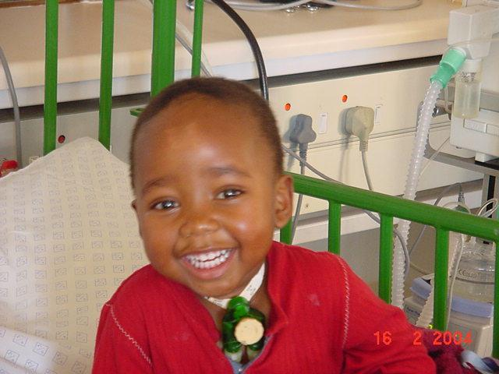

Slide 12
the context
what is the context of this child?
family
support structure
access to medical support services
mind the GAP

Slide 13
sunken assets
money that has already been spent is gone, and should therefore not affect decisions about current and future behaviour
although the past does help to inform the present, decisions should not be taken on the basis of what has happened, but on the basis of what is happening now and is likely to happen in the future

Slide 14
the referral context
what care is available to this patient in their present situation?
what is the risk related to staying in that situation?
who is involved in the care of this patient and how are they coping?
are there alternative resources that could be brought into play?

Slide 15
the PICU context
is there a bed available?
staff
equipment
physical space
will admission of this child compromise another child?

Slide 16
inadequate information
misinformation
lack of information
lack of medical knowledge to inform a decision
information that is not yet available, but will become available in the near future

Slide 17
the process
explicit vs. implicit
transparency vs. hidden
open to discussion / change and review
applied to all

Slide 18
A 4 R
accountability for reasonableness
policy should be clear and available to all
based on rationale that “fair-minded people” would agree are reasonable
open to change and modification
applied consistently to all
Kapiriri L et al, Health Policy 2007

Slide 19
background information
the interests of the child
benefit from intensive care admission relative to staying in current place of care
appropriate utilization of available resources
look at excluding those who are likely to gain the least benefit from ICU
give preference to patients who gain the most benefit from the shortest possible ICU stay.
motivation for appropriate allocation of resources for paediatric intensive care
We have to protect the PICU staff from burnout,
or we will systematically destroy the existing PICU services
Notes:
It is important to note that ventilation of children in hospital wards is no solution to the problems. This provides a poor quality service to the children being ventilated, and may profoundly compromise the care of other children in the wards (particularly in the context of the staffing levels current in the hospital wards).

Slide 20
background information
emergency vs elective
very few paediatric elective surgical interventions are truly elective, and delays mean that elective surgery is converted to emergency surgery, or complications ensue that mean that surgery is more complicated
refusal of elective surgery blocks hospital beds
refusal of elective surgery causes extremely ineffective utilisation of theatre resources, particularly personnel
refusal or delay of elective surgery is hugely disruptive to families and children

Slide 21
use of resources
Discipline | Count | % | Average duration of stay | % bed days | Mortality
Paediatrics | 411 | 54.44 | 5.4 | 66.61 | 15.6
Cardiac | 107 | 14.17 | 3.92 | 12.59 | 3.74
Thoracic | 16 | 2.12 | 3.8 | 1.82 | 0
Abdominal surgery | 63 | 8.34 | 1.96 | 3.71 | 1.5
Neurosurgery | 26 | 3.44 | 3.11 | 2.43 | 0
Other surgery including accidents and burns | 65 | 8.61 | 4.7 | 9.17 | 13.8

Slide 22
policy - futile care
children will not be admitted to the PICU in circumstances where intensive care is deemed to be futile. This includes:
any child who has had a cardiac arrest and has not re-established a normal respiratory pattern, or who has fixed dilated pupils
the child who is brain dead (by legally defined criteria, taking into account all possible confounding situations)
the child who has suffered a head injury such that there is no chance of recovery from that injury (the only possible exception is the situation in which other organ systems are intact, and that child may constitute a potential organ donor).
concerns regarding the development of alternative care plans
Notes:
<5% of children in this category survive the PICU admission with an acceptable neurological outcome.
Comment: in reality there are many children in the above context where PICU admission is still desirable because:
management of the family is best conducted in that context
all the necessary information is not available at the time of admission request, and information must be collated before a fully informed decision can be made
the clinical situation is not totally clearcut and clarity must be obtained in order to make reasonable and defensible decisions
In reality excluding these children from PICU admission will make very little difference to the bed availability of the PICU as the number of cases is very small.
It is also essential that no discussion of possible organ donation is ever initiated with families until there is clarity that the child is dead (is actually certified as such)

Slide 23
policy - underlying lethal condition
Children will not be admitted to the PICU when they have a potentially lethal underlying condition that is not currently amenable to therapy. This includes:
children with established HIV infection. The only exception would be a child who is successfully established on ARV, and where the reason for admission does not relate to the underlying disease and/or it’s therapy
children with major burns, where the surgical team are not able to guarantee that debridement and appropriate cover will happen within 24-48 hours of admission
Children with chronic renal failure where there is no commitment to long term dialysis
Children with severe and lethal chromosomal abnormalities (e.g. Edward’s syndrome, or thanatropic dwarfism)
Children with malignancies that are not responding to therapy.
Notes:
Comment: this is based on data that shows that despite the availability of ARV only approximately 20% of children with HIV infection who are admitted to the PICU are known to be alive and on ARV 6 months later. On average these children spend 5-6 days in the PICU and thus consume considerable resources for little apparent gain.
A real clinical problem relates to children who are HIV exposed, have clinical features that are compatible with HIV related infections, but for whom confirmatory HIV testing has not been completed. If the PICU does not have space, then children in this category who are deteriorating on appropriate therapy in the wards, will be regarded as HIV infected. If space is available then these children should probably be admitted.
Comment: this is based on data that shows that if children are not debrided and grafted early on in the course of their burn management, they suffer a prolonged course with considerably pain, anxiety and recurrent infection. The death rate in these children is also unacceptably high

Slide 24
policy - currently poor outcome
Children with extremely poor PICU outcome will not be admitted to the PICU. This includes children with :
children with established HIV infection. 'Children with established HIV infection whose lives are in danger from AIDS-related diseases will not normally be considered for admission. A child who is successfully established on ARV, and where the reason for admission does not relate to the underlying disease and/or its therapy will be considered for admission."
kwashiorkior
who have been in hospital wards for > 5 days and are deteriorating despite appropriate therapy
severe adenoviral pneumonia that has not responded to appropriate therapy in the wards
Notes:
Comment: this is based on a virtual 100% mortality in the ICU for these patients
Comment: This is based on an extremely high mortality rate in this group of patients. The failure to respond to therapy suggests that they have underlying conditions that are not amenable to conventional therapy
Comment: this is based on data that shows that children with severe adenoviral infection requiring ventilation have a high mortality and very high morbidity from chronic lung disease
Comment: this is based on the fact that these children have a very poor likelihood of reasonable outcome

Slide 25
policy – currently poor outcome (contd)
diagnosed severe metabolic disorders (e.g maple syrup urine disease) for which treatment programmes in the hospital and community are not established
Children with acute hepatic failure, unless there is a reasonable likelihood that an acute transplant will be offered within the first 24-48 hours of PICU admission
Children with complications of meningitis requiring ventilation (i.e the requirement for ventilation is related to CNS disease rather than pneumonia)
Children with cardiomyopathy that is not responding to therapy, and where transplantation is not being considered.

Slide 26
implications of this policy
Implementation of this policy will still not free up enough PICU beds to meet the needs of children in the Western Cape.
Implementation of this policy will have implications for children and for the rest of the hospital including:
It may limit advances in therapy
It will mean that more children will die in the wards and in the emergency areas of the hospital. Resources will have to be made available to deal with this situation
If children are refused admission to the PICU, ward decisions will have to be made as to whether these children will then be placed on a palliative programme (i.e. not put in High Care, but getting palliative therapy) or will continue on a full curative programme
The presence of sicker children in the ward will have negative impact on the quality of care that can be administered to other children in those areas.
Notes:
Comment: The PICU mortality of HIV infected patients with PJP has improved from 100% approximately 8 years ago to <30% currently. As the longer term outcome of these children has not changed significantly over time, we will be compelled to exclude these children from PICU admission. This despite the probability that advances in management could improve the outcome for these children.

Slide 27
admission policies
document drawn up in consultation
included information on resources available and the need for increased resources to meet demand
principles established
distributed throughout SCAH
distributed to CEO, Head of Health, Medicolegal department
implemented

Slide 28
issues on implementation
dissemination of information on ongoing basis
consistency of application of policy
feedback (or lack of … from clinicians)
failure to address resource issues
attempts have been made but ….
recurrent pressures to “ring-fence” beds

Slide 29
background information
risk adjusted mortality
predicted mortality (approximately 10%)
actual mortality (approximately 10%)
SMR at Red Cross < 1
benefit from PICU admission relates to the difference
in outcome between care in a ward and care in the ICU
overall predicted mortality of 10% means very few children :
with low severity of illness
with extremely high predicted mortality
are being admitted
Notes:
The extra data that would be useful, is the data on the number of children who die without PICU admission where PICU admission would have had the potential to save lives. This is not formally available, but informally it appears that there are very few children in this category.

Slide 30
conclusions
it is essential to optimize utilization of PICU resources
the A4R process may be a useful process
need to balance the processes for control of policy and implementation

Slide 31
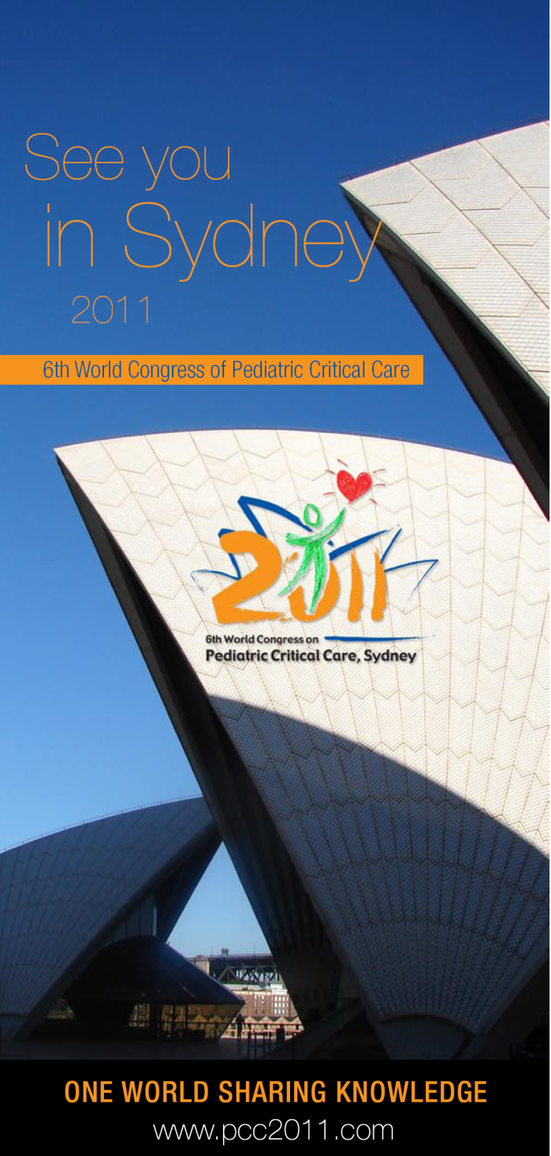
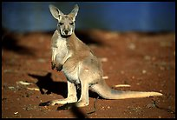
6th World Congress
on Pediatric Critical Care
13-17 March 2011
Check the website www.pcc2011.com regularly for Congress updates!
We look forward to welcoming you to a memorable event in Sydney in 2011!

