Slide 1
Managing Severe Sepsis
in
Children and Neonates
J. O. Ahrens
Red Cross War Memorial Children’s Hospital and
University of Cape Town

Slide 2
Introduction
Developing countries: 5 major contributors to deaths in children < 5 yrs age: 1. pneumonia
2. malaria
3. diarrhoea
4. measles
5. neonatal sepsis
Underlying pathophysiology = SEPSIS

Slide 3
Causes of death in under 5’s in sub-Saharan Africa (excluding neonates)
Lancet 2005; 365: 1147–52
Notes:
3
This pie chart is the traditional way that causes of death in the region are described. This was published in a high profile journal recently and this type of data is very influential in policymaking at national and international levels. We see the three major causes outside the neonatal period.

Slide 4
Introduction
in the USA
> 42 000 severe sepsis pa (1995)
infants at 10X higher risk (neonates)
LBW and VLBW make up 25% of infant deaths
< 10 years: boys at higher risk than girls
49% have underlying disease
Chronic lung disease (infants)
Congenital heart disease (infants)
Neuromuscular diseases (children)
Cancer (adolescents)
Pediatr Crit Care Med 2005 Vol. 6, No. 3 (Suppl)

Slide 5
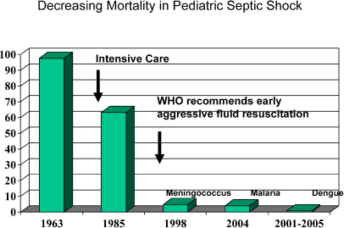
Carcillo JA, Tasker RC. Intensive Care Med 2006;32:958-961

Slide 6
Definitions
Sepsis
Inflammatory response (SIRS) with a suspected or proven infection
Septic Shock
Sepsis with cardiovascular dysfunction and signs of hypoperfusion and organ dysfunction
Severe Sepsis
Sepsis with organ dysfunction (CVS / Resp / CNS / renal / liver / haematology)

Slide 7
Adults vs Children
Adults
in adults mortality ~ 28%
hypovolaemia a component
death associated with normal to high cardiac output and low SVR
Children
in children mortality ~ 9% (reduced from 97% in 1968)
severe hypovolaemia is common
range of haemodynamic responses but frequently high SVR and low cardiac output.

Slide 8
study of emergency department management

Slide 10
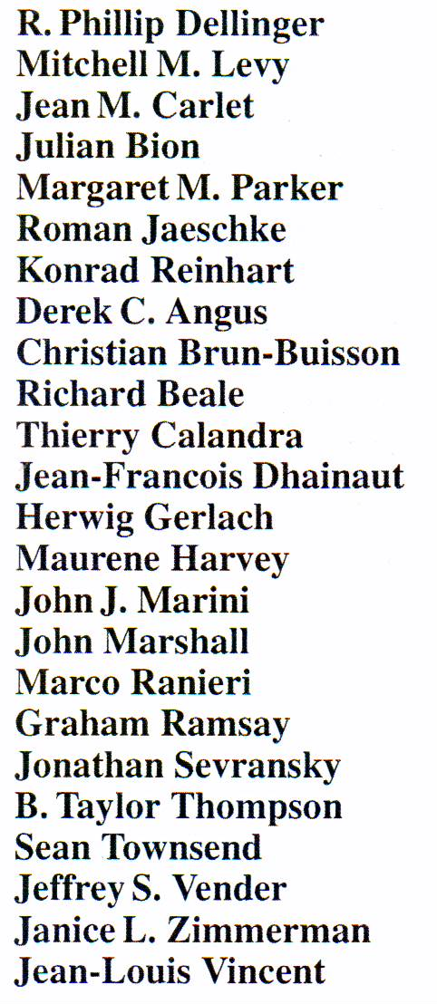
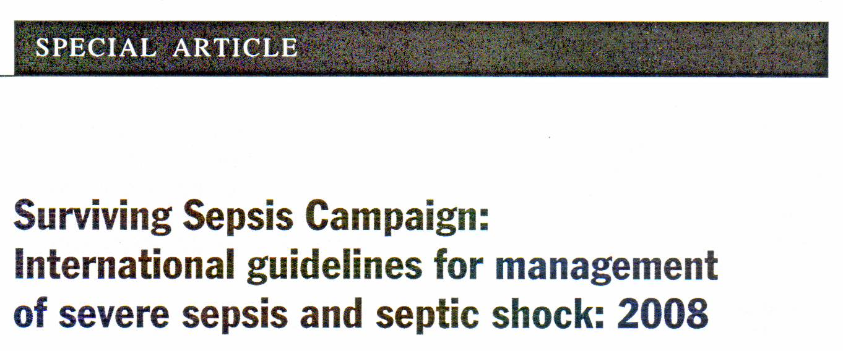

Slide 11
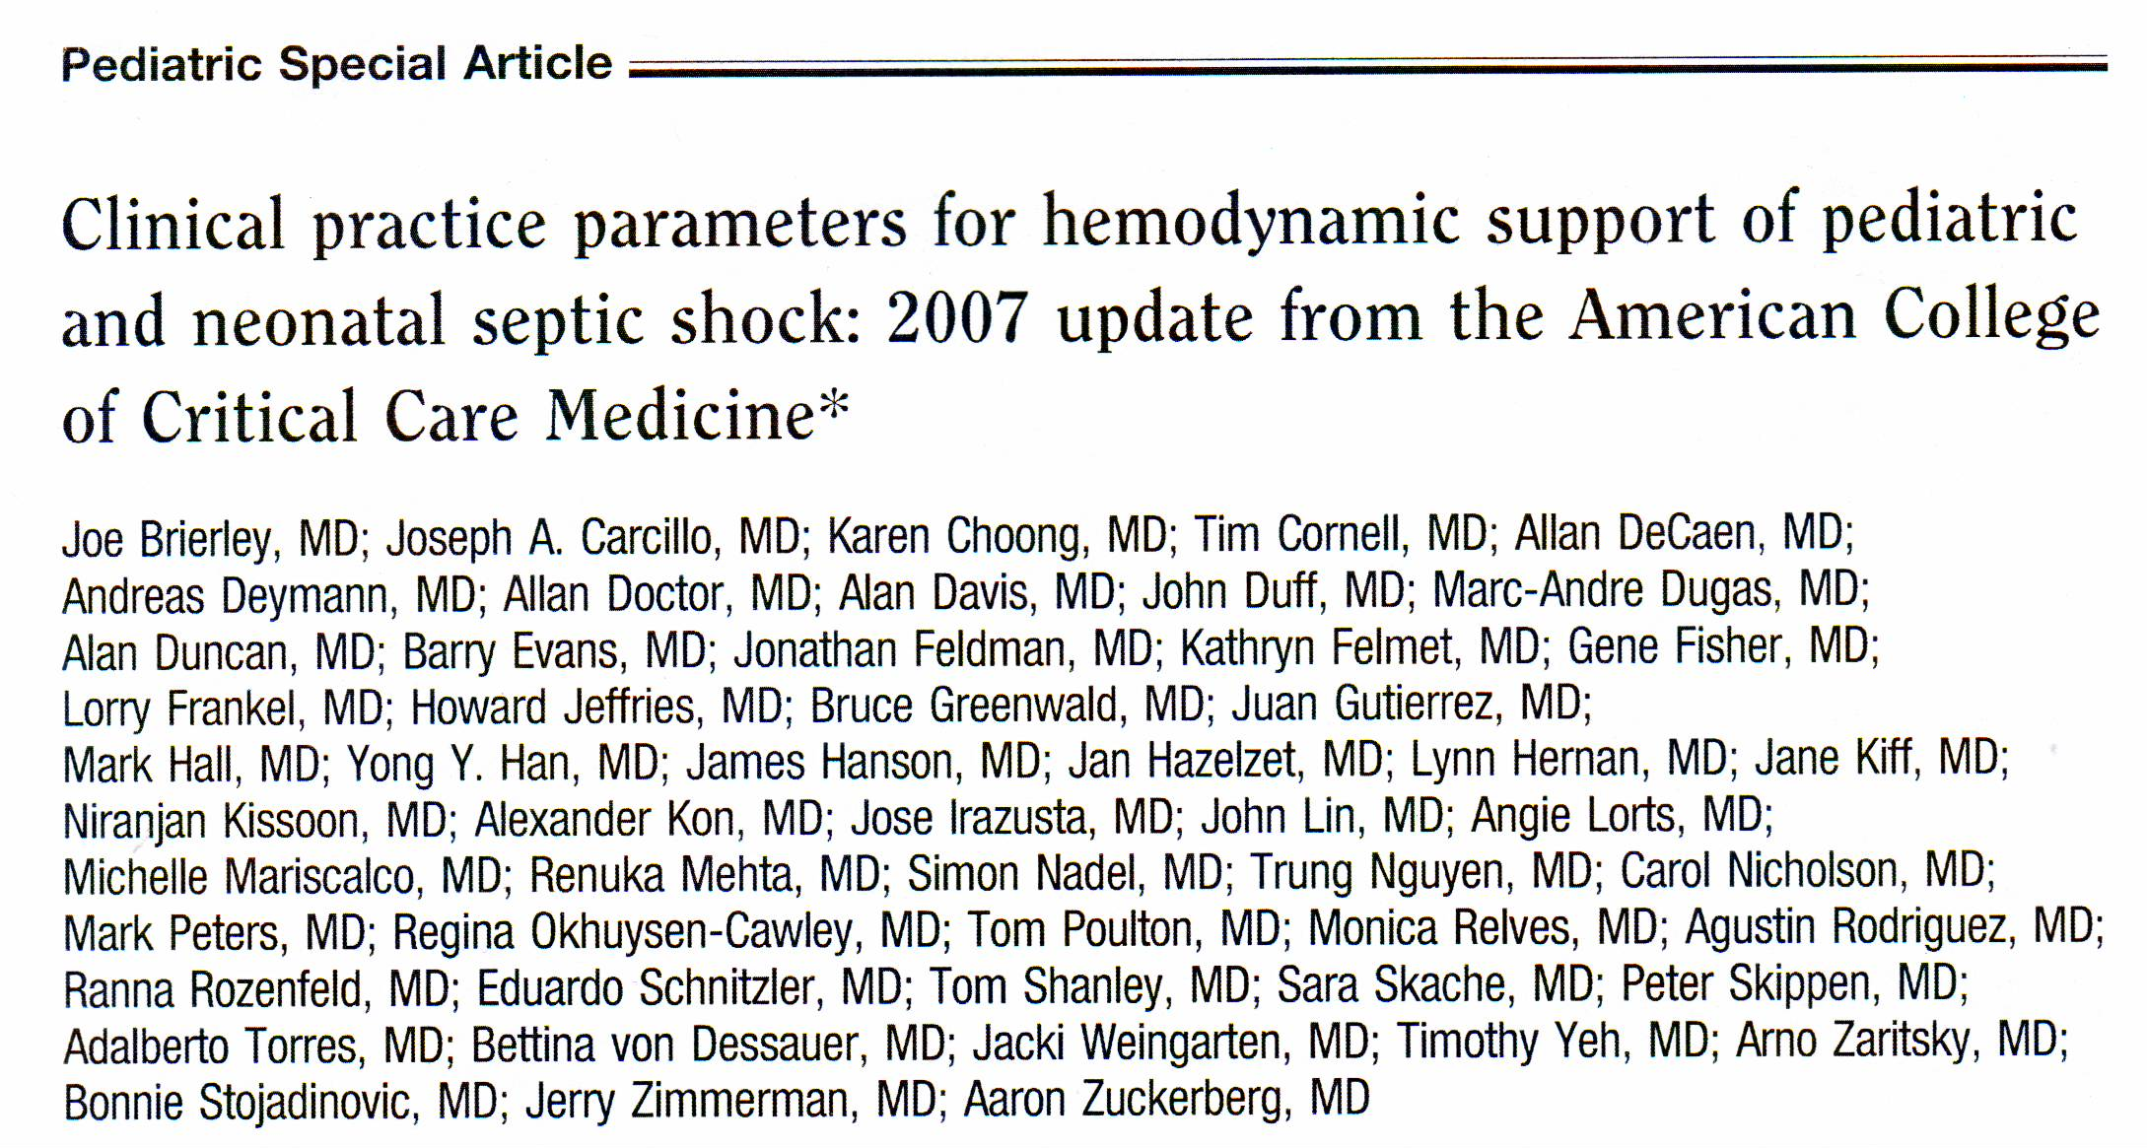

Slide 12
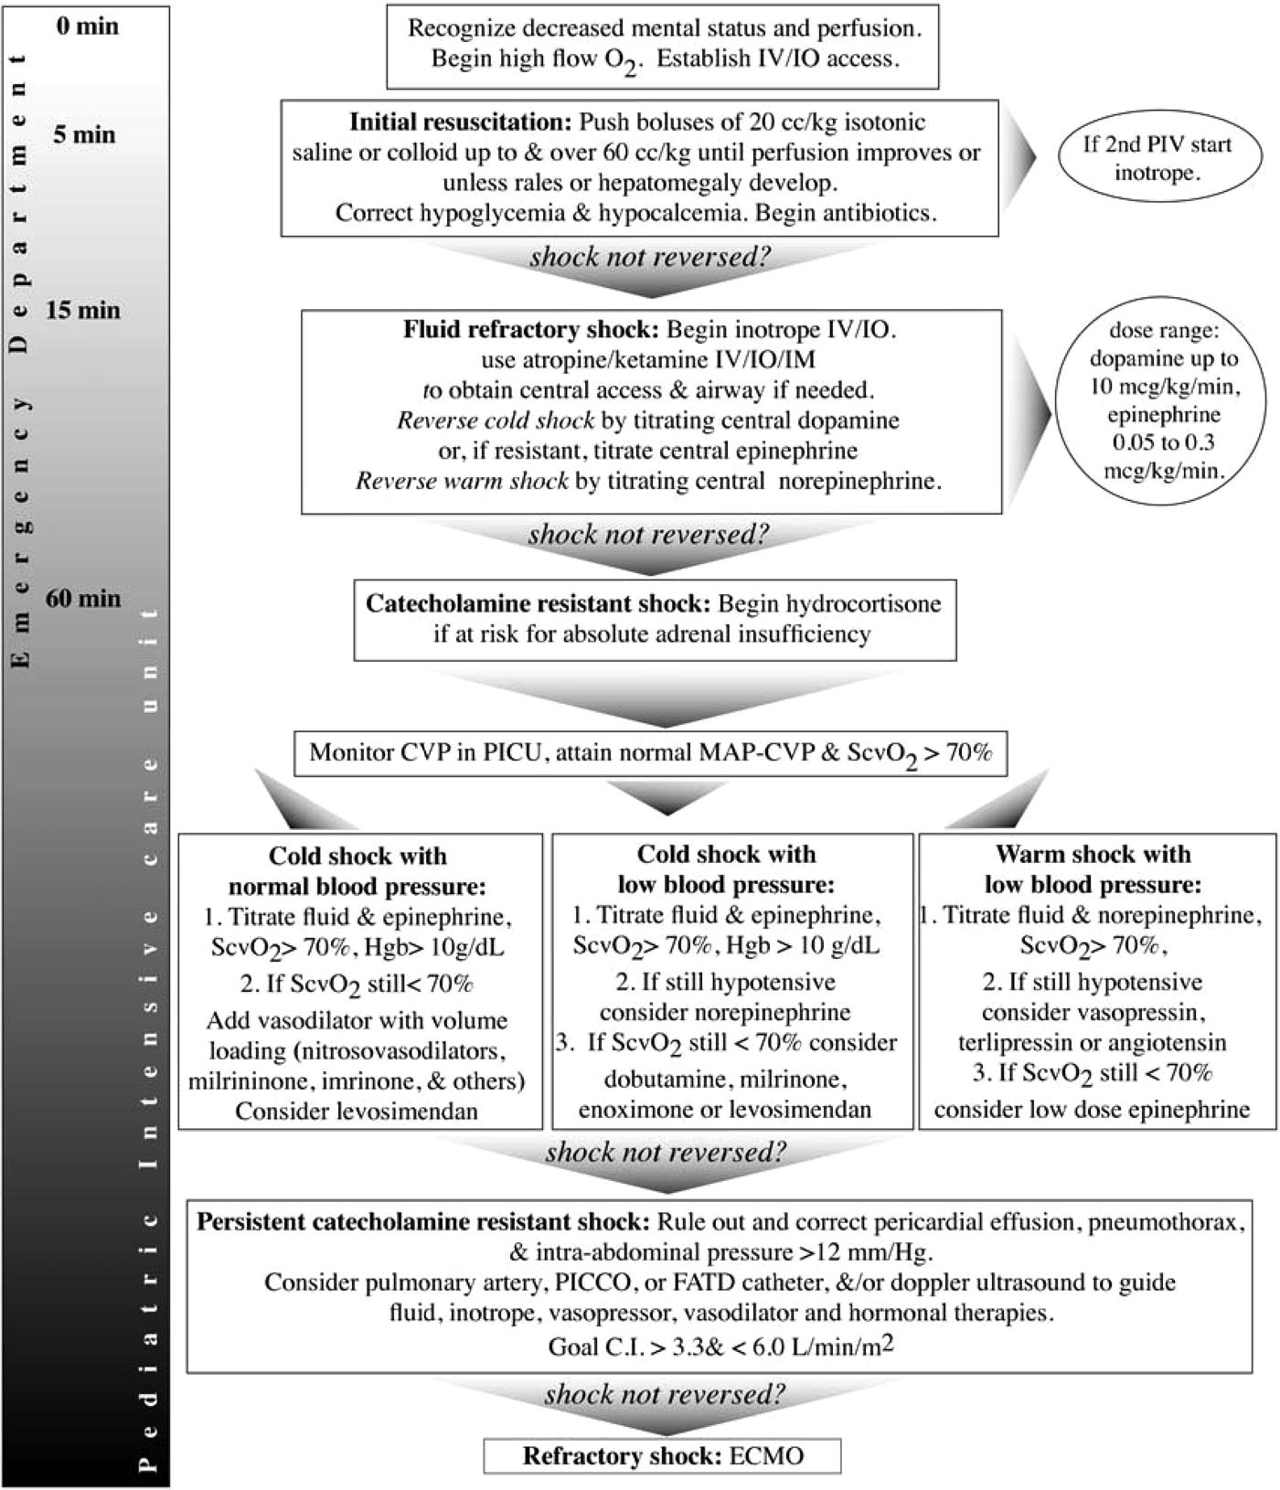
Emergency Department
PICU

Slide 13
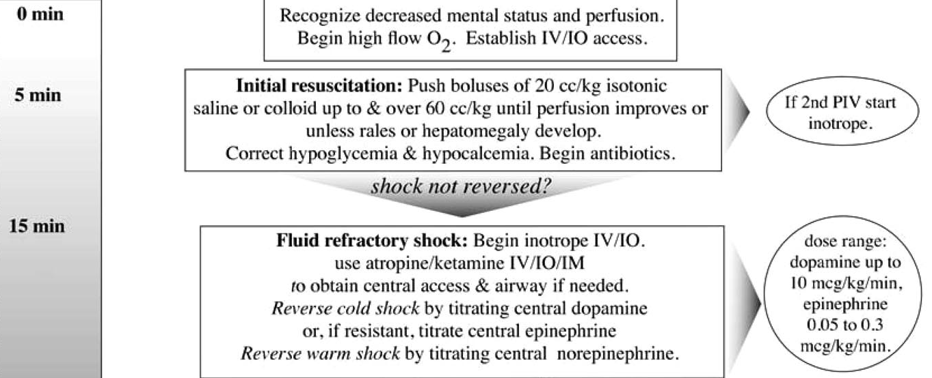
1
Emergency Department
60 min

Slide 14
1
2
Emergency Department
60 min

Slide 15
1
2
3
Emergency Department
60 min

Slide 16
1
2
3
4
Emergency Department
60 min

Slide 17
1
2
3
4
Emergency Department
5
60 min

Slide 18
1
2
3
4
Emergency Department
5
6
60 min

Slide 19
Reduction in Oxygen Demand (Ongoing)
Temperature control
Hypothermia / hypothermia
Sedation
Ketamine for intubation / procedures
Benzodiazepines and morphine for long tem
Intubation and ventilation
Sepsis with O2 deficit: up to 10X increase in work of breathing to try to meet O2 demand
Early intubation and ventilation essential, before child becomes moribund
May “buy” enough time for resuscitation of child and allow early extubation once O2 deficit reversed

Slide 20
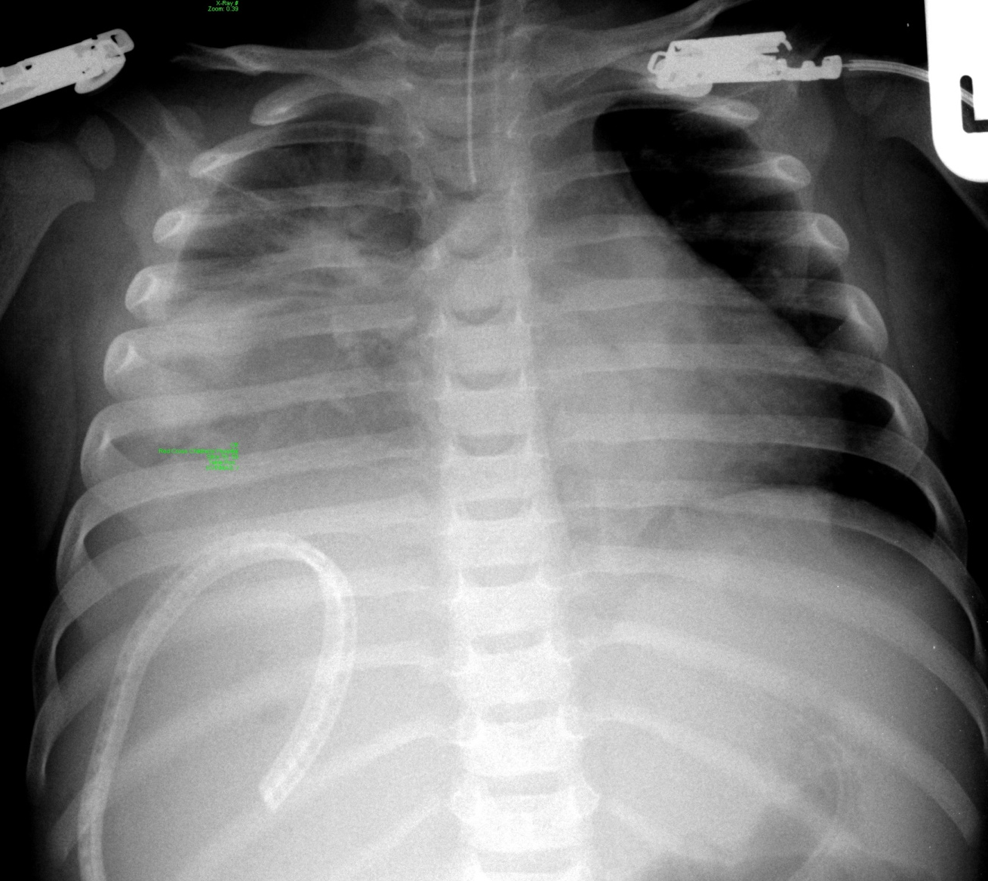
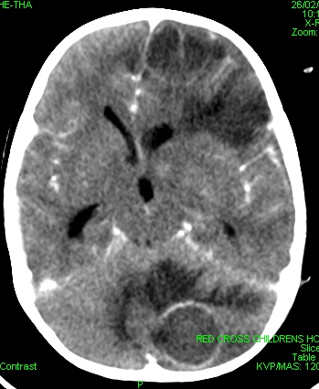
Brain Abscess
Liver Abscess with supradiaphragmatic extension

Slide 21
Therapeutic end-points
Circulation
Heart rate normal for age
Normal pulses (no central-to-periph diff)
Warm and pink extremities
CFT < 2 sec
Normal SBP for age with normal pulse pressure
Respiration / oxygenation
normal respiratory rate for age
normal work of breathing (if lungs normal)
Sats > 94%
Renal
Urine output > 1ml/kg/hr
Mental status
AVPU

Slide 22
Therapeutic end-points
With increasing resources and skills:
CVP 10 - 12 mmH2O
Perfusion pressure (MAP – CVP) > 65mmHg
SVO2 or ScVO2 > 70%
Lactate < 2 mmol/l
Resolution of increased anion gap metabolic acidosis
CI > 3.3 and < 6.0 l/min/m²

Slide 23
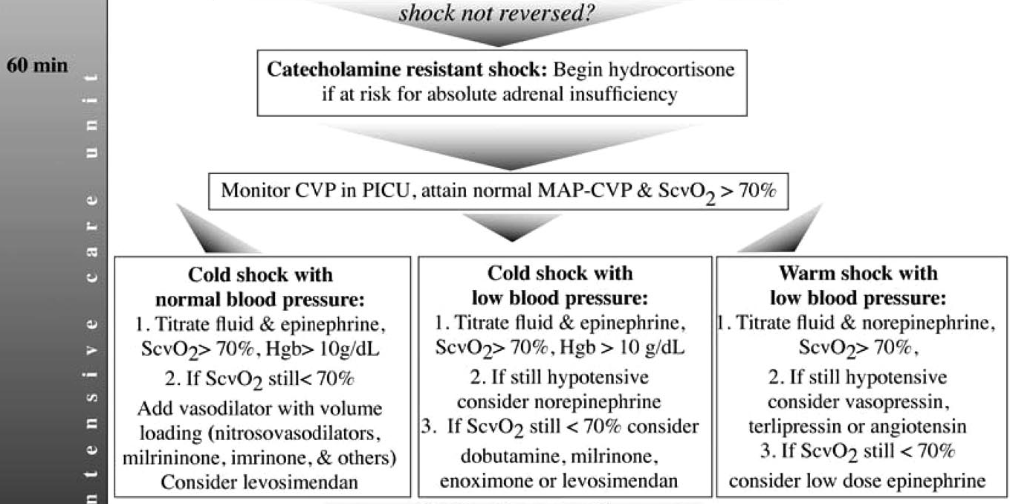
60 min
*
*
*
*
PICU
*
*
*

Slide 24
*

Slide 25
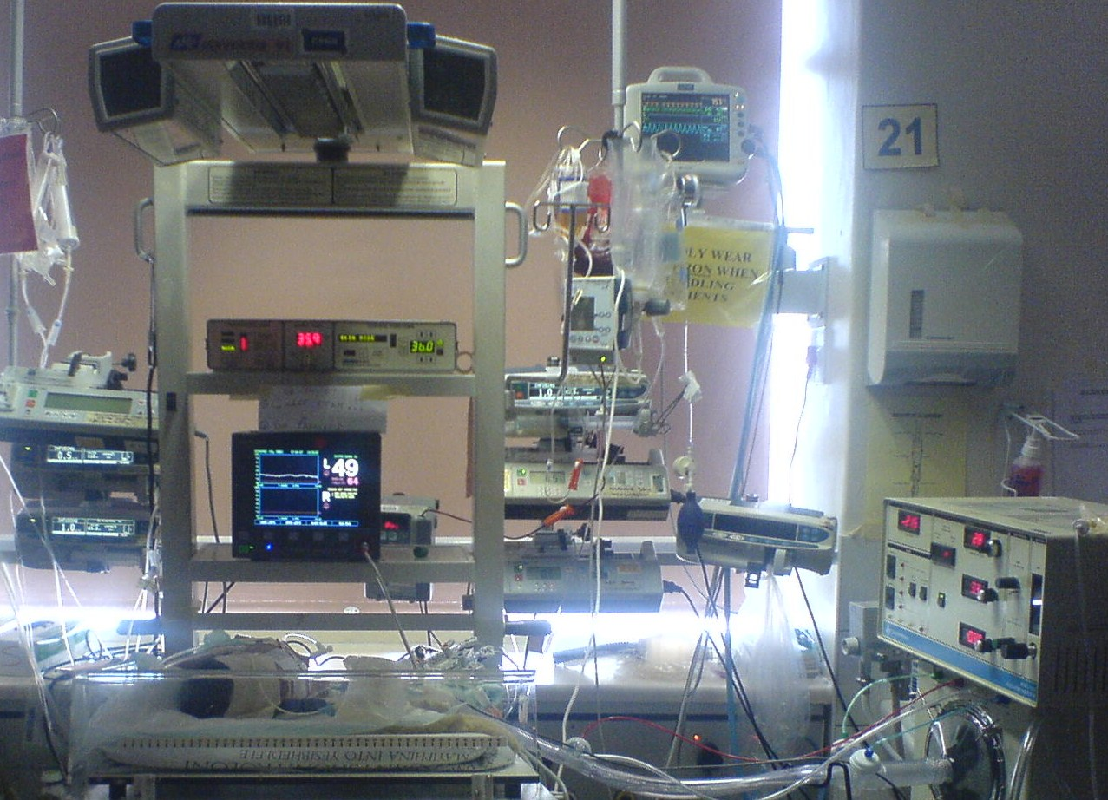

Slide 26
Neonates / Infants
high pulmonary vascular resistance
susceptibility to persistent pulmonary hypertension
possibility of extensive right to left shunts
dependence on glucose as energy source
neonatal heart has limited capacity to respond to increased load

Slide 27
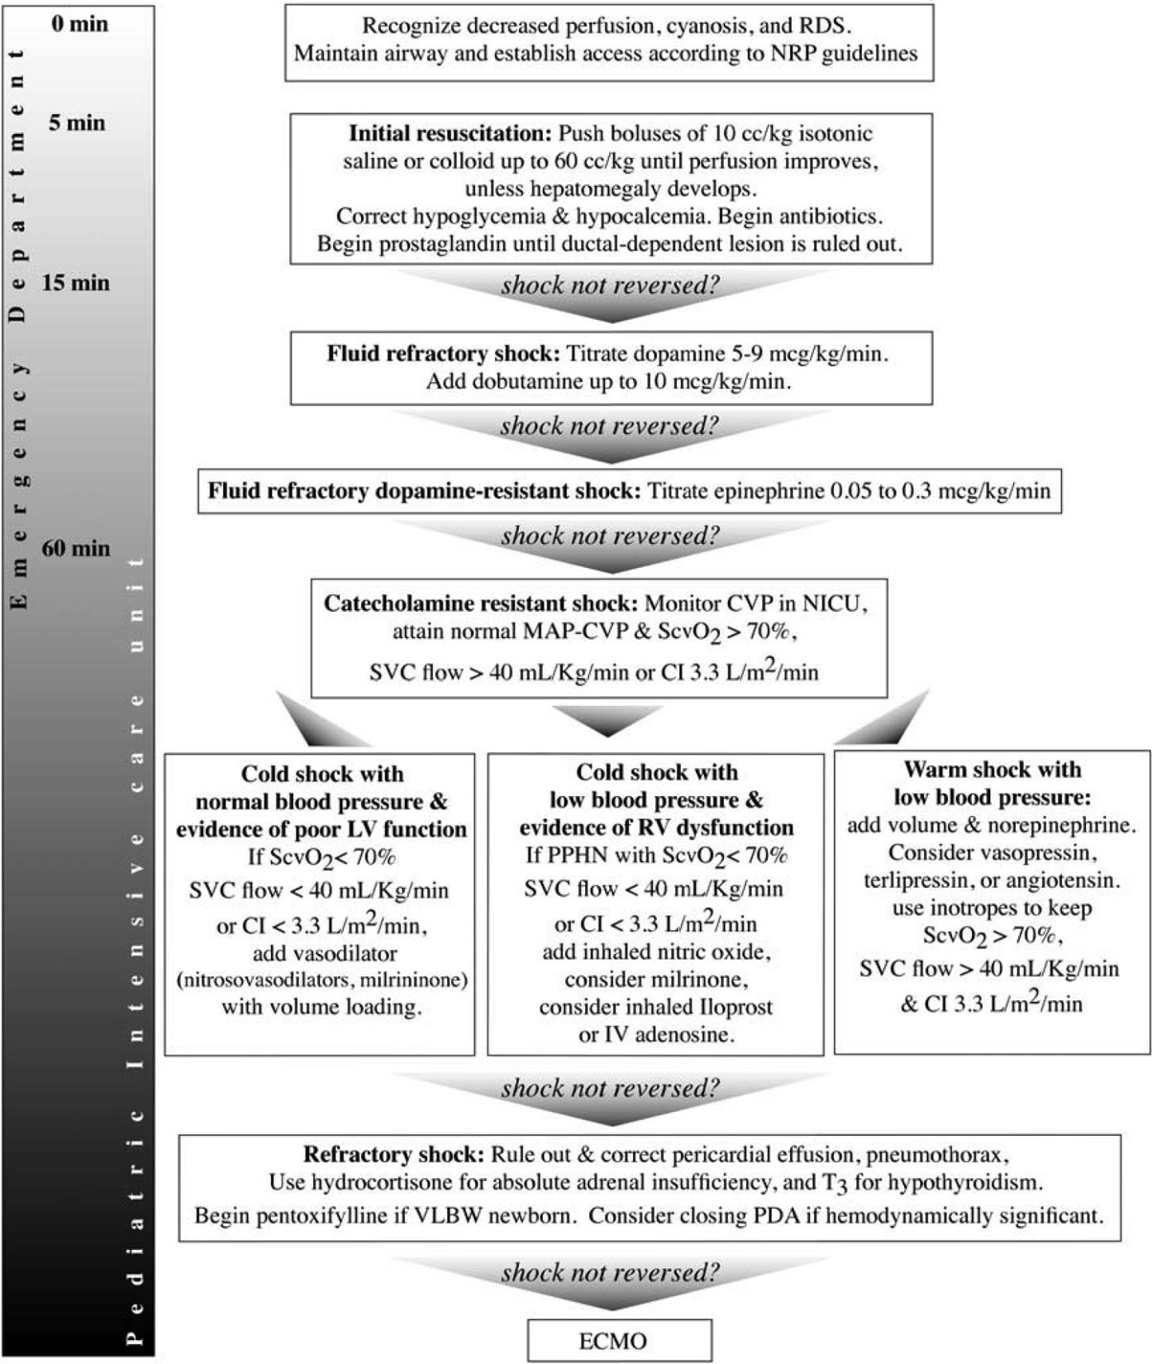
Management
of
Neonatal
Septic
Shock

Slide 28
Neonatal Septic Shock
Neonates / Infants:
Hearts do not cope well with overdistension
Pulmonary arterial hypertrophy / hyperresponsiveness (PPHN) with foetal circulation or duct-dependent lesions
Age-dependent responsiveness of myocardium to dopamine

Slide 29
Neonatal Septic Shock
LV Failure
RV Failure / PPHN
Peripheral Vasodilatation

Slide 30
Neonatal Septic Shock

Slide 31
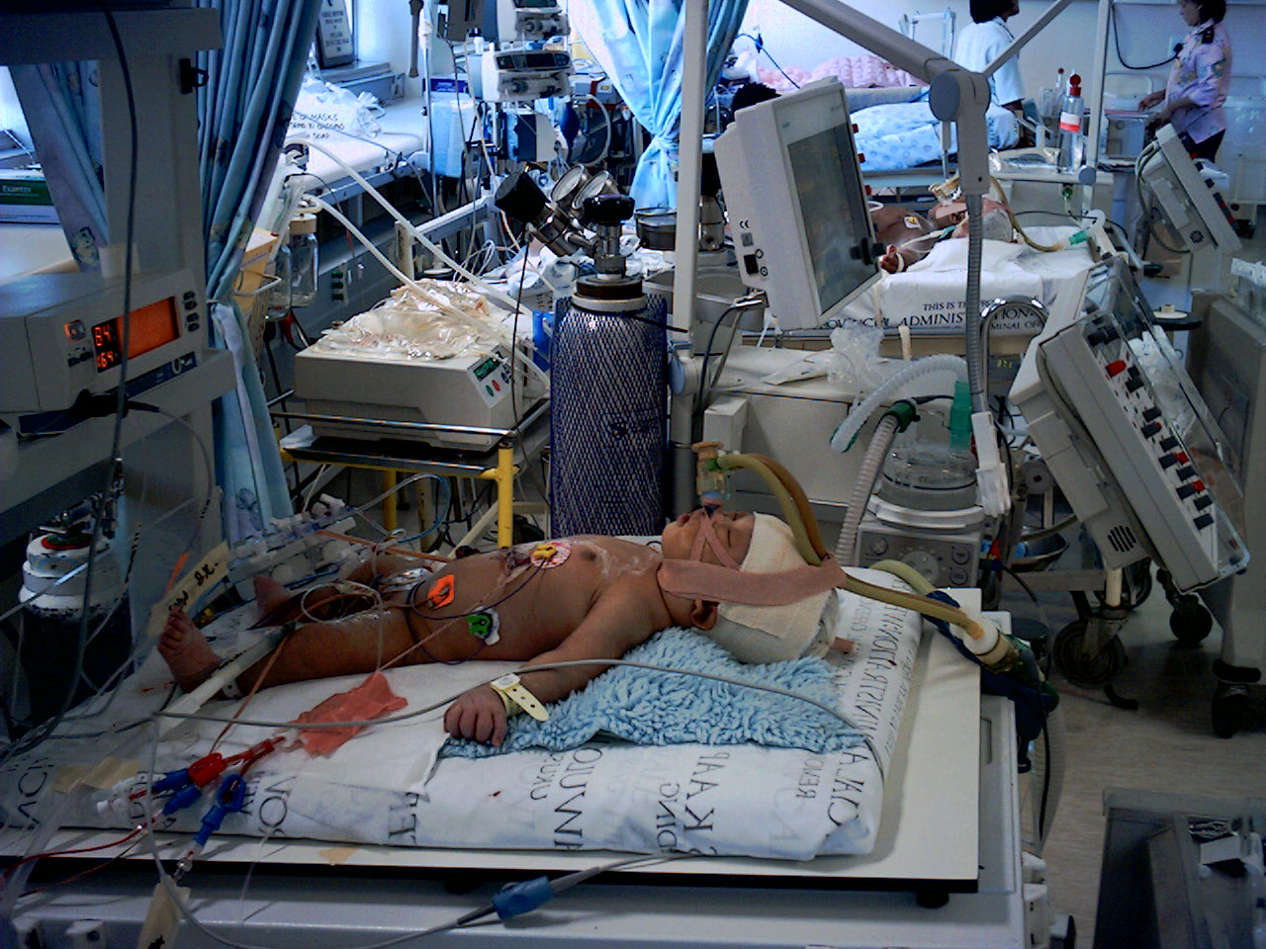

Slide 32
Bundles A – D
A Child mortality > 30/1000
B Child Mortality < 30/1000
C Developing nation
D Developed nation
Rotterdam and St Mary’s: 1-2% mortality (previous 20-22%) with meningococcal septic shock, with 1st hour resuscitation and transport, and access to ECMO
D
Extra-
Corporeal
Support
Transport
Sao Paolo: mortality reduced from 40% to 12% in septic shock with ScvO2 guided to 70% using fluids, inotropes, pRBC
C
1st hour Antibiotics
Fluid Resuscitation
Inotrope Infusion
Mechanical Ventilation
Available at All (PICU)
Kenya: 4% mortality with ivi fluids in malaria
Thailand: 60% drop in mortality with NPO2 for pneumonia
B 1st hour IV fluids and Antibiotics
Oxygen / nCPAP
Emergency Clinics
Vietnam: mortality reduced from 24-60% to 0-1% in Dengue shock with ivi fluid resusc
India: mortality reduced from 16% to 2% in neonatal sepsis with oral Cotrimox and imi Genta
A Immunisations, Potable Water, Breast Feeding, Nutrition, Zinc, Vitamin A, Oral / IM Antibiotics
Available to all through Health Care Workers

Slide 33
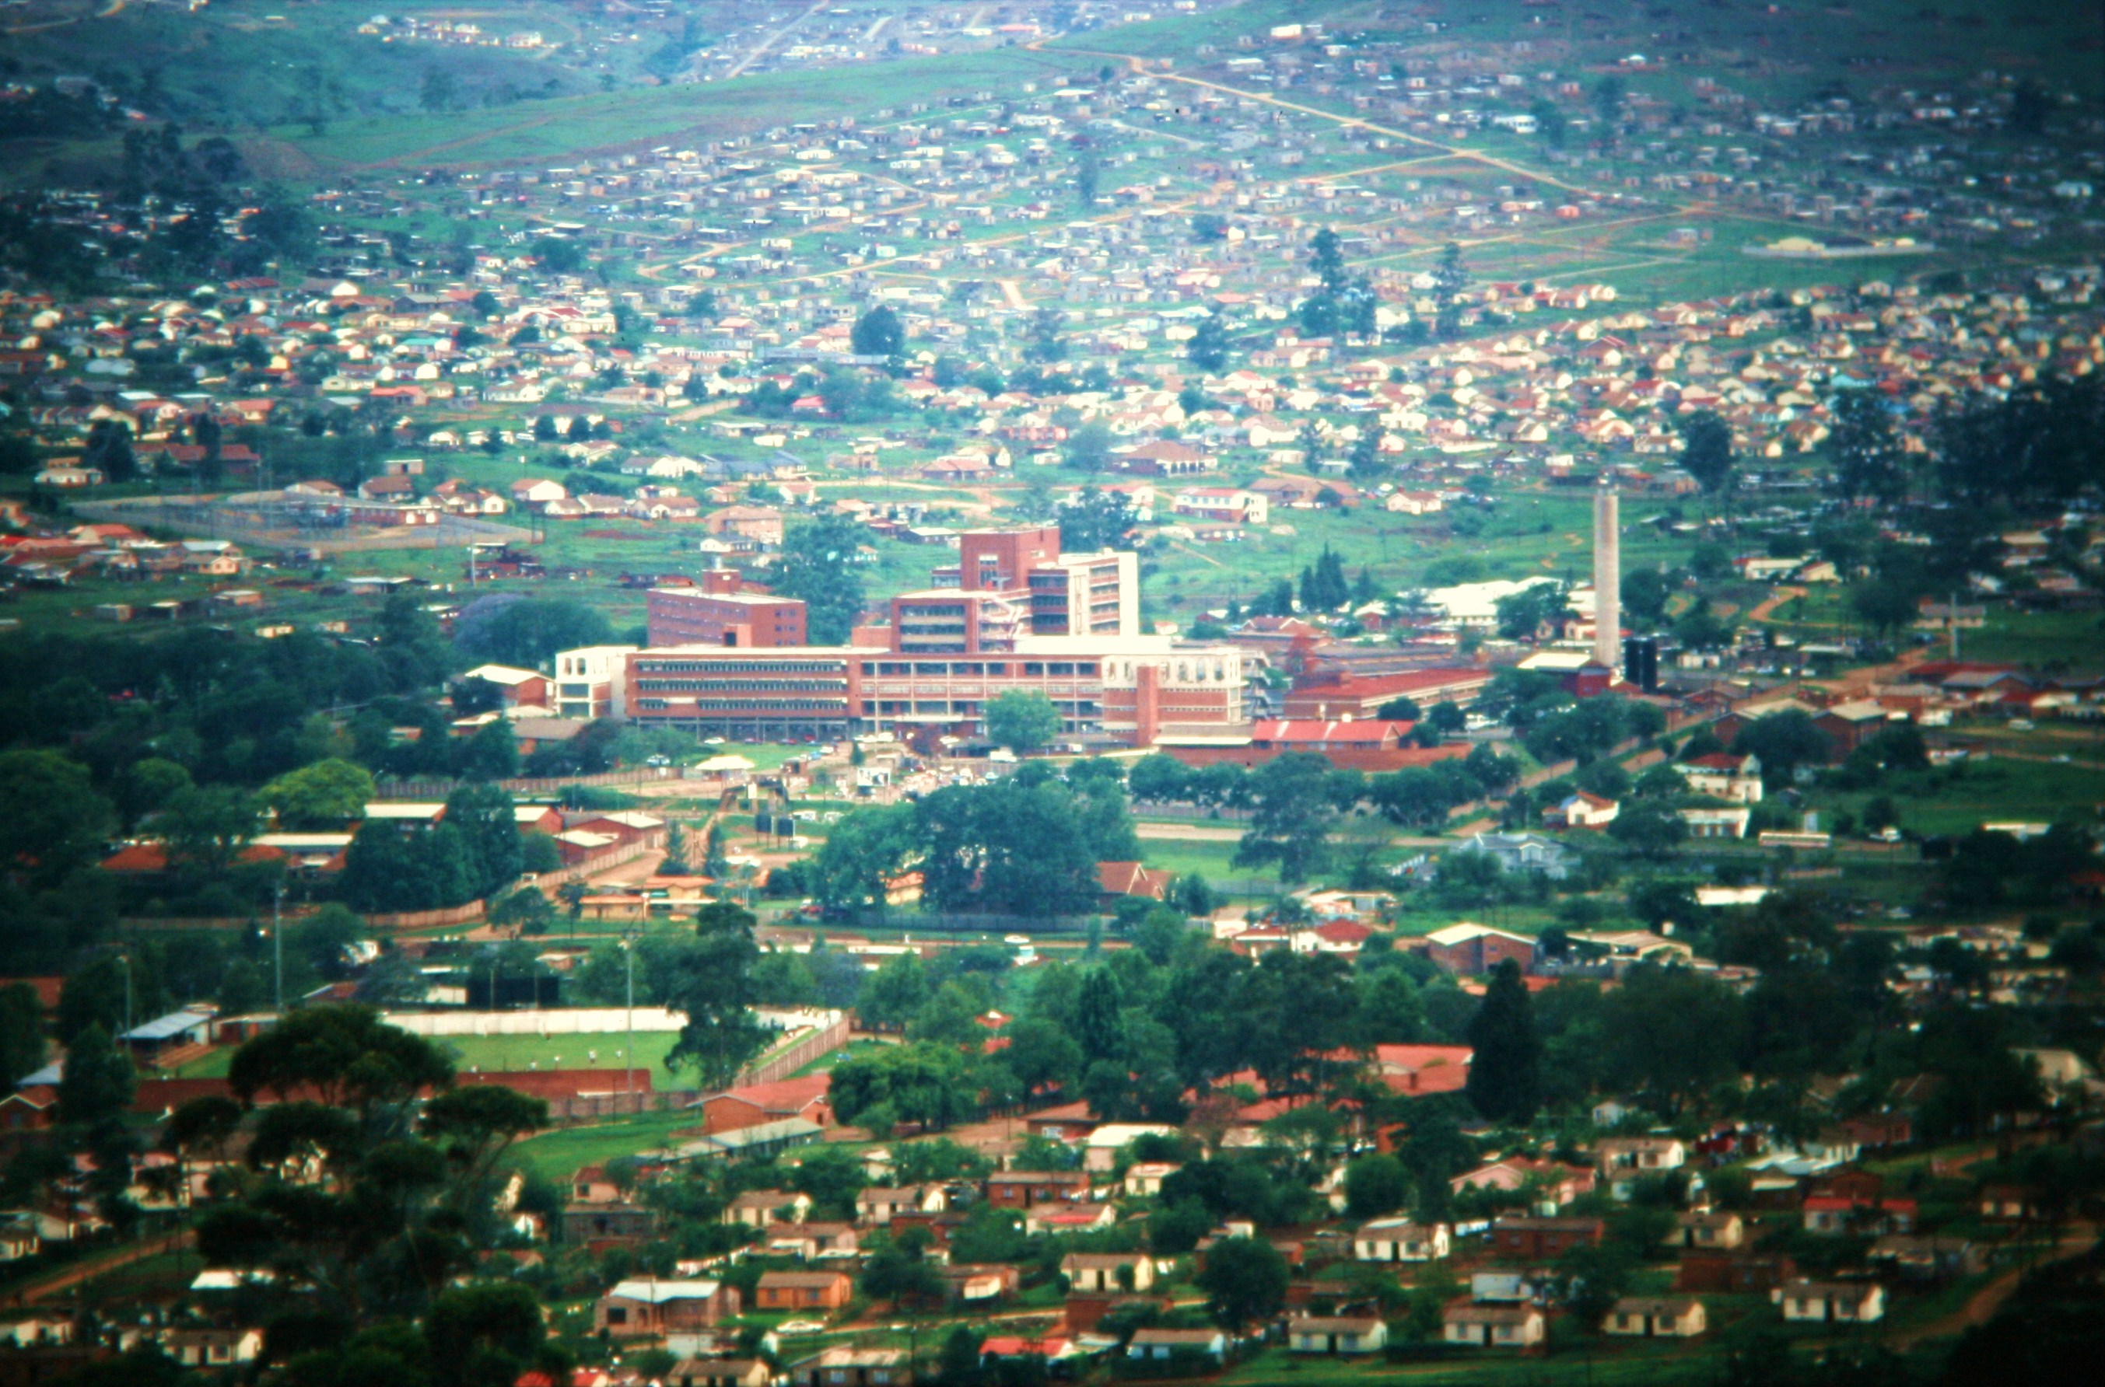
Edendale Hospital
4. PICU
3. POPD
1. Home
2. Community Clinic

Slide 34
Edendale Hospital
4. PICU
3. POPD
+
1. Home
2. Community Clinic

Slide 35
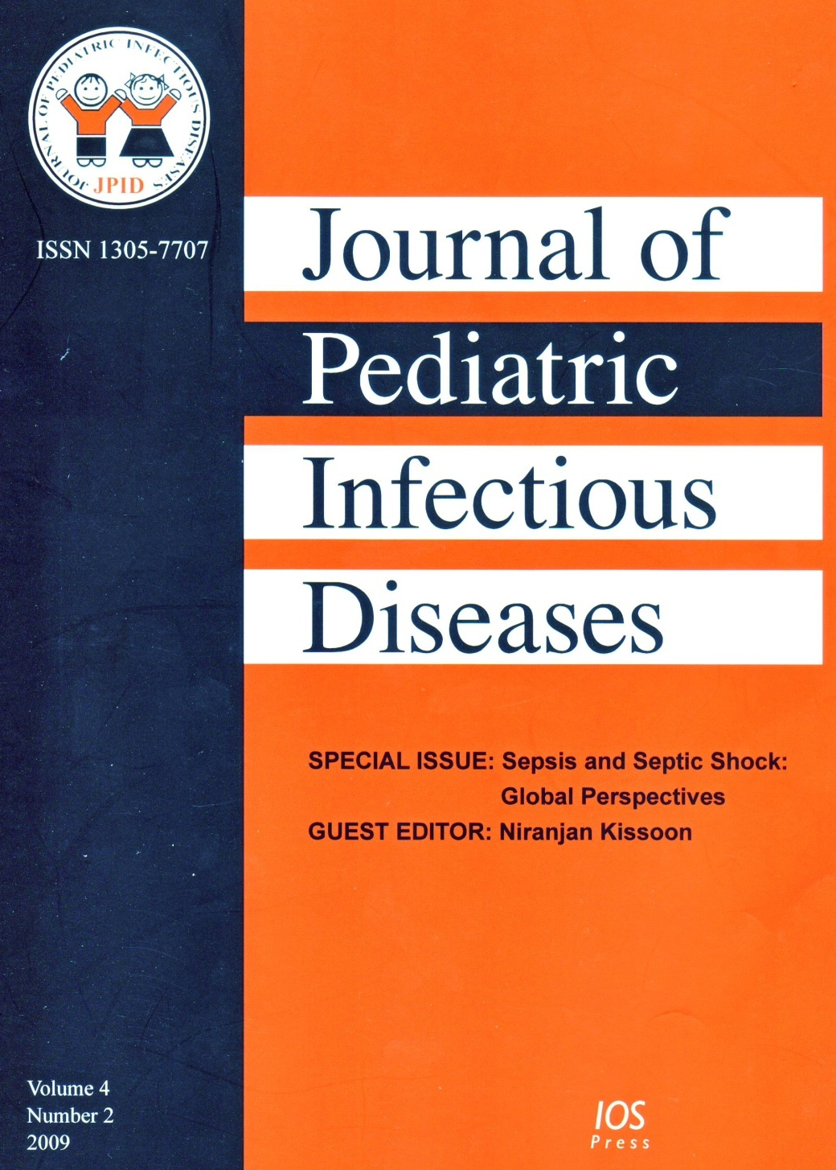
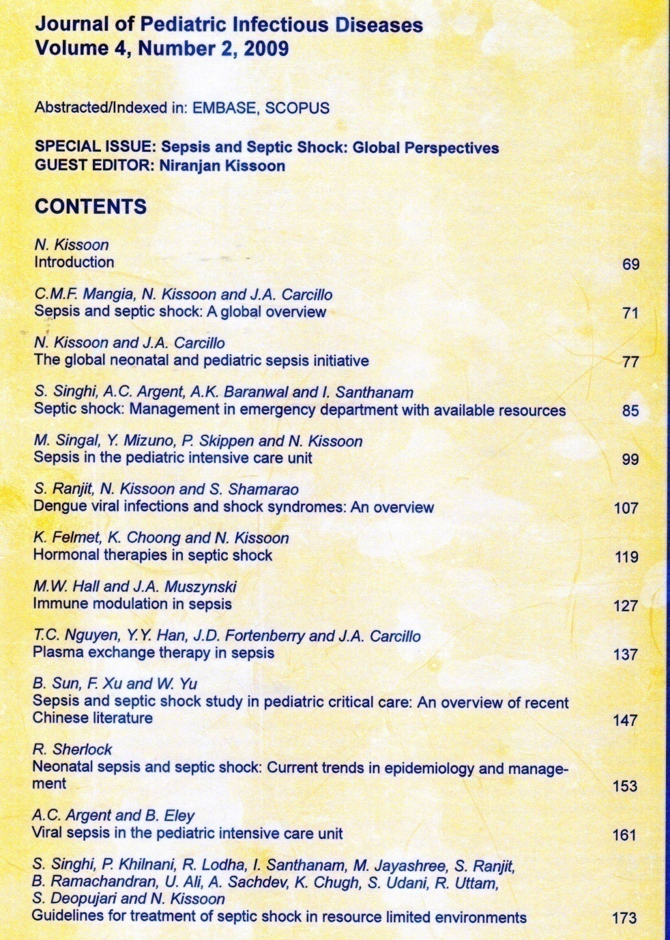

Slide 36
www.wfpiccs.org

Slide 37
Sepsis Forum Sepsis Guidelines Sepsis Bundle Registry
» ENTER » You are here » ENTER

Slide 38
Notes:
38

Slide 39
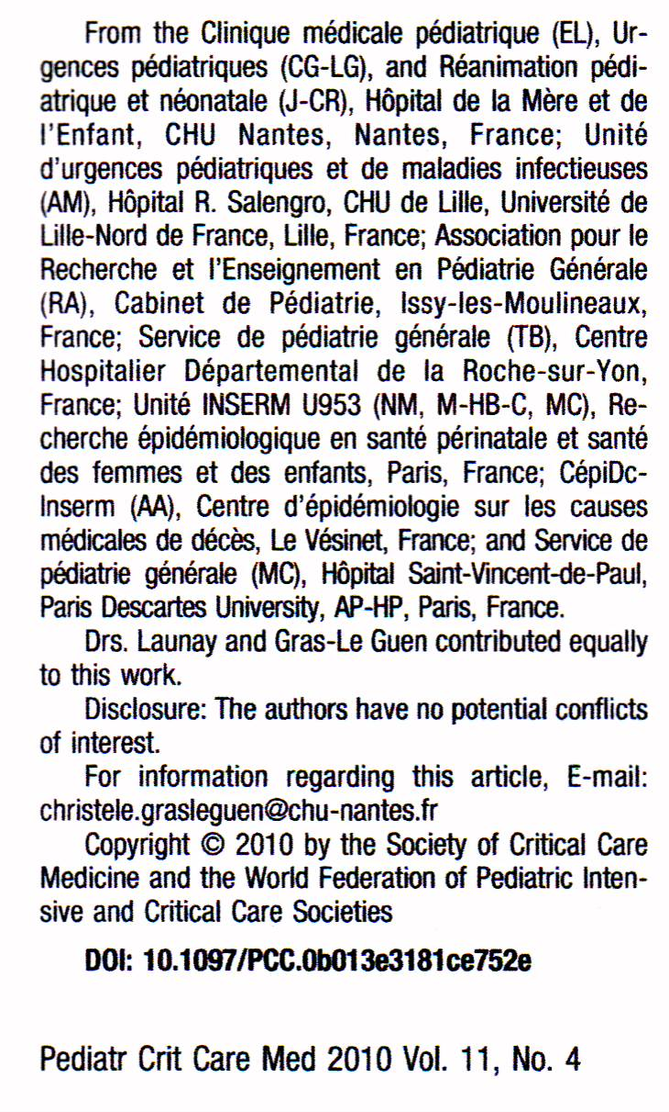
Aspects of suboptimal care identified:
Parental delay in seeking medical care.
Physician’s delay in administering appropriate antibiotic.
Insufficient resuscitation (dose / failure to repeat)
Underestimation of disease severity.

Slide 40
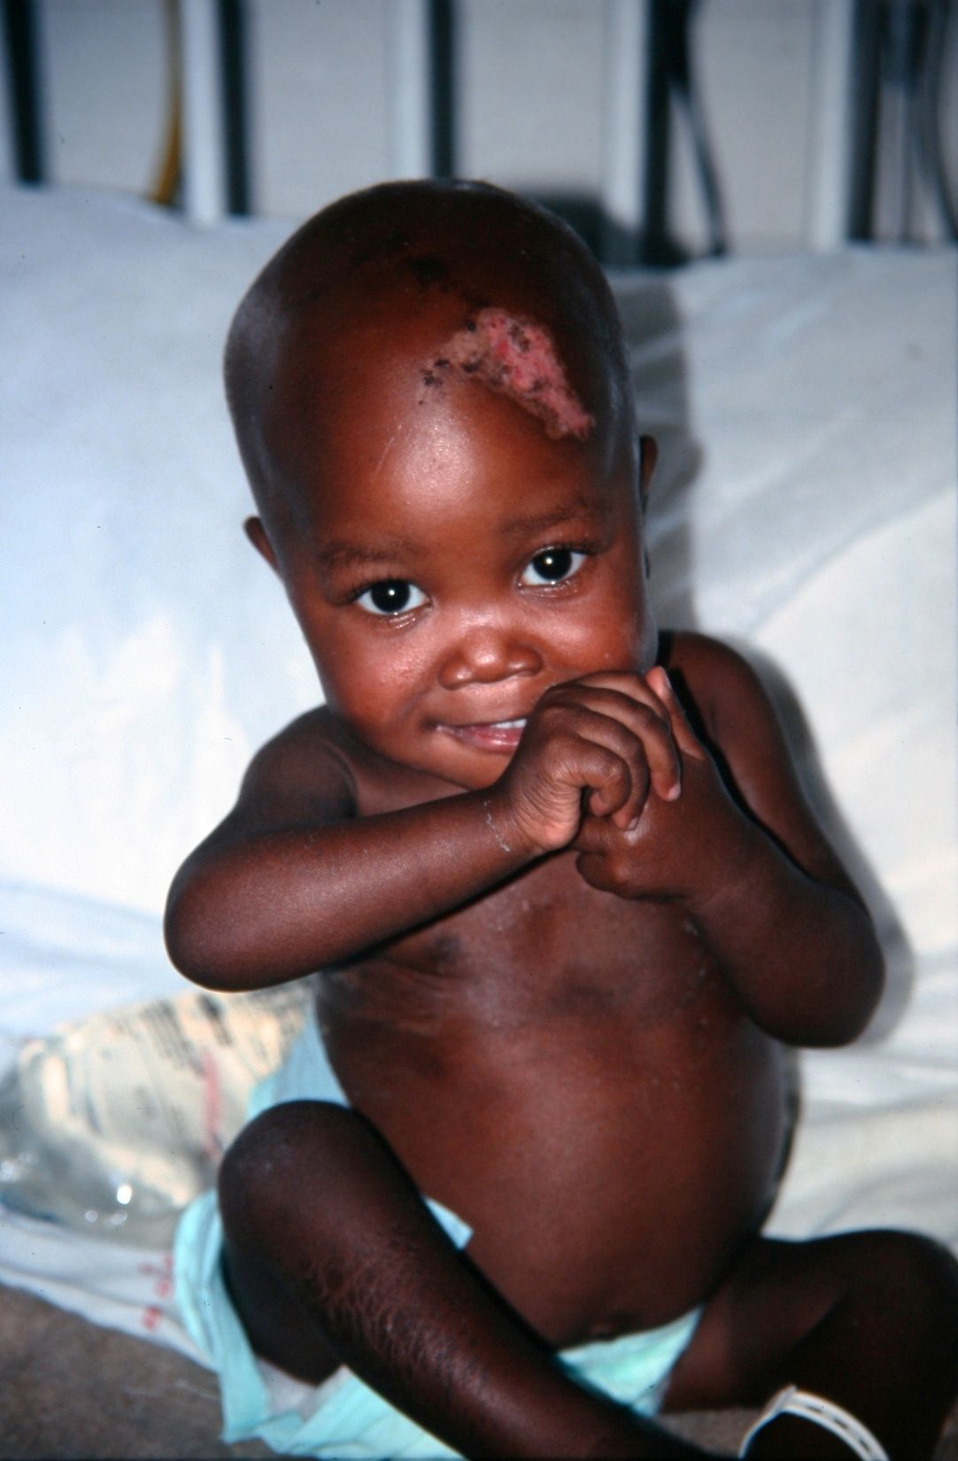
The End

Slide 41
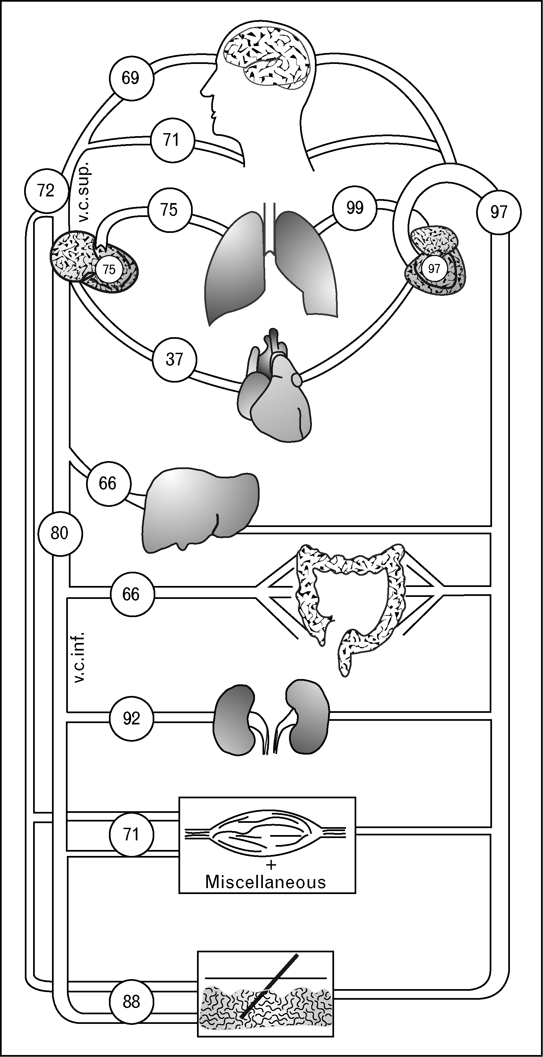
Brain NIRS
(Transcranial)
70
69
Mixed Venous
Oxygen Sats
(SVO2)
Pulmonary Artery
75
97
80
Central Venous
Oxygen Saturation
(ScVO2)
Superior Vena Cava

Slide 42
Limits of mixed venous oxygen saturation (SvO2)
SvO2 level Consequences
SvO2 > 75% Normal extraction
O2 supply > O2 demand
75% > SvO2 > 50% Compensatory extraction
Increasing O2 demand or decreasing O2 supply
50% > SvO2 > 30% Exhaustion of extraction
Beginning of lactic acidosis
O2 supply < O2 demand
30% > SvO2 > 25% Severe lactic acidosis
SvO2 < 25% Cellular death

Slide 43
Principles of Management of Severe Sepsis
5.Time-sensitive goal-directed therapy
6. Other
Corticosteroids
Red cell transfusion, FFP, Platelets
Mechanical ventilation
IVIG
Glucose and Calcium control
Renal replacement therapy
Plasmapharesis
Activated Protein C

Slide 44
Components in two Sepsis Bundles formulated by the Surviving Sepsis Campaign
Bundle Title Components
Acute sepsis bundle *Obtain microbiology samples and lactate measure
(To be completed within *Administer appropriate antibiotics
6 hrs of admission) *Administer early goal directed therapy including:
- Fluids to achieve a CVP of 8 to 12 mmHg
- Vasopressors to achieve a MBP of 65 mm Hg
- Maintain ScVO2 of 70% with packed red blood cells or inotrope therapy
Sepsis management bundle *Administer low-dose corticosteroids based on
(To be completed within hospital policy
24 hrs of admission) *Administer recombinant human activated protein C
based on hospital policy
*Maintain glycemic control (120–150 mg/dL)
*Maintain plateau airway pressures 30 cm H2O in
mechanically ventilated patients

Slide 45
Definitions
Sepsis
SIRS in the presence of or as a result of a suspected or proven infection
Infection
a suspected or proven infection caused by any pathogen OR a clinical syndrome associated with high probability of infection
(clinical exam, lab tests, i.e. WC in body fluids, perforated viscus, CXR typical of pneumonia, purpuric / petechial rash, purpura fulminans)

Slide 46
SIRS
presence of at least 2 of the following,
1 of which must be abnormal temperature or leucocyte count
core temp >38.5ºC or <36ºC
Tachycardia, or for children <1 year: bradycardia
mean respiratory rate > 2 sd above normal or mechanical ventilation
leucocyte count increased or decreased for age or >10% immature neutrophils

Slide 47
other definitions
septic shock
sepsis and cardiovascular organ dysfunction as defined:
Hypotension ( BP < 5th centile for age, or SBP < 2 SD below normal for age) OR
Need for vasoactive drug to maintain BP within normal range despite ivi fluids (dopamine> 5/ dobutamine / adrenaline / noradrenaline at any dose) OR
2 of the following
Oliguria (< 0.5ml/kg/hr)
CFT > 3 sec
Core-to-Periph Temp Gap > 3 degrC
Unexplained metabolic acidosis: BE > 5
Increased arterial lactate: > 2 times upper limit (4 mmol/l)

Slide 48
other definitions
severe sepsis
sepsis plus one of the following:
cardiovascular organ dysfunction (as defined above)
OR Respiratory: ARDS / PaCO2 > 65 mmHg / Need for FIO2 > 50% to maintain Sats > 92% / emergency mechanical ventilation
OR > 2 other organ dysfunctions
Neurology: GCS < 11 / acute deterioration in GCS by > 3
Haematology: platelets < 80,000 (or drop of > 50% previous 3 days) / INR > 2
Renal: Creat > 2X upper limit for age (or 2X increase)
Hepatic: Total bili . 68 mmol/l / ALT > 2X upper limit for age

