Slide 1




Management of fluids in the critically ill child
Andrew C Argent
Red Cross War Memorial Children’s Hospital and
University of Cape Town

Slide 2
introduction
aggressive early fluid resuscitation for shock is important
many of the “normal” guidelines for fluid administration in children are based on relatively poor data and often do not apply in critically ill children
there are current controversies regarding Na concentrations in fluids for critically ill children, but hypotonic fluids are probably bad

Slide 3
milestones in fluid therapy
1612 Sanctorius Described insensible water loss
1616 W. Harvey Demonstrated closed circulation of the blood
1831–32 W.B. O’Shaughnessy Analyzed stool and serum of
and T. Latta cholera patients and applied
rational therapy based on the analyses
1860–1970 R.A. Phillips Successful oral therapy of cholera
1896 E.H. Starling Balance of oncotic and hydrostatic forces in circulation

Slide 4
milestones in fluid therapy
1915 L.E. Holt Sr. et al Analyzed stool content of infants with diarrhea
1926 G.P. Powers Comprehensive therapy for infant diarrheal dehydration
1933–56 J.L. Gamble Extensive studies of body fluids emphasizing ECF in therapy
1935–60 D.C. Darrow Series of studies defining dehydration and disturbance of diarrheal dehydration and its role in therapy

Slide 5
fluid status
intravascular volume (approximately 80ml/kg)
  shock if lose 20ml/kg
overall body water (approximately 500 -700ml/kg)
  interstitial fluid
  intracellular fluid
  clinical dehydration if lose 50ml/kg
may be:
  shocked and not dehydrated (early gastro)
  dehydrated and not shocked (ongoing gastro)
  overhydrated and shocked (nephrotic syndrome)

Slide 6
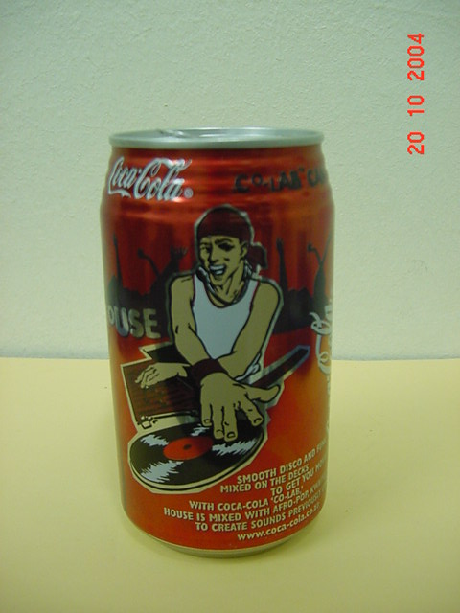
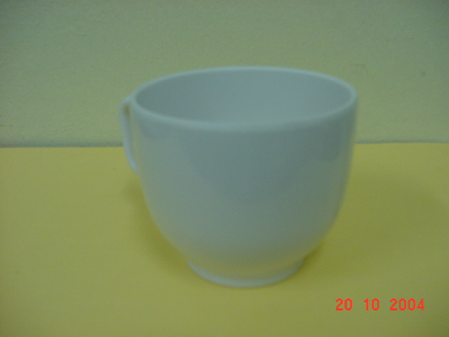
resuscitation volumes
total blood volume = 80ml/kg
volume for shock = 20ml/kg
for 6m infant 340ml = total blood volume
for 3kg infant 240ml = total blood volume

Slide 7
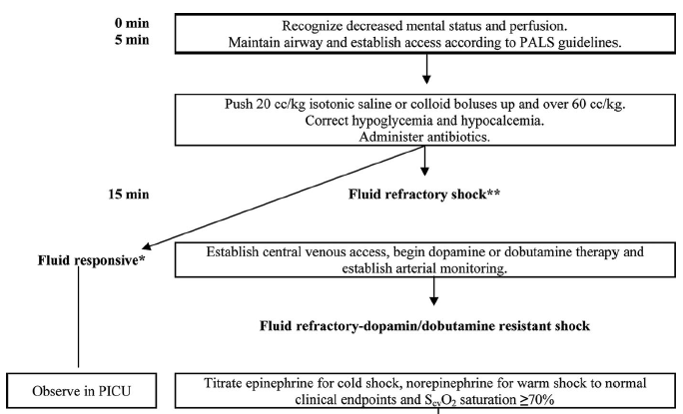
severe sepsis and septic shock guidelines 2008

Slide 8
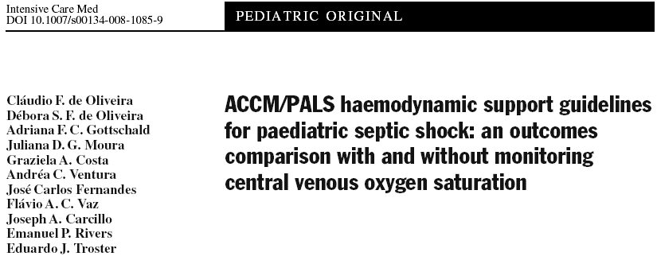
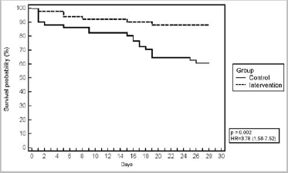
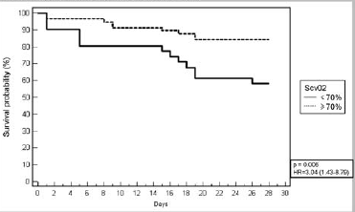

Slide 9
de Oliveira CF et al, Intensive Care Med, 2008

Slide 10
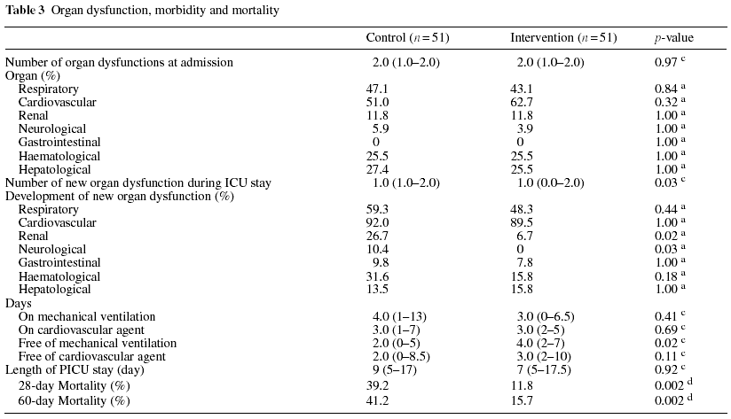
de Oliveira CF et al, Intensive Care Med, 2008

Slide 11
fluid resuscitation (early and aggressive)
high volume (early)
  40-60ml/kg boluses
  intra-osseous access
  Ringer’s lactate most commonly used
colloid vs. crystalloid
  in malaria (crystalloid vs. starch vs. albumen)
    Maitland et al
  in dengue
    Wills et al, N Engl J Med, 2005
early arterial access (if possible)
is this safe if there are no ventilators available?

Slide 12
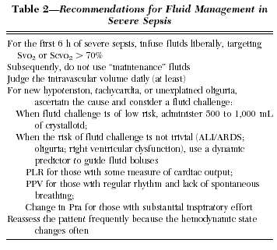
ongoing fluids?
renal function
ongoing losses
fluid balance
rapid changes
beware of fluid creep
leading to
compartment syndromes
etc
Durairaj and Schmidt, Chest, 2008

Slide 13
ongoing water – how much?
Holliday and Segar assumed:
  caloric intake of 100kcal/kg/day
    calculated approximate fluid loss related to this on basis of even older data
  intake in the form of cow’s milk
  passing 3ml/kg/day of urine in order to excrete the solute load

Slide 14
water – how much?
insensible losses
  as little as ± 10ml/kg/day
    humidification
    particular environment
urine output
  predict 1-2ml/kg/hour = ± 30ml/kg/day
stool losses
  may range from 0 - > 300mlk/kg/day ± 10ml/kg/day
other sites
  drains
Total: ± 50ml/kg/day
maintenance….. what for?

Slide 15
fluid balance in the body
intake
  thirst
usual output
  urine
    renal control (aldosterone, antidiuretic hormone, normal tubular function
  stool
  insensible losses (sweating, breathing, evaporation)
unexpected losses
  urine
    diabetes
    diabetes insipidis (nephrogenic, cerebral, cerebral salt wasting)
  nasogastric fluid
  csf drains
  burns
iatrogenic fluid administration

Slide 16
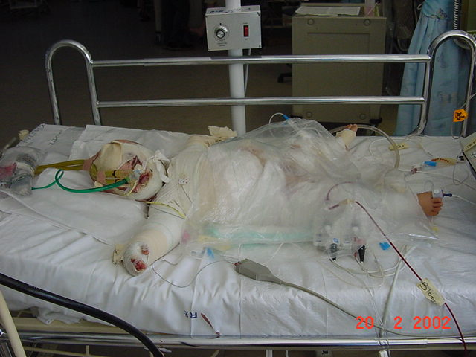

Slide 17
problem 1
standard fluid regimens for children give too much fluid for critically ill children without abnormal fluid losses
many sick children cannot excrete water for reasons of:
  renal function
  hormonal milieu
solute free fluids are particularly difficult to excrete

Slide 18
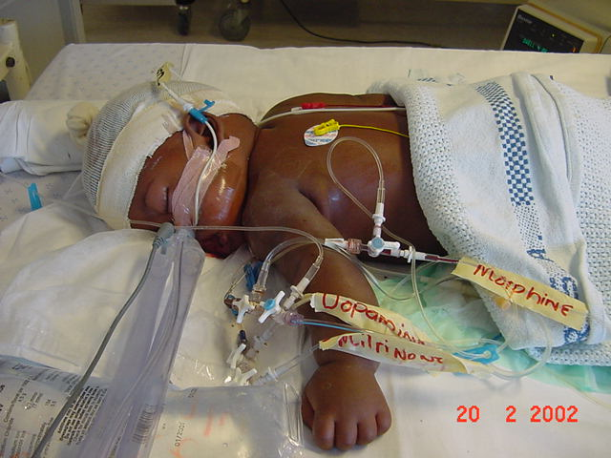

Slide 19
why pass urine?
get rid of excess fluid
get rid of waste material
  salts
  breakdown products of proteins (products of fat and carbohydrates = H₂O and CO₂)
  other metabolic waste
the amount of urine passed does not depend only the water, but also on the “solute load”

Slide 20
problem 2
many children have had large volumes of fluid resuscitation on admission
  sepsis guidelines
  60-80ml/kg of fluid in the first hour of resuscitation
there is an ongoing need for fluid input for
  administration of medication
  maintenance of IV lines
  maintenance of blood sugar

Slide 21
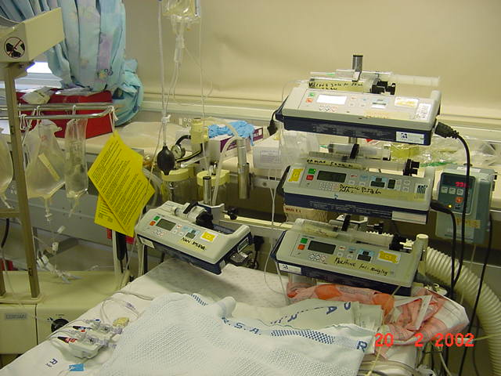

Slide 22
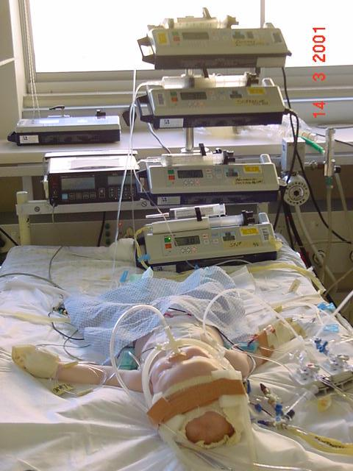
problem 3
It’s not always easy to find space for food in the midst of all the water

Slide 23
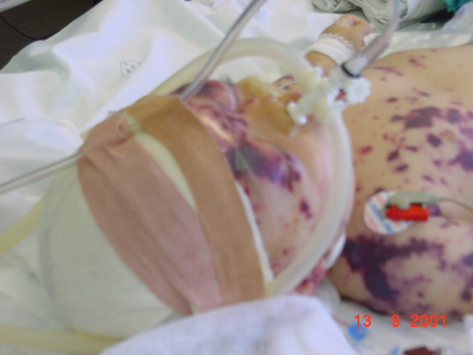

Slide 24
specific conditions
93 children with pneumonia or bacterial meningitis on their admission to hospital.
  hyponatraemia (sodium value 134 mmol/l or less) was present in 33 (45%) of the 73 children with pneumonia, and in
  10 (50%) of the 20 children with bacterial meningitis
  the maintenance fluid requirement in these children is usually about 50 ml/kg/per day,
  and children with hyponatraemia caused by water overload need even lower fluid intakes.
  Shann F, Germer S, Arch Dis Child, 1985
Notes:
Shann F, Germer S.

Slide 25
asthma
20 children during severe attacks of acute asthma
  mean body weight on admission 97.8% of their reference stable weight
  3 children > 5% dehydrated
  bedside assessment of dehydration was unreliable.
  mean packed cell volume was significantly higher on admission than 7-10 days later (0.44 compared with 0.42, difference 0.02 SE 0.01).
  Na and K and osmolality on admission were within normal ranges.
  fluid given at a rate of 50 ml/kg/24 hours was safe and appropriate for these children.
    Potter P, Klein M, Weinberg EG, Arch Dis Child, 1991

Slide 26
specific conditions and water
CNS infections
  “maintenance water requirement in these children is usually about 50ml/kg/day”
    Shann & Germer, 1985, Arch Dis Child
post CNS surgery
  balances of:
    SIADH
    cerebral salt wasting
    diabetes insipidus

Slide 27
Incidence of Postoperative Hyponatremia and Complications in Critically- Ill Children Treated with Hypotonic and Normotonic Solutions
ALICIA K. AU, MD, PATRICIO E. RAY, MD, KEVIN D. MCBRYDE, MD, KURT D. NEWMAN, MD, STEVEN L. WEINSTEIN, MD, AND
MICHAEL J. BELL, MD
Objective To determine the incidence and clinical consequences of postoperative hyponatremia in children.
Study design We performed a retrospective analysis of postoperative admissions to the pediatric intensive care unit (excluding cardiac, neurosurgical, and renal). The incidence of severe (serum sodium < 125 mmol/L or symptoms) and moderate (serum sodium < 130 mmol/L) hyponatremia in children receiving hypotonic (HT) and normotonic (NT) fluids was calculated.
Results Out of a total of 145 children (568 sodium measurements; 116 HT and 29 NT), we identified 16 with hyponatremia (11%). The incidences of moderate (10.3% vs 3.4%, P .258) and severe (2.6% vs 0%; P .881) hyponatremia were not significantly different in the HT and NT groups. There were no neurologic sequelae or deaths related to hyponatremia.
Conclusions In our study group, hyponatremia was common, but morbidity and death were not observed. Careful monitoring of serum sodium level may be responsible for this lack of adverse outcomes. Larger, prospective studies are neededto determine whether the incidence of hyponatremia differs between the HT and NT groups. (J Pediatr 2008;152:33-8)

Slide 28
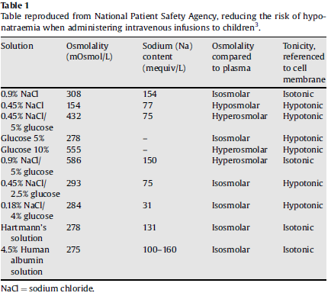
Campbell C, Current Anaesthesia & Critical Care 19 (2008) 299–301

Slide 29
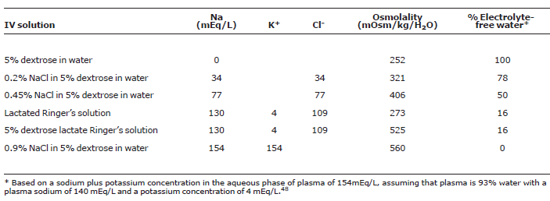
Choong and Bohn, Jornal de Pediatria, 2008

Slide 30
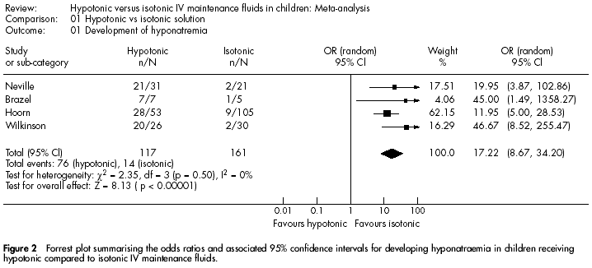
Choong et al, Arch Dis Child, 2006

Slide 31
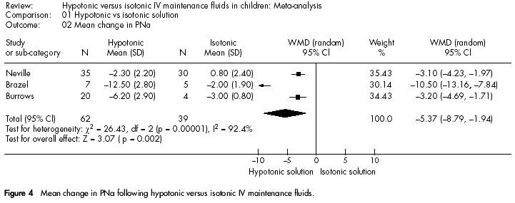
Choong et al, Arch Dis Child, 2006

Slide 32
Acute Hyponatremia Related to Intravenous Fluid Administration in
Hospitalized Children: An Observational Study
Ewout J. Hoorn, MD*; Denis Geary, MB‡§; Maryanne Robb, MD‡§; Mitchell
ABSTRACT. Objective. To develop hyponatremia (plasma sodium concentration [PNa] <136 mmol/L), one needs a source of water input and antidiuretic hormone secretion release to diminish its excretion. The administration of hypotonic maintenance fluids is common practice in hospitalized children. The objective of this study was to identify risk factors for the development of hospital-acquired, acute hyponatremia in a tertiary care hospital using a retrospective analysis.
Methods. All children who presented to the emergency department in a 3-month period and had at least 1 PNa measured (n 1586) were evaluated. Those who were admitted were followed for the next 48 hours to identify patients with hospital-acquired hyponatremia. An age- and gender-matched case-control (1:3) analysis was performed with patients who did not become hyponatremic.
Results. Hyponatremia (PNa <136 mmol/L) was documented in 131 of 1586 patients with >1 PNa measurements. Although 96 patients were hyponatremic on presentation, our study group consisted of 40 patients who developed hyponatremia in hospital. The case-control study showed that the patients in the hospital-acquired hyponatremia group received significantly more EFW and had a higher positive water balance. With respect to outcomes, 2 patients had major neurologic sequelae and 1 died.
Conclusion. The most important factor for hospital acquired hyponatremia is the administration of hypotonic fluid. We suggest that hypotonic fluid not be given to children when they have a PNa <138 mmol/L.
Pediatrics 2004;113:1279 –1284;

Slide 33
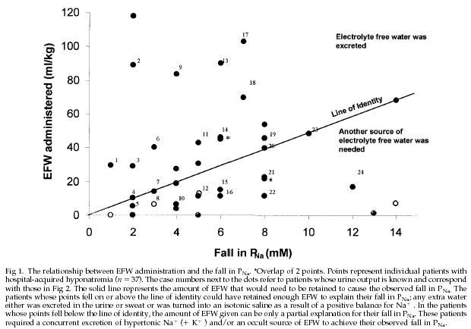
Hoorn et al, Pediatrics, 2004

Slide 34
development of hyponatraemia
“if a patient receives intravenous fluid that exceeds 5% of total body water (30ml/kg) then their plasma sodium concentration should be measured”
“the use of hypotonic solutions should be reserved for patients who have a plasma sodium concentration greater than 140mmol/l”
    Halberthal, Halperian and Bohn, 2001 BMJ

Slide 35
proposal ..
for children (neonates may be different)
  paediatric maintenance fluid should be removed from general use
  a minimum of 0.45% Na Cl should be given in maintenance IV fluids (probably 0.9% NaCl in high risk children)
  Na levels should be checked regularly in children on significant IV fluid volumes

Slide 36
conclusions
early and aggressive use of fluid for resuscitation in shock is appropriate
many standard recommendations for fluid administration in children are excessive in the critically ill
it may be appropriate to remove hypotonic (certainly paediatric maintenance solution) from general use in critically ill children
fluid balances have to be watched extremely carefully,

Slide 37
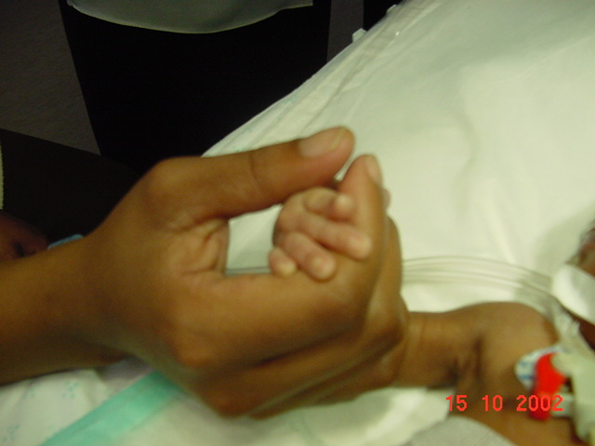

Slide 38








6th World Congress
on Pediatric Critical Care
13-17 March 2011
Check the website www.pcc2011.com regularly for Congress updates!
We look forward to welcoming you to a memorable event in Sydney in 2011!

