Slide 1

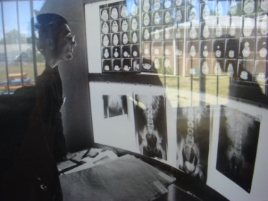
Imaging for the critically ill child
Those in favour of Paediatricians doing it
Those against this practice
Savvas Andronikou
MBBCh, FCRad, FRCR, PhD

Slide 2
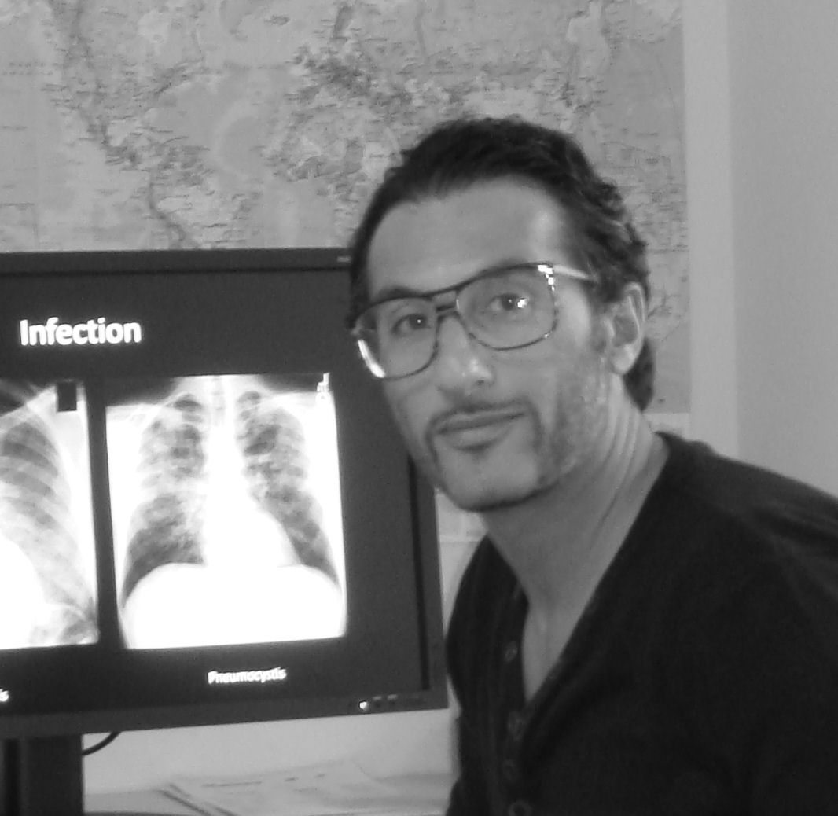
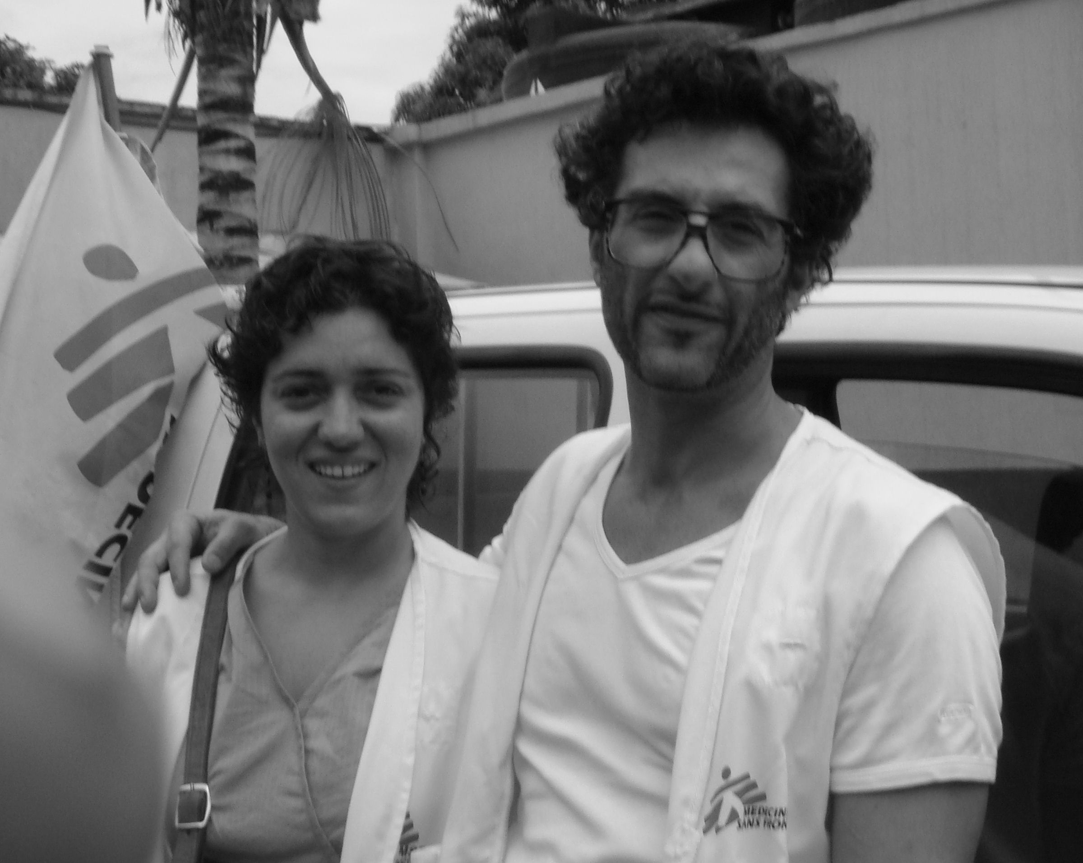
Two hats:
Radiologist: against
Health provider: in favour

Slide 3
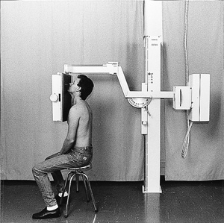
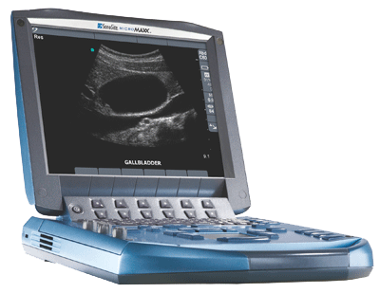
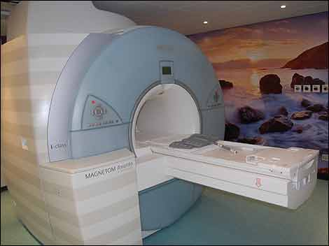
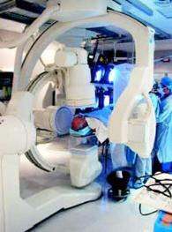
What is it you want to do?
Radiographs
Ultrasound
CT
MRI
Intervention
Do you want to..?
do the procedure
interpret it
charge for it

Slide 4
Rules: against
HPCSA
The ownership and use of high technology equipment creates a special problem, not only because of inappropriate use by health care professionals not duly qualified, but also due to over-servicing by appropriately qualified health care professionals.
Health care practitioners shall only own and use technological equipment if it forms an integral part of their scope of the profession and practice and on condition that the health care practitioner concerned has received appropriate training in using and managing such equipment.

Slide 5
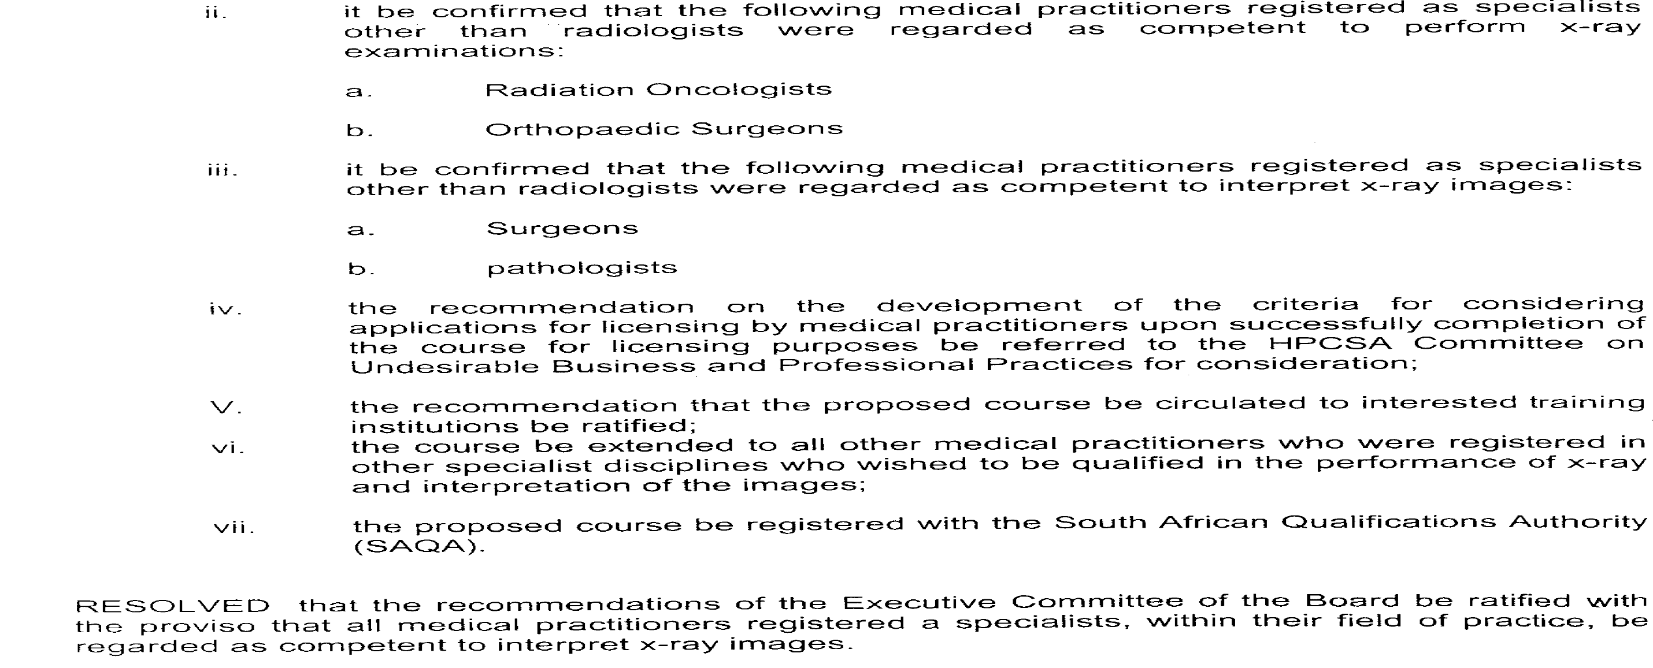
Rules: in favour - HPCSA

Slide 6
Opinion: In favour - AMA
There is value to having imaging interpretations performed by a physician who has a full knowledge of his/her patient's medical history...
Additional restrictions on physician ownership and referral of imaging services will force patients to go elsewhere for diagnostic testing and will disrupt the important continuity of care.
AMA issued a resolution advocating protection of current self-referral rules that allow in-office imaging by a doctor for his or her patients.

Slide 7
Facts: against
Specialists who had in-office imaging capabilities performed an average
4-5X sonography, echocardiograpy and NM
3X MR imaging;
2X radiography and CT
[Florida State University for the Florida Heath Care Cost Containment Board (1990)]
Nonradiologists performing their own imaging are at least 1.7-7.7 times as likely to order imaging as non—self-referring physicians
[Physician Self-Referral for Diagnostic Imaging: Review of the Empiric Literature (2002) Brian E. Kouri, R. Gregory Parsons and Hillel R. Alpert]

Slide 8
Facts: against
Usage
Expense
For MRI of spinal trauma:
37% a self-referred
22% in non-self-referred
For standard imaging of the knee and lower leg:
58% self-referrers
35% non-self-referrers
Self-referral inevitably leads to high utilization
[Medicare Payment Advisory Commission
James Brice, June 19, 2009 Diagnostic Imaging]
Imaging performed in an in-office environment is more expensive than services provided elsewhere.
Physicians who have a financial interest in medical imaging equipment are more likely to refer patients to use it
They incur higher costs generally than physicians who do not have similar financial incentives.

Slide 9
Facts: against
Radiation
Growth
Self referral was a primary driver of the radiation exposure increase.
[International Congress of Radiology in June 2008. NCRP executive director David A. Schauer]
Physician self-referral and the growing use of multislice CT and nuclear imaging have been blamed for a sevenfold increase in the exposure of U.S. residents to ionizing radiation from medical imaging in the 20 years ending in 2006.
Peer reviewed medical studies noted that in-office self-referred CT, MRI, and nuclear medicine exams charged to Medicare from 1998 through 2005 grew at three times the rate of the same exams performed in hospitals and independent diagnostic testing facilities.
[2008 Government Accountability Office report ]
Nearly half of these exams might have been unnecessary.
[Blue Cross Blue Shield organization]

Slide 10
Position: against
Radiological Society of South Africa
In SA, Radiology is a referred to discipline.
If additional examinations are required the findings are discussed with the referring physician before such additional studies are performed.
Radiologists are prevented, as far as possible, from generating their own referrals.
Isolation of the diagnostic disciplines is in the best interest of the public, in other words, it removes financial incentives in the diagnostic imaging work-up of the patient.
We have a skill. Our residencies and our practices have selected those of us who can "see" where things are and their relationship to other structures.
A weekend course or a week-long externship doesn't convey this knowledge.
Even if a specialty can learn to interpret images, they generally learn only the salient features in which they have an interest and tend to ignore the other findings and structures on the film.
We provide a complete exam evaluation, able to evaluate the multiple structures visible on a host of studies and compare them to other imaging tests, many of these completely unfathomable to the referring doctor.

Slide 11
Reality: against
Discovery medical aid was approached by a cardiologist last year to motivate for funding for purchasing a MDCT. He stated that he would perform approximately 200 CCTA’s per month, yet he had only referred a three cases over a two year period to an existing accredited facility in the hospital where he works.

Slide 12
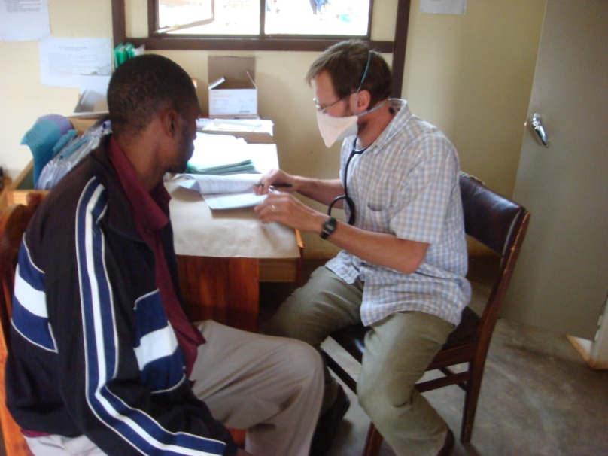
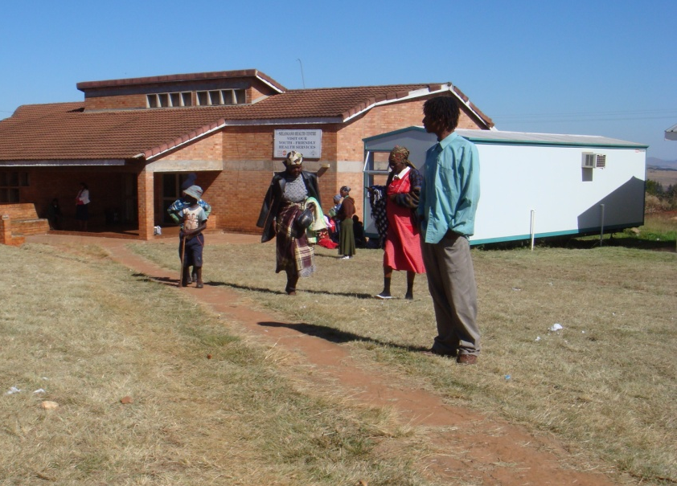
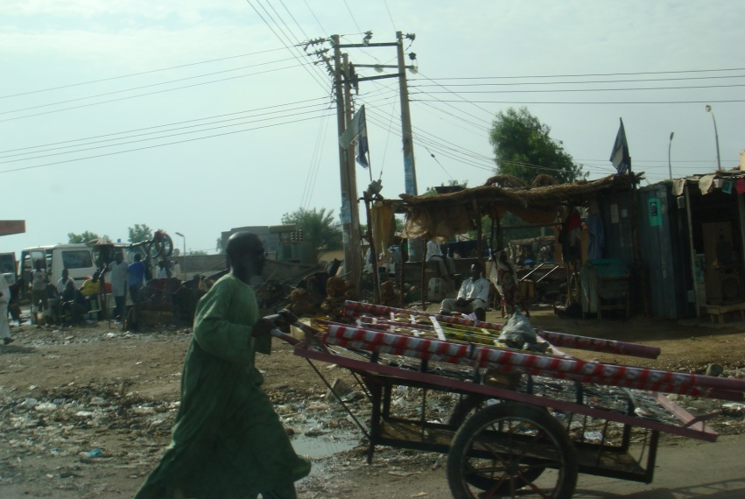
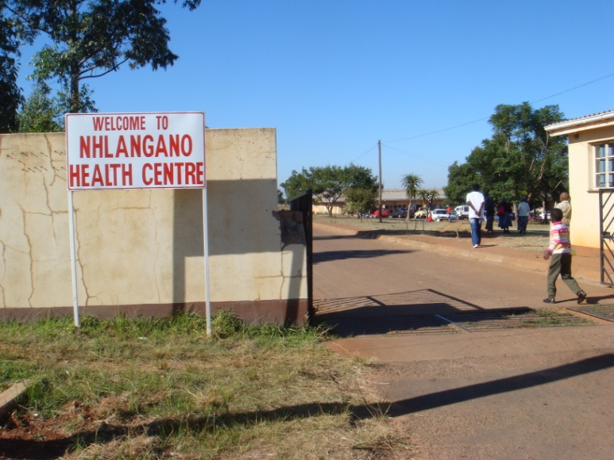
Reality: in favour

Slide 13
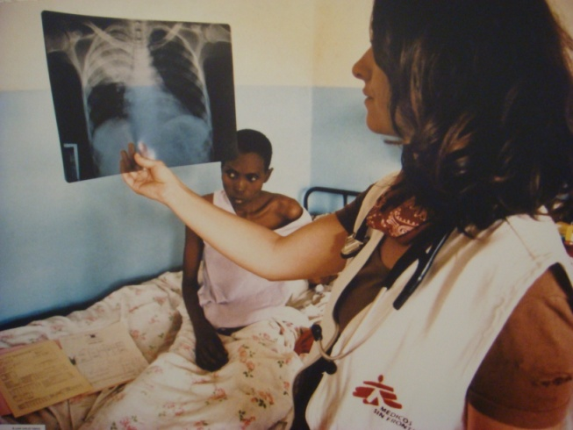
Precedent: in favour

Slide 14
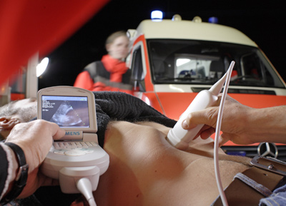
Precedent: in favour
FAST

Slide 15
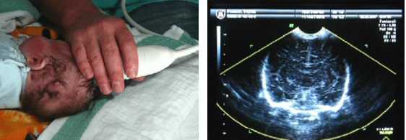
Precedent: Good uses

Slide 16
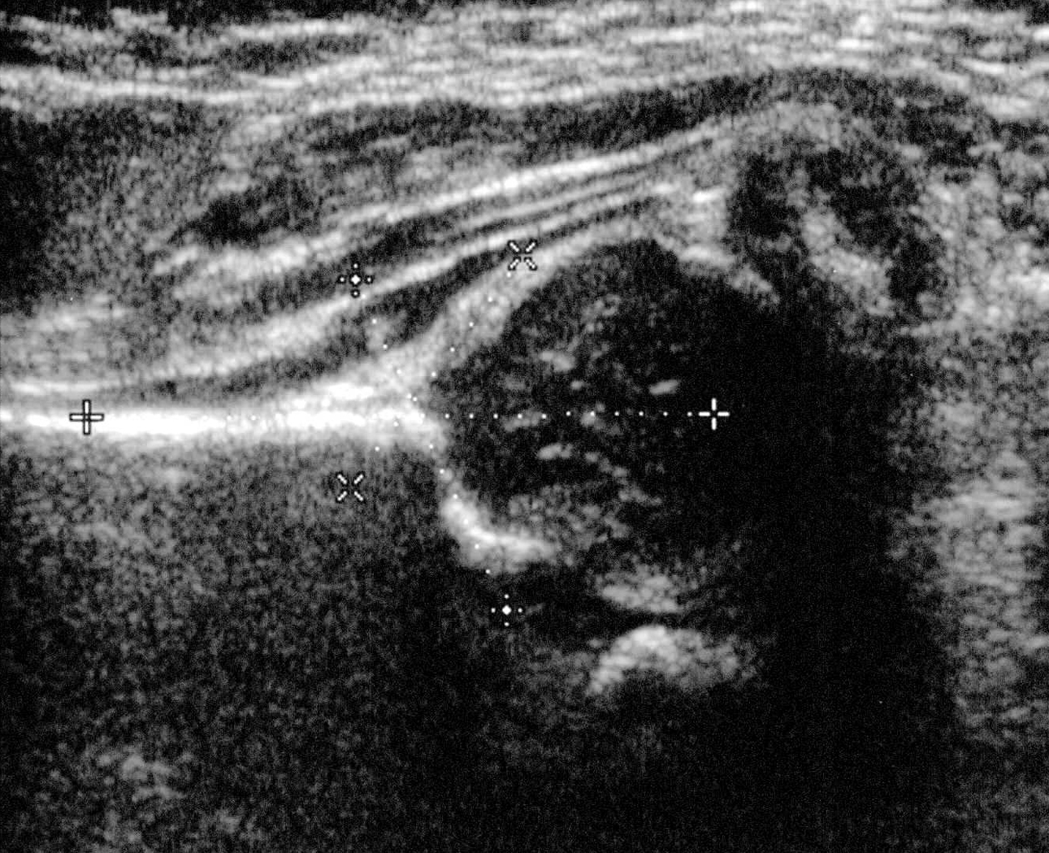
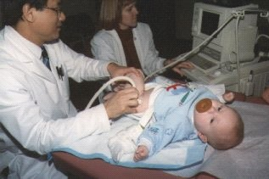
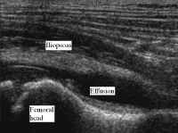
Precedent: good uses

Slide 17
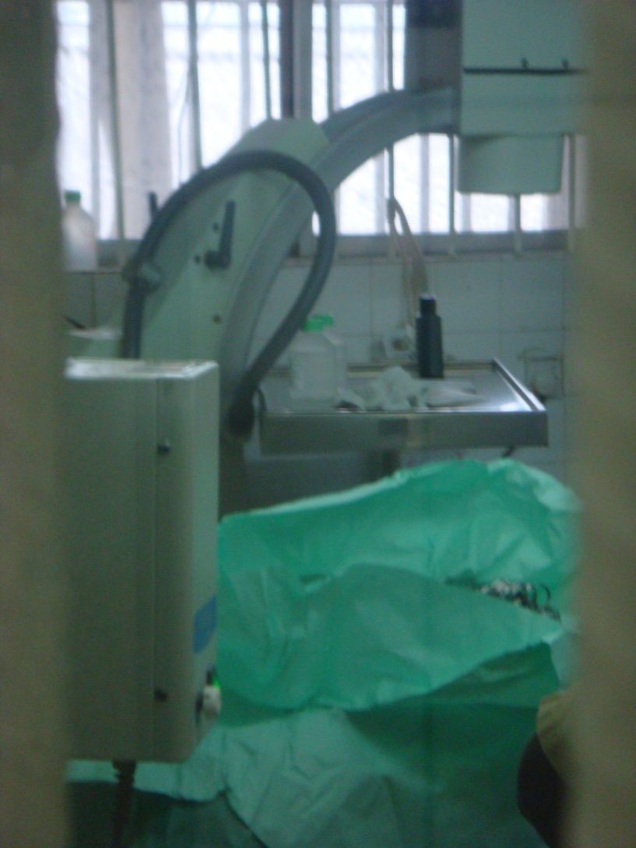
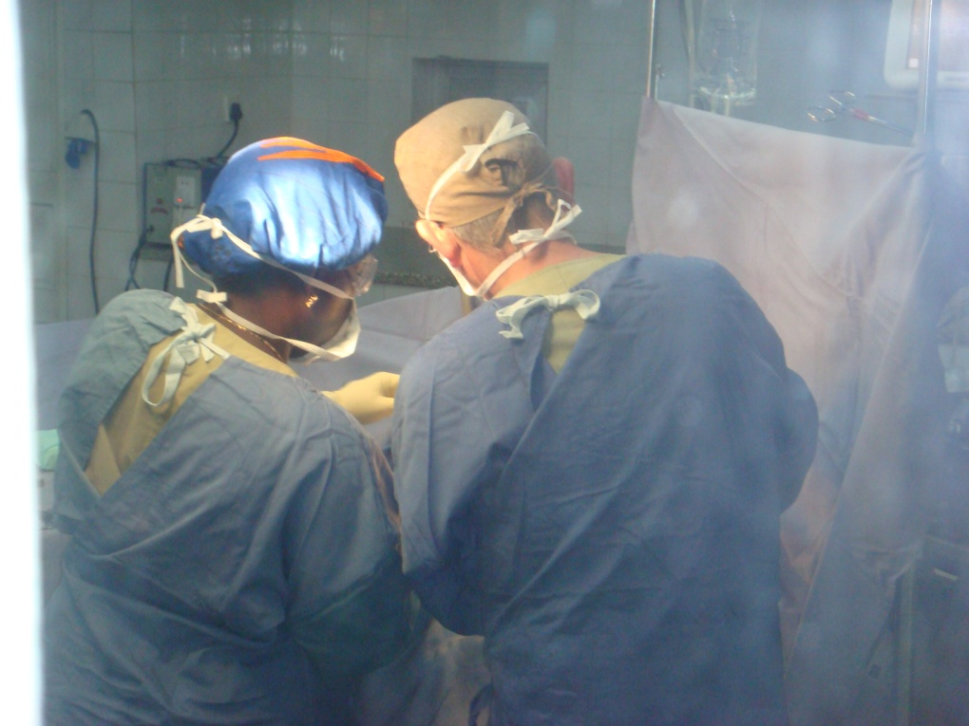
Precedent: against

Slide 18
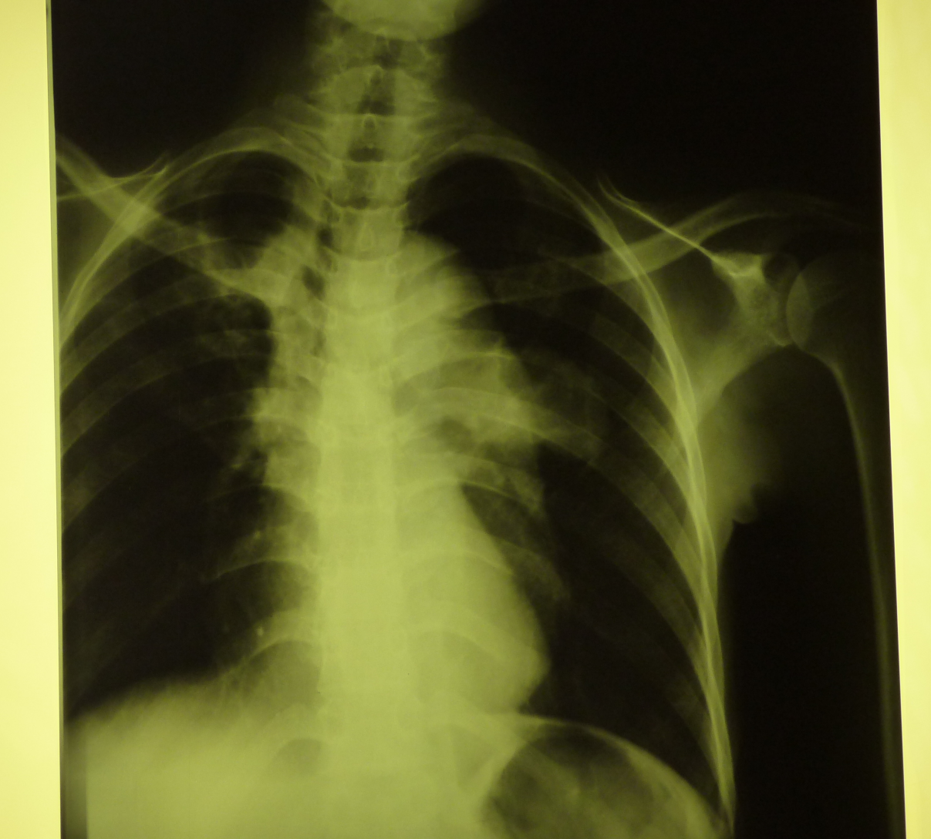
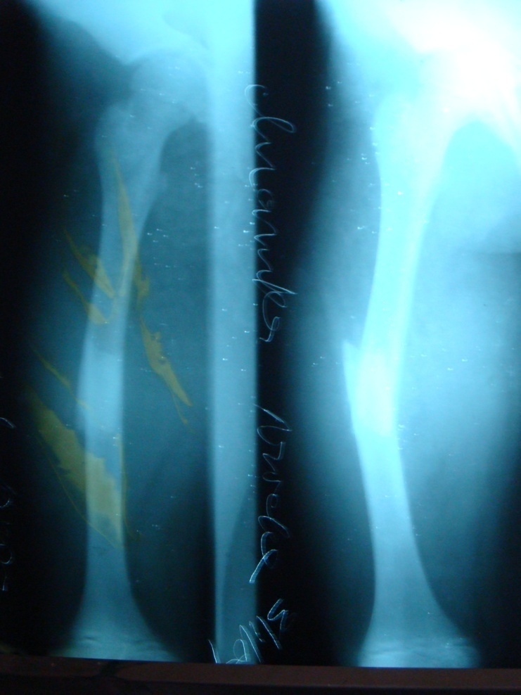
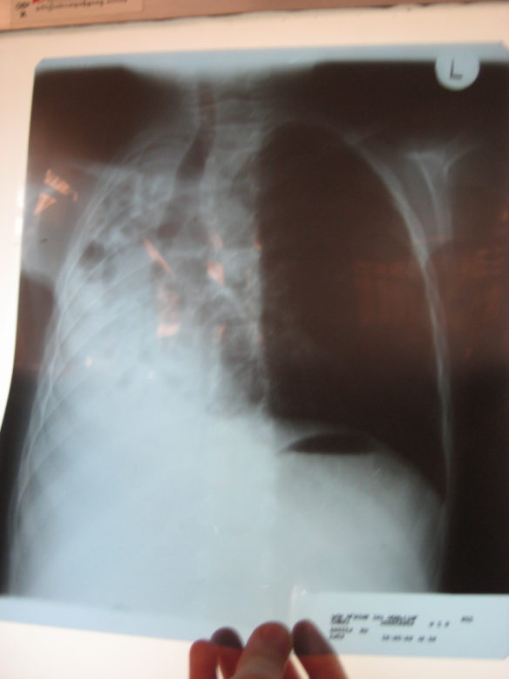
Quality: against

Slide 19
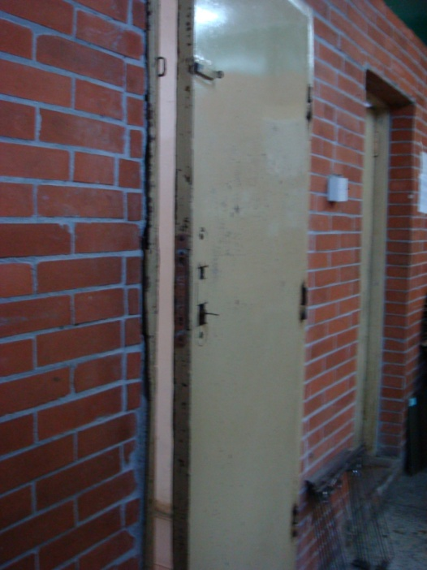
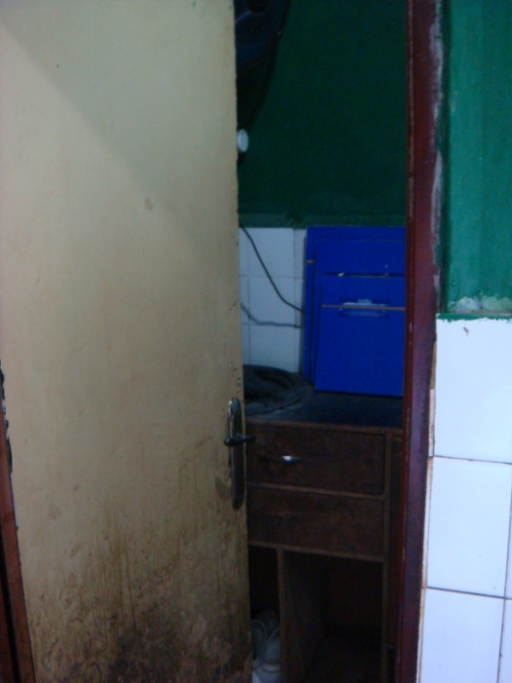
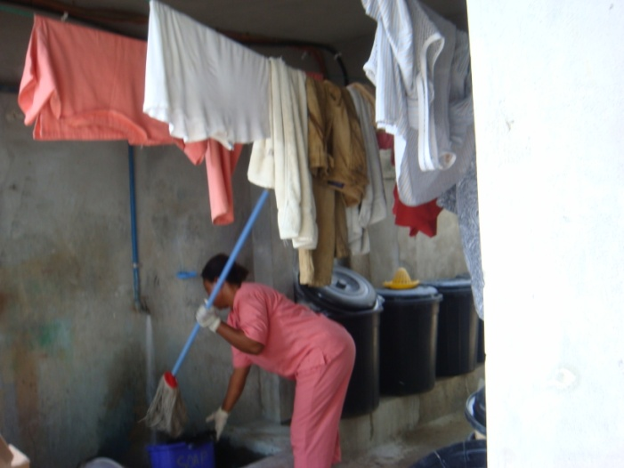
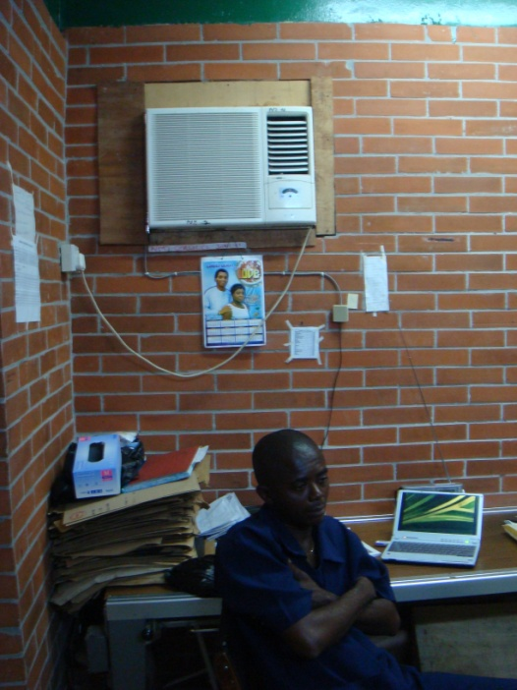
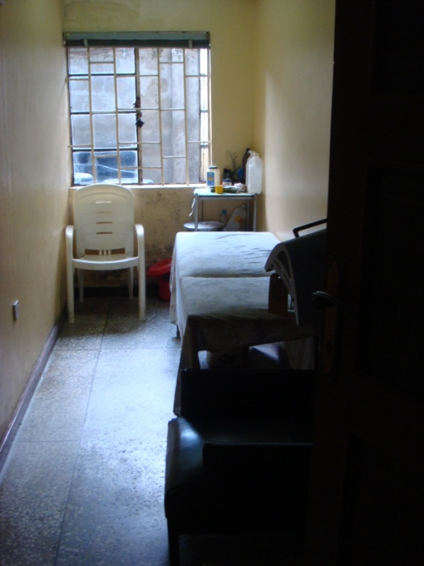
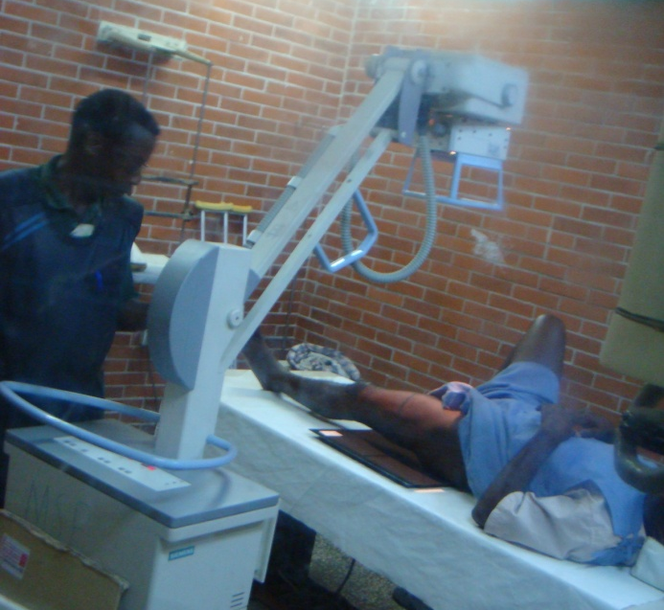
Safety: against

Slide 20
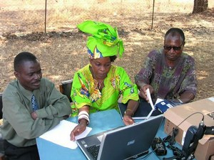
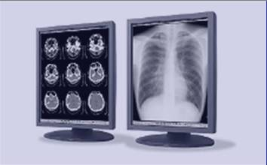
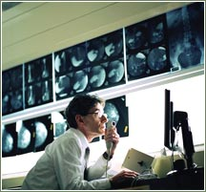
Alternatives: against

