Slide 1
Autism – a practical approach
Dr. Birgit Schlegel
Feb 2010

Slide 2
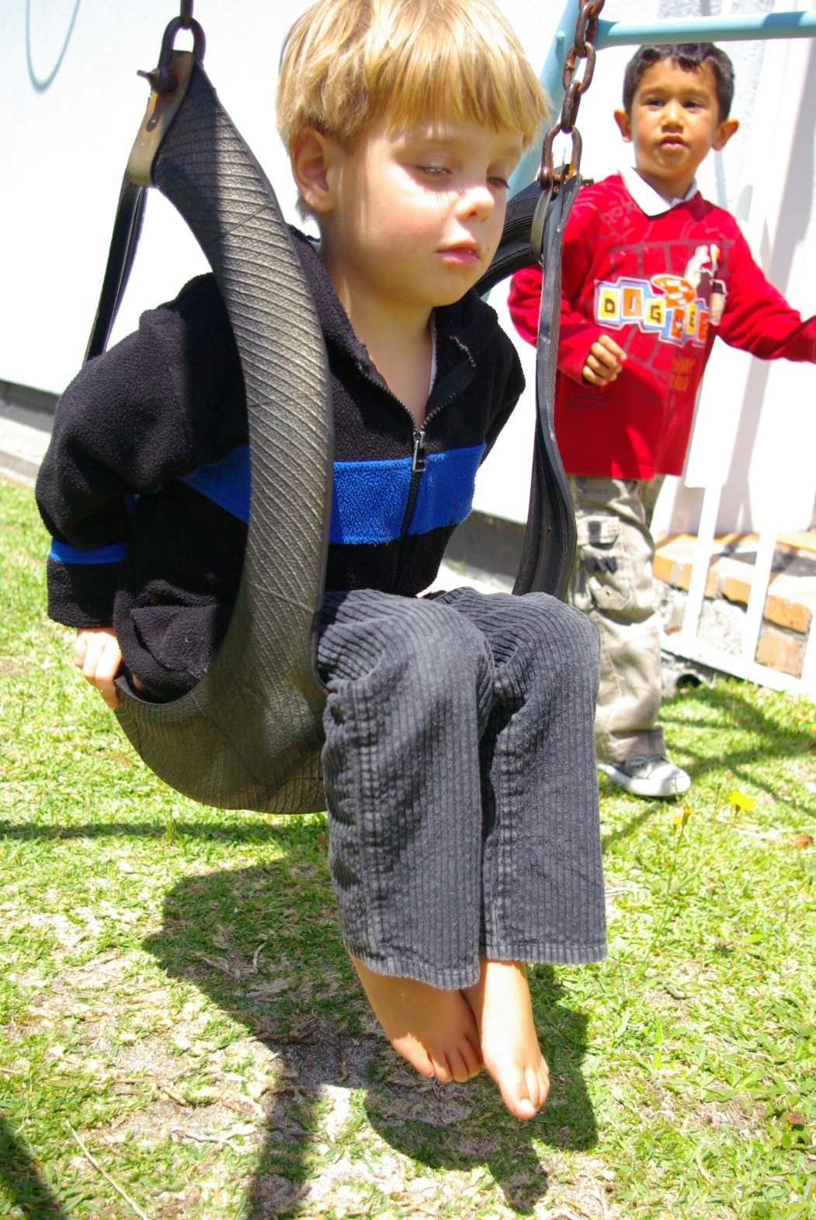

Slide 3
What this talk is all about:
This talk aims at giving an overview of a highly complex disorder and it does not profess to give enough detail and information to make anyone an Autism expert!

Slide 4
MYTHS!
“Autism Epidemic”
Vaccination causes Autism
“Refrigerator Mothers”
Cow’s milk , wheat and gluten

Slide 5
Facts!
Autism is a POLYGENETIC NEUROBIOLOGICAL disorder
Multi organ system involvement
Disorder of the ASSOCIATION cortex

Slide 6
…MORE FACTS!
Disorder of CONNECTIVITY
PREVALENCE : 1 : 150 (USA)
HERITABILITY : concordance rate 70-90% in monozygotic twins
RECURRENCE risk : 2-8% if one affected child higher if >1 child affected

Slide 7
….and more FACTS!
Genetic HETEROGENEITY
Candidate genes -------synapse formation
----------------plasticity
Eg. Neurexin
Neuroligin
Fragile X
Contactin assoc. protein like 2 gene

Slide 8
…and even more FACTS!
Larger volume brains
MIRROR NEURON SYSTEMS - pathways activated both by performance and by observation

Slide 9
Areas of brain involved in Autism
Temporal lobes - language, auditory processing + synthesis
Amygdala (deep within temp. lobes) - switchboard of social interaction
Brainstem - mailbox for sensory stimuli
Cerebellum - coordination of motor movement
Frontal lobes - executive function

Slide 10
THE TRIAD
Deficits in SOCIAL INTERACTION
Deficits in VERBAL and NON VERBAL COMMUNICATION
Deficits in IMAGINATIVE PLAY

Slide 11
1 . POOR SOCIAL INTERACTION
Little awareness of others and their feelings
Poor ability to make social contact
Indifference or dislike of being held or cuddled
Preference for solitary play
Problems in engaging people or in forming relationships

Slide 12
2.POOR LANGUAGE AND COMMUNICATION
Delayed lang. dev. or language regression
Poor facial expression and gestures
Repetition of phrases and words
Jargon, Echolalia
Words used without their normal meaning
Accent, odd intonation
Poor symbolic activity
Difficulties initiating and maintaining conversations

Slide 13
3. POOR PLAY , unusual BEHAVIOUR
Motor Stereotypes (rocking, hand flapping, spinning)
Attachments objects
Hyperactive or withdrawn
Tantrums
Resistance to change, inflexible
Limited interests, obsessions
Poor imitation

Slide 14
THE THEORIES!
‘AUTISM ‘ comes from AUTOS (Self)
THEORY OF MIND (being able to put oneself into some body else’s shoes)
Responses to a strange world ----FLIGHT( fear)
----FIGHT(defense)
----FREEZE(incapable of meaningful activity)

Slide 15
THE SPECTRUM!
Broad Autism Spectrum
Aspergers
PDD. NOS
Classic Autism
Retts Syndrome
Childhood disintegrative disorder

Slide 16
The PRESENTATION!
INFANCY:
decreased vocalisation and cooing
decreased attention to people
increased attention to objects
decreased response to name
decreased communicative intent

Slide 17
INFANCY –DANGER SIGNALS
Poor response to being called
Poor eye contact
No intentional smile
Poor visual referencing
The placid “unneedy” baby
The severely fretful, restless baby with many sensory problems

Slide 18
TODDLERHOOD, PLAY AND PRE SCHOOL CHILD
Lang. Dev. Delay/Regression
Clumsiness/’Stiffness”/fear of heights
Persistent toe walking
Delayed toilet training
Not waving good-bye
Poor eye contact
Does not settle down at play school
No interactive play
Poor imaginative play
Temper tantrums
Good at puzzles

Slide 19
Language problems in older children
Jargon, Echolalia
Reticent to speak
Poor verbal communicative intent
“surprise “words
Repetition of phrases
Verbal stereotypes
Receptive difficulties
Accent
Stilted ‘schoolmasterly’ speech
Difficulties engaging in reciprocal conversation

Slide 20
PLAY and BEHAVIOR
No real play
Repetitive activities
Lining up, matching, sorting, ordering, hoarding
Object scrutiny/peripheral vision
Inappropriate object use
Attachment objects
Dinosaurs, Thomas The Tank Engine
Wheels, ties ,strings, lawnmowers, vacuum cleaners

Slide 21
MORE BEHAVIOUR
Cooperates on own terms only-’My way or no way’
Non functional routines and rituals
Resistance to change
Phobias and fears
Motor stereotypes
Sensory difficulties

Slide 22
The DO’s and DON’Ts

Slide 23
History
Pregnancy:
high fever?
other risk factors? (Alcohol, CMV, Rubella)
Maternal depression
Family History!
Epilepsy
Developmental History
Behaviour History

Slide 24
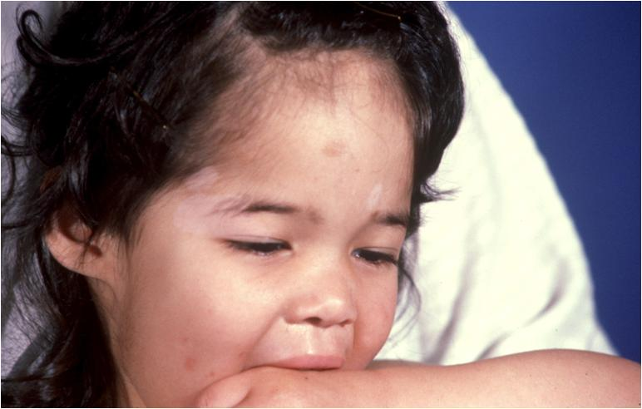
EXAMINATION
Tuberous Sclerosis
NF 1
Fragile X
C22DS
Angelman
specific medical or neurological findings
clumsiness, motor planning problems

Slide 25
Common Associations with ASD
Intellectual Disability
Epilepsy ( if severe –ASD also severe)
Impaired Vision
Impaired Hearing
Speech problems
Motor problems
GIT-GOR ,diarrhoea, constipation
IMMUNE System Problems
SENSORY INTEGRATION issues

Slide 26
MORE DO’s
DEVELOPMENTAL ASSESSMENT
BEHAVIOR QUESTIONNAIRES
M-CHAT
CARS
others!

Slide 27
DO NOT:
Overwhelm parents with the Autism word!
Give false sense of ‘all is well’ and not mention Autism at all! (Parental complacency)
Over investigate (most yield: Genetic tests, EEG)
Promise complete resolution
Paint too bleak a picture—especially after first visit where child may APPEAR handicapped

Slide 28
Basic Management Principles!

Slide 29
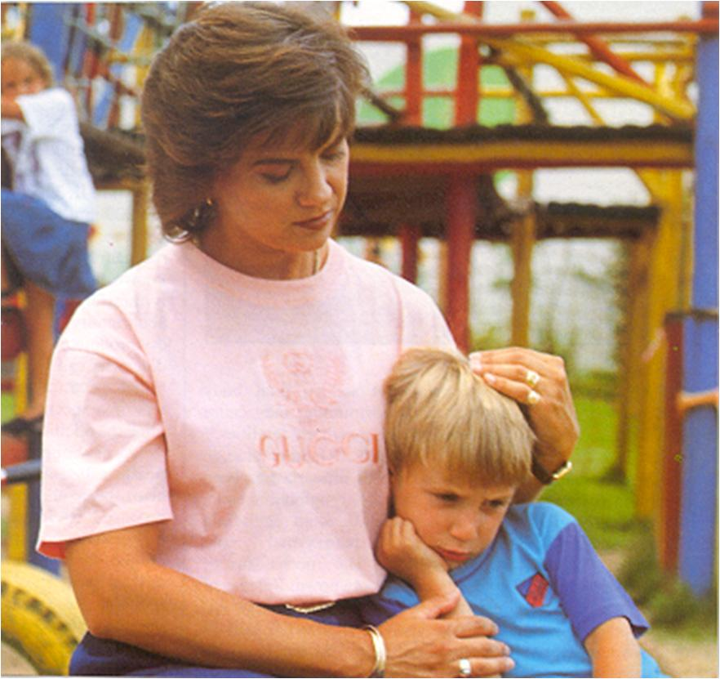
WHO NEEDS HELP?
The Child with Autism
Sibling/s
Parents
Nanny and Granny
The wider family
Teachers, other care givers

Slide 30
PARENTS
Discuss functional approach
Provide Information
Acknowledge that symptoms can change
Refer for support
Guard against exploitation

Slide 31
Child
Empathy
Respect
Structure
Predictability and Routine
Visual aids and Cues

Slide 32
PRINCIPLES OF INTERVENTION
Engage
Develop motivation and Imitation
Focus on functional communicative skills
Expand on special interests and obsessions
Reduce linguistic complexity and overload
Use visual cues and prompts

Slide 33
MULTIDISCIPLINARY APPROACH
DEVELOPMENTAL STIMULATION—OT/PT/ST
BEHAVIOR MODIFICATION---Behaviour EXPERT!
SENSORY PROBLEMS—SI OT
LEARNING PROGRAMMES-ED.PSYCHOLOGIST
Med. MX---Dev. Paed/ Neurologist/Psychiatrist
Dietician
Others-Music Therapist/ART therapy/RDA

Slide 35
Specific Intervention Programmes
IEP—Individ. Ed. Progamme
TEACCH---Treatment and Ed. of Autistic and related communication handicapped children
MAKATON—Augmented communication using symbols with normal grammatical speech
HYGASHI—emphasis on physical strength and coord.
PECS—Picture Exchange Communication System
RDA—Riding for the disabled

Slide 36
RESOURCES / INITIATIVES
Schools—Vera and Alfa
Private ‘Programmes’—SNAP/Trish Brodricks Early Learning Centre
Autism SA---info/accredited Professionals
Psychologists/psychiatrists/paeds. with special interest
Parent Support/Education—Aspergers Support Group/Muizenberg Southern Suburbs parent support initiative/Janine Jerling(Somerset West)
AUTISM DIY---Mrs. Jenny Buckle
Autism Forum for professional Networking
Autism Working Group—Dep. Of Health, Education and Social Services

Slide 37
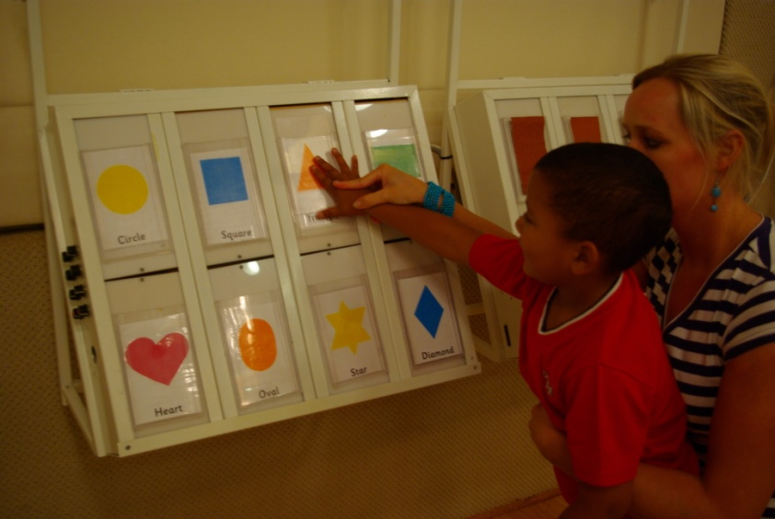
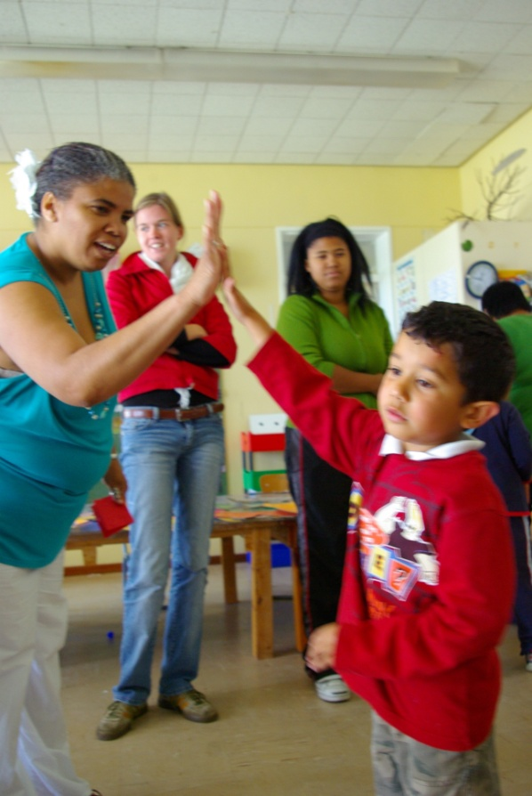
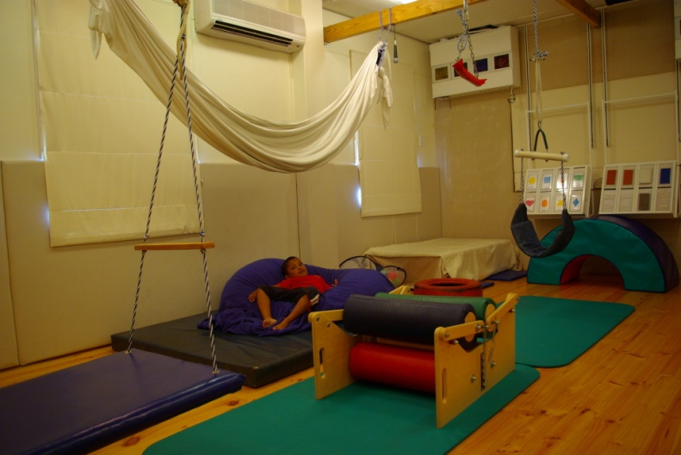
Questions?

