Slide 1
Nutrition for the critically ill child
Andrew C Argent
Red Cross War Memorial Children’s Hospital and
University of Cape Town

Slide 2
introduction
malnutrition is common on admission to PICU
nutrition may deteriorate within the PICU unless specific attention is paid to the issues
there is very little quality data available on the optimal nutrition of critically ill children
there is a need to set and achieve nutritional goals in the PICU
Nutrition must be assessed in context

Slide 3
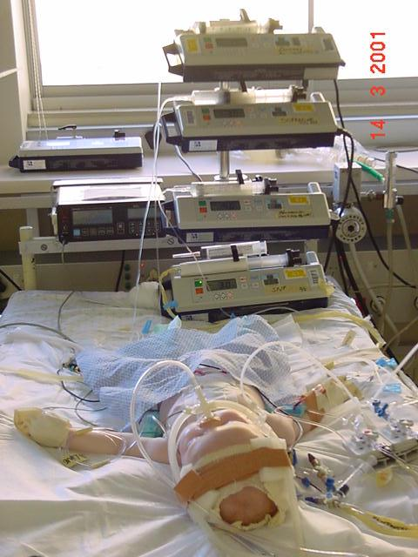
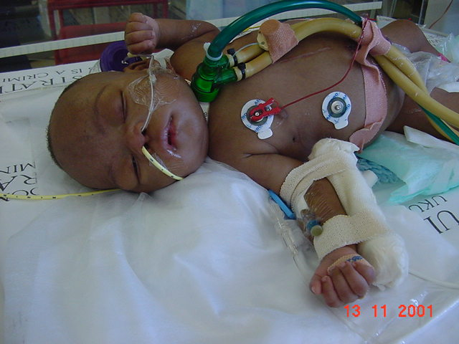
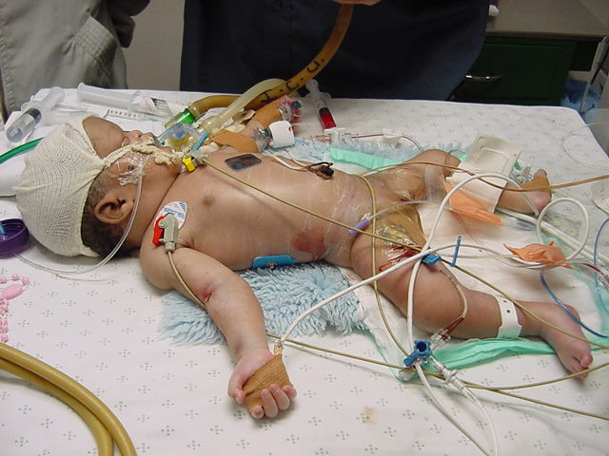
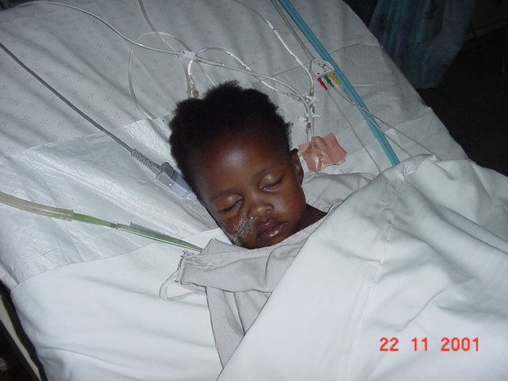
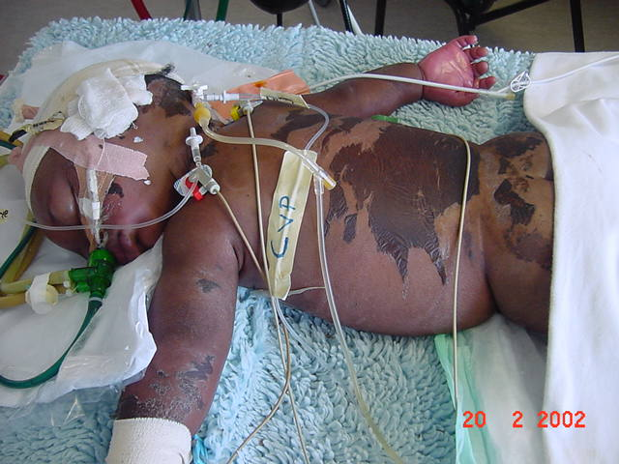
who is the critically ill patient?
post cardiac surgery
chronic ventilation
pre-term infant
abdominal injury
kwashiorkior
others…..

Slide 4
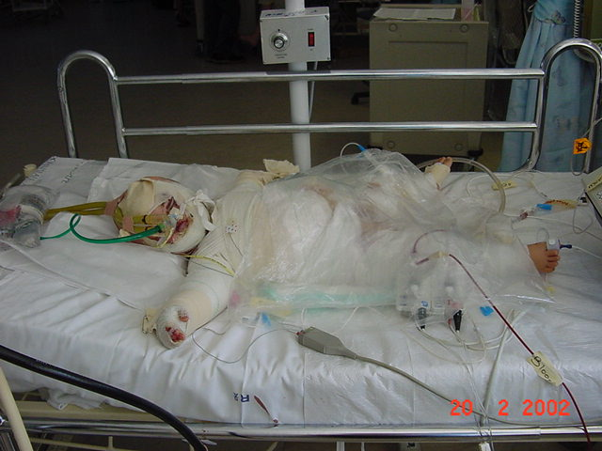

Slide 5
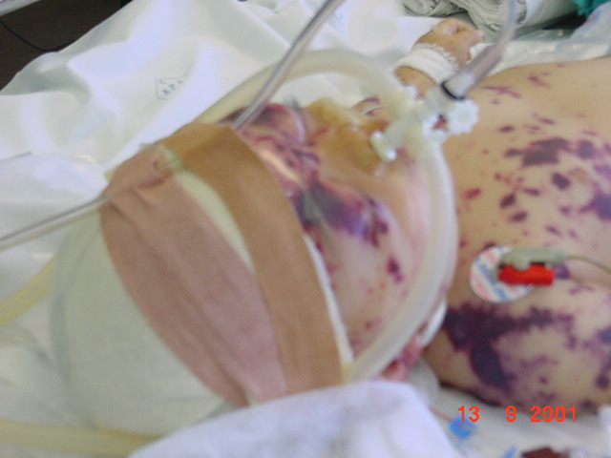

Slide 6
nutrition – why worry? problems are common
acute PEM in 19%, chronic PEM in 18% of PICU admissions
Pollack et al JPEN 1982
16.7% of PICU admissions depleted of protein and 31% of fat stores
survivors had higher prealbumin levels
Briassoulis et al Nutrition 2001
12 of 43 patients had normal nutritional status
Vazquez Martinez et al PCCM 2004
53% of admissions had moderate or severe malnutrition(adolescents and children)
Delgado et al, Clinics, 2008
malnutrition is common in critically ill children
Notes:
Pollack showed that acute PEM was present in 19% and chronic PEM in 18% of PICU admissions.
Briassoulis showed that 16.7% of ICU admissions in Athens were already depleted of protein and 31% of fat stores. 16.9% were at risk of chronic PEM and 21.1% for acute PEM whereas 4.2% and 5.6% already had chronic or acute PEM.
Survivors had higher prealbumin levels than non-survivors.

Slide 7
nutrition – why worry? problems may get worse
group of infants and children studied from admission to 6 months after discharge
24% malnourished on admission, and a decline in nutritional status occurred during the admission
majority showed good long term outcome
Hulst J et al Clin Nutr 2004
Notes:
a group of children studied from from admission to 6 months after discharge. Clin Nutr 2004; 23:223–232.
In this follow-up study, the course of anthropometric parameters over time is shown, from admission to the ICU to 6 months after discharge, in a large group of preterm neonates, term neonates and older children. Of all the children, 24% appeared to be undernourished at admission, whereas a decline in nutritional status occurred during admission. The majority of children showed a good longterm outcome.

Slide 8
what limits how much you get in?
42 children in tertiary PICU
received mean of 37.7% of EER (cardiac patients had lower intake)
barriers
fluid restriction (66.7%)
GIT intolerance (57.1%)
procedures (61.0%)
surgical (42.9%)
extubation (33.3%)
Rogers et al, Nutrition, 2003
55 critically ill children
aged 8.2 +/- 11.4 months
delivered vs required energy <90% in 55.7% days.
low prescription main reason for not achieving energy goal in the first 5 days
de Olivera Iglesias et al, Clin Prac Nutr, 2007
what to do when feeds interrupted?
increase feed rate to compensate?
gradually increase from baseline?
? benefits of transpyloric feeds

Slide 9
how to measure nutritional status?
anthropometry technically difficult
frequently not done
most biochemical markers associated with acute phase reaction
trends may be useful
indirect calorimetry
technically challenging
time consuming
monitoring of intake

Slide 10
principles
treat the underlying illness aggressively
infection in the malnourished child
manage the Airway, Breathing, Circulation, (Don’t Ever Forget the Glucose)
manage fluid and electrolytes
FEED (enterally if at all possible)

Slide 11
get the basics right all the time
appropriate water intake
enough food
calories to meet REE
enough protein to prevent proteolysis
enough trace elements and vitamins
enteral food to prevent gut complications
“use the gut or lose it”
avoid constipation!!!!!!
treat the underlying problem

Slide 12
calories – how much is used?
resting energy expenditure
37- 62 kcal /kg/day
Vazquez Martinez et al, Pediatr Crit Care Med, 2004
Taylor RM et al, Pediatr Crit Care Med. 2003
Coss-Bu JA et al, Am J Clin Nutr. 2001
Coss-Bu JA et al, Nutrition. 1998
lower in multiple organ system failure (1019 + 166 kcal/m2 vs. 862 + 241; p = .025).
Briassoulis G et al, Crit Care Med. 2000
predictions are unreliable
Notes:
Taylor – included a large group of patients with liver injury and after liver transplant

Slide 13
calories how much is used? on ventilation
critically ill children on ventilators have a REE of approximately 45kcal/kg/day
White SM et al Crit Care Med 2000
spontaneously breathing are likely to have a higher energy expenditure.
Vernon DD, Witte MK. Crit Care Med 2000
neuromuscular blockade will decrease the energy requirements
temperature
Eccles MP, Whitehead RG. 1989 Eur J Clin Nutr
McIntyre J, Hull D. 1996. Arch Dis Child

Slide 14
calories – how much is used? stage of illness
energy consumption of critically ill children in the ICU range from:
42 kcal/kg/day on day 1
44 kJ/kg/day on day 2
Steinhorn DM, Green TP, Crit Care Med, 1991
50 kJ/kg/day on day 5
Verhoeven JJ et al, Intensive Care Med, 1998
69 kJ/kg/day on day 12
Coss-Bu JA et al, Am J Clin Nutr, 1998
Notes:
The problem is that these children are all different. The child who is still in the PICU on day 12 is completely different to the one who was in the ICU and has long since been discharged by day 12

Slide 15
how much is needed?
resting energy expenditure
measured energy expenditure (MEE) + 10%
Chwals, New Horiz, 1994
MEE + 20 to 50% (? higher in infants)
de Klerk et al, Intensive Care Med, 2001
Goran et al, Am J Physiol, 1990
Briassoulis et al, J Nutr Biochem, 2002
metabolic response to injury much shorter in children
Bouwmeester et al, Br J Anaesth, 2001

Slide 16
proteins
albumin
serum albumin associated with severity of illness
no evidence that albumin supplementation improves outcome
in burns
in sepsis
all available evidence that albumin supplementation increases mortality (exception is cirrhotic with septic peritonitis)
Sort Pet al, N Engl J Med. 1999.
Notes:
Effect of intravenous albumin on renal impairment and mortality in patients with cirrhosis and spontaneous bacterial peritonitis.

Slide 17
trace elements
potassium
Maitland et al, PCCM, 2004
Singhi, Marudkar, Indian Pediatr, 1996
phosphate
refeeding syndromes
magnesium
Singhi et al, J Trop Pediatr, 2003
calcium
Singhi et al, J Trop Pediatr, 2003
avoid iron in the early stages of refeeding

Slide 18
zinc
low levels of zinc in patients with severe pneumonia
Shakur MS, et al. Indian Pediatr. 2004
Kumar S, et al. Indian Pediatr. 2004
Zinc for :
severe pneumonia in very young children double-blind placebo-controlled trial.
Brooks WA, Lancet. 2004
Bhandari N, et al, BMJ. 2002
in children with measles accompanied by pneumonia: a double-blind, randomized controlled trial.
Mahalanabis D, et al, Am J Clin Nutr. 2002
prevention of diarrhea and pneumonia
Bhutta ZA et al, J Pediatr. 1999
Notes:
Zinc status in well nourished Bangladeshi children suffering from acute lower respiratory infection.
Blood zinc levels in children hospitalized with severe pneumonia: a case control study.

Slide 19
vitamins
vitamin A paradox
if evidence of malnutrition or HIV infection then vitamin A supplementation of children with acute pneumonia may improve health of the children over the next 6 months
Fawzi WW et al, J Pediatr 2000.
clear evidence of some adverse effects of vitamin A if given to children with pneumonia but no clinical evidence of vitamin A deficiency or malnutrition
Stephensen CB et al. Pediatrics 1998

Slide 20
thiamine deficiency
18% (1/12 with VSD and 3/10 with TOF) of children with congenital heart disease had thiamine deficiency before surgery.
3 of the 4 children with TD had adequate intake of thiamine.
6 (27%) had TD 5 days postsurgery (3 children with VSD and 3 children with TOF).
Shamir R, JPEN J Parenter Enteral Nutr. 2000
Notes:
Shamir R, JPEN J Parenter Enteral Nutr. 2000 May-Jun;24(3):154-8.

Slide 21
fibre
constipation!!!!!
King W et al, JPEN J Parenter Enteral Nutr. 2004
major issue in patients with weakness
cellulose fibre may ameliorate barrier failure in the small intestine (animal data)
Mosenthal et al, CCM 2002
diarrhoea
Notes:
Constipation was reported in 36% of patients but cited only 4 times as a reason for feeding interruption.

Slide 22
how should one give food?
KISS
gastric
transpyloric
TPN
combination
small frequent or continuous feeds
start as soon as possible
don’t delay placement of tube and initiation
need a specific team with daily review process

Slide 23
when can you start enteral nutrition?
clinical scores don’t predict tolerance
higher PRISM and PELOD scores correlated with a
later time of starting enteral nutrition
longer time to reach maximum daily energy delivery and
longer duration of the TEN.
abdominal distension or excessive gastric residues seen in 4·7% and diarrhoea in 4·3%
ability of the severity scores to predict diarrhoea was of 0·67 for PRISM, 0·63 for PELOD and 0·60 for PIM-2
Sanchez et al, Nutrition, 2007
Notes:
209 critically ill children aged between 3 d and 17 years and who received TEN
Higher scores of clinical severity at the time of starting enteral nutrition correlate with a later initiation of the nutrition, a longer time to reach the maximum energy delivery and a longer duration of TEN. However, their ability to predict digestive tract complications is low

Slide 24
when can you start enteral nutrition?
65 critically ill children with shock, aged 21 days to 22 years on jejunal feeds 75.4% of patients with shock received PEN exclusively.
20 (30.7%) presented gastrointestinal complications,
10 (15.4%) abdominal distension and/or excessive gastric residue,
13 (20%) diarrhoea
1 NEC and 1 duodenal perforation
frequency of GIT complications significantly higher than in the other 461 critically ill children (9.1%).
PEN was suspended due to GIT complications in 6 (9.2%) patients with shock
18 (27.7%) deaths among the patients with shock and PEN, (death related to complications of the nutrition in 1).
Lopez Herce et al , Nutrition Journal, 2008

Slide 25
transpyloric feeding
in postoperative cardiac surgical patients
Sanchez et al, J Pediatr Surg, 2006
in PICU patients – review of 240
increased incidence of NEC in cyanotic (2.1%)
Babbitt et al, JPGN, 2007
in renal failure
López- Herce, Intensive Care Med, 2006

Slide 26
how to give enteral feeds?
off ventilation
ongoing considerations of airway security
need very careful monitoring
on ventilation
bolus gastric
continuous gastric
continuous jejunal

Slide 27
what about prokinetics?
up to 50% of patients intolerant to enteral feeding
gastric emptying is delayed
often not easy to pass post-pyloric tube
consider opiate effects
oral naloxone
Tofil et al PCCM 2006
consider prokinetic agents
Landzinski et al J Parent Enter Nutr 2008
Notes:
One major problem associated with enteral feeding in critically ill patients is that gastrointestinal motility is frequently impaired and up to 50% of patients are intolerant to enteral feeding (5). If gastric emptying is delayed, nutritional supply will be decreased, and there are increased risks of vomiting, gastroesophageal reflux, nosocomial often not easy to pass a feeding tube beyond the gastric pylorus. In addition, postpyloric feeding does not appear to reduce the incidence of pulmonary aspiration (7). Therefore, the effective use of prokinetic drugs to reduce residual gastric volume would be crucial.

Slide 28
making it happen
use of a feeding protocol
prospective
goal nutrition within mean of 18.5 hours
retrospective
goal feedings within mean of 57.8 hours
Petrillo-Albarano, PCCM 2006
having a “nutrition team”

Slide 29
conclusions
identify malnutrition early on
resuscitate and treat the underlying condition(s)
use the gut if at all possible
set goals for the individual patient
constantly review nutritional requirements and intake
we are not going to have easy answers

Slide 30
6th World Congress
on Pediatric Critical Care
13-17 March 2011
Check the website www.pcc2011.com regularly for Congress updates!
We look forward to welcoming you to a memorable event in Sydney in 2011!

