Slide 1
Vomiting

Slide 2
HPS
2-8 weeks of age
Nonbilious vomiting
Projectile
Occasional Haematemesis
DD
Gatroenteritis
Reflux
ICP
Metabolic disorders
Antral Webs
Pyloric atresia
Duodenal atresia

Slide 3
Diagnosis
Pre-op preparation
Clinical examination “olive”
AXR
Biochemistry
US
Contrast
Dehydration
Malnutrition
Hyponatremia
Hypochloremia
Hypokalemia
NPO- NG tube if vomiting
½ NS with 5%Dextrose
1.5-2 X Maintenance volume
Vitamin K

Slide 4
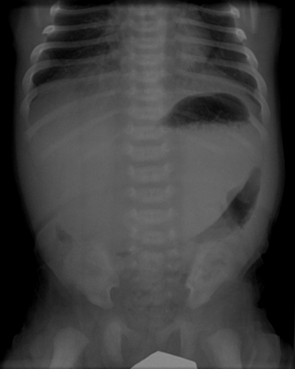
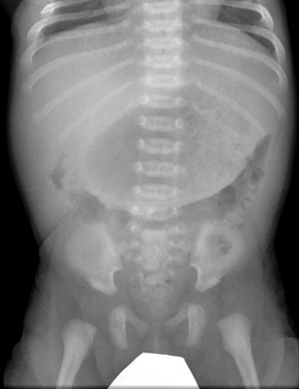
6 week baby, vomiting milk

Slide 5
Hypertrophic Pyloric Stenosis
Massive stomach below 2nd lumbar vertebra
Frothy gastric contents
Minimal other bowel gas

Slide 6
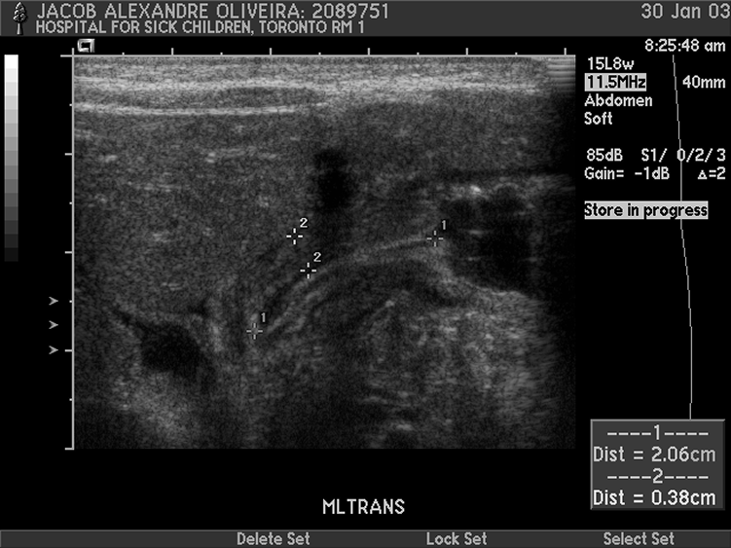

Slide 7
Hypertrophic Pyloric Stenosis
Gastric outlet
Thickened Pyloric Muscle

Slide 8
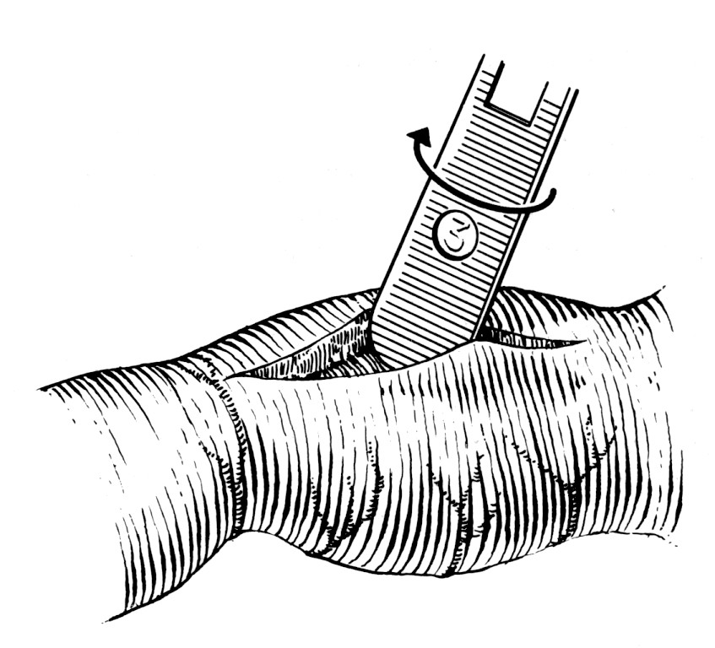
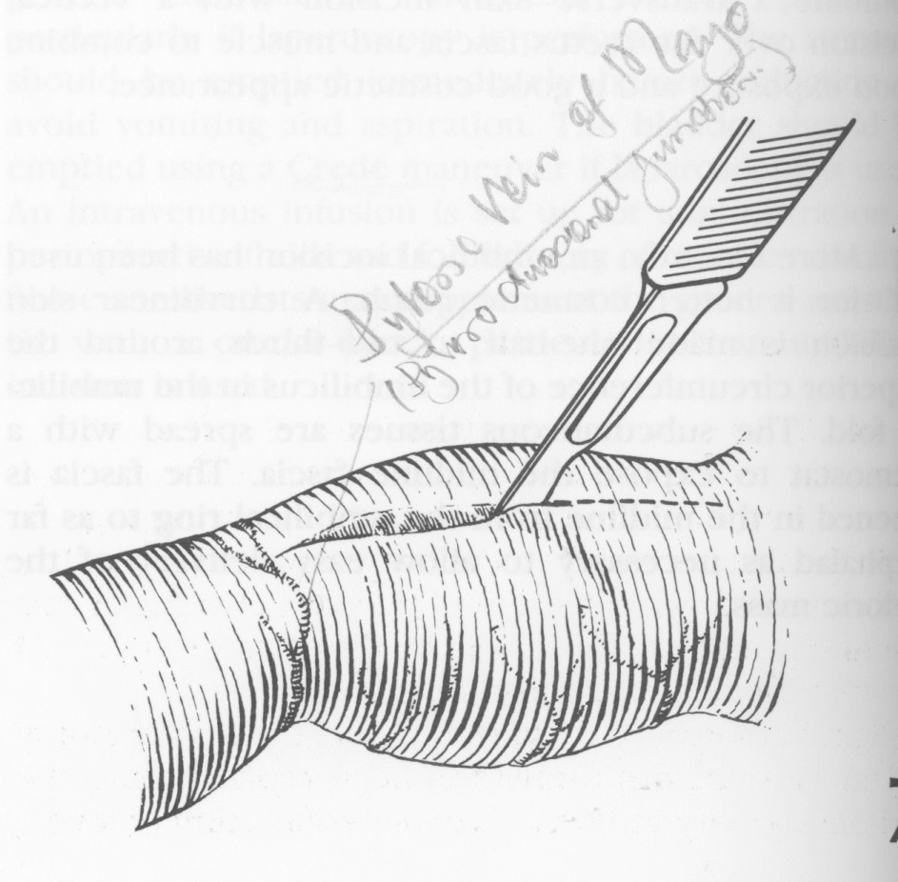
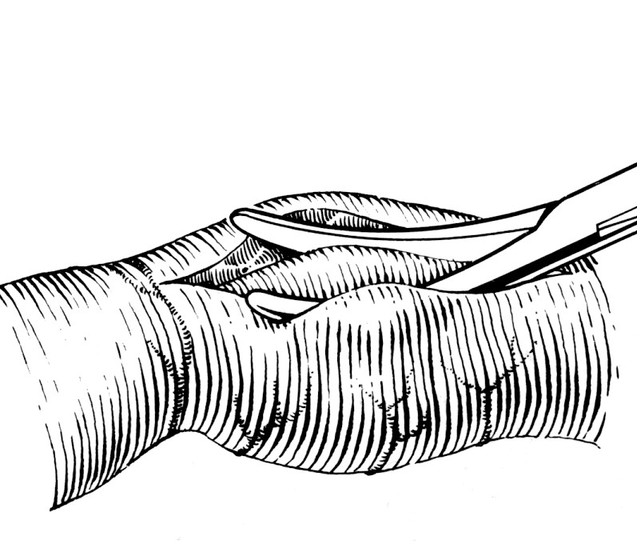
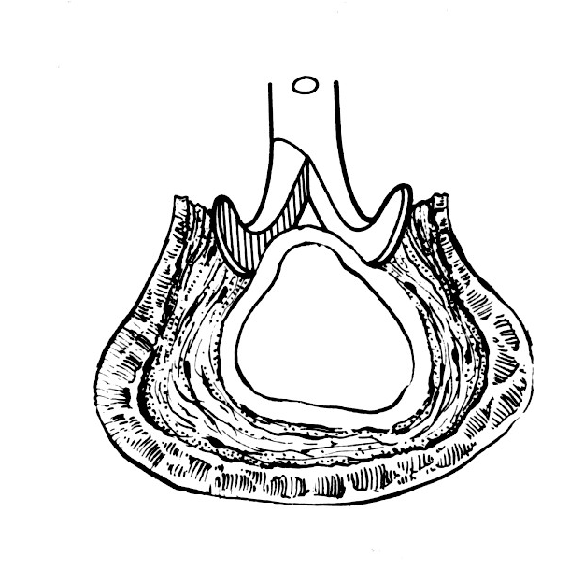
HPS Surgery
Pyloromyotomy Incision
Ramstedt

Slide 10
Malrotation Normal Rotation

Slide 11
Malrotation
Non-rotation
Atypical malrotation
Incomplete rotation
Mixed rotation
Reverse rotation
Associations
CDH
Gastroschisis
Omphalocoele
Associated abnormalities
Duodenal atresia
Hirschsprung’s Disease
ARM’s
Mesenteric cysts

Slide 12
Clinical presentation
Acute Midgut Volvulus
Clockwise twisting
Most under 1 month
Bilious vomiting
Colicky abdominal pain
PR bleeding
Hypovolemia
Shock
Tenderness & peritonitis
Acidosis
Chronic Midgut Volvulus
Older age (2>)
Chronic vomiting
Intermittent pain
Diarrhoea
Hematemesis
Chyle ascitis
Asymtomatic (Appendicitis)
Corrective surgery is indicated at any age

Slide 13
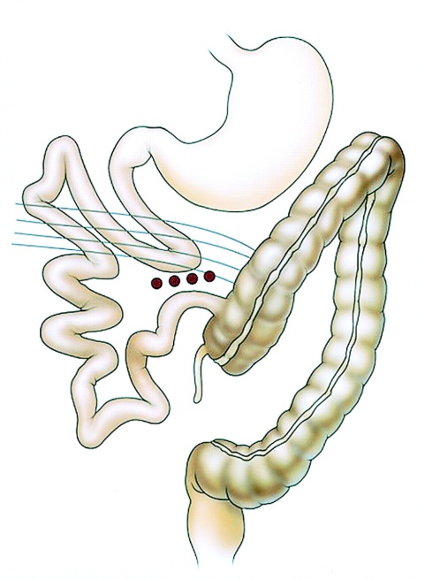
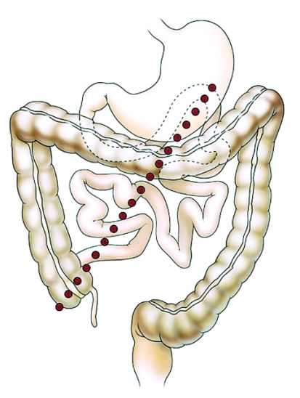

Slide 14
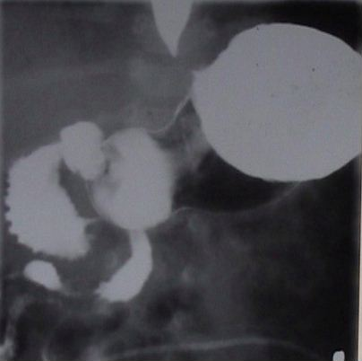
Radiology
AXR
Contrast meal
Contrast Enema
Ultrasound

Slide 17
Treatment
Severe dehydration requires aggressive resuscitation
Electrolytes need to be corrected (Hyponatremia)
N/G tube placement
Antibiotics
Surgery after initial rapid resuscitation

Slide 18
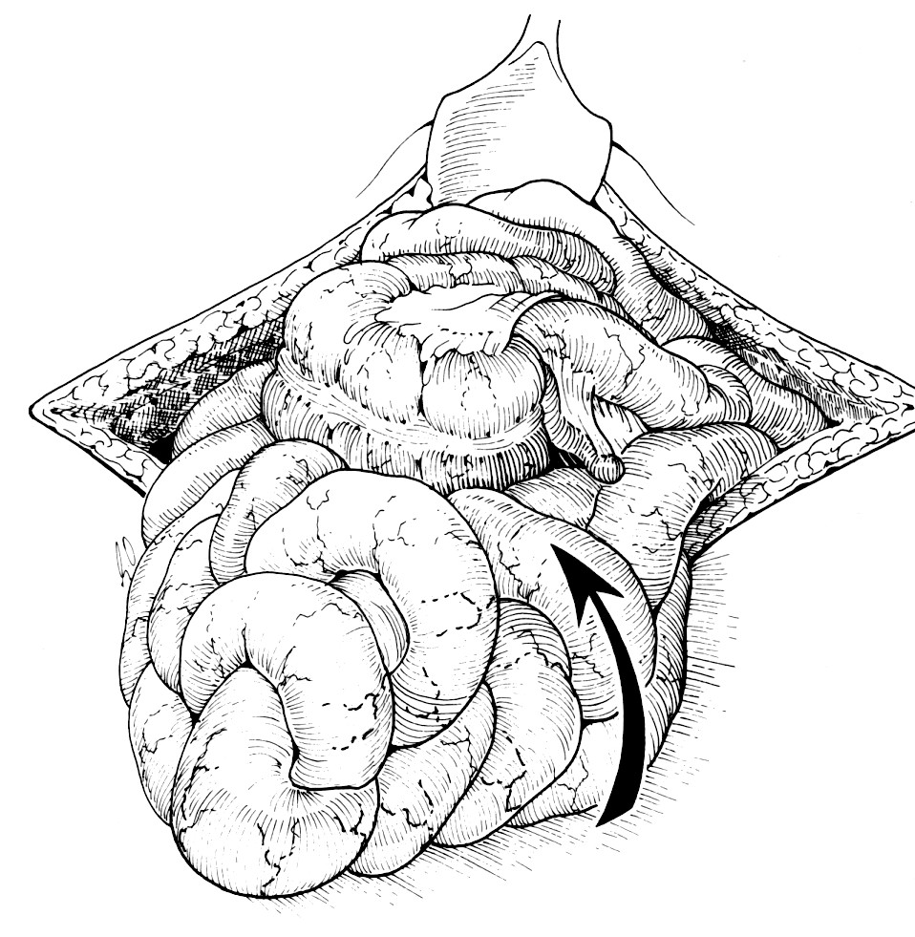
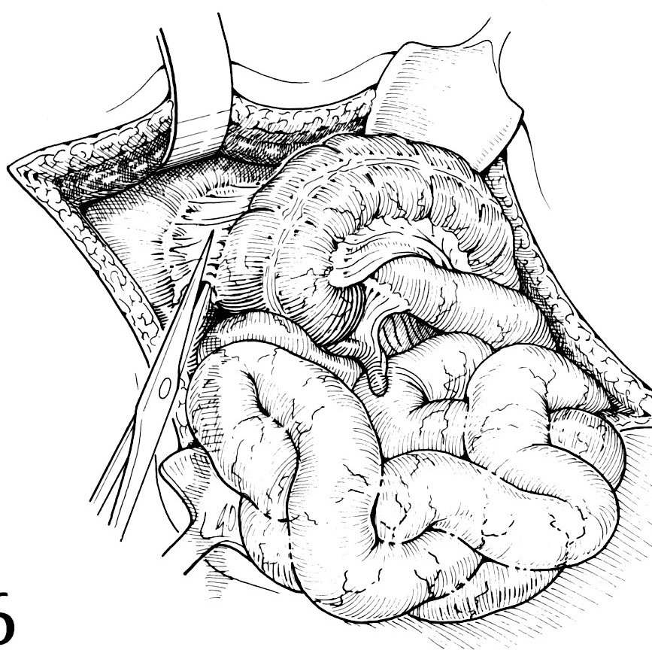
Surgery

Slide 19
Intussusception
75% < 2 years
50% 3-9 months
Red Currant Jelly Stool
Colicky pain
95% idiopathic, 5% lead point, 1% Post-op
Palpable mass
Up to 10% recurrent

Slide 20
Investigations
US
Air enema

Slide 21
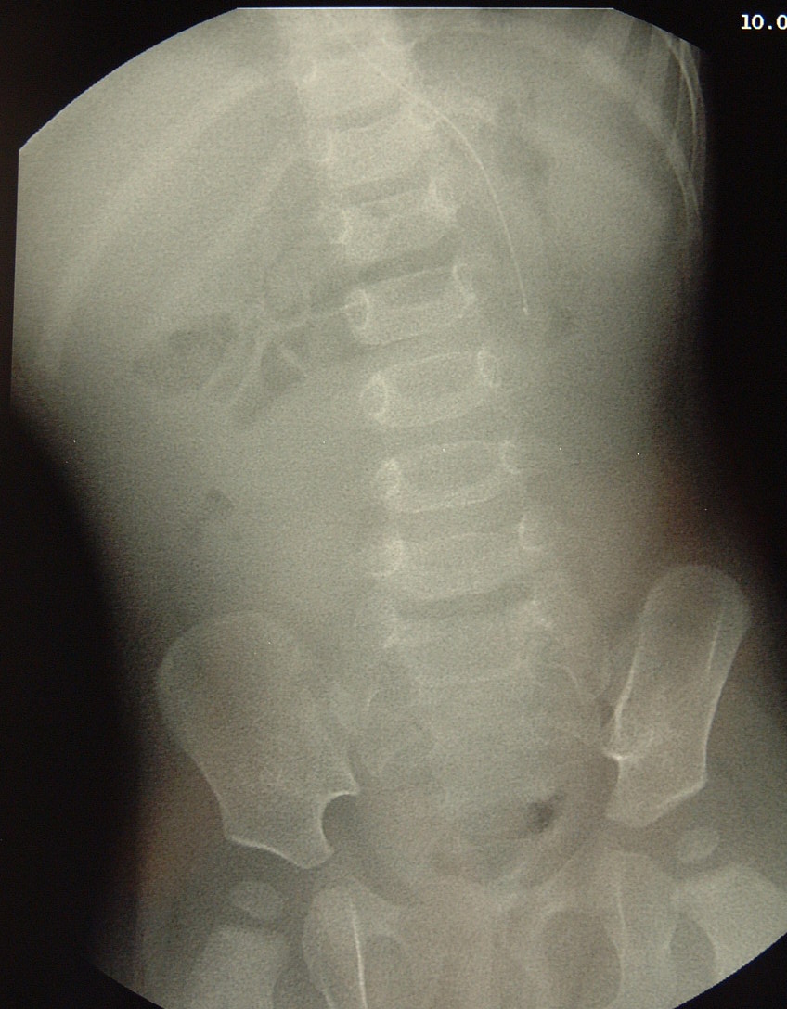
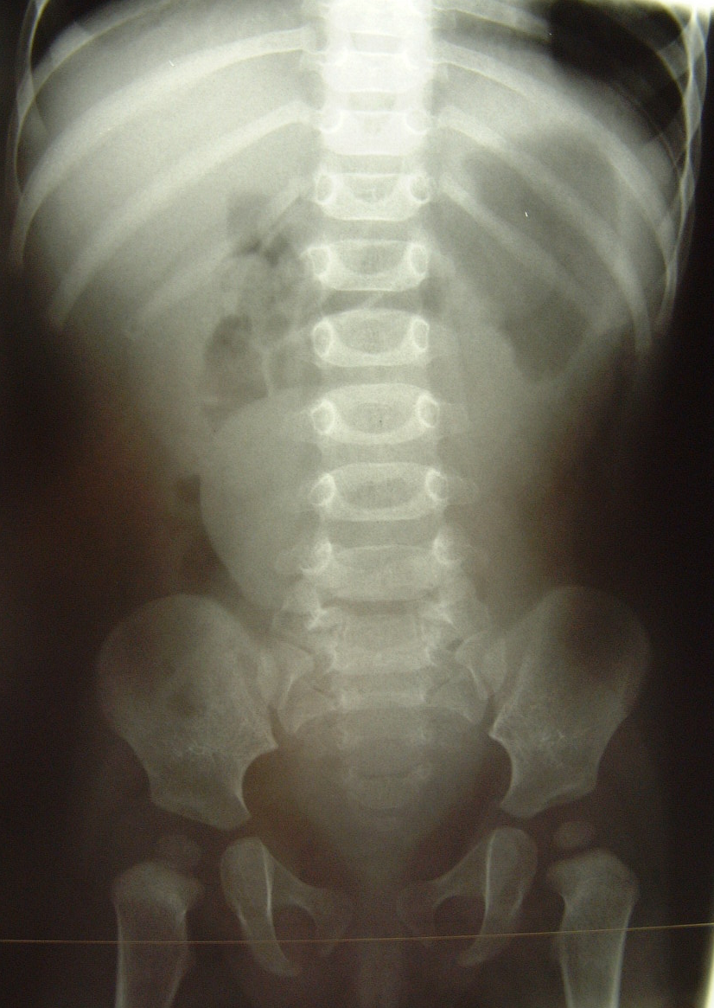
6 month old cramping abdominal pain bloody diarrhoea

Slide 22
Intussusception
Soft tissue mass
Minimal distal air

Slide 23
Intussusception
Typical Ultrasound findings

Slide 24
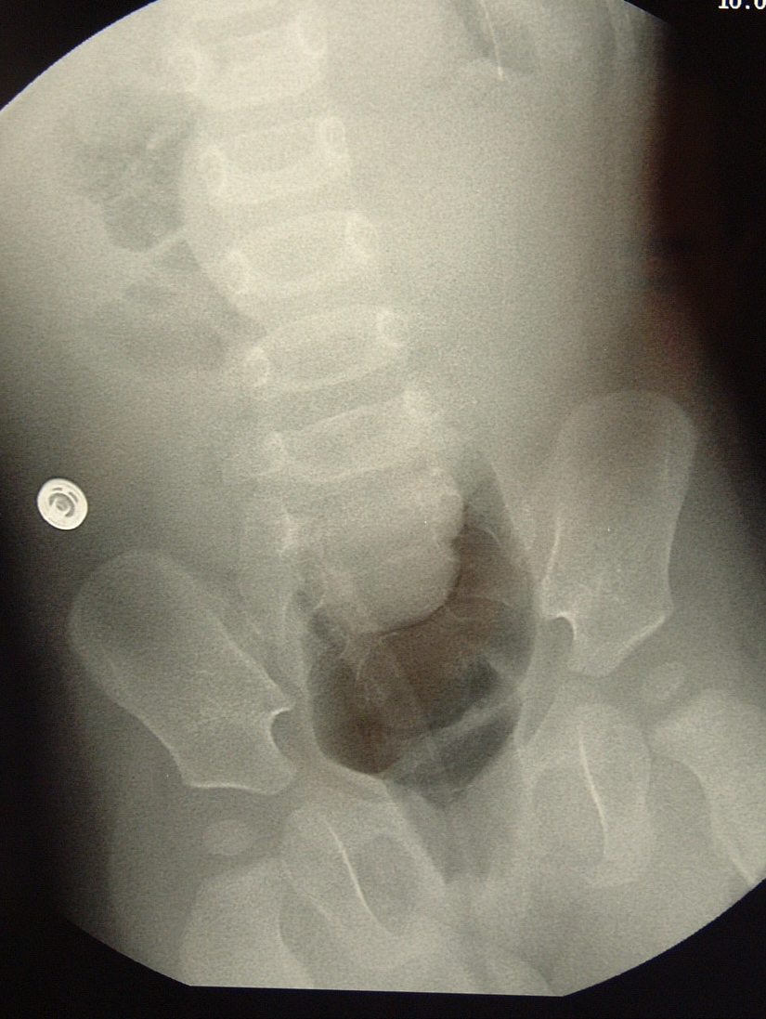
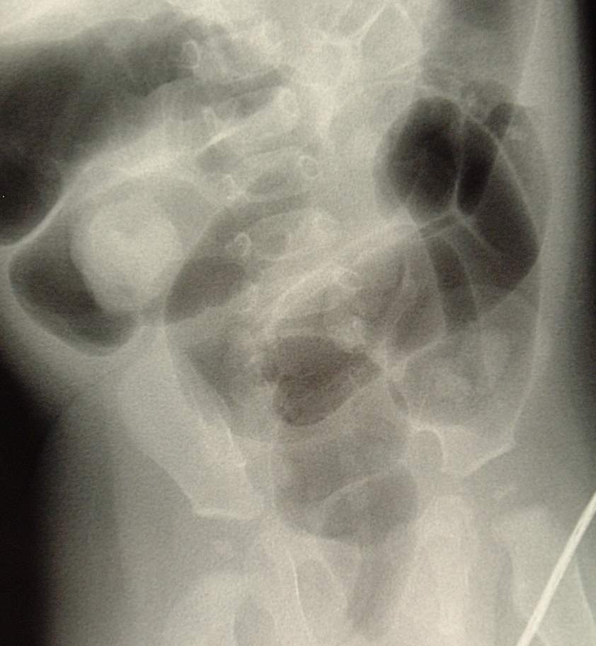
Intussusception - Air reduction

Slide 25
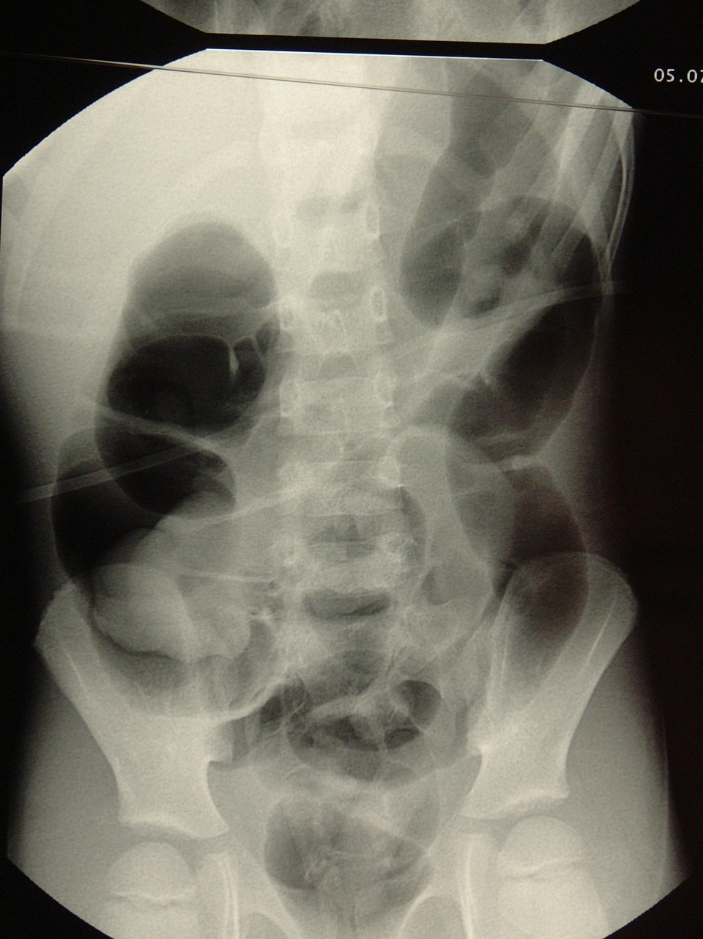
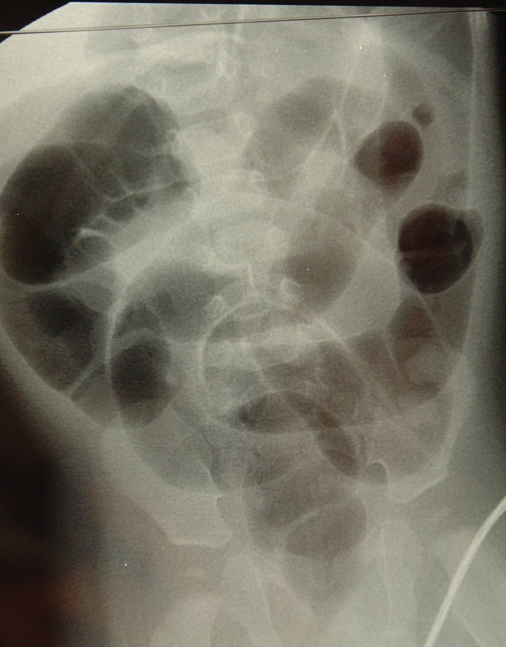
Intussusception - Air reduction

Slide 26
Air enema
Fully resuscitated, under AB cover
Sedation
3 times 3 minutes low pressure 50-120mmHg
Perforation (Jelco)
Delayed air enema

Slide 27
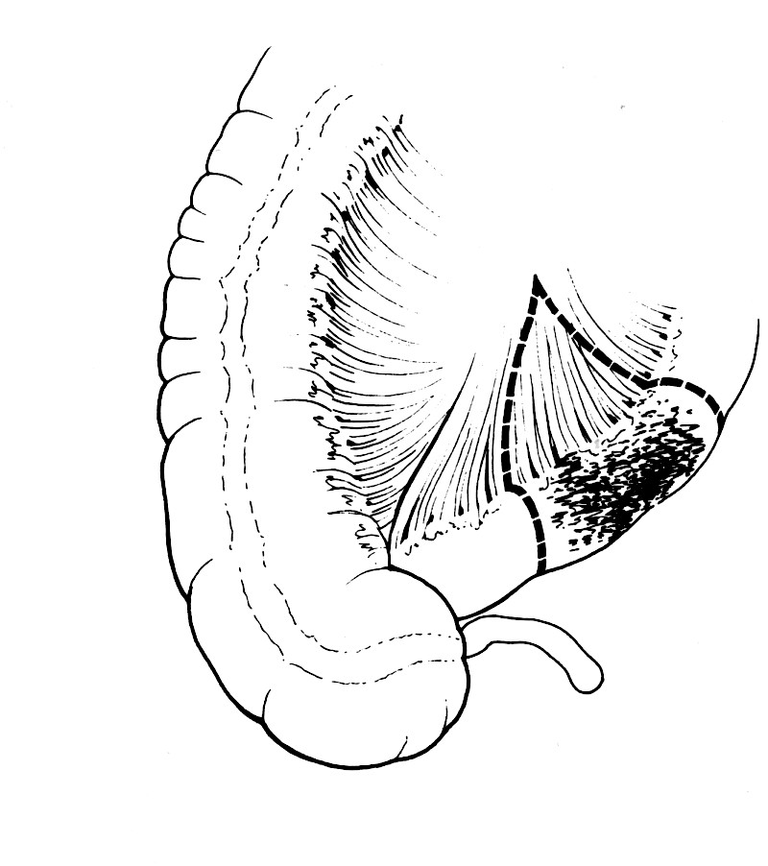
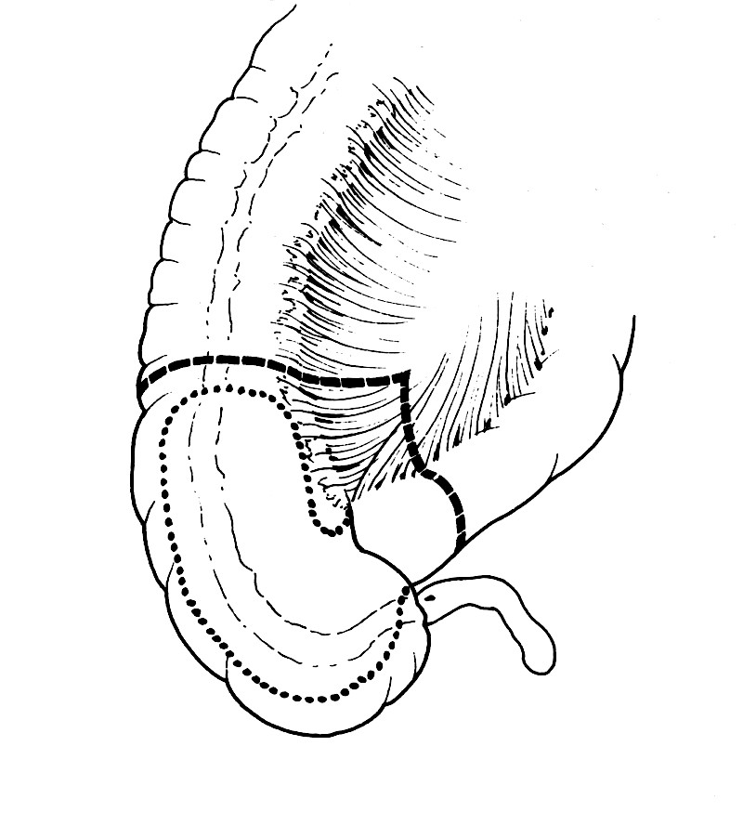
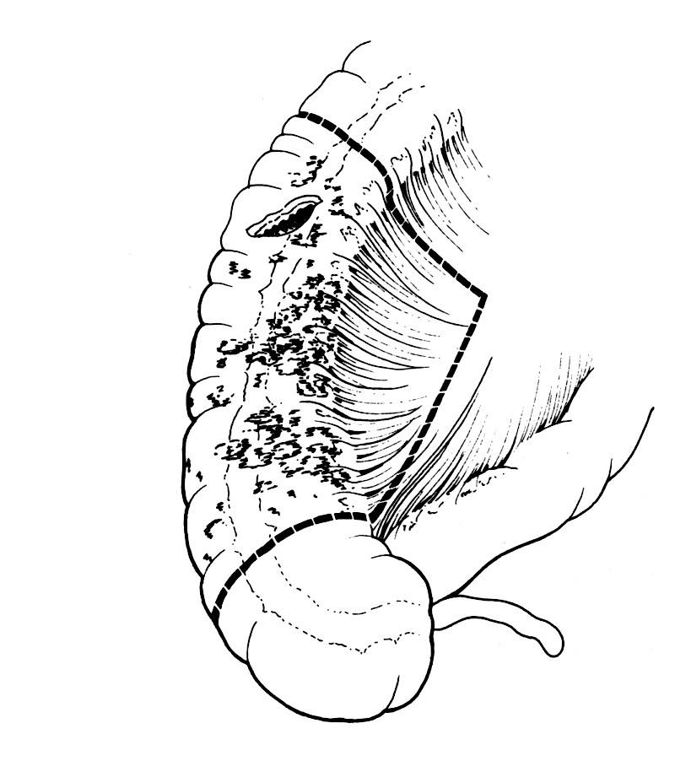
Surgery

Slide 29
Distal perforation !!

Slide 30
Conclusion
Easy to diagnose
Management is well established
Minimally invasive surgery increasing
Outcome should be excellent

