Slide 1
ABDOMINAL TUBERCULOSIS
D. Sidler, Paediatric Surgery, Tygerberg Children’s Hospital, SUN

Slide 2
GLOBAL EMERGECY
30%-50% of world population has TB (3 billion)
8-10 Mill /yr
>3 Mill in Sub-Saharan Africa
5,000 people die/d = 2.3 million/ yr
TB kills more young women than any other disease
More than 100,000 children will die from TB this year
Hundreds of thousands of children become TB orphans

Slide 3
CAUSES OF RESURGENCE IN INCIDENCE OF TB
Worsening economic situations
Multidrug resistance
HIV pandemic
Decline of national tuberculosis control programmes
Large number of displaced persons living in poor conditions as a result of conflicts and wars

Slide 4
GREAT MIMICKER
Very varied presentation ⇒ Great mimicker
TB of GIT- 6th most frequent extra-pulmonary site
TB can involve any part of GIT

Slide 5
HIV & TB
Before HIV era > 80% pTB
In HIV+ pt 40%–60% extra-pulmonary TB
Globally co-infected pts >8 %

Slide 6
Estimated HIV-TB Co-infection Prevalence, 2000
Rate per 100 000
< 5
5 - 9.9
10 - 99
100 - 999
1000 - 4999
5000 or more
No estimate
Source: WHO 2002
Notes:
This map depicts the overlap of TB infection and HIV infection. In sub-Saharan Africa, it is estimated that more than 1% of the population has both infections. In South Africa, approximately 8 or 9% of the population has both infections. This overlap has a devastating impact on TB morbidity, mortality and control.

Slide 7
AETIO-PATHOGENESIS
Primary (non pasteurised milk)
Secondary (sputum)
Route of abdominal infection
Direct ingestion
Haematogenous spread
Direct extension from contiguous organ
Through lymph channels

Slide 8
ABDOMINAL TB CLASSIFICATION
Intestinal
- ulcerative
- hyperplastic
- perforative
Peritoneal
- wet
- dry/plastic
- fibrotic fixed
- acute primary peritonitis
Mesenteric involvement
- mass
- abscess
- nodal
Solid organ
- liver , spleen, pancreas

Slide 9
CLINICAL PRESENTATION
Intestinal obstruction
Acute
Subacute
Chronic
Perforation
Ascites
Diffuse
Loculated
Organized
Lump/Mass
Abscess
LN Mass
Bowel mass
IC mass
Omental mass

Slide 10
Differential Diagnosis
Malignancy
Hodgkin’s lymphoma
Acute lymphocytic leukemia
Infection
Pyogenic lymphadenitis
Fungal infection of lymph nodes
Infection with atypical mycobacteria
HIV/AIDS

Slide 11
Most common site - ileocaecal region
Ileum >caecum> ascending colon > jejunum>appendix > sigmoid > rectum > duodenum> stomach >oesophagus
Increased physiological stasis
Increased rate of fluid and electrolyte absorption
Minimal digestive activity
Abundance of lymphoid tissue

Slide 12
UNCOMMON PRESENTATION
Gastro-duodenal TB
Oesophagus
Segmental colonic
Rectal
Anal TB
Genitourinary TB

Slide 13
INVESTIGATION
Imaging
AxR
US
CT
Lab-tests
Sputum bacteriology (gram stain, culture)
Tuberculin test
Ascites ADA
FNAB/C

Slide 14
X-RAY ABDOMEN WITH CALCIFIED LYMPH NODE

Slide 15
AxR WITH INTESTINAL OBSTRUCTION

Slide 16
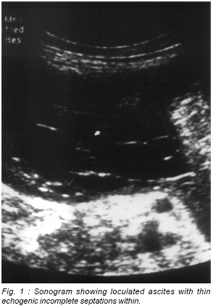
US IN ABDOMINAL TB
Intra abdominal fluid
Septae
Peritoneal Thickening
Lymphadenopathy
GUIDED PROCEDURES
Ascitic tap
FNAC / Biopsy

Slide 17
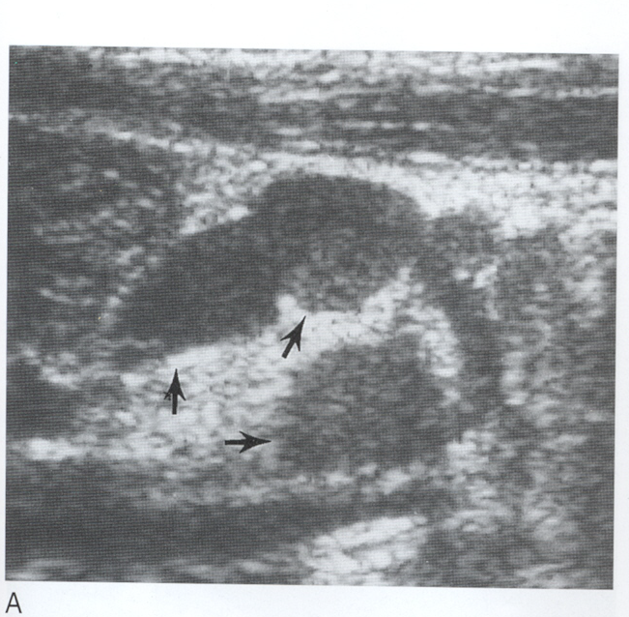
US NECROTIC/CALCIFIED LYMPH NODE MASS

Slide 18
BARIUM CONTRAST STUDY WITH IC-TUBERCULOSIS
Fleishner sign
Conical caecum
Increased IC angle

Slide 19
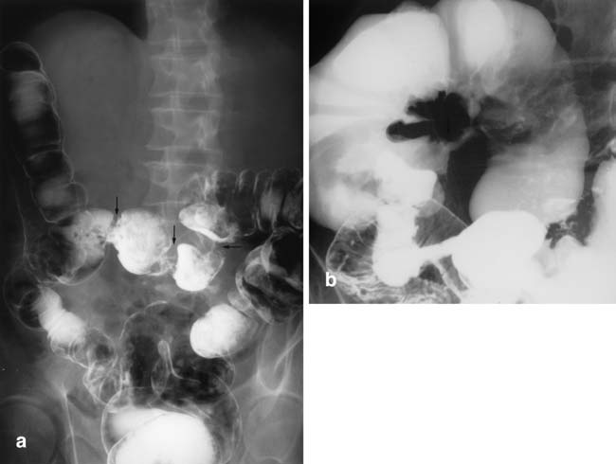
STRICTURES/ FISTULAE

Slide 20
CT SCAN ABDOMEN
Whenever diagnosis in doubt
Lymphadenopathy
I C Mural thickening
High density ascitis
Irregular soft tissue densities in omental area

Slide 21
CT SCAN BOWEL THICKENING

Slide 22
TB peritonitis
a Axial contrast-enhanced CT
ascites paracolic gutter
thickened peritoneum (white arrow)
omental thickening (open arrow)
multiple rim-enhancing lymph nodes (black arrows)

Slide 23
Mesenteric TB
a Ultrasound demonstrates multiple enlarged hypoechoic lymph nodes within the mesentery (arrows)
b Contrast-enhanced CT scan reveals extensive infiltration of the mesentery, with presence of loculated ascites, thickening and enhancing of the peritoneum (curved arrow), low attenuation mesenteric & retroperitoneal lymph nodes (black arrows) and omental thickening (white arrow)

Slide 24
ASCITES FLUID
Routine microscopy
AFB stain
AFB culture
TB PCR
ADA
Serum
Ascites fluid
LDH > 90 U/L

Slide 25
Adenosine Deaminase (ADA)
Aminohydrolase that converts adenosine àinosine
ADA increased due to stimulation of T-cells by mycobacterial Ag
Serum ADA >54 U/L
Ascitic fluid ADA >40 U/L
Ascitic fluid to serum ADA ratio > 0.985 ( Bhargava et al)
Coinfection with HIV → normal or low ADA

Slide 26
BACTEC FAST METHOD OF TB CULTURE
Liquid (BACTEC) – results available in 10-14 days
Solid (LJ Media) media – 4-6 wks

Slide 27
TB PCR
It is genetic test
Sensitive and specific
Rapid & Result available in few hours
Quantitative – 1 to 2 bacilli

Slide 28
LAPAROSCOPY
Advantage
Diagnostic
Biopsy
Therapeutic
May avoid empirical use of ATT
Disadvantage
Invasive investigation
Difficult
Costly
Expertise
Complications

Slide 29
Laparoscopic Findings
Thickened peritoneum with tubercles
Multiple, yellowish white, uniform (~ 4-5mm) tubercles
Peritoneum is thickened & hyperemic
Omentum, liver, spleen also studded with tubercles
Thickened peritoneum without tubercles
Fibro adhesive peritonitis
Markedly thickened peritoneum and multiple thick adhesions
Caseatinggranulomas + in 85%-90% of Bx

Slide 30
TREATMENT
ATT as per dots recommendation
Ideally 6/52 before Sx
Might need increased oral dosage (malabsorption)
Empirical ATT to be condemned
Aspiration of abscess
Surgery for unrelieved obstruction
Surgery for perforation

Slide 31
COMPLICATIONS
Obstruction & perforation
Malnutrition and superinfection
Blind loop
Malabsorption
Enterocutaneous fistula
Short bowel syndrome
Infertility

Slide 32
TB AND HIV/AIDS
Children who acquire HIV by MTCT are also likely to be exposed to TB
HIV Infection:
Increases the severity of TB in children
Prolongs Morbidity
Increases Mortality
Treatment may take longer to be effective.
HIV and TB increase the side effect from anti- TB drugs
Antiretroviral drugs interfere with anti -TB drugs

Slide 33
Extra-pulmonary manifestations &
severity of immuno-suppression (CD4 count)
% Extra-Pulmonary TB
High CD4 cell count low
Notes:
Orient participants to this graph: the vertical axis shows the percentage of HIV-TB patients with extrapulmonary manifestations of TB; the horizontal axis shows CD4 cell count ranges, from high to low.
With progressive immunodeficiency, extrapulmonary manifestations of TB become increasingly common, such that among patients with CD4 cell counts < 100, most patients (75%) have extrapulmonary TB
So, TB becomes a systemic disease, rather than primarily a pulmonary disease, with progressive immunodeficiency

Slide 34
Immune reconstitution events in HIV - related TB
Definition - increase in manifestations of TB at prior sites or new manifestations of disease
Closely associated with starting ARV (days to weeks)
Rarely associated with starting TB therapy
Natural history
duration - days to months
waxing and waning is common

Slide 35
Types of immune reconstitution events
with HIV - related TB
Hectic fever
New or worsening lymphadenitis
peripheral or central nodes
New or worsening pulmonary infiltrates, including resp failure
New or worsening pleuritis, pericarditis, or ascites
Intracranial tuberculomas, worsening meningitis
Disseminated skin lesions
Epididymitis, hepatosplenomegaly, soft tissue abscesses

Slide 36
Management of suspected immune reconstitution
Inform patients about the possibility of an event after starting ARV (“You may feel like the TB is coming back”)
Evaluate for possible TB treatment failure
Assess for other HIV-related complications, e.g. another opportunistic infection
Management of symptoms, e.g. use non-steroidal anti inflammatory drugs
Steroids may be needed for severe symptoms (1mg/kg)
Notes:
Before concluding that an event is an immune reconstitution event, it is important to consider other possible explanations – failure of TB treatment or the occurrence of another process (a new opportunistic infection, a tumor, etc.)
There are many uncertainties about the optimal management of immune reconstitution events
Relatively mild events may be managed with reassurance and encouragement – the event is a sign that the HIV treatment is working
Fevers and pain may respond to non-steroidal antiinflammatory drugs, like Aspirin
Severe manifestations – enlarging lymph nodes that compromise ability to move the neck, swallow or breath, an enlarging tuberculoma in the central nervous system, worsening meningitis,respiratory failure – should be treated with corticosteroids. In addition, it may be necessary to stop antiretroviral therapy for a time.
The duration of steroid therapy has not been studied, but most experts would try to taper the steroids after several weeks, if there has been a good response.

Slide 37
Adverse events during treatment
54% (99/167) had adverse events
34% interrupted TB or HIV therapy
Common adverse events
Peripheral neuropathy (21%)
Skin rash (17%)
TB drugs (16)
co-trimoxazole (7)
nevirapine (2)
other drugs (4)
hepatitis (6%) – TB drugs (6), unknown (5)
AIDS 2002;16:75-83
Notes:
Because of the degree of immunodeficiency and the use of multiple medications, it isn’t surprising that adverse events are common among patients being treated for HIV-related TB.
In this cohort study from London, 34% of patients stopped TB or HIV therapy, at least temporarily
The most common adverse events were peripheral neuropathy, skin rash, and hepatitis

Slide 38
Managing adverse events during treatment of HIV-TB
Do one thing at a time
makes it easier to decide the cause of an event
Stop medications for severe adverse events
Use sequential re-challenge to decide the cause of an event
Don’t switch from the first-line TB drugs (especially INH and RIF) without evidence of an association with a significant side effect
Remember immune reconstitution events as a possible cause

Slide 39
Association between HIV & risk of death during TB Rx
Am J Respir Crit Care Med 1999;159:733-40
Notes:
This slide shows the effect of HIV infection on the death rate of TB during treatment (6 months)
Orient participants to the graph
The vertical axis shows the percent of patients who died during the first 6 months of TB diagnosis; the horizontal axis divides patients by HIV status
Patients with HIV-TB had a much higher death rate – 14% vs. 0.5%
The high death rate suggests that treatment of HIV, in addition to treatment of TB, could improve outcomes of patients with HIV-TB

Slide 40
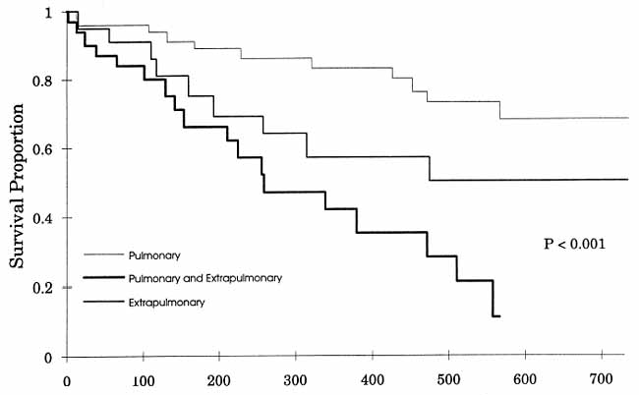
Association between pattern of TB & survival of patients with HIV-TB
AIDS 1997;11:455-50
Notes:
This slide shows that the clinical pattern of TB disease is associated with survival among people with HIV-related TB.
Orient participants to this graph
The vertical axis shows survival after the diagnosis of HIV-related TB
The horizontal axis shows time since that diagnosis, in days
Patients with pulmonary-only TB had the best survival, patients with pulmonary + extrapulmonary TB had the worst survival
This relationship is probably due to the effect of CD4 count and presence of extrapulmonary TB – the lower the CD4 cell count, the more the chance of extrapulmonary involvement.
The results of this study suggest that presence of extrapulmonary TB can be one way of targeting patients to receive potent antiretroviral therapy

Slide 41
CONCLUSIONS
Suspicion
Diagnosis is possible
FNAC/B, ADA, TB PCR are valuable tests
Empirical ATT should be avoided
Laparoscopy is an important diagnostic tool
Surgery for unavoidable reasons only
Complex issues (IRIS) with HIV

Slide 42
THANK YOU!

