Slide 1
Performance of Parallel Programs
Michelle Kuttel

Slide 2
Analyzing algorithms
Like all algorithms, parallel algorithms should be:
Correct
Efficient
First we will talk about efficiency
Notes:
correct: does the same as serial version ALWAYS
efficient: is faster

Slide 3
Work and Span
Let T_{P} be the running time if there are P processors available
Two key measures of run-time:
Work: How long it would take 1 processor = T₁
e.g. for divide-and-conquer, just “sequentialize” the recursive forking
Span: How long it would take infinity processors = T∞
The longest dependence-chain
Example: O(log n) for summing an array with divide-and-conquer method
Notice that for this case, having > n/2 processors is no additional help
Also called “critical path length” or “computational depth”
slide adapted from: Sophomoric Parallelism and Concurrency, Lecture 2

Slide 4
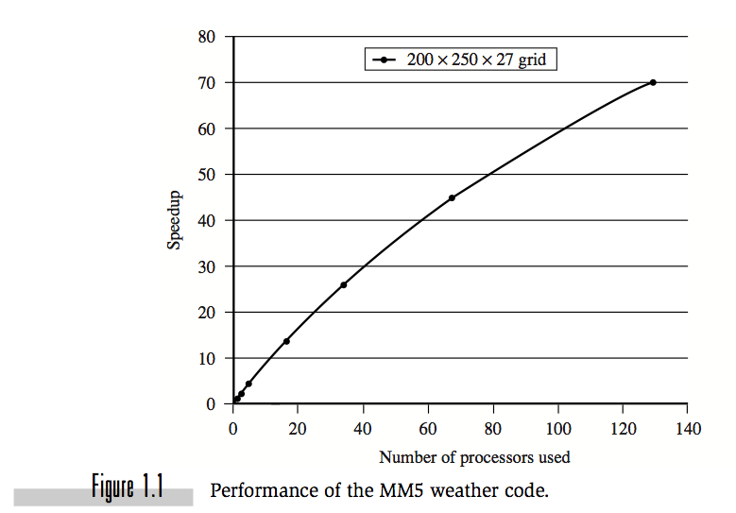
Speedup
Speedup is the factor by which the time is reduced compared to a single processor
Speedup for P processes =
time for 1 process
time for P processes
= T₁/T_{P}.
In the ideal situation, as P increases, so T_{P} should decrease by a factor of P.
Figure from “Parallel Programming in OpenMP, by Chandra et al.

Slide 5
Scalability
Scalability is the speed-up of a program as the number of processors being used increases.
perfect linear speedup = P
Perfect linear speed-up means doubling P halves running time
Usually our goal; hard to get in practice
an algorithm is termed scalable if the level of parallelism increases at least linearly with the problem size.
running time is inversely proportional to the number of processors used.
In practice, few algorithms achieve linear scalability; most reach an optimal level of performance and then deteriorate, sometimes very rapidly.
slide adapted from: Sophomoric Parallelism and Concurrency, Lecture 2

Slide 6
Parallelism
Parallelism is the maximum possible speed-up: T₁ / T ∞
At some point, adding processors won’t help
What that point is depends on the span
Parallel algorithms is about decreasing span without
increasing work too much
slide adapted from: Sophomoric Parallelism and Concurrency, Lecture 2

Slide 7
Traditional Scaling Process
7x
Speedup
3.6x
1.8x
User code
Traditional
Uniprocessor
Time: Moore’s law
Notes:
Recall the traditional scaling process for software: write it once, trust Intel to make the CPU faster to improve performance.

Slide 8
Multicore Scaling Process
7x
3.6x
Speedup
1.8x
User code
Multicore
Unfortunately, not so simple…
slide from: Art of Multiprocessor Programming
Notes:
With multicores, we will have to parallelize the code to make software faster, and we cannot do this automatically (except in a limited way on the level of individual instructions).

Slide 9
Real-World Scaling Process
Speedup
2x
2.9x
1.8x
User code
Multicore
Parallelization and Synchronization
require great care…
slide from: Art of Multiprocessor Programming
Notes:
This is because splitting the application up to utilize the cores is not simple, and coordination among the various code parts requires care.

Slide 10
Early Parallel Computing
Why was it not pursued more thoroughly before 1990’s?
Because of dramatic increase in uniprocessor speed, the need for parallelism turned out to be less than expected
and …

Slide 11
Amdahl’s law
For over a decade prophets have voiced the contention that the organization of a single computer has reached its limits and that truly significant advances can be made only by interconnection of a multiplicity of computers in such a manner as to permit co-operative solution...The nature of this overhead (in parallelism) appears to be sequential so that it is unlikely to be amenable to parallel processing techniques. Overhead alone would then place an upper limit on throughput of five to seven times the sequential processing rate, even if the housekeeping were done in a separate processor...At any point in time it is difficult to foresee how the previous bottlenecks in a sequential computer will be effectively overcome.
Gene Amdahl,1967
IBM - the designer of IBM 360 series of mainframe architecture

Slide 12
Amdahl’s Law (mostly bad news)
So far: analyze parallel programs in terms of work and span
In practice, typically have parts of programs that parallelize well…
e.g. maps/reductions over arrays and trees
…and parts that are inherently sequential
e.g. reading a linked list, getting input, doing computations where each needs the previous step, etc.
“Nine women can’t make one baby in one month”
slide adapted from: Sophomoric Parallelism and Concurrency, Lecture 2
Notes:
Where does file reading fall?

Slide 13
We also have the parallelization overhead
Refers to the amount of time required to coordinate parallel tasks, as opposed to doing useful work. e.g.
starting threads
stopping threads
synchronization and locks

Slide 14
Amdahl’s law*
Total running time for a program can be divided into two parts:
Serial part (s)
Parallel part (p)
T₁=s+p
For n processors:
T_{n}= s+p/n
If set T₁=1, then s= 1-p
and
T_{n}= 1-p+p/n
* G. M. Amdahl, “Validity of the single processor approach to achieving large scale computing capabilities”, AFIPS Proc. Of the SJCC, 30,438-485,1967

Slide 15
Amdahl’s Law
Speedup=
Notes:
AVOID USING THE WORD “CODE”, P is not a fraction of the code but if the execution time of the solution algorithm. It could be that 5% of the code are executed in a loop and account for 90% of the execution time.

Slide 16
Amdahl’s Law
Parallel fraction
Speedup=

Slide 17
Amdahl’s Law
Sequential fraction
Parallel fraction
Speedup=

Slide 18
Amdahl’s Law
Sequential fraction
Parallel fraction
Speedup=
Number of processors

Slide 19
Amdahl’s law*
parallelism (infinite processors) = 1/s
* G. M. Amdahl, “Validity of the single processor approach to achieving large scale computing capabilities”, AFIPS Proc. Of the SJCC, 30,438-485,1967

Slide 20
Example
Ten processors
60% concurrent, 40% sequential
How close to 10-fold speedup?

Slide 21
Example
Ten processors
80% concurrent, 20% sequential
How close to 10-fold speedup?

Slide 22
Example
Ten processors
90% concurrent, 10% sequential
How close to 10-fold speedup?
Notes:
With 90% parallelized we are using only half our computing capacity…

Slide 23
Example
Ten processors
99% concurrent, 01% sequential
How close to 10-fold speedup?

Slide 24
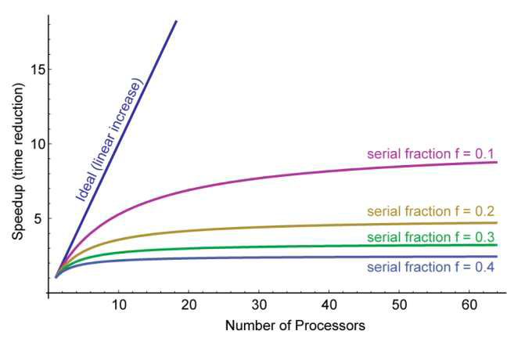
Graphing Amdahl’s Law
graphic from lecture slides: Defining Computer “Speed”: An Unsolved Challenge, Dr. John L. Gustafson, Director Intel Labs, 30 Jan 2011

Slide 25
Why such bad news
T₁ / T_{P} = 1 / (S + (1-S)/P) T₁ / T∞ = 1 / S
Suppose 33% of a program is sequential
Then a billion processors won’t give a speedup over 3
Suppose you miss the good old days (1980-2005) where 12ish years was long enough to get 100x speedup
Now suppose in 12 years, clock speed is the same but you get 256 processors instead of 1
For 256 processors to get at least 100x speedup, we need
100 ≤ 1 / (S + (1-S)/256)
Which means S ≤ .0061 (i.e., 99.4% perfectly parallelizable)
slide adapted from: Sophomoric Parallelism and Concurrency, Lecture 2

Slide 26
Amdahl’s law*
This indicated that parallel processing has no future because it is not possible to speedup an application indefinitely by using more and more processors.
Amdahl argued that for typical Fortran codes, T_{s} = 40% and that you therefore cannot use more than a small number of processors efficiently.

Slide 27
Amdahl’s Law
It is now accepted that Amdahl was probably quite correct from a historical point of view.
In the late 1960’s problem sizes were too small for parallel computing and, had it existed, it would not have been used efficiently.

Slide 28
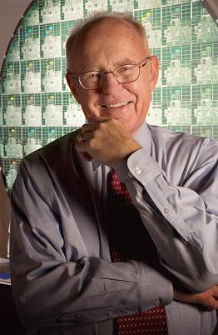
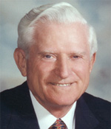
Moore and Amdahl
Moore’s “Law” is an observation about the progress of the semiconductor industry
Transistor density doubles roughly every 18 months
Amdahl’s Law is a mathematical theorem
Diminishing returns of adding more processors
Both are incredibly important in designing computer systems
slide adapted from: Sophomoric Parallelism and Concurrency, Lecture 2

Slide 29
Ahmadl’s law is based on relative speed
Compute relative speed by taking the ratio of times
Speed1 = work1 / time1.
Speed2 = work1 / time2.
Speedup = Speed1 / Speed2 = time2 / time1.
Sounds reasonable, right?
Yet, this approach held back
parallel processing for 20 years!
From lecture slides: Defining Computer “Speed”: An Unsolved Challenge
Dr. John L. Gustafson, Director
Intel Labs, 30 Jan 2011

Slide 30
The absurdity of basing parallel performance on time reduction:
Ambrose Bierce, from The Devil’s Dictionary (1911):
Logic, n. The art of thinking and reasoning in strict accordance with the limitations and incapacities of the human misunderstanding. The basis of logic is the syllogism, consisting of a major and a minor premise and a conclusion--thus:
Major Premise: Sixty men can do a piece of work sixty times at quickly as one man.
Minor Premise: One man can dig a post-hole in sixty seconds.
Conclusion: Sixty men can dig a post-hole in one second.
This may be called the syllogism arithmetical, in which, by combining logic and mathematics, we obtain a double certainty and are twice blessed.
From lecture slides: Defining Computer “Speed”: An Unsolved Challenge, Dr. John L. Gustafson, Director
Intel Labs, 30 Jan 2011

Slide 31
Flaws in Amdahl’s law: Gustafson’s Law
Amdahl’s law has a assumption that may not hold true:
the ratio of T_{S} to T_{P} is not constant for the same program and usually varies with problem size.
Typically, the T_{P} grows faster that T_{S}.
i.e. the computational problem grows in size through the growth of parallel components – Amdahl effect
Also, the serial algorithm may not be the best solution for a problem

Slide 32
Scalability
strong scaling:
defined as how the solution time varies with the number of processors for a fixed total problem size.
weak scaling:
defined as how the solution time varies with the number of processors for a fixed problem size per processor.

Slide 33
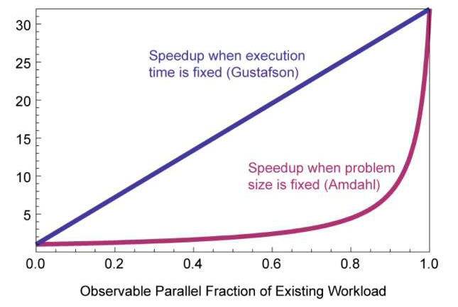
What if t1 = t2, and work is what changes?
From lecture slides: Defining Computer “Speed”: An Unsolved Challenge, Dr. John L. Gustafson, Director
Intel Labs, 30 Jan 2011

Slide 34
People in parallel benchmarking
John L. Gustafson
American computer scientist and businessman, chiefly known the invention of Gustafson's Law, introducing the first commercial computer cluster. Since March 2009, he has been Director of Intel's Extreme Technologies Research laboratory at Intel's headquarters in Santa Clara.

Slide 35
Performance Issues
coverage
Coverage is the percentage of a program that is parallel.
granularity
how much work is in each parallel region.
load balancing
how evenly balanced the work load is among the different processors.
loop scheduling determines how iterations of a parallel loop are assigned to threads
if load is balanced a loop runs faster than when the load is unbalanced
locality and synchronization
cost to communicate information between different processors on the underlying system.
synchronization overhead
memory cache utilization
need to understand machine architecture

Slide 36
Superlinear speedup
Is it possible?
“For a P-processor algorithm, simply execute the work of each processor on a single processor and the time will obviously be no worse than P times greater. It will usually be less, because sources of parallel inefficiency are eliminated.”

Slide 37
Superlinear Speedup
Sometimes superlinear speedups can be observed!
sources of superlinear speedup:
inefficiencies in the serial solution
hidden memory latency and the effect of tiered memory structures
More processors typically also provide more memory/cache.
Total computation time decreases due to more page/cache hits.
subdivision of system overhead
shift in time fraction spent on different speed tasks
Notes:
Discuss each one

