Slide 1
Parallel programming with Java Slides 1: Introduction
Michelle Kuttel
August/September 2012
mkuttel@cs.uct.ac.za
(lectures will be recorded)
Notes:
Each stand up, give a brief statement on what you think this module is about, OR what you want to get out of it etc.

Slide 2
Changing a major assumption
So far, most or all of your study of computer science has assumed that
one thing happens at a time
this is sequential programming
everything is part of one sequence
start
end
A B C D E F G H I J K L M N O P Q R S T U V W X Y Z

Slide 3
Changing a major assumption
start
end
Removing the sequential assumption creates both opportunities and challenges
Programming:
Divide work among threads of execution and coordinate (synchronize) them
Algorithms:
more throughput: work done per unit wall-clock time = speedup
more organization required
Data structures:
May need to support concurrent access (multiple threads operating on data at the same time)
A B C D
D E F G H
T U V W X Y Z
I J K L M
R S
N O P Q

Slide 4
Why is parallel programming important?
Parallel programming is a lot of work…
Writing correct and efficient multithreaded code is often much more difficult than for single-threaded (i.e., sequential) code
Especially in common languages like Java and C
So typically stay sequential if possible
Why is it necessary?

Slide 5
Origins of Parallel Computing
None of the “future is parallel” argument is new :
“A Universal Computer Capable of Executing an Arbitrary Number of Sub-programs Simultaneously” J. Holland, 1959, Proc. East Joint Computer Conference, Vol16, pp 108-113

Slide 6
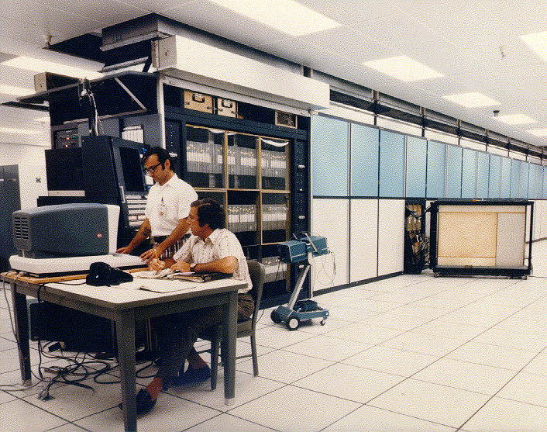
Early Parallel Computing: ILLIAC IV
ILLIAC IV project at University of Illinois 1965-76
one of the most infamous supercomputers ever.
Designed to have fairly high parallelism:
256 processing elements driven by 4 CPUs and a 13MHz clock.
64-bit registers
BUT, the final machine
had only 16 processors, due to costs escalating from projected $8 million (1966) to $31 million (1972)
Had to be moved due to student protests (Vietnam war)
In 1976 it ran its first successful application.
Used to perform computational fluid dynamics simulations, but
actual performance of 15 MFLOPS compared to estimated performance of 1000 MFLOPS.

Slide 7
Early Parallel Computing
Why not pursued more thoroughly before 1990’s?
Because of dramatic increase in uniprocessor speed, the need for parallelism turned out to be less than expected
From roughly 1980-2005, desktop computers became exponentially faster at running sequential programs
traditional doubling of clock speeds every 18–24 months

Slide 8
Now, the “Power Wall”
Nobody knows how to continue the speed increase
Increasing clock rate generates too much heat: power and cooling constraints limit increases in microprocessor clock speeds
Relative cost of memory access is too high

Slide 9
Will Power Problems Curtail Processor Progress? Neal Leavitt, Computer, Vol 45, number 5, pages 15-17

Slide 10
Era of multicore
We can keep making “wires exponentially smaller” (Moore’s “Law”), so put multiple processors on the same chip (“multicore”)
During the next decade, the level of parallelism on a single microprocessor will rival the number of nodes in the most massively parallel supercomputers of the 1980s*
By 2020, extreme scale HPC systems are anticipated to have on the order of 100,000–1,000,000 sockets, with each socket containing between 100 and 1000 potentially heterogeneous cores*
These enormous levels of concurrency must be exploited efficiently to reap the benefits of such exascale systems.
*Parallel Computing, Volume 37, Issue 9, September 2011, Pages 499-500, Emerging Programming Paradigms for Large-Scale Scientific Computing

Slide 11
What to do with multiple processors?
Run multiple totally different programs at the same time
Already do that? Yes, but with time-slicing
Do multiple things at once in one program
Our focus – more difficult
Requires rethinking everything, from asymptotic complexity to how to implement data-structure operations

Slide 12
Why Parallel Programming?
Multicore architectures are now ubiquitous
Performance gain from multiprocessing hardware
Increased application throughput
an I/O call need only block one thread.
Increased application responsiveness
high priority thread for user requests.
More appropriate structure
for programs which interact with the environment, control multiple activities and handle multiple events.
Notes:
Aim to solve a given problem in less wall-clock time
Throughput: if pne thread is waiting for something (IO) the other can execute.
OR Achieve better solutions in same time
e.g. use a more accurate scen

Slide 13
Why NOT parallel programming?
Increased pain (complexity) of the programs:
Managing this complexity and the principles and techniques necessary for the construction of well-behaved parallel/concurrent programs is the main subject matter of this module

Slide 14
Concurrency versus parallelism
Parallel:
Use extra computational resources to solve a problem faster
Concurrent:
Correctly and efficiently manage access to shared resources
work
resource
resource
resource
resource
resource
These terms are NOT standard, but perspective is important
Many programmers confuse these terms
request
request
request
request
request
resource
*A Sophomoric Introduction to Shared-Memory Parallelism and Concurrency, Dan Grossman, online notes, version Feb 2012

Slide 15
Why is Parallel/Concurrent Programming so Hard?
Try preparing a seven-course banquet
By yourself
With one friend
With twenty-seven friends …
Notes:
cook analogy works well for parallel computing

Slide 16
Cooking analogy
A serial program is a recipe for one cook
the cook does one thing at a time (sequential)
Parallel options
use lots of helpers to slice lots of potatoes (data decomposition)
use helpers to dedicate to different tasks, such as beating eggs, slicing onions, washing up (task decomposition)
have a list of tasks and assign them to workers as they are free (work pool)
But too many chefs = too much time coordinating!

Slide 17
Cooking analogy
Concurrency example
Lots of cooks making different things, but only 4 stove burners
want to allow access to burners, but not cause spills or incorrect burner settings

Slide 18
Parallelism Example
Parallelism: Use extra computational resources to solve a problem faster (increasing throughput via simultaneous execution)
Pseudocode for array sum
Bad style for reasons we’ll see, but may get roughly 4x speedup
int sum(int[] arr){
res = new int[4];
len = arr.length;
FORALL(i=0; i < 4; i++) { //parallel iterations
res[i] = sumRange(arr,i*len/4,(i+1)*len/4);
}
return res[0]+res[1]+res[2]+res[3];
}
int sumRange(int[] arr, int lo, int hi) {
result = 0;
for(j=lo; j < hi; j++)
result += arr[j];
return result;
}

Slide 19
Concurrency Example
Concurrency: Correctly and efficiently manage access to shared resources (from multiple possibly-simultaneous clients)
Pseudocode for a shared chaining hashtable
Prevent bad interleaving (correctness)
But allow some concurrent access (performance)
class Hashtable<K,V> {
…
void insert(K key, V value) {
int bucket = …;
prevent-other-inserts/lookups in table[bucket]
do the insertion
re-enable access to arr[bucket]
}
V lookup(K key) {
(like insert, but can allow concurrent
lookups to same bucket)
}
}

Slide 20
Focus on parallelism
In reality, parallelism and concurrency are mixed
Common to use threads for both
If parallel computations need access to shared resources, then the concurrency needs to be managed
However, in the first half of this course we focus on parallelism
Structured, shared-nothing parallelism
once you are comfortable with threads, we will talk about mutual exclusion, interleaving etc.

Slide 21
Where does parallel/concurrent processing occur?
Time
operating systems
supercomputers
internet and distributed computing systems
multicore chips
GPU’s and other accelerators
Notes:
concurrent programming grew out of problems associated with operating systems, specifically task switching.
operating systems evolved to allow more than one program to run at once, running individual programs in processess: isolated programs. If they needed to, programs could communicate with one another through communication mechanisms: sockets, signal handlers, shared memory, semaphores and files.

Slide 22
Everywhere
Many programs today are inherently concurrent or parallel:
operating and real-time systems,
event-based implementations of graphical user interfaces,
high-performance parallel simulations like climate prediction using weather models,
Internet applications like multiuser games, chats and ecommerce.

Slide 23
This explosion of parallelism has two significant challenges from a programming perspective:
how to best manage all the available resources to ensure the most efficient use of the peak performance provided by the hardware designs.
how the enormous potential of these systems can be effectively utilized by a wide spectrum of scientists and engineers who are not necessarily parallel programming experts.
from: Parallel Computing, Volume 37, Issue 9, September 2011, Pages 499-500, Emerging Programming Paradigms for Large-Scale Scientific Computing

Slide 24
What is a parallel computer?
Parallel processing is:
the use of multiple processors to execute different parts of the same program simultaneously
But that is a bit vague, isn’t it?
What is a parallel computer?

Slide 25
TOP500
Created in 1993
a list of the top 500 super computers
updated twice yearly
Each computer is ranked according to performance on High Performance Linpack (HPL) software package from the Innovative Computing Laboratory at the University of Tennessee:
LINPACK provides 3 separate benchmarks to evaluate a systems performance on a dense system of linear equations

Slide 26
Class volunteer?
Outline of machine currently at top of top500

Slide 27
The problem for application programmers is further compounded by the diversity of multicore architectures that are now emerging, ranging from:
complex out-of-order CPUs with deep cache hierarchies,
to relatively simple cores that support hardware multithreading,
to chips that require explicit use of software-controlled memory.
from: Parallel Computing, Volume 37, Issue 9, September 2011, Pages 499-500, Emerging Programming Paradigms for Large-Scale Scientific Computing

Slide 28
A parallel computer is
Multiple processors on multiple separate computers working together on a problem (cluster)
Or a computer with multiple internal processors (multicore and/or multiCPUs) ,
Or accelerators (GPU’s)
Or multicore with GPU’s
Or multicore with GPU’s in a cluster
Or …a cloud?
Or…. the internet?
Notes:
e.g adding a list of numbers

Slide 29
Memory Parallelism
CPU
CPU
CPU
shared memory computer
serial
computer
memory
memory
CPU
distributed memory computer
CPU
CPU
CPU
memory
memory
memory
Notes:
SMP versus NUMA

Slide 30
We focus on: The Shared Memory Multiprocessor (SMP)
All memory is placed into a single (physical) address space.
Processors connected by some form of interconnection network
Single virtual address space across all of memory. Each processor can access all locations in memory.
cache
cache
cache
Bus
Bus
shared memory
Notes:
And we had expensive multiprocessor chips in the enterprise, that is, in server farms, high performance computing centers and so on. The
Shared memory multiprocessor (SMP) consists of multiple CPUs connected by a bus or interconnect network to a shared memory. Shared memory designs are broken down into two major categories – SMP and NUMA - depending on whether or not the access time to shared memory is uniform or non-uniform.

Slide 31
Communication between processes
Processes must communicate in order to synchronize or exchange data
if they don’t need to, then nothing to worry about!
The challenge in concurrent programming comes from the need to synchronize the execution of different processes and to enable them to communicate.

Slide 32
Broadly speaking, researchers have taken two paths for leveraging the parallelism provide by modern platforms:
The first focuses on optimizing parallel programs as aggressively as possible by leveraging the knowledge of the underlying architecture
The second path provides the tools, libraries, and runtime systems to simplify the complexities of parallel programming, without sacrificing performance, thereby allowing domain experts to leverage the potential of high-end systems.
from: Parallel Computing, Volume 37, Issue 9, September 2011, Pages 499-500, Emerging Programming Paradigms for Large-Scale Scientific Computing

Slide 33
Programming a Parallel Computer
can be achieved by:
an entirely new language – e.g. Erlang
a directives-based data-parallel language e.g. HPF (data parallelism), OpenMP (shared memory + data parallelism)
an existing high-level language in combination with a library of external procedures for message passing (MPI)
threads (shared memory – Pthreads, Java threads)
a parallelizing compiler
object-oriented parallelism (?)
Notes:
most current parallel languages provide exgtensions to existing languages - familar (ST - esperanto)

Slide 34
Parallel Programming Models
Different means of communication result in different models for parallel programming:
Shared-memory model (this course)
Message-passing
each thread has its own collection of objects.
communication is via explicitly sending and receiving messages
Dataflow
program written as a DAS
a node executes after all its predecessors in the graph
Data parallelism
primitives for things like: “apply function to every element of an array in parallel”
Notes:
in fact, all technologies!

Slide 35
Parallel programming technologies
Technology converged around 3 programming environments:
OpenMP
simple language extension to C, C++ and Fortran to write parallel programs for shared memory computers (shared memory model)
MPI
A message-passing library used on clusters and other distributed memory computers (message passing model)
Java
language features to support parallel programming on shared-memory computers and standard class libraries supporting distributed computing (shared memory model and message passing model)

Slide 36
Our Needs
To write a shared-memory parallel program, need new primitives from a programming language or library
Ways to create and run multiple things at once
Let’s call these things threads
Ways for threads to share memory
Often just have threads with references to the same objects
Ways for threads to coordinate (a.k.a. synchronize)
For now, a way for one thread to wait for another to finish
Other primitives when we study concurrency

Slide 37
Theory not in this course: Modelling processes
We can model processes as finite state machines
A simplification that considers a process as having a state modified by atomic actions.
Each action causes a transition from the current state to the next state.
The order in which actions are allowed to occur is determined by a transition graph
abstract representation of the program
The use of state machines as an abstract model for processes is widely used in the study of concurrent and distributed algorithms.

Slide 38
Some terminology you will encounter
parallel concurrent
threads processors processes
data race synchronization thread safety correctness isolation
mutual exclusion
locks monitors
liveness deadlock starvation

Slide 39
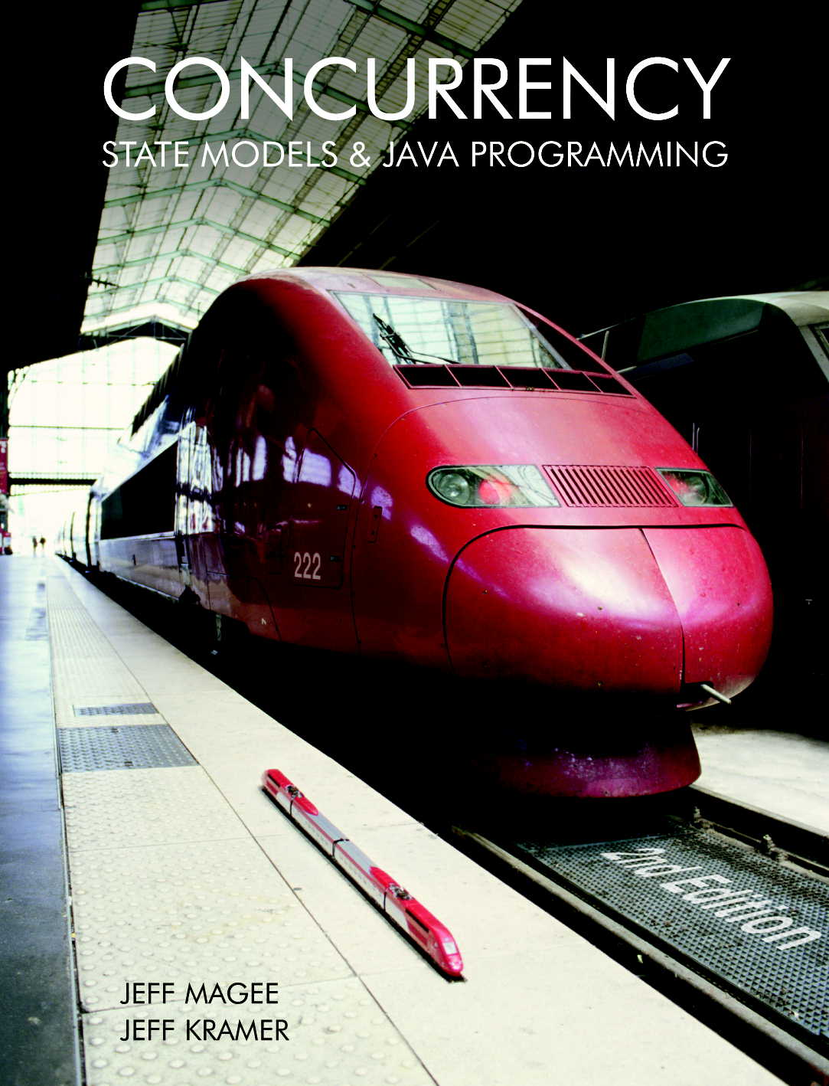
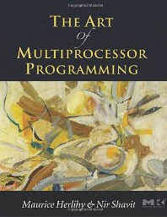
Required and Recommended Reading
A Sophomoric Introduction to Shared-Memory Parallelism and Concurrency
Dan Grossman, online notes (and up on Vula)
Java Concurrency in Practice
Joshua Bloch, Brian Goetz, Tim Peierls, Joseph Bowbeer, David Holmes, Doug Lea
For more “theoretical” approaches:
Concurrency: State Models and Java Programs, 2nd Edition
Jeff Magee and Jeff Kramer
The Art of Multiprocessor Programming
Maurice Herlihy
Principles of Concurrent and Distributed Programming (2nd Edition)
Mordechai Ben-Ari

Slide 40
Tutorial
Released 27th August
Hand in: 9am on Friday 21st of September
with a 5% penalty if they take the long weekend and handin by Tuesday 24th at 9am
with 10% per day (OR PART THEREOF) thereafter

