Slide 1
Psychology and Religion in the Search for Personal Wholeness: Synthesis and Personal View
Johann Maree
Summer School, UCT
January 2012

Slide 2
Synthesis of whole course and Personal View
This presentation commences with an overview and synthesis of the whole course. It presents a flow-chart first and then summarises the main points made by each psychological approach with regards to the search for personal wholeness.
This is followed by a personal view of the different approaches.
Finally, a selected reading list is provided.

Slide 3
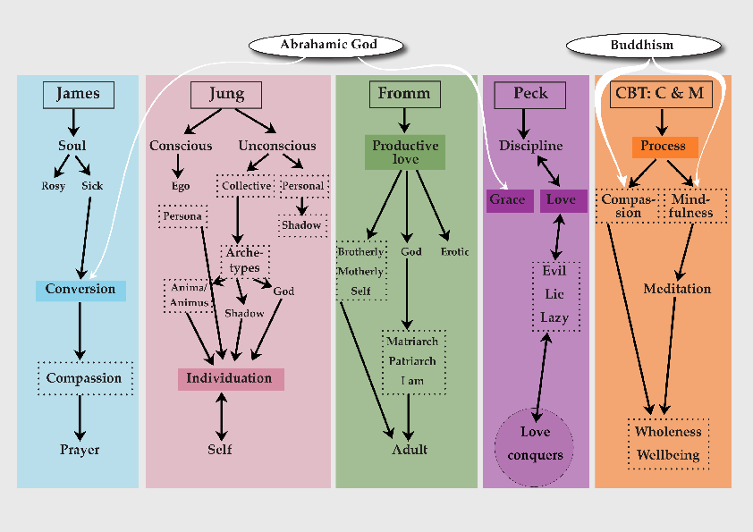
Flow-chart of presentations

Slide 4
Explanation of flow-chart
The flow-chart on the preceding slide presents the main themes covered in each of the five lectures emphasizing the search for personal wholeness.
The darkened colours for each of the four psychologists and CBT indicates the location where growth towards personal wholeness takes place.
The white curved arrows indicate where the Abrahamic God works directly on the human psyche and where Buddhism has been a major influence.

Slide 5
William James
James’ starting point is to sketch two extreme types of humans, the ‘healthy-minded’ who look at life with a rosy tint and ‘the sick soul’ who suffer deep mental torment.
He found that the ‘sick soul’ is transformed upon experiencing a religious conversion. As a result, religious aims become the ‘habitual centre’ of the converted. The practice of ‘tenderness and charity’, that is, compassion, makes the world a better place. Prayer is the means by which the person draws energy from a divine source in a spiritual universe.

Slide 6
Carl Jung
Jung transformed Freudian theory of the psyche by introducing the existence of the collective unconscious that we humans inherited from our ancestors. The collective unconscious contains archetypes. The most important of these primordial images are the anima, animus, shadow and God-image.
In order to grow towards personal wholeness it is necessary for the conscious ego to differentiate and integrate these unconscious forces into consciousness and so grow into a whole being, the Self.

Slide 7
Erich Fromm
Fromm considers the essence of love to be able to give of oneself, one’s attention, one’s care, and one’s joy to others. This is productive love, the capacity to give.
He distinguishes between five kinds of love: Brotherly (love of neighbour), Motherly (unconditional), Self-love, Erotic love (fusion with one other person), and love of God.
Love of God has gone through phases as humans evolved and became alienated from nature. To love God now is to take responsibility for ourselves, for all of nature and the societies we create.

Slide 8
Scott Peck
Peck defines love as ‘the will to extend one’s self for the purpose of nurturing one’s own or another’s spiritual growth.’ Love requires discipline to practice and Peck lists four disciplines: taking responsibility, commitment to truth, delayed gratification, and control of our emotions. God provides grace which nurtures the spiritual growth of human beings.
Evil, says Peck, is the result of laziness and living a complete lie by denying the evil within oneself. Evil cannot be destroyed. It can only be conquered by love.

Slide 9
CBT: Mindfulness and Compassion
Cognitive behaviour therapy is a process through which people learn to replace negative and destructive views of themselves with thoughts, speech and behaviour that build self-esteem, self-love and constructive behaviour.
Attaining compassion and mindfulness are two goals of CBT. Mindfulness is learning to hold one’s attention in the present moment and direct it to a specific focus. It is linked to meditation which means becoming familiar with our minds and how they work. Through mindfulness we change our relationship to our thoughts and grow towards wholeness and wellbeing.

Slide 10
Personal view: Biblical Approach
Although William James used only real examples of what people actually experienced, he came closest to the classical biblical approach on how to achieve personal wholeness: by means of conversion.
Saint Paul has given the clearest exposition of how Christian conversion turns a person from self-destruction to redemption. He starts from an anguished position: “I know that nothing good dwells in me... The good which I want to do, I fail to do; but what I do is the wrong which is against my will... Wretched creature that I am, who is there to rescue me from this state of death?” (Romans 7:18-24)

Slide 11
Saint Paul: life in Christ Jesus
And his answer is: “Who but God? Thanks be to him through Jesus Christ our Lord! ... In Christ Jesus the life-giving law of the Spirit has set you free from the law of sin and death.” (Romans 7:25 & 8:2)
And so Paul creates a dichotomy: “What human nature does is quite plain. It shows itself in immoral, filthy and indecent actions... But the Spirit produces love, joy, peace, patience, kindness, goodness, faithfulness, humility and self-control... And those who belong to Christ Jesus have put to death their human nature with all its passions and desires.” (Galatians 5:19-24)

Slide 12
Faith alone not always enough
But in real life Christian conversion does not work so straightforwardly for most people even though James has shown that it does work for some people. For many reasons, including repression of our shadow, dishonesty with ourselves and others, self-bullying, our personal woundedness and brokenness, faith alone does not help us to overcome our “human nature”.
Psychology, psychotherapy and self-therapy can play a strong complementary role in the quest for personal wholeness.

Slide 13
Learning to love oneself
Fromm and Peck both point out that love is not based on feeling, but on capacity and will. Fromm points out that humans have to develop the capacity to love by giving and Peck that love is a matter of will. They both assert that it is necessary to love oneself in order to love others.
Cognitive behaviour therapy provide self-help techniques to learn to love oneself. It shows that there are many unconscious ways in which we put ourselves down that can be corrected once we become aware of them.

Slide 14
Humans in charge
Jung and Fromm both point to the need for humans to take responsibility for their own lives and those of others.
Fromm goes furthest in arguing that God has left it up to us as human beings to search and work out our own salvation. Through upward evolution we have become alienated from nature and there is no turning back. We can only save humanity – and the world for that matter – by taking full responsibility to do so. Nobody else is going to come and do it for us.

Slide 15
Humans can connect with God
William James maintains that we humans are not entirely on our own. Through prayer – and only through prayer – can we can receive energy from a divine force. For Christians it is from God through the Spirit of Christ Jesus.
The Quaker, William Littleboy, captured the same insight by a reflection he wrote in 1916:
‘My own belief is that outward circumstances are not often (I will not say never) directly altered as the result of prayer. That is to say, God is not always interfering with the working of the natural order. But indirectly by the work of mind upon mind great changes may be wrought. (Cont.)

Slide 16
Prayer the way of being in God
‘We live and move and have our being in God; we are bound up in the bundle of life in Him, and it is reasonable to believe that prayer may often find its answer, even in outward things, by the reaction of mind upon mind.
‘Prayer is not given us to make life easy for us, or to coddle us, but to make us strong, … to make us masters of circumstance and not its slaves. We pray, not to change God’s will, but to bring our will into correspondence with His.’

Slide 17
Selected Reading List William James
James, William. 1975 (1901-2). The Varieties of Religious Experience. London: Fontana.
James, William. 1908. Pragmatism. London: Longmans, Green & Co.
Perry, Ralph B. 1996 (1948) The Thought and Character of William James. Nashville: Vanderbilt University Press.
Taylor, Charles. 2002. Varieties of Religion Today: William James Revisited. Cambridge, Mass: Harvard University Press.

Slide 18
Readings: Carl Jung
Jung, Carl. 1938. Psychology and Religion. New Haven: Yale University Press.
Jung, Carl. 1959. The Basic Writings of C.G.Jung: Edited with an Introduction by Violet Stab de Laszlo. New York: Random House.
Jung, Carl. 1963. Memories, Dreams, Reflections. London: Collins Press. The Fontana Library.
Papadopoulos, Renos, ed. 2006. The Handbook of Jungian Psychology. London: Routledge.

Slide 19
Readings: Erich Fromm
Fromm, Eric, 1966. The Art of Loving. London: Unwin Books.
Fromm, Eric. 1972. Psychoanalysis and Religion. New York: Bantam Books.
Fromm, Eric, 1980. To Have or to Be. London: Abacus.
Fuller, Andrew. 2008. Psychology and Religion: Classical Theorists and Contemporary Developments. Fourth Edition. New York: Rowman and Littlefield.
Funk, Rainer. 1982. Erich Fromm: The Courage to be Human. New York: Continuum.

Slide 20
Readings: Scott Peck
Jones, Arthur. 2007. The Road He Travelled: The Revealing Biography of M Scott Peck. London: Rider.
Peck, M Scott. 1978. The Road Less Travelled: A New Psychology of Love, Traditional Values and Spiritual Growth. London: Arrow Books 1990.
Peck, M Scott. 1983. People of the Lie: The Hope for Healing Human Evil. London: Arrow Books 1991.
Peck, M Scott. 1987. The Different Drum: The Creation of True Community – the First Step to World Peace. London: Arrow Books 1991.

Slide 21
Readings: CBT, Compassion & Mindfulness
Armstrong. Karen. 2010. Twelve Steps to a Compassionate Life. New York: Knopf Doubleday.
Beck, Aaron, John Rush, Brian Shaw and Gary Emery. 1979. Cognitive Therapy of Depression. New York: The Guilford Press.
Williams, Mark, John Teasdale, Zindel Segal and Jon Kabat-Zinn. 2007. The Mindful Way through Depression. New York: The Guilford Press.
Gilbert, Paul. 2009. Overcoming Depression: A self-help guide using Cognitive Behavioral Techniques. Fully Revised 3rd Edition. London: Constable & Robinson.

