Slide 1
Research Essays
Structure, Argumentation, Originality, & Etiquette

Slide 2
Lecture Outline
Structure and Weighting
Argumentation
Issue of Originality and Using Sources
Etiquette of Writing

Slide 3
Structure and Weighting
Structure and Weighting are immensely important. Most essay questions ask you to do several things – what you need to do is figure out how many words to spend on each part.

Slide 4
Make an outline
Looking at the well-known conflict between Middle Earth and Mordor (Tolkien, 1955)

Slide 5
Causes/Explanations
Actors/Roles
Evaluations

Slide 6
Causes/Explanations
What was the impact of resource interests on the outbreak of the war between Middle Earth and Mordor?
Was religion the main reason behind conscientious objection among the Elves during the Middle Earth-Mordor war?

Slide 7
What was the impact of resource interests on the outbreak of the war between Middle Earth and Mordor?
Intro
Historical background – Mordor-Middle Earth relations in the run-up to the war
The resource crunch in Mordor
Other factors:
Differences in ideology
Regime change and instability in Gondor
False diplomacy by Saruman and others
History of influence in the region
Conclusion

Slide 8
Actors/Roles
What is a fellowship and what was its role during the Mordor-Middle Earth conflict?
What is an “orc” and what role did they play in the termination of the Mordor-Middle Earth conflict?

Slide 9
What is a fellowship and what was its role during the early stages Mordor-Middle Earth conflict?
Intro
Theory on the roles of fellowships
Define and explanation of Fellowship in the case
Critique of theory
What are the other explanations that the theory doesn’t account for?
Overall assessment of usefulness of theory
Conclusion

Slide 10
Evaluations
What was the impact of general amnesty on the successes/failures of the Middle Earth TRC with regards to truth finding?
How successful was the Middle Earth TRC with regards to achieving restorative justice through reparations?

Slide 11
What was the impact of general amnesty on the successes/failures of the Middle Earth TRC with regards to truth finding?
Intro
Criteria of evaluation
Theoretical discussion of amnesty and its impact on transitional justice
What is a success in the context of a TRC in Middle Earth
Mandate
Other standards to judge it by
The impact of amnesty in Middle Earth
Perpetrator participation
Quality of the findings
Conclusion

Slide 12
Argument
The trick to writing a strong research paper is to know which of the numerous sources fit best with your argument and methodology.

Slide 13
Argumentation
Given the length of this assignment, we want one main argument (maximum two).
This does not mean you ignore all current arguments within the literature. It merely means you don’t have to cover all of them in detail.
It’s okay to have sub-arguments, but they must be directly linked to your main argument.

Slide 14
Validity and Soundness
All toasters are items made of gold.
All items made of gold are time-travel devices.
Therefore, all toasters are time-travel devices.
Valid: The truth of the premises logically guarantee the truth of the conclusion.
Not Sound: The premises in this argument are not true.

Slide 15
Validity and Soundness
We look for both.
Sources should assist the validity of your argument (e.g. show that other authors have followed the line of reasoning used)
Sources should show your argument is sound, by illustrating facts that prove your premises/sub-arguments to be true.

Slide 16
Example – A C&H Style Argument
Question: To what extent was the 1991 RUF invasion caused by Sierra Leone’s weak economy?
Thesis Statement: The greatest extent! Everything the RUF did was based around greed.
Sub-Argument 1 – The RUF had no real political ideology. (Refute political grievance)
Sub-Argument 2 – All recruited members of the RUF were poor and unemployed.
Sub-Argument 3 – The RUF made a habit of looting and raiding civilians, and diamond mines. (Refute political grievance)
Therefore: Economic issues far outweighed political issues.

Slide 17
Note
Here one cause is being examined (economic), but in doing so another cause is simultaneously refuted (political grievance).
‘Other authors have discussed causes such as A, B, C, D, E etc. I will be concentrating on cause F and K, as they appear to be the most prominent in the literature.’

Slide 18
Did the South African TRC succeed in establishing the truth?
Thesis Statement: No! The South African TRC sacrificed factual accuracy in favour of creating a feel good truth.
Argument : The truth established by the South African TRC was factually inaccurate.
List of reasons/evidence
A
B
C
Etc

Slide 19
Note
Just because you are arguing against the TRC’s truth telling does not mean you can merely state it is an entire failure, and ignore the literature.
E.g. The need to aware of your scope, “The South Africa TRC can be lauded for allowing victims the cathartic effects of telling their stories, and letting their pain be shared. One could even say that the TRC succeed in establishing a reconciliatory collective truth...”

Slide 20
Using Sources and The Issue of Originality

Slide 21
Sources
Sources are used to state ‘facts’:
Important facts describe the context
Provide evidence for your argument
Sources are used to assist your argument:
Show that other authors agree with you
Show that authors disagreeing with you make less sense than you

Slide 22
How to read…
Individual process – find what works for you!
Read the abstract, introduction, subheadings and conclusion.
Jot down the thesis statement.
How does this reading relate to your own argument?
Agree? Disagree? Make notes.

Slide 23
Originality (Impossible)
You are not expected to undertake original research
Why…? It is essentially impossible to do
The challenge is to place yourself in an existing literature or debate and contribute to it
How do you make a contribution or make your research valuable even if is not ‘new’?

Slide 24
Originality (Possible)
New analysis is possible with ‘old’ ideas
Criticism
Relating ideas
Comparing authors and their arguments
Testing theories against new cases
Unique comparisons
Paraphrasing and quoting – pp.10-13 in Writing Guide

Slide 25
The Etiquette of Writing

Slide 26
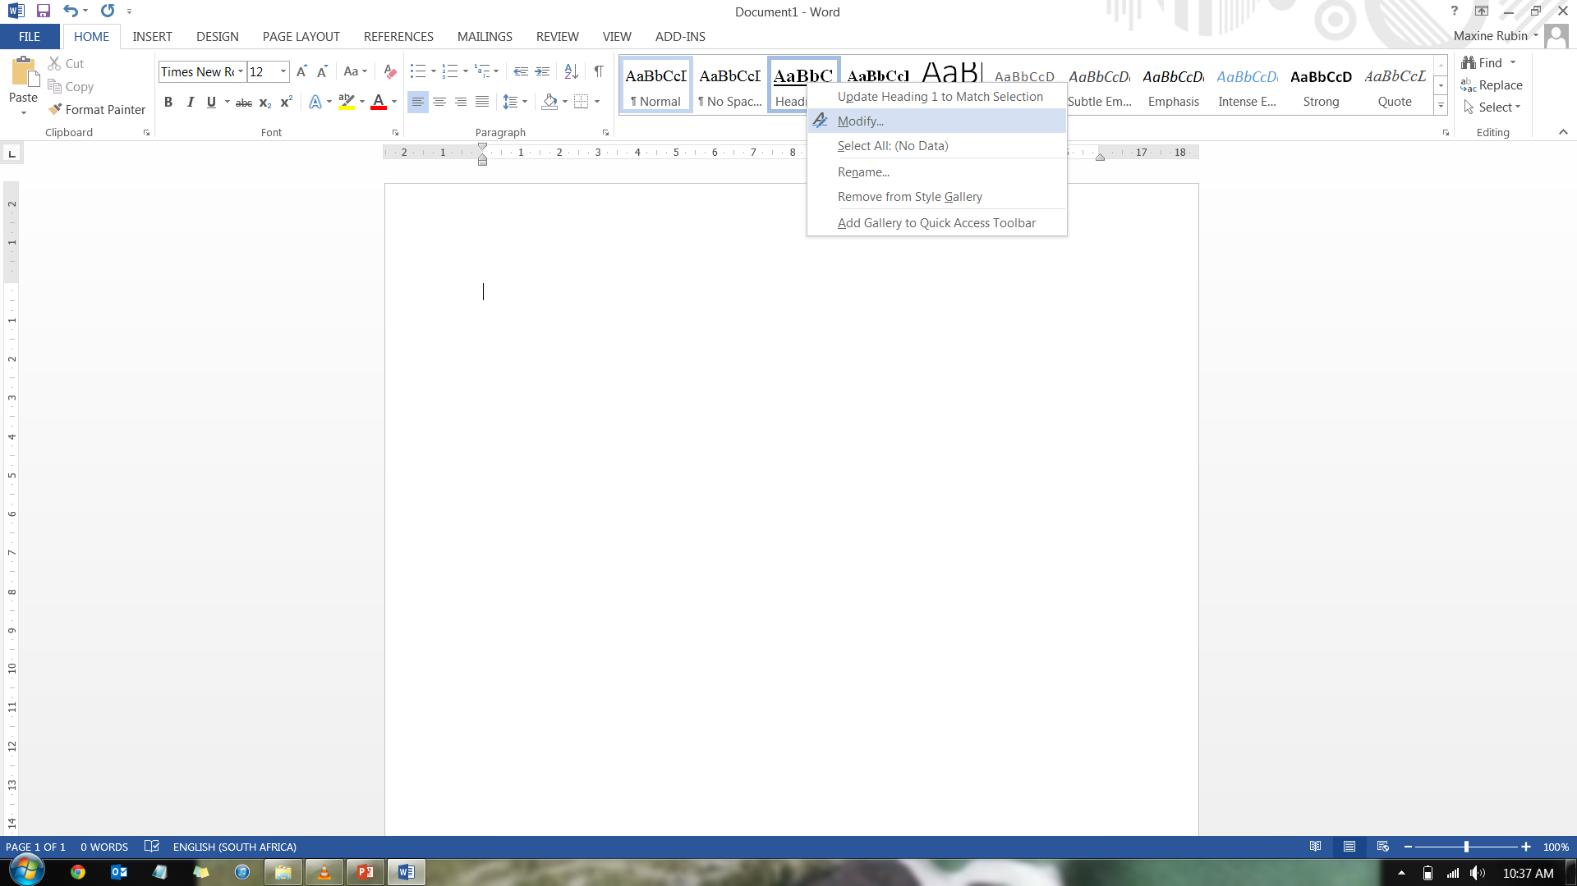
Making a Table of Contents in Word
Use “Styles” for headings and subheadings.

Slide 27
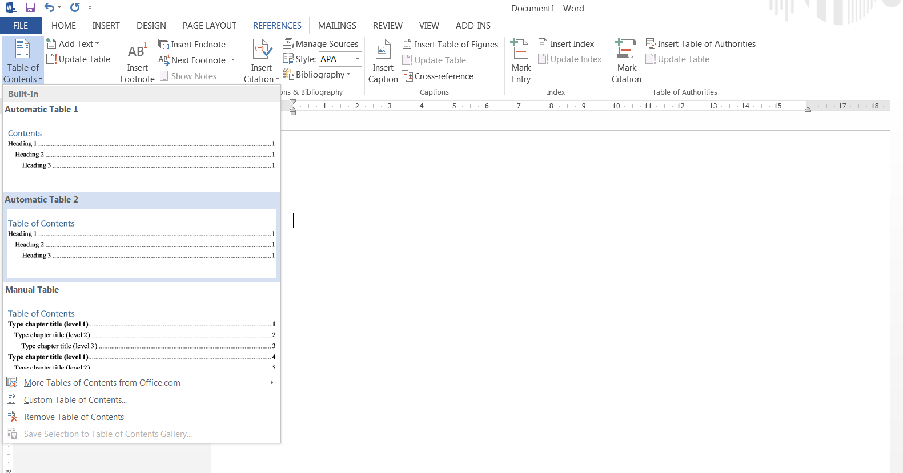
Once all your headings have been assigned a “Style”, go to the “References” toolbar → “Table of Contents” → Select one of the “Automatic Tables”

Slide 28
Once you’ve finished editing your paper and it is ready for submission, do not forget to “Update Entire Table” so that the page numbers are accurate

Slide 29
To What Extent has Mine Action in Mozambique Contributed to Peacebuilding?
Plagiarism Declaration | ii
Acronyms | iii
Introduction | 1
1. Peacebuilding | 3
2. Landmine Contamination in Mozambique | 4
3. Landmine Action in Mozambique | 6
4. Mine Action and Peacebuilding in Mozambique | 9
i. The Security Dimension | 9
ii. The Socio-Economic Dimension | 13
iii. The Political Dimension | 19
Concluding Remarks | 21
Appendix 1, Figure 1 –The Provinces of Mozambique | 25
Appendix 2, Figure 2 – The spatial distribution and density of landmines in Mozambique | 26
Reference List | 29

Slide 30
The Etiquette of Writing
Ensure that you edit your work – use spellcheck; ensure capital letters have been used appropriately; check your grammar
Write short and simple sentences. It is more difficult to write simply. Big words are not impressive.
Think carefully about the words you use and what they imply.
Do your findings prove X or do they suggest X?

Slide 31
The Etiquette of Writing
4000-5000 words
Must include on cover page(s), or will receive 0%:
Word Count
Title: your research question
Table of contents
Full bibliography
In addition to usual: name + student number + course + TUTOR’S NAME
Signed plagiarism declaration

Slide 32
Referencing and formatting
Must be a recognised and widely accepted referencing style within the discipline, e.g. Harvard in-text; Chicago footnotes
Formatting requests:
Page numbers
Double Space
Justify
Margins
Font: TNR; 12

Slide 33
Good Luck!!
Please see the resources that accompany this lecture on Vula:
Table of Contents guide → “MS Word 2007 Training Manual”: sections “Using Styles” and “Table of Contents”
UCT Humanities Referencing Guide
Research Writing and Style Guide Adaptation
Useful websites
Research Essay Checklist

Slide 34
This presentation is licenced under the Creative Commons Attribution 2.5 South Africa License. To view a copy of this licence, visit http://creativecommons.org/licenses/by/2.5/za/
Or
send a letter to Creative Commons, 171 Second Street, Suite 300, San Francisco, California 94105, USA.

