Slide 1
Essay Structure and Outlining
Writing a Well-Structured Essay

Slide 2
Presentation Outline
Structure of an Essay
  Introduction
  Body
  Conclusion
Definition & Purpose of Outlining
Creating an Outline

Slide 3
Introduction
Significance of the topic
background & context
clarity on the purpose of the paper- thesis statement
the methods that will be used to support the argument/roadmap of the essay.
Remember:
•Do NOT just repeat the topic/question.
•You may need to briefly define any key terms in the essay.

Slide 4
Writing a good Introduction
These 3 questions will help you write a good introduction:
What is the essay about?
What argument(s) will be made?
How will the question be answered?

Slide 5
body
Check-list:
Develop your argument with the necessary ideas, facts, evidence.
Put it in a logical order; what needs to be addressed first, second, last; follow your introduction roadmap.
Build the argument with paragraphs that cover one clear idea and help support your main argument.
Link the ideas being presented together; tell the reader why you are defining/discussing/explaining the concepts and theories that you are covering.
Include counter-arguments: illustrate knowledge of both sides of the argument.

Slide 6
CONCLUSION
A good conclusion should offer a summary of the findings of the paper, repeating the thesis statement, and include any criticisms or shortcomings that were present in the argument.
Avoid bringing up a new idea/concept in your conclusion.
Emphasize what you have shown by using phrases like:
- Thus it is clear that......
- This essay has illustrated that.......

Slide 7
Outlines
What is an Outline?
An outline is the skeleton of a writer’s ideas, it is an essay plan. It helps the writer organize their material logically by helping him/her sort and classify the material systematically.

Slide 8
Why should you make an outline?
It will help you organize your ideas, which makes it much more likely that you will be able to produce a coherent argument.
Constructs an ordered overview of your writing.
You avoid doing the complex thinking at the same time as trying to find the right words to express your ideas.

Slide 9
The outlining process
A
ANALYSE THE QUESTION
Essay Question:
What are some of the factors that led to the democratic transition in South Africa?

Slide 10
The outlining process
B
Brainstorm: The next step is to generate ideas from the course material which is relevant to the topic.
Some ideas on where to start:
  What theories and concepts are relevant in discussing and/or understanding this topic?
  Who are the main authors (and their arguments on the theme/question)?
  What do I need to find out to answer this question?

Slide 11
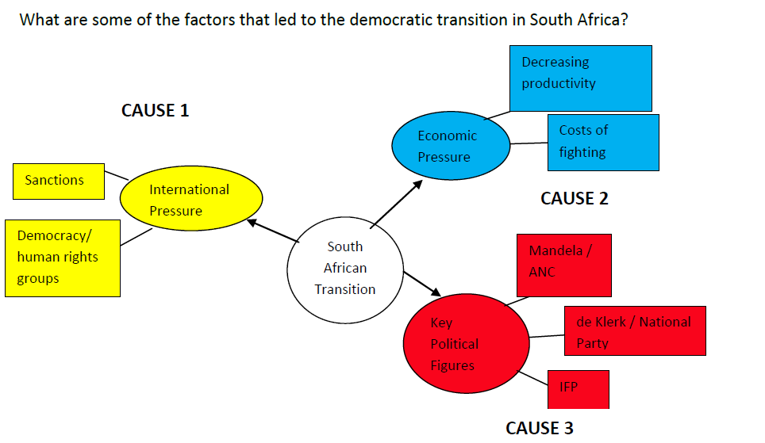
Mind Map

Slide 12
The outlining process
C
Choose the ideas most relevant to the question and its central issue.
It is impossible to cover everything in an essay, and your markers will be looking for evidence of your ability to choose material and put it in order.
You should be able to link each idea to your thesis statement, and clearly explain the link between the point and the essay question.

Slide 13
The outlining process
D
Defend
There is no right or wrong answer to most questions posed in the social sciences, there are simply good or bad arguments.
Support and justify your argument with evidence!

Slide 14
The Outline
Introduction
The purpose of the essay, context and background, thesis statement, the methods used/roadmap of the essay.
Body
1. Domestic political figures
a. Key parties and stances
i. ANC
ii. NP
iii. IFP
b. Political calculations and decision-making
2. Economic factors
a. Decreasing economic productivity and output
b. Costs of continued fighting
3. International pressure
a. Sanctions and lost prestige
b. Democracy/human rights group pressure
Conclusion
Summary of content discussed in body: how economic and international pressure came to bear on political decision making and the main political actors (must show how this content has supported the thesis statement)

Slide 15
This presentation is licenced under the Creative Commons Attribution 2.5 South Africa License. To view a copy of this licence, visit http://creativecommons.org/licenses/by-sa/2.5/za/
Or
send a letter to Creative Commons, 171 Second Street, Suite 300, San Francisco, California 94105, USA.

