Slide 1
Physics 1025F Geometric Optics
THE EYE
Dr. Steve Peterson
Steve.peterson@uct.ac.za

Slide 2
Chapter 25: Optical Instruments
Like a camera, the human eye can focus light and produce sharp images.
We will investigate the imaging (lens) function of the eye and some of the eye’s common defects.

Slide 3
The Human Eye
The human eye resembles a camera in its basic functioning, with an adjustable lens, the iris, and the retina.
The lens adjusts its focal length to capture images at different distances.
The iris automatically controls the light entering the eye.
The retina captures the light entering the eye and is where the lens focuses the image.

Slide 4
The Human Eye
The human eye resembles a camera in its basic functioning, with an adjustable lens, the iris, and the retina.
Most of the refraction occurs as the light crosses the cornea.
The aqueous humor (n = 1.336) is a watery fluid that bends the light towards a focal point (determined by the shape of the cornea).

Slide 5
The Human Eye
Most of the refraction is done at the surface of the cornea.
The role of the lens (n = 1.386 to 1.406) is to acts as a fine adjustment to enable the eye to view objects at different distances (achieved by the lens having the ability to change the curvature of its surfaces).

Slide 6
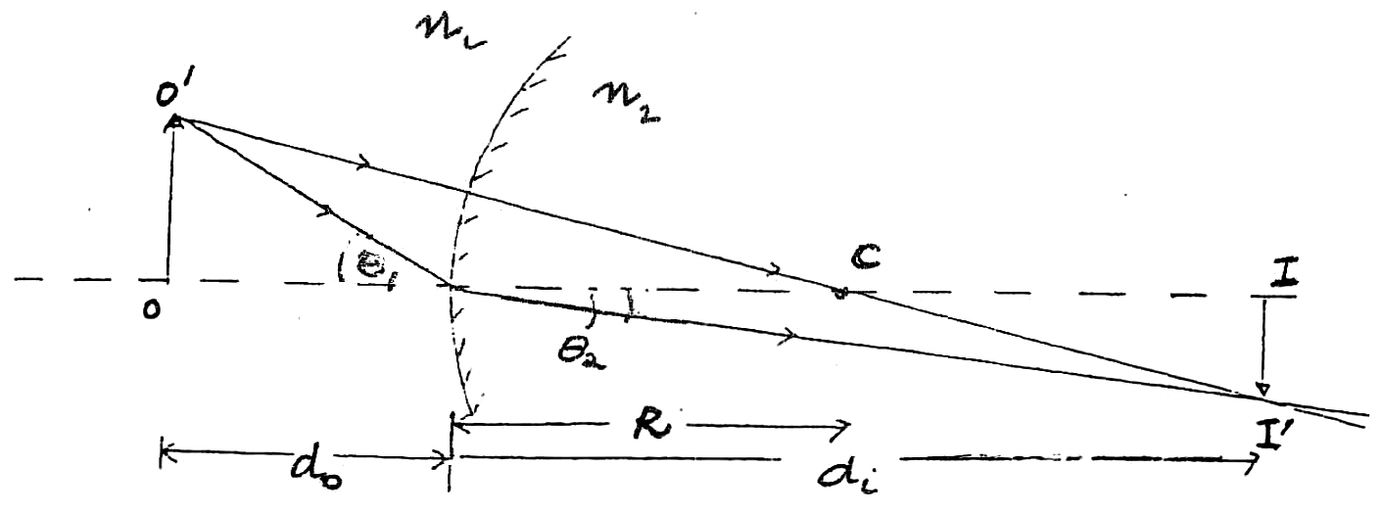
Refraction from Spherical Surface
When light hits a converging spherical surface, it bends toward the radius of curvature, which doubles as the focal point.

Slide 7
Seeing Underwater
Vision is blurry underwater because light rays are bent much less than they would be if entering the eye from air. This can be avoided by wearing goggles.

Slide 8
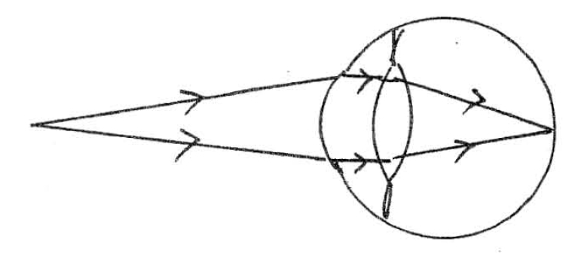
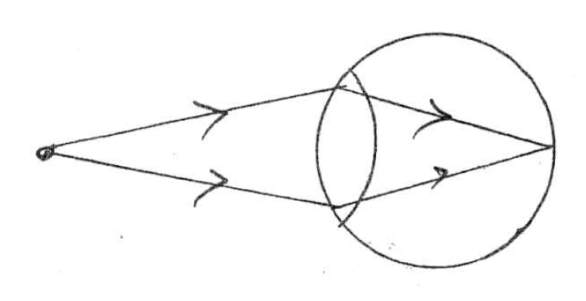
The Human Eye
For convenience we treat the "double" refraction at the cornea and the lens as a single refraction.

Slide 9
The Human Eye: Defects
Near point: closest distance at which eye can focus clearly. Normal is about 25 cm.
Far point: farthest distance at which object can be seen clearly. Normal is at infinity.
Nearsightedness: far point is too close.
Farsightedness: near point is too far away.

Slide 10
Defects of the Eye: Myopia
(a) Myopia (nearsightedness) - can focus on nearby objects, but can't see distant objects.
(i) unaided eye

Slide 11
Defects of the Eye: Myopia
We therefore need spectacle lenses that make distant objects appear to be nearby.
(ii) aided eye

Slide 12
Defects of the Eye: Myopia
Nearsightedness can be corrected with a diverging lens.
The diverging lens takes an object at infinity and creates a virtual image at the person’s far point.

Slide 13
Defects of the Eye: Hyperopia
(b) Hyperopia (farsightedness) - can focus on distant objects, but can't see nearby objects.
(i) unaided eye

Slide 14
Defects of the Eye: Hyperopia
We therefore need spectacle lenses that make nearby objects appear to be distant.
(ii) aided eye

Slide 15
Defects of the Eye: Hyperopia
Farsightedness can be corrected with a converging lens.
The converging lens takes an object at a normal near point of 25 cm and creates a virtual image at the person’s near point.

