Slide 1
Physics 1025F
Heat & Properties of Matter
THERMODYNAMICS
Dr. Steve Peterson
Steve.peterson@uct.ac.za

Slide 2
Chapter 15: Thermodynamics
Thermodynamics is the study of heat and work.

Slide 3
Known: The Ideal Gas Law
Assume that you are familiar with the ideal gas law:
where n is the number of moles and R is the universal gas constant.
Note: the term “ideal” is used because real gases do not follow this equation precisely. However, at pressure near 1 atm and temperatures near room temperature, it is quite accurate.

Slide 4
Where does the Energy go?
When energy is added to a substance what happens?
  OPTION 1: the object’s temperature may increase…
  OPTION 2: the phase of the substance may change…
  OPTION 3: the substance may use that energy to do work
  (i.e. expand) – First Law of Thermodynamics

Slide 5
First Law of Thermodynamics: Work
Consider a gas contained by a cylinder (volume V) fitted with a moveable piston at uniform pressure P.
Determine the work done by the gas at constant pressure (isobaric process).

Slide 6
First Law of Thermodynamics: Work
When the gas expands
  ΔV is positive
  The work done by the gas is positive
When the gas is compressed
  ΔV is negative
  The work done by the gas is negative
When the volume stays constant
  No work is done by the gas

Slide 7
First Law of Thermodynamics: Work
Work done through volume change:
The work done by the gas can also be calculated using a PV diagram, by calculating the area under the curve.
Work done by the gas depends on the path followed.

Slide 8
First Law of Thermodynamics
The change in internal energy (ΔU) of a closed system will be equal to the heat (Q) added to the system minus the work (W) done by the system on its surroundings.
This is the law of conservation of energy, written in a form useful to systems involving heat transfer.

Slide 9

First Law of Thermodynamics
The change in internal energy of a closed system will be equal to the heat added to the system minus the work done by the system on its surroundings.

Slide 10
Thermodynamics Terminology
System: collection of objects one is interested in
Surroundings: everything else
Typically, system = gas
State of a system: a complete set of variables describing the system (pressure, volume, temperature, …)

Slide 11
First Law of Thermodynamics
For the First Law of Thermodynamics, the sign conventions are very important. It can be tricky trying to remember when Q and W are positive and negative.
For heat Q:
Heat flows into a system: Q > 0
Heat leaving the system: Q < 0
The amount of heat flowing into (or out of a system also depends on the path taken

Slide 12
First Law of Thermodynamics
Suppose system gains heat Q while no work is done
By conservation of energy, the internal energy of the system changes:
U increases if system gains heat
U decreases if system loses heat
Heat Q is positive when the system gains heat and negative when the system loses heat

Slide 13
First Law of Thermodynamics
Suppose system does work W on surroundings while no heat flows
By conservation of energy, the internal energy of the system decreases:
U decreases if work done by system
U increases if work done on system
Work W is positive when it is done by the system and negative when it is done on the system

Slide 14
Ideal-Gas Processes
We can represent the state of a gas by a point on a pV diagram. A process can be represented by a path on this diagram.

Slide 15
Thermodynamic Processes
A quasi-static process occurs slowly enough that a uniform temperature and pressure exist throughout all regions of the system at all times
We will consider 4 different thermal processes:
isobaric: constant pressure
isovolumetric: constant volume
adiabatic: no transfer of heat
isothermal: constant temperature

Slide 16
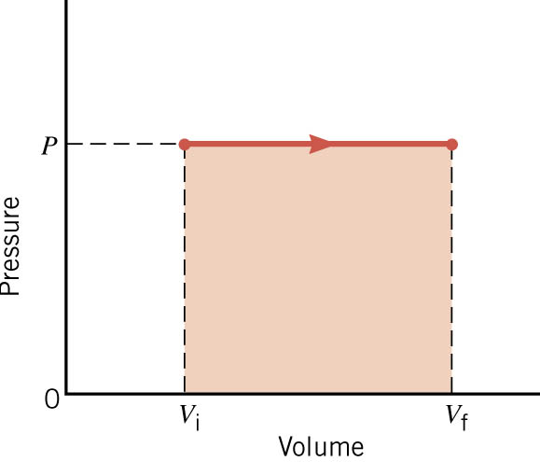


Thermodynamic Processes: Isobaric
An isobaric process is one that occurs at constant pressure
Work done:
area under PV curve
Isobaric process:

Slide 17

Problem: Isobaric Process
What is the change in internal energy of the system after 1 g of water (at 100 ºC) is converted to steam? Assume process is done at atmospheric pressure. (L_{v} for water = 2256 x 10³ J/kg, 1 g of water = 1671 cm³ of steam)

Slide 18
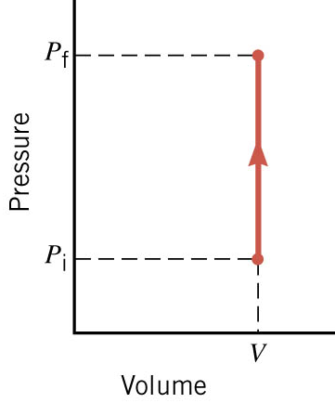
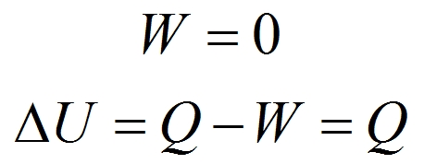
Thermodynamic Process: Isovolumetric
An isovolumetric (or isochoric) process is one that occurs at constant volume
Work done:
area under PV curve
Isovolumetric process:

Slide 19

Problem: Isovolumetric Process
V&S Example 12-7: How much thermal energy must be added to 5.00 moles of monatomic ideal gas at 300 K and with a constant volume of 1.5 L in order to raise the temperature of the gas to 380 K?

Slide 20
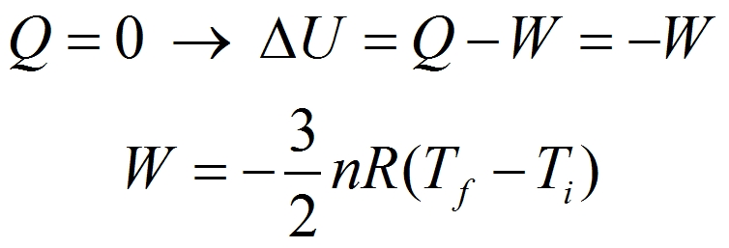
Thermodynamic Processes: Adiabatic
An adiabatic process is one in which no heat flow occurs
Adiabatic Expansion: T_{f} < T_{i}
Adiabatic Compression: T_{f} > T_{i}
Adiabatic process:

Slide 21
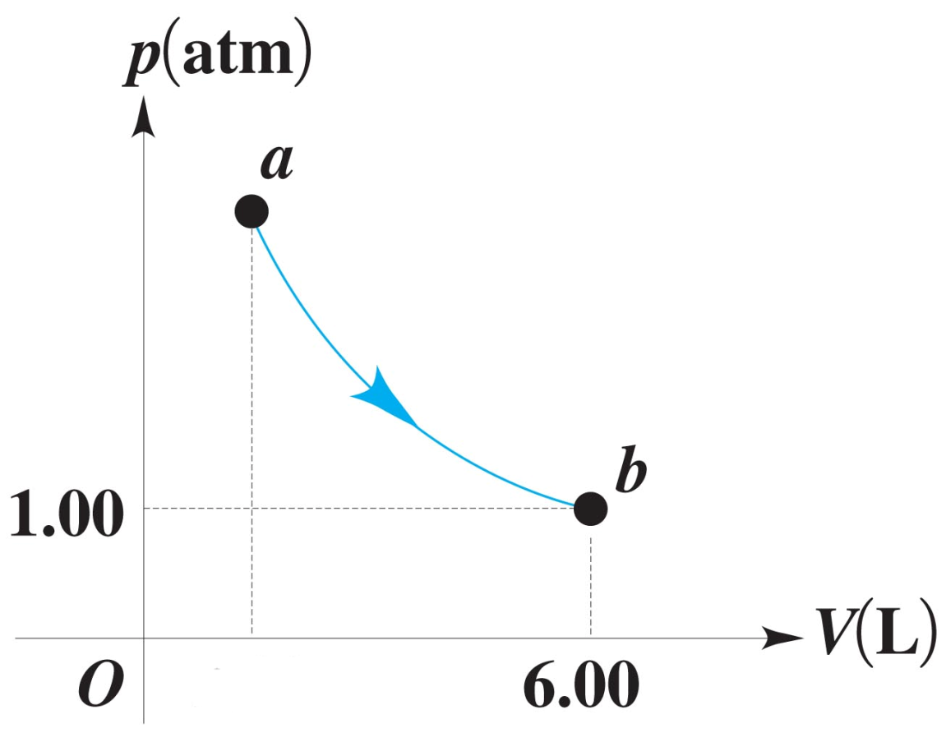
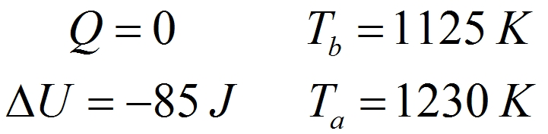
Problem: Adiabatic Process
In the PV diagram shown alongside, 85.0 J of work was done by 0.0650 mole of an ideal monatomic gas during an adiabatic process.
a) How much heat entered or left this gas from a to b?
b) By how many joules did the internal energy of the gas change?
c) What is the temperature of the gas at b?
d) What is the temperature of the gas at a?

Slide 22
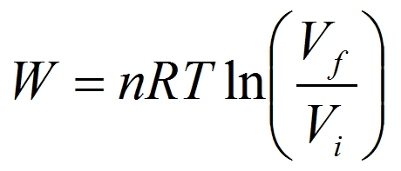
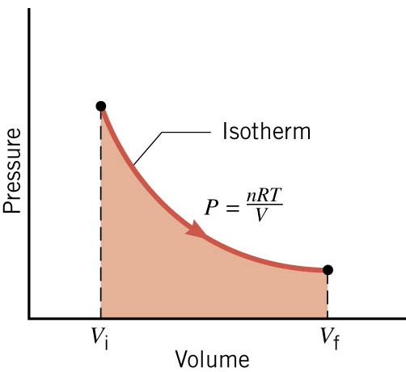
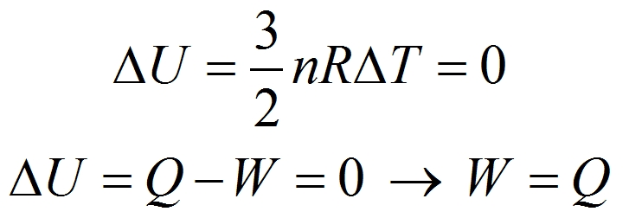
Thermodynamic Processes: Isothermal
An isothermal process is one that occurs at constant temperature
Work done:
area under PV curve
Isothermal process:

Slide 23
Problem: Isothermal Process
C&J Example 15-5: Two moles of the monatomic gas argon expand isothermally at 298 K, from the initial volume of 0.025 m³ to a final volume of 0.050 m³. Assuming that argon is an ideal gas, find (a) the work done by the gas, (b) the change in the internal energy of the gas, and (c) the heat supplied to the gas.

Slide 24
Problem: Thermodynamic Processes
A cylinder, fitted with a frictionless piston, contains 0.250 moles of an ideal monatomic gas at an initial pressure of 6.0 x 10⁴ Pa and an initial volume of 3.0 x 10⁻³ m³.
The gas expands isobarically to twice its initial volume, and then its pressure is decreased isochorically to half its initial pressure. Finally it is compressed isothermally back to its original pressure and volume.
a) Draw a PV diagram showing the three stages.
b) Determine the amount of work done on or by the gas in each stage, and the amount of heat flowing into or out of the gas in each stage.
A to B: W = +180 J, Q = +450 J B to C: W = 0, Q = -270 J
C to A: W = -124.7 J, Q = -124.7 J

Slide 25
Human Metabolism & The First Law
We can apply the first law of thermodynamics to the human body:
Work W is done by the body in its various activities.
In order to maintain our internal energy level, there must be energy coming in.
Energy does not enter the body through heat absorption, instead the body loses heat.
Rather, the energy entering the body through the chemical potential energy stored in foods.

Slide 26
Human Metabolism & The First Law
The metabolic rate (ΔU / Δt) is the rate at which internal energy is transformed in the body.

Slide 27
Measuring Metabolic Rate
The metabolic rate is related to oxygen consumption by
About 80 W is the basal metabolic rate, just to maintain and run different body organs

Slide 28
Aerobic Fitness
One way to measure a person’s physical fitness is their maximum capacity to use or consume oxygen

Slide 29
Efficiency of the Human Body
Efficiency is the ratio of the mechanical power supplied to the metabolic rate or total power input

