Slide 1
Physics 1025F
Vibrations & Waves
SOUND
Dr. Steve Peterson
Steve.peterson@uct.ac.za

Slide 2
Characteristics of Sound (12-1)
Sound is a longitudinal wave transmitted though a medium.
Sound requires a source, a medium of transmission, and a means of detection.
Speed of sound in air is about 340 m/s
  depends slightly on temperature
  depends strongly on the medium

Slide 3
Why speed depends on medium
elastic modulus
rod
density
bulk modulus
solid

Slide 4
Wave Energy & Intensity
A traveling wave transfers energy from one point to another, like carrying a surfer or vibrating an eardrum.
The power of a wave is the rate (J/s) at which the wave transfers energy.

Slide 5
Spherical Waves
Spherical waves propagate radially outward from a source.
The wave fronts are concentric arcs.
Distance between successive wave fronts is the wavelength
Rays are radial lines pointing out from the source perpendicular to the wave fronts

Slide 6
Plane Waves
Far away from the source, the wave fronts are nearly parallel planes.
The rays are nearly parallel lines.
A small segment of the wave front is approximately a plane wave

Slide 7
Plane Waves
Any small portion of a spherical wave that is far from the source can be considered a plane wave.
Consider a plane wave moving in the positive x direction.
The wave fronts are parallel to the plane containing the y- and z-axes.

Slide 8
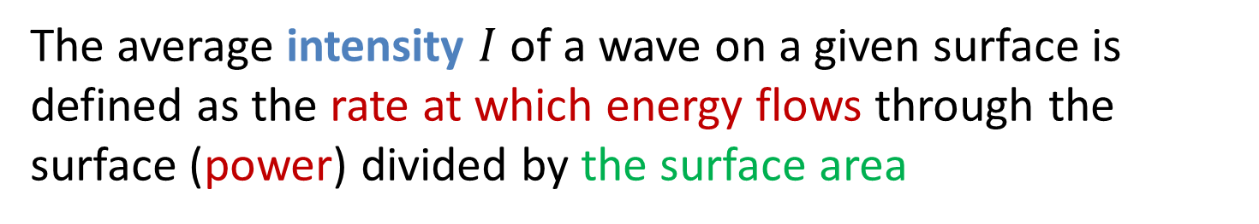
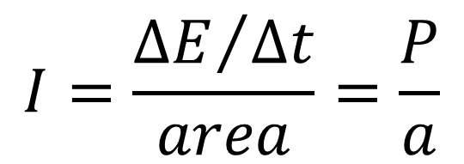
Power, Energy & Intensity
The average intensity $I$ of a wave on a given surface is defined as the rate at which energy flows through the surface (power) divided by the surface area
$$I=\frac{{ΔE}/{Δt}}{area}=\frac{P}{a}$$
The direction of energy flow is perpendicular to the wave fronts (or parallel to the rays)
SI unit of intensity: W/m²

Slide 9
Power, Energy & Intensity
Because intensity is a power-to-area ratio, a wave focused onto a small area has a higher intensity than a wave of equal power that is spread out over a large area.
60 W light bulb vs. 20 – 40 mW laser

Slide 10


Intensity of a Point Source
To conserve energy, the intensity of a point source must decrease.
The average power is distributed over any spherical surface centered on a point source.
To compare intensities at two different points:
$$I=\frac{P}{a}=\frac{P_{source}}{4πr^{2}}$$
$$\frac{I_{1}}{I_{2}}=\frac{{r_{2}^{}}^{2}}{{r_{1}^{}}^{2}}$$

Slide 11
Example: Intensity
If you are standing 2.0 m from a lamp that is emitting 100 W of infrared and visible light, what is the intensity of radiation on your skin? How does this compare with the intensity of sunlight, approximately 1000 W/m² at the surface of the earth?

Slide 12
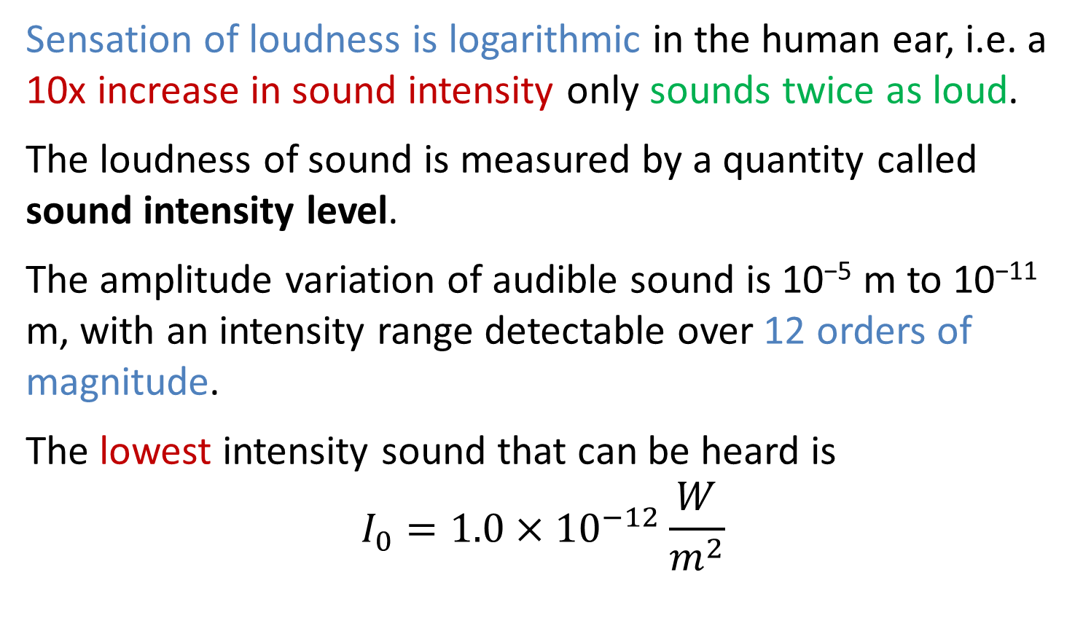
Sound Intensity Level: Decibel Scale
Sensation of loudness is logarithmic in the human ear, i.e. a 10x increase in sound intensity only sounds twice as loud.
The loudness of sound is measured by a quantity called sound intensity level.
The amplitude variation of audible sound is 10⁻⁵ m to 10⁻¹¹ m, with an intensity range detectable over 12 orders of magnitude.
The lowest intensity sound that can be heard is
$$I_{0}=1.0×{10}^{−12}\frac{W}{m^{2}}$$

Slide 13
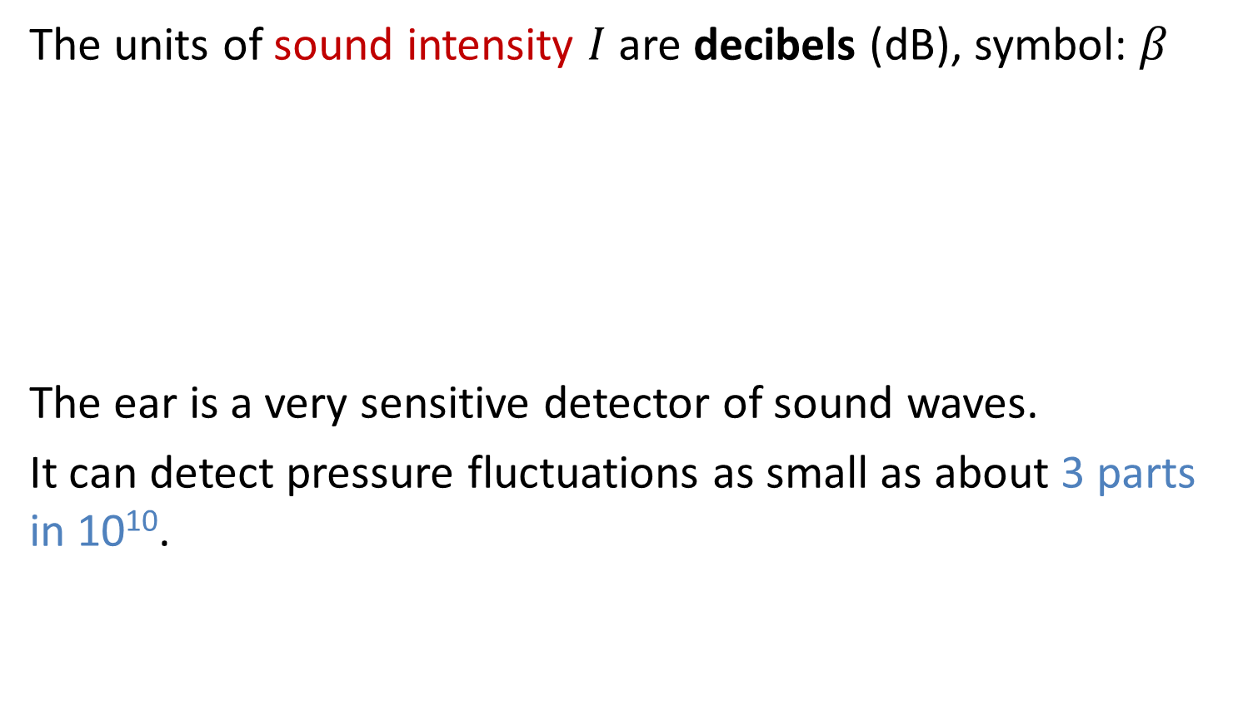
Sound Intensity Level: Decibel Scale
The units of sound intensity $I$ are decibels (dB), symbol: $β$
The ear is a very sensitive detector of sound waves.
It can detect pressure fluctuations as small as about 3 parts in 10¹⁰.

Slide 14

Math Review: Logarithms
a logarithm (log) is defined as
we will use base-10 logarithms right now, so A=10
some rules for logarithms
(subscript A is dropped)

Slide 15
Sound Intensity Level: Decibel Scale
Intensity level is a convenient mathematical transformation of intensity to a logarithmic scale.
Threshold of hearing is 0 dB (faintest sound most humans can hear – about 1 x 10⁻¹² W/m²).
Threshold of pain is 120-130 dB (loudest sound most humans can tolerate – about 1 – 10 W/m²).
Jet airplanes are about 150 dB.
Multiplying a given intensity by 10 adds 10 dB to the intensity level.

Slide 16
Example: Sound Intensity
One student talking in the PHY1025F class produces 60 dB of noise. What is the sound level of five students talking?

Slide 17
The Ear and Its Response (12-3)
The human ear is an incredibly sensitive detector of sound
The eardrum transfers sound to the 3 ear bones, which vibrates the oval window where the cochlea produces electrical energy

Slide 18
Loudness, pitch, & audible range
We perceive two aspects of sound:
Loudness is related to the intensity of a sound wave
Pitch is related to the frequency of a sound wave
Whether or not we can hear a sound depends if it is in our audible range:
frequencies above our audible range are ultrasonic
frequencies below our audible range are infrasonic

Slide 19
Example: Sound Intensity
You are working in a shop where the noise level is a constant 90 dB.
Your eardrum has a diameter of approximately 8.4 mm. How much power is being received by one of your eardrums?
This level of noise is damaging over a long time, so you use earplugs that are rated to reduce the sound intensity level by 26 dB, a typical rating. What is the power received by one eardrum now?

Slide 20

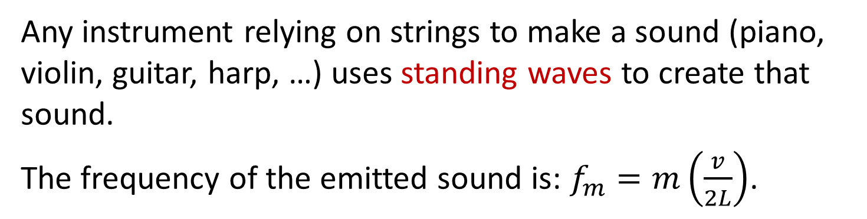

Stringed Musical Instruments
Any instrument relying on strings to make a sound (piano, violin, guitar, harp, …) uses standing waves to create that sound.
The frequency of the emitted sound is: $f_{m}=m\left(\frac{v}{2L}\right)$.
$$\boxed{f_{1}=\frac{1}{2L}\sqrt{\frac{T_{s}}{μ}}}$$
The speed of a wave on a string is: $v=\sqrt{{T_{s}}/μ}$.
So, the frequency produced depends on the tension ($T_{s}$), the length ($L$) and the linear mass density ($μ$) of the string.

Slide 21
Example: Violin
The A string on a violin has a fundamental frequency of 440 Hz. The length of the vibrating portion is 32 cm, and it has a mass of 0.35 g. Under what tension must the string be placed?

Slide 22
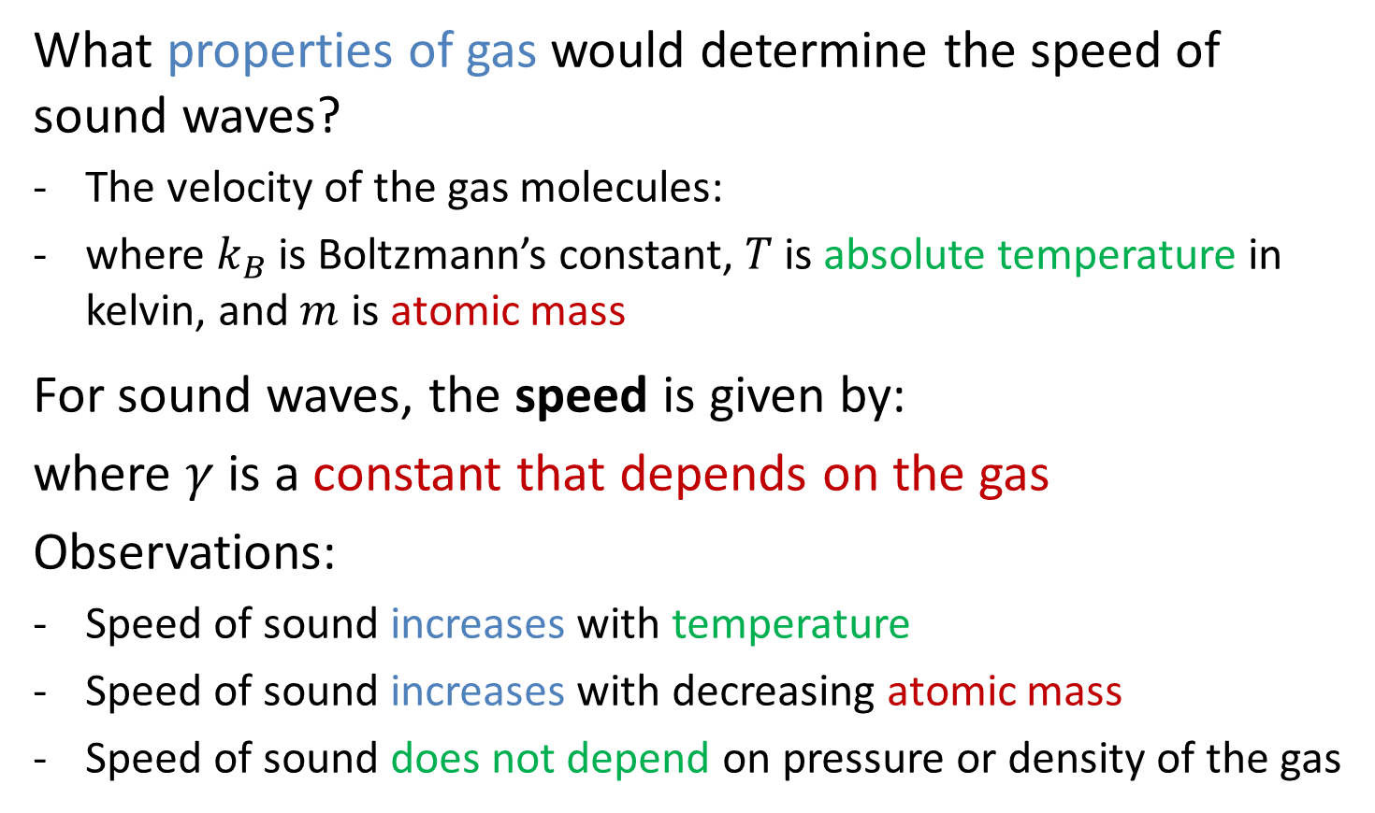
Wave Speed: Sound
What properties of gas would determine the speed of sound waves?
The velocity of the gas molecules:
where $k_{B}$ is Boltzmann’s constant, $T$ is absolute temperature in kelvin, and $m$ is atomic mass
For sound waves, the speed is given by:
where $γ$ is a constant that depends on the gas
Observations:
Speed of sound increases with temperature
Speed of sound increases with decreasing atomic mass
Speed of sound does not depend on pressure or density of the gas

Slide 23
Example: The Speed of Sound
During a thunderstorm, you see a flash from a lightening strike. 8.0 seconds later, you hear a crack of thunder. How far away did the lightening strike?
Notes:
[Knight Example 15.3]

Slide 24
Example: The Speed of Sound
A particular species of spider spins a web with silk threads of density 1300 kg/m³ and diameter 3.0 µm. A typical tension in the radial threads of such a web is 7.0 mN. If a fly lands in this web, which will reach the spider first, the sound or the wave on the web silk?
Answer: wave, v = 436.4 m/s

Slide 25
Sound Waves
Sound waves are longitudinal waves composed of regions of compression and rarefaction of the medium or pressure waves.
Like a wave on a string, sound waves will also reflect at a boundary.
Two possible boundaries:
Open end
Closed end

Slide 26
Open End of Tube
An open end of a tube has similar characteristics to the fixed end of a string.
The pressure at the end of an open tube is fixed at atmospheric pressure and will not vary, thus producing a node for a pressure wave.

Slide 27
Closed End of Tube
A closed end of a tube has similar characteristics to the free end of a string.
The waves bounce off the closed end, thus resembling a free end as the pressure swings between compression and rarefaction, producing an anti-node for the pressure wave.

Slide 28
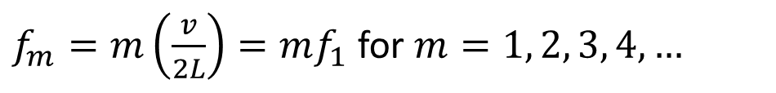
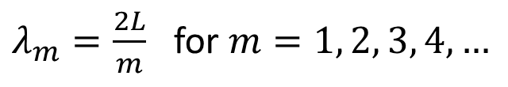
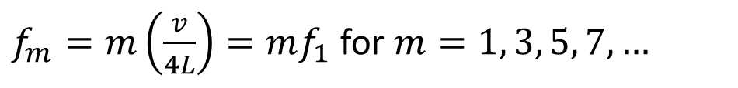
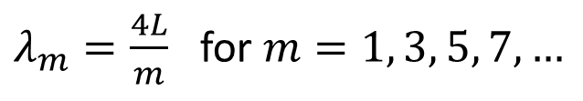
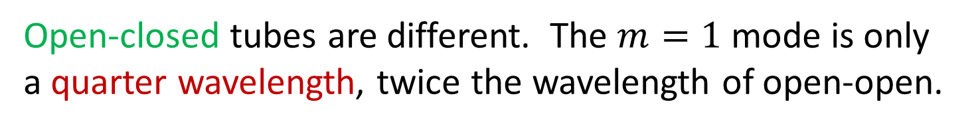
Sound Standing Wave Equations
Open-open and closed-closed tubes use the same equations as waves on a string with fixed ends.
$λ_{m}=\frac{2L}{m}$ for $m=1, 2, 3, 4, …$
$f_{m}=m\left(\frac{v}{2L}\right)=mf_{1}$ for $m=1, 2, 3, 4, …$
Open-closed tubes are different. The $m=1$ mode is only a quarter wavelength, twice the wavelength of open-open.
$λ_{m}=\frac{4L}{m}$ for $m=1, 3, 5, 7,…$
$f_{m}=m\left(\frac{v}{4L}\right)=mf_{1}$ for $m=1, 3, 5, 7, …$

Slide 29
Wind Instruments
Typically blowing into a mouthpiece creates a standing sound wave inside a tube of air.
Different notes are played by covering holes or opening valves, changing the effective length of the tube.
The first open hole becomes the node because it is open to the atmosphere.
A clarinet uses a “reed” to produce the sound. It creates a continuous range of frequencies, but only the resonant frequencies produce standing waves.

Slide 30
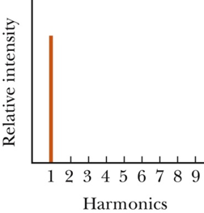
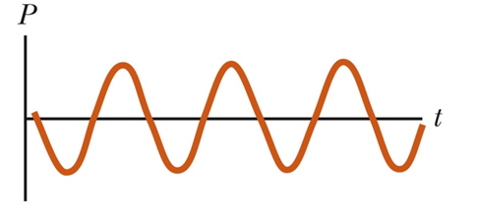
Physics of Speech and Hearing
Any standing wave can be broken down into a frequency spectrum.
Tuning fork produces only the fundamental frequency.

Slide 31
Physics of Speech and Hearing
Other sources of standing wave will have a more complicated structure which can be seen in both the history graph and in the frequency spectrum.
Characteristic sound of an instrument is referred to as the quality of sound (or timbre) and depends on the mixture of harmonics in the sound.

Slide 32
Example: The Ear Canal
The human ear canal is approximately 2.5 cm long. It is open to the outside and is closed at the other end by the eardrum. Estimate the frequencies (in the audible range) of the standing waves in the ear canal.

Slide 33
Sensitivity to Frequency
Equal Perceived Loudness: the sound intensity level required to give the impression of equal loudness for sinusoidal waves at the given frequency.
The easiest frequency to hear is about 3300 Hz. When sound is loud, all frequencies are heard equally well.

Slide 34
Example: Open-Open Tube
A tube, open at both ends, is filled with an unknown gas. The tube is 190 cm in length and 3 cm in diameter. By using different tuning forks, it is found that resonances can be excited at frequencies of 315 Hz, 420 Hz, and 525 Hz, and at no frequencies in between these. What is the speed of sound in this gas?

Slide 35

Doppler Effect
Doppler Effect has to do with the frequency or pitch of a moving sound source.
Stationary Sound Source
Moving Sound Source

Slide 36

Doppler Effect
Extreme Case: Source moving at sound speed or faster
At Speed of Sound
Faster than Speed of Sound

Slide 37
The Doppler Effect (Sound)
When either the listener or the sound source move, the frequency heard by the listener is different to that when both are stationary

Slide 38
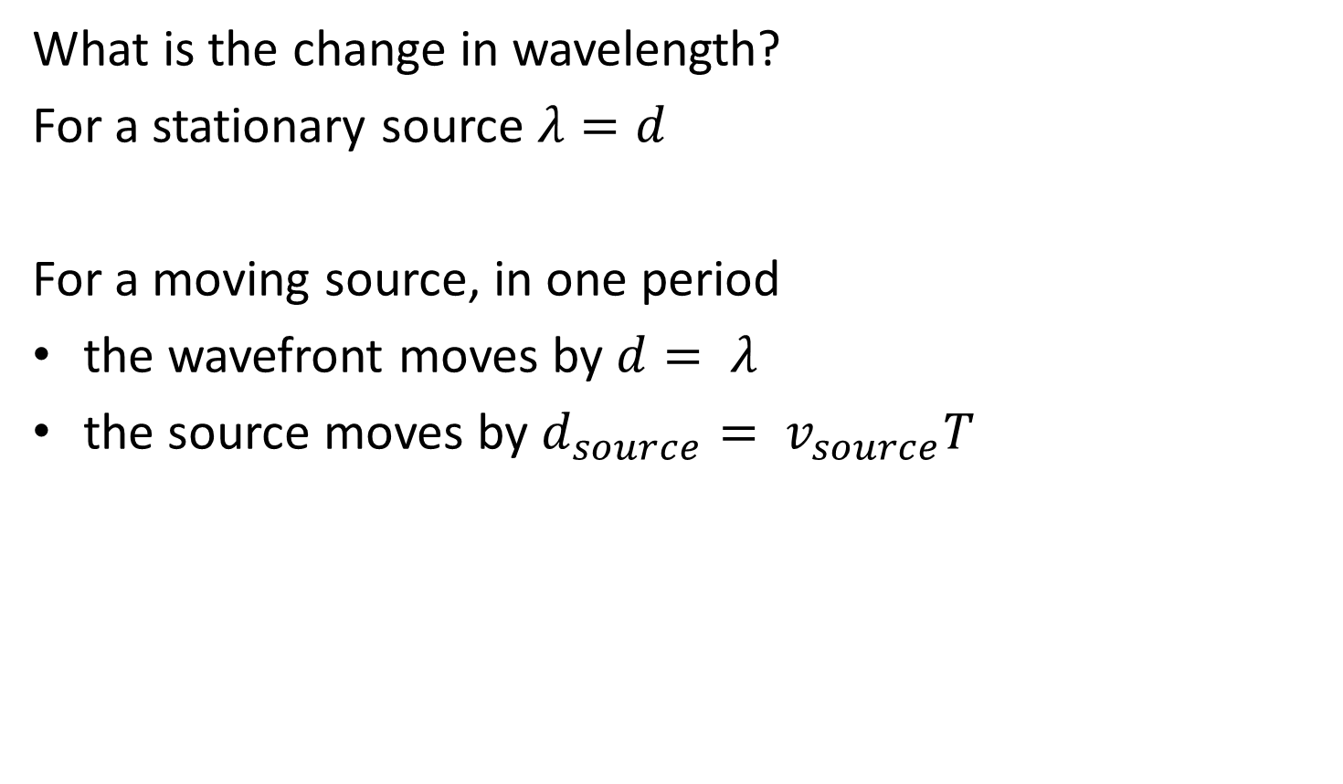
Doppler Effect
What is the change in wavelength?
For a stationary source $λ=d$
For a moving source, in one period
the wavefront moves by $d= λ$
the source moves by $d_{source}= v_{source}T$

Slide 39
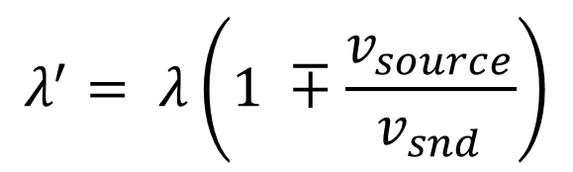




Moving Source, Stationary Listener
The observer will hear wave fronts a distance $λ′$ apart
The observer will hear a frequency $f′$
$$λ^{′}= λ\left(1 ∓\frac{v_{source}}{v_{snd}}\right)$$
$$(−toward, +away)$$
$$f^{′}= \frac{1}{1 ∓ \left(\frac{v_{source}}{v_{snd}}\right)}$$
$$(−toward, +away)$$

Slide 40
Example: Doppler Effect
A car hoots its horn at a frequency of 500 Hz as it passes you at 20 m/s. What frequency do you hear as it moves (a) toward (b) away?

Slide 41
Moving Source, Stationary Listener
Important:
With the source approaching the listener, the pitch heard by the listener is higher than when the source is stationary.
However, as the source gets closer, the pitch does not increase further; only the loudness increases!
As the source passes and begins to recede from the listener, the pitch heard by the listener drops to a value that is lower than when the source is stationary.
However, as the source recedes, the pitch does not decrease further; only the loudness drops!

Slide 42
Example: Doppler Effect
You are standing at x = 0 m, listening to a sound that is emitted at frequency f_{S}. At t = 0 s, the sound source is at x = 20 m and moving toward you at a steady 10 m/s.
Draw a graph showing the frequency you hear from t = 0 s to t = 4 s.

Slide 43
Stationary Source, Moving Listener
Unlike with a moving source, the waves are not squashed or stretched. The observer sees the waves at a different rate.

Slide 44
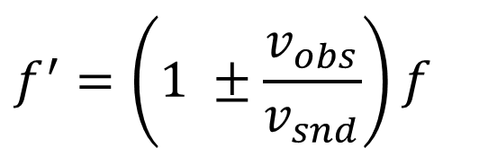
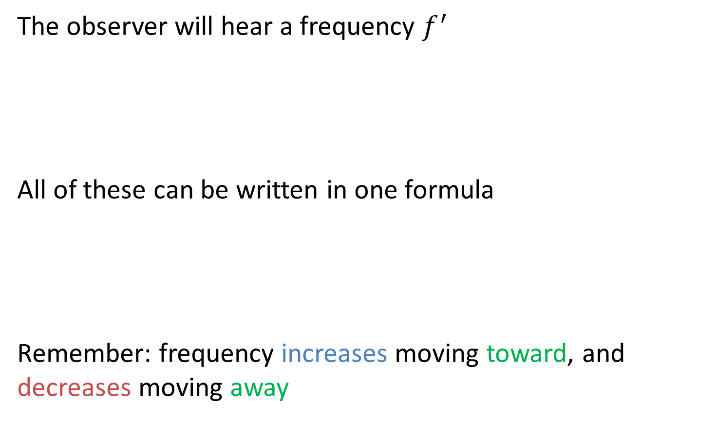

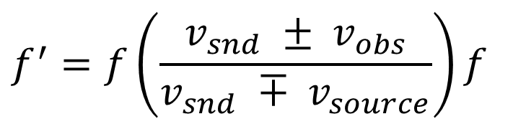

Stationary Source, Moving Listener
The observer will hear a frequency $f^{′}$
All of these can be written in one formula
Remember: frequency increases moving toward, and decreases moving away
$$f^{′}=\left(1 ±\frac{v_{obs}}{v_{snd}}\right)f$$
$$(+ toward, − away)$$
$$f^{′}=f\left(\frac{{v_{snd} ± v}_{obs}}{v_{snd} ∓ v_{source}}\right)f$$
$$(upper toward, lower away)$$

Slide 45
Case 1
moving source
Case 2
moving listener
+ listener towards
− listener away
+ source away
− source towards
NB: applies only in frame where medium is at rest!

Slide 46
Reflection from Moving Objects
Important Fact:
When a sound wave reflects off a surface, the surface acts like a source of sound emitting a wave of the same frequency as that heard by a listener travelling with the surface.

Slide 47
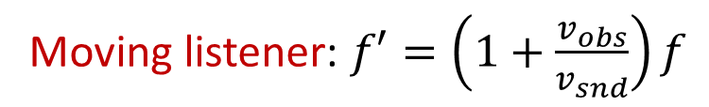

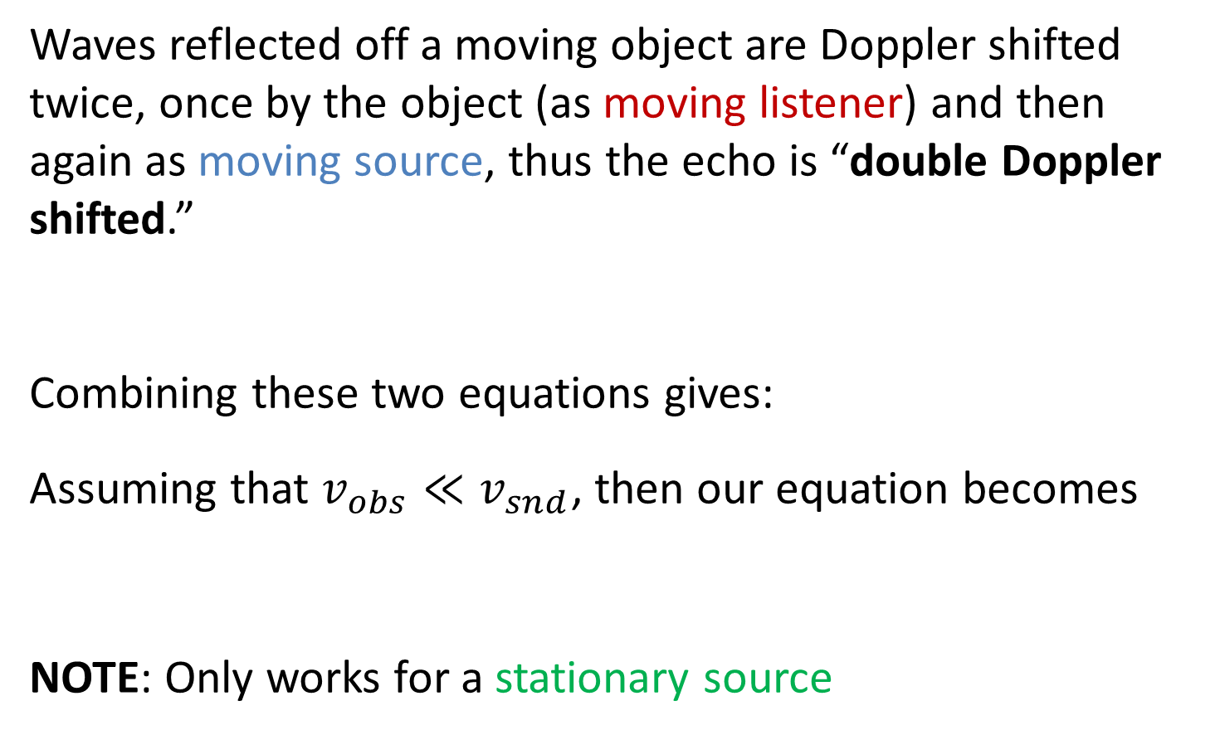
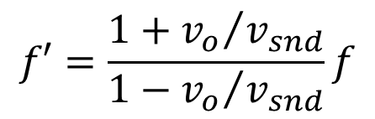
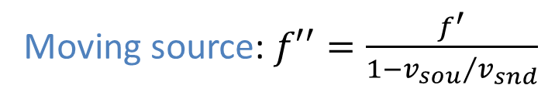

Reflection from Moving Objects
Waves reflected off a moving object are Doppler shifted twice, once by the object (as moving listener) and then again as moving source, thus the echo is “double Doppler shifted.”
Combining these two equations gives:
Assuming that $v_{obs}≪v_{snd}$, then our equation becomes
NOTE: Only works for a stationary source
Moving listener: $f′=\left(1+\frac{v_{obs}}{v_{snd}}\right)f$
Moving source: $f′′=\frac{f^{′}}{1−{v_{sou}}/{v_{snd}}}$
$$(v_{source}= v_{obs})$$
$$f′=\frac{1+{v_{o}}/{v_{snd}}}{1−{v_{o}}/{v_{snd}}}f$$
$$Δf=±2f\frac{v_{obs}}{v_{snd}}$$

Slide 48
Applications of Doppler in Medicine
Doppler Flow Meter (Ultrasound)
Ultrasound
Echocardiagraphy
Used to locate regions where blood vessels have narrowed
pulses at ultrasonic frequencies emitted by transducer.
time of reflected pulses give distance of reflecting surface.
Doppler shift allows you to measure the speed of the reflected surface in an ultrasound image.

Slide 49
The Doppler Effect (Light)
The Doppler effect applies to all waves.
For example, the Doppler effect applies also to light (an electromagnetic wave).
When a light source moves away from an observer, the frequency of the light observed is less than that emitted (equivalently the wavelength of the light observed is greater).
Since a shift to lower frequencies is towards the red part of the spectrum, this is called a redshift.

Slide 50
The Doppler Effect (Light)
The Doppler effect for light is used in astronomy to measure the velocity of receding astronomical bodies
It is also used to measure car speeds using radio waves emitted from radar guns

Slide 51
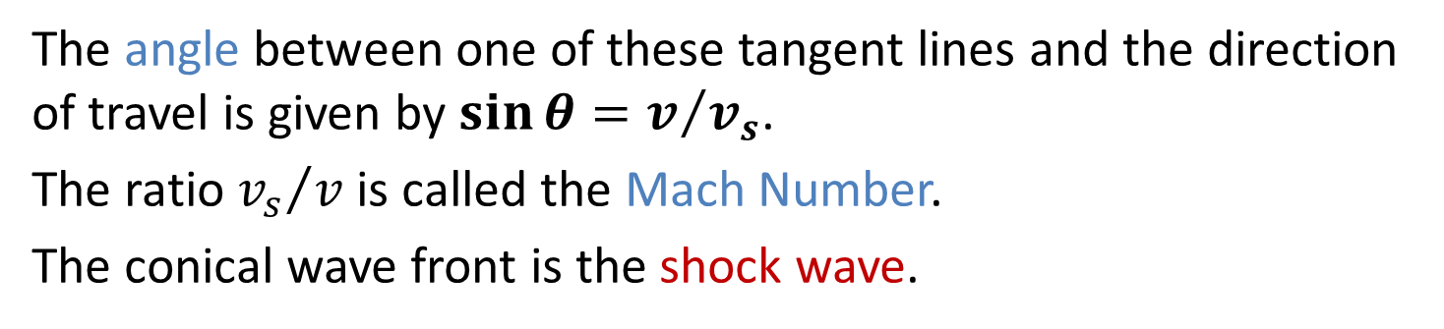
Doppler Effect, Shock Waves
A shock wave results when the source velocity exceeds the speed of the wave itself.
The circles represent the wave fronts emitted by the source.
Tangent lines are drawn from S_{n} to the wave front centered on S_{o}.
The angle between one of these tangent lines and the direction of travel is given by $\sin{θ}=v/{v_{s}}$.
The ratio ${v_{s}}/v$ is called the Mach Number.
The conical wave front is the shock wave.

Slide 52
Doppler Effect, Shock Waves
Shock waves carry energy concentrated on the surface of the cone, with correspondingly great pressure variations.
A jet produces a shock wave seen as a fog of water vapor.

Slide 53
Example: Standing Wave
Two strings with linear densities of 5.0 g/m are stretched over pulleys, adjusted to have vibrating lengths of 50 cm, and attached to hanging blocks. The block attached to string 1 has a mass of 20 kg and the block attached to string 2 has mass M. When driven at the same frequency, the two strings support the standing waves shown.
What is the driving frequency?
What is the mass of the block suspended from String 2?

