Slide 1
Physics 1025F Mechanics
EQUILIBRIUM
Dr. Steve Peterson
Steve.peterson@uct.ac.za

Slide 2
Chapter 7: Centre of Mass
Until now, we have assumed that motion of an extended object could be approximated as a point particle or only undergoes translational motion

Slide 3
Centre of Mass
For real extended bodies (particularly if they are undergoing rotation) it is important to know the point where we may consider all the mass to be located. This point is known as the “centre of mass".

Slide 4
Centre of Mass
Gravity, for example, will act as if all the mass were located at the centre of mass – for this reason the point is sometimes also referred to as the centre of gravity.
The general motion of an object can be considered as the sum of the translational motion of the CM, plus rotational, vibrational, or other forms of motion about the CM.

Slide 5
Centre of Mass
For symmetrical bodies the centre of mass is at the centre of symmetry.

Slide 6
Centre of Mass
For irregularly shaped bodies the center of mass is best obtained experimentally.

Slide 7
Centre of Mass
To be stable, the centre of mass must lie above the base of support.

Slide 8
Centre of Mass
Consider a system made up of two particles of masses m_{A} and m_{B}, both lying along the x-axis at positions x_{A} and x_{B}. Let’s calculate the centre of mass.
y
x
For two particles, the center of mass lies closer to the one with the most mass.

Slide 9
Centre of Mass
Now let’s consider a body composed of masses m₁, m₂, m₃ located at three different positions.

Slide 10
Chapter 8: Rotational Motion
From Newton’s second law, we see that a force will cause a body to accelerate. What causes a body to undergo a rotational acceleration?

Slide 11
Rotational Equivalent of Force
Newton’s Second Law tells us that a force produces an acceleration.
Can a force also produce an angular acceleration or is something else required?
Let’s look at opening a door, which requires a rotational acceleration.

Slide 12
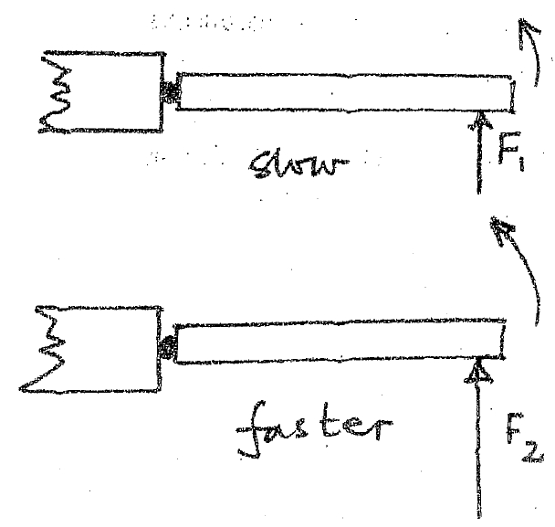
Opening the Door
The magnitude of the applied force determines how quickly the door opens.

Slide 13
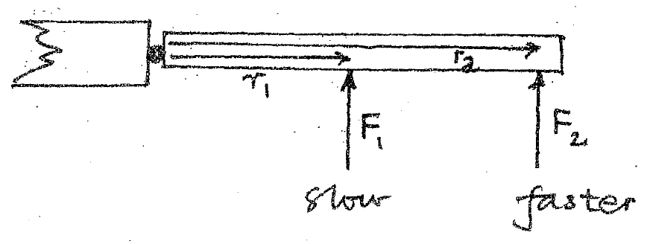
Opening the Door
The location of the applied force makes a difference, with different locations producing different accelerations. Therefore it appears that the distance r from the axis of rotation is important.

Slide 14
Opening the Door
The direction of the force is also important. The force applied perpendicularly to the door is most effective in achieving rotational acceleration, that at 45° is less effective while the force parallel to the door won’t produce any rotation at all!

Slide 15
Opening the Door
Therefore the ability to cause rotational acceleration depends on both the magnitude of the applied force, F, and the perpendicular distance from the axis of rotation to the line of action of the force.

Slide 16
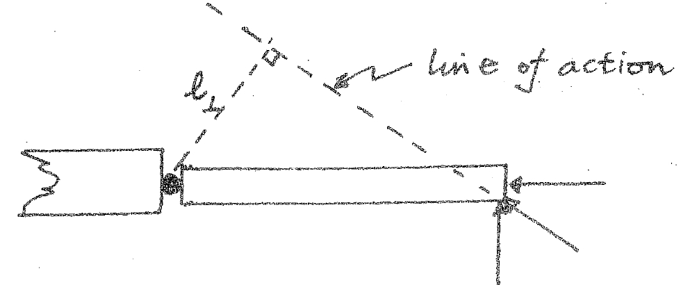
Opening the Door
Therefore the ability to cause rotational acceleration depends on both the magnitude of the applied force, F, and the perpendicular distance from the axis of rotation to the line of action of the force.

Slide 17
Torque
This product of the two, , is referred to as the “torque”, τ, while is referred to as the “moment arm” or “lever arm”.
Therefore torque is given by
Cross Product: Another form of Vector Multiplication

Slide 18
Torque
Torque, τ, is the tendency of a force to rotate an object about some axis.
τ is torque and represented by the Greek symbol, tau
F is the applied force
r is the length of the position vector
SI unit is N.m

Slide 19
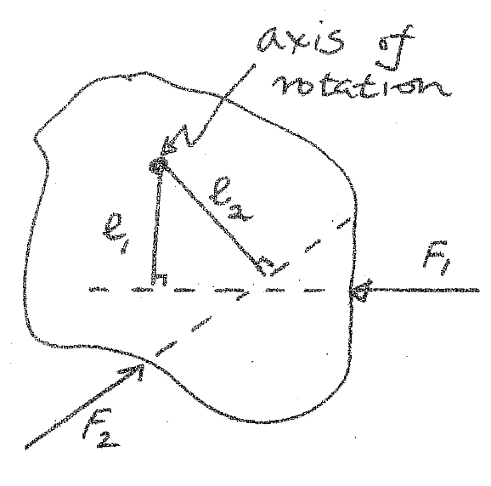
Direction of Torque
Torque is a vector quantity
The direction is perpendicular to the plane determined by the position vector and the force .
If the turning tendency of the force is counterclockwise, the torque will be positive.
If the turning tendency (F₁) is clockwise, the torque will be negative .

Slide 20
Example: Torque
Revolutionaries attempt to pull down a statue of the Great Leader by pulling on a rope tied to the top of his head. The statue is 17 m tall, and they pull with a force of 4200 N at an angle of 65° to the horizontal. What is the torque they exert on the statue? If they are standing to the right of the statue, is the torque positive or negative?

Slide 21
Torque
If more than one torque acts on a body then it is the net torque acting on the body which will determine whether the body undergoes rotational acceleration or not.
If ,
If ,
Rotational Equilibrium

Slide 22
Example: Torque
A 2 kg and a 3 kg hang from the left hand side of a beam balance as shown below – where must a 4 kg be hung to “balance” these two weights?

Slide 23
Chapter 9: Static Equilibrium
Statics is concerned with the calculation of the forces acting on and within structures that are in equilibrium

Slide 24
The Conditions for Equilibrium
An object with forces acting on it, but that is not moving, is said to be in equilibrium.
The first condition for equilibrium is that the forces along each coordinate axis add to zero.
The second condition of equilibrium is that there be no torque around any axis; the choice of axis is arbitrary.

Slide 25
Solving Statics Problems
Choose one object at a time, and make a free-body diagram showing all the forces on it and where they act.
Choose a coordinate system and resolve forces into components.
Write equilibrium equations for the forces.
Choose any axis perpendicular to the plane of the forces and write the torque equilibrium equation. A clever choice here can simplify the problem enormously.
Solve.

Slide 26
Solving Statics Problems
If a force in your solution comes out negative, it just means that it’s in the opposite direction from the one you chose. This is trivial to fix, so don’t worry about getting all the signs of the forces right before you start solving.
If there is a cable or cord in the problem, it can support forces only along its length. Forces perpendicular to that would cause it to bend.

Slide 27
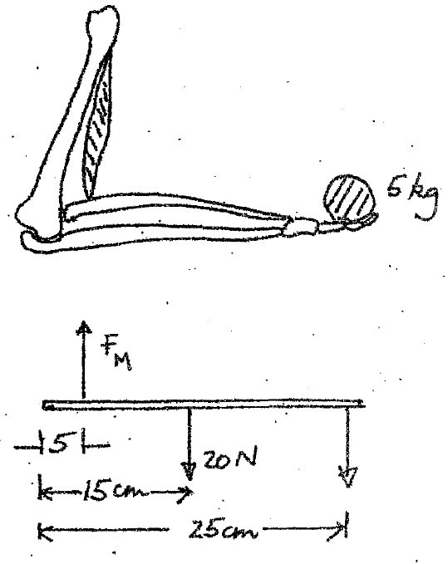
Example: Static Equilibrium
Determine the force exerted by the biceps muscle on the forearm when supporting a 5.0-kg mass in the hand, 25.0 cm from the elbow. The biceps muscle is attached to the forearm 5.0 cm from the elbow joint, the weight of the forearm is 20.0 N and its centre of mass is 15.0 cm from the joint.

Slide 28
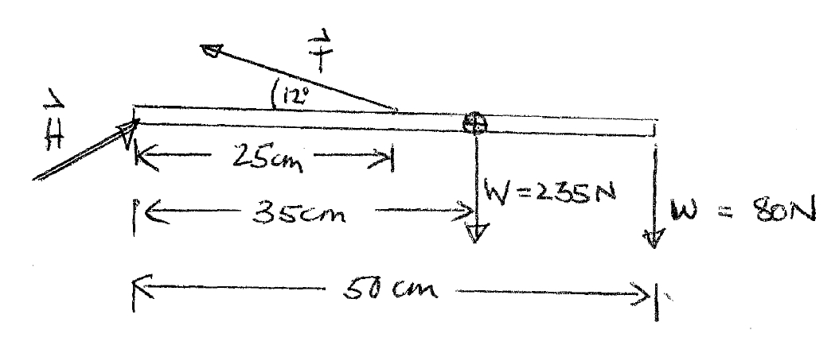
Example: Static Equilibrium
A woman bends from the hip to lift an 80.0-N weight. The forces acting on her spine are represented schematically in the diagram below. The upper part of her body has a weight of 235 N, T is the force exerted by the back muscle on the spine, and H is the force of hips on the spine. Applying the condition of static equilibrium, determine the magnitudes of H and T.

Slide 29
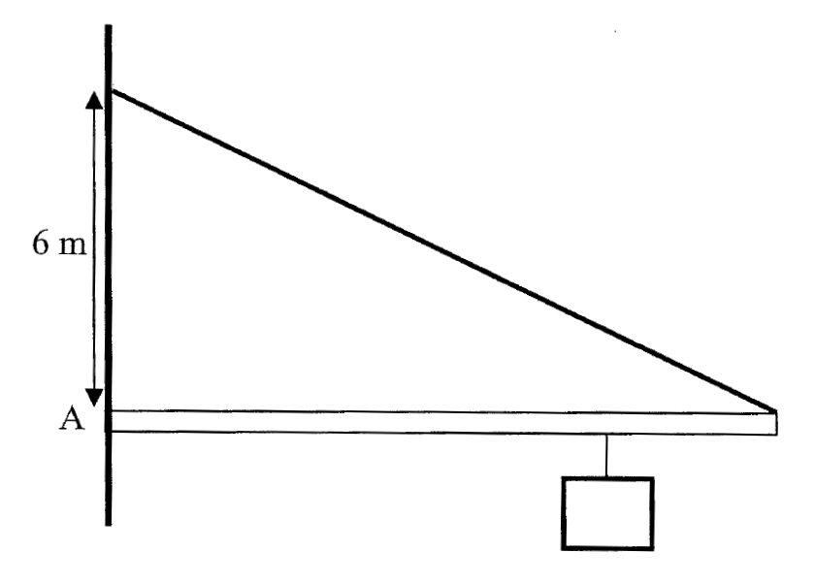
Example: Static Equilibrium
A 25 kg uniform bar, 10.0 m in length, is fixed to a wall on one side and is supported in a horizontal position by a steel wire attached to the other end. A mass of 15 kg is hung from the bar at a distance of 7.5 m from the fixed end. What is the tension in the wire and the magnitude of the force exerted by the wall on the bar at A? How would the tension in the wire change if the weight were moved closer to the wall?

Slide 30
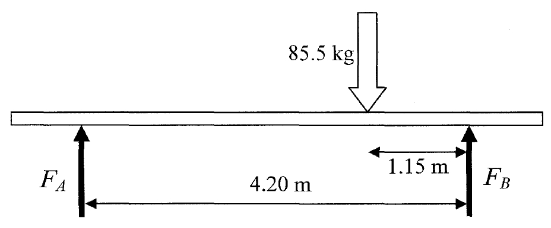
Example: Static Equilibrium
To paint a wall a painter (mass 85.5 kg) places a 5.60 m board (mass 15.3 kg symmetrically on top of two supports 4.20 m apart (see diagram below). If the painter stands on the board 1.15 m from the right-hand support what are the magnitudes of the forces exerted by the two supports on the board? The painter now moves slowly to the right. How close to the end of the board can he move before it begins to tip?

