Slide 1
Physics 1025F Mechanics
VECTORS
Dr. Steve Peterson
Steve.peterson@uct.ac.za

Slide 2
Chapter 1: Dimensions & Units
To communicate the result of a measurement for a quantity, a unit must be defined.

Slide 3
Units & Standards
Quantity | Unit | Standard
Length | Meter (m) | Length of the path traveled by light in 1/299,792,458 second.
Time | Second (s) | Time required for 9,192,631,770 periods of radiation emitted by cesium atoms.
Mass | Kilogram (kg) | Platinum cylinder in International Bureau of Weights and Measures, Paris.

Slide 4
Dimensional Analysis
Dimensions of a quantity are the base units that make it up; they are generally written using square brackets.
Examples: Mass = [M], Distance = [L], Time = [T]
Area = distance x distance →
Speed = distance / time →

Slide 5
Dimensional Analysis
Quantities being added or subtracted must have the same dimensions.
In addition, a quantity calculated as the solution to a problem should have the correct dimensions, or [RHS] = [LHS]

Slide 6
Example: Dimensional Analysis
A famous physicist combines mass and velocity in order to find the energy of a particle. Use dimensional analysis to find an equation relating energy to these two quantities.
Notes:
[ENERGY] = [M L² / T²]
[MASS] = [M], [VELOCITY] = [L/T]
E = mc²

Slide 7
Converting Units
Converting between metric units, for example from kg to g, is easy, as all it involves is powers of 10.
Converting to and from British units is considerably more work.
For example, the world’s second highest peak, K2, is 8611-m high.
Given that 1 m = 3.28084 ft, this 8611-m mountain is 28251 feet high.

Slide 8
Example: Converting Units
A firkin is an old British unit of volume equal to 9 gallons. How many cubic meters are there in 6.00 firkins?
(1 gal = 3.786 L, 1 L = 1000 cm³)
Notes:
Vuille/Serway Q1.17

Slide 9
Example: Converting Units
A swimming pool is 2 m deep, 6 m wide and 15 m long. Water flows into the pool at the rate of 40 L/min. How long does it take to fill?
(1 L = 1000 cm³).
Notes:
Vuille/Serway Q1.17

Slide 10
Chapter 3: Vectors
Each physical quantity can be categorized as either a vector quantity or a scalar quantity

Slide 11
Vector Representation
We can represent vector quantities with arrows
The direction of the vector is represented by the direction of the arrow
The magnitude of the vector is represented by the length of the arrow

Slide 12
Vector Addition
The net force acting on the body will be the vector sum of the two forces.
Adding vectors is not simply a matter of adding the magnitudes (except in one-dimension)

Slide 13
Vector Addition (Tip to Tail Method)
Graphically, the vectors F_{A} and F_{B} can be added by using the “Tip to Tail” method, giving the resultant vector R = F_{A} + F_{B}.
Note: R = F_{A} + F_{B} = F_{B} + F_{A}.

Slide 14
Vector Addition (Subtraction)
For vector subtraction, it can easily be rewritten as an addition, i.e. R = F_{A} - F_{B} = F_{A} + (-F_{B}). Using the vector property that (-F_{B} is equal in magnitude, but opposite in direction from F_{B}.
Note: same as R + F_{B} = F_{A}.

Slide 15
Example: Vector Addition
F_{A} is a force of 10 N to the West
F_{B} is a force of 15 N to the South-East

Slide 16
Vector Addition (1-dimension)
Vectors do behave a little like numbers when they lie in the same or opposite directions (i.e. one-dimensional vectors). Consider these two 1D vectors. (A = 3 m, B = -1 m)
Determine the following vectors.
R = A + B
S = A – B
T = B – A

Slide 17
Vector Addition (1-dimension)
We can get the same result if we drop the vector notation and assign + or – to the magnitude (based on the direction)
i.e.
A = +3 B = -1
R = A + B =
S = A – B =
T = B – A =
Positive direction

Slide 18
Vector Addition Using Components
Adding vectors graphically has limitations, and a more accurate answer can be found by adding vectors after breaking them into components.
Any 2D vector can be expressed as the sum of two other vectors, typically chosen along the x and y directions, such as C shown here.
y
x

Slide 19
Vector Addition Using Components
The component vectors of C are C_{x} and C_{y}. The magnitudes of C_{x} and C_{y}, which are C_{x} and C_{y} respectively, are generally called the components of C.
From the figure, we can see:
where C is the magnitude of C.
y
x

Slide 20
Vector Addition Using Components
We can recover the initial vector C from the components C_{x} and C_{y} with the following equations:
y
x

Slide 21
Example: Vector Components
An airplane is traveling 735 km/h in a direction 41.5° West of North. Find the components of the velocity vector in the Northerly and Westerly directions.
Notes:
Vuille/Serway Q1.17

Slide 22
Vector Addition Using Components
If we want to add two vectors, R = C + D, then we need to find the components of D.
From the figure, we can see:
where D is the magnitude of D.
y
x

Slide 23
Vector Addition Using Components
Adding the two vectors, R = C + D.
y
x

Slide 24
Vector Addition Using Components
Find the resultant magnitude and angle.
y
x

Slide 25
Vector Subtraction Using Components
Subtracting the two vectors, R = C – D.
y
x

Slide 26
Vector Subtraction Using Components
Find the resultant magnitude and angle.
y
x

Slide 27
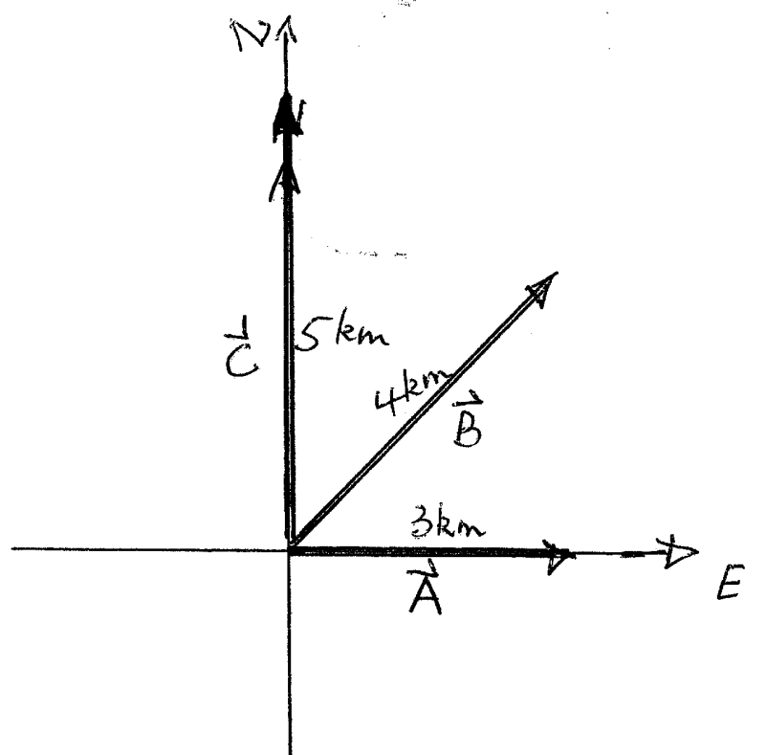
Example: Vector Addition
Consider the following 3 vectors,
A = 3 km to the East
B = 4 km 60° North of East
C = 5 km to the North
Determine R = A + B + C
and S = A – B – C
Notes:
Vuille/Serway Q1.17

Slide 28
Problem-Solving Strategy
A required skill in Physics is problem-solving. We all use a problem-solving strategy whether we realize it or not.
Let me introduce you to a general Physics problem-solving strategy.
The problem-solving strategy has three steps:
Prepare (Setup the problem)
Solve (Do necessary math or reasoning)
Assess (Check your answer)

Slide 29
Problem-Solving Strategy: Prepare
The Prepare step of a solution is where you identify important elements of the problem and collect information you will need to solve it. It’s tempting to jump right to the Solve step, but a skilled problem solver will spend the most time on this step, the preparation.
Preparation includes:
Drawing a picture
Collecting necessary information
Doing preliminary calculations

Slide 30
Problem-Solving Strategy: Prepare
Drawing a picture
Most important part of the problem. The picture lets you model the problem and identify the important elements. A picture can also be a motion diagram or graph.
Collecting necessary information
Gather the given values and variables and compile a list of relevant information
Doing preliminary calculations
There are a few calculations, such as unit conversion, that are best done in advance of the main part of the problem.

Slide 31
Problem-Solving Strategy: Solve
The Solve step of a solution is where you actually do the mathematics or reasoning necessary to arrive at the answer needed.
This is the part of the problem-solving strategy that you likely think of when you think of “solving problems.”
But don’t make the mistake of starting here!
The Prepare step will help you be certain you understand the problem before you start putting numbers in equations.

Slide 32
Problem-Solving Strategy: Assess
The Assess step of a solution is very important. When you have an answer, you should check to see whether it makes sense.
Ask yourself:
Does my solution answer the question that was asked?
Does my answer have the correct units and number of significant figures?
Does the value I computed make physical sense?
Can I estimate what the answer should be to check my solution?
Does my final solution make sense in the context of the material I am learning?

Slide 33
Example: Problem-Solving Strategy
A fully loaded Boeing 747 with all engines at full thrust accelerates at 2.6 m/s². Its minimum takeoff speed is 70 m/s. How much time will the plane take to reach its takeoff speed? What minimum length of runway does the plane require for takeoff?
Notes:
Knight Example 2.11

Slide 34
Example: Problem-Solving Strategy
A car is traveling at a speed of 30 m/s, a typical highway speed, on wet pavement. The driver sees an obstacle ahead and decides to stop. For this instant, it takes him 0.75 s to begin applying the brakes. Once the brakes are applied, the car experiences an acceleration of -6.0 m/s². How far does the car travel from the instant the driver notices the obstacle until stopping?
Notes:
Knight Example 2.12

