Slide 1
Physics 1025F ELECTRICITY
Dr. Steve Peterson
Steve.peterson@uct.ac.za

Slide 2
Chapter 16: Electric Charge & Field
Study of electricity aims to understand the interaction between “charged” objects

Slide 3
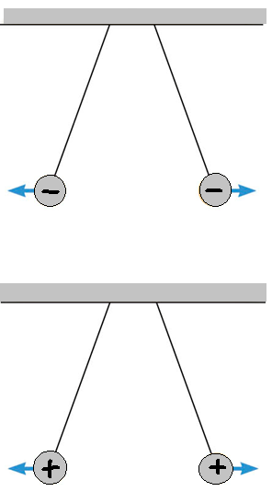
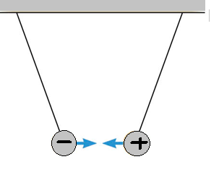
Electric Charge & Matter
Charge is an intrinsic property
There exist only two types of charge
positive & negative
‘LIKES’ REPEL
‘OPPOSITES’ ATTRACT

Slide 4
Electric Charge & Matter: DNA
The interaction between charges forms the basis for chemistry & biochemistry
Atoms and molecules
are held together by
electric forces!

Slide 5
Electric Charge & Matter: The Atom
positive (+e)
neutral
negative (-e)

Slide 6
Electric Charge & Matter: The Atom
The magnitude of the charge on an electron or proton is the smallest amount of free charge yet discovered
Charges of larger magnitude are built up on an object by adding or removing multiple electrons
Charge is said to be quantised!
(first found experimentally by Robert Millikan in 1909)

Slide 7
Electric Force: Coulomb’s Law
COULOMB’S LAW
The magnitude of the electrostatic force
exerted by one stationary point charge on another is:
directly proportional to the magnitude of the charges, and
inversely proportional to the square of the distance between them

Slide 8
Electric Force: Coulomb’s Law
Force directed along line joining the two particles
Mathematically,
Applies to stationary point charges and spherical charge distributions only

Slide 9
Electric Force: Coulomb’s Law
Important:
When applying Coulomb’s Law, use only the magnitudes of the charges to find the magnitude of the force using,
Then determine the direction of the force by considering the force diagram

Slide 10
Electric Force: Coulomb’s Law
Coulomb’s Law looks very similar to Newton’s Law of Gravitation,
but is different in two aspects:
electric force is much stronger
and
electric force can be attractive or repulsive

Slide 11
Electric Force: Superposition Principle
When a number of separate charges act on the charge of interest, each exerts an electric force.
These forces can be computed separately and then added as vectors to give the net electric force on the charge of interest.
Notation: force exerted by i on j

Slide 12
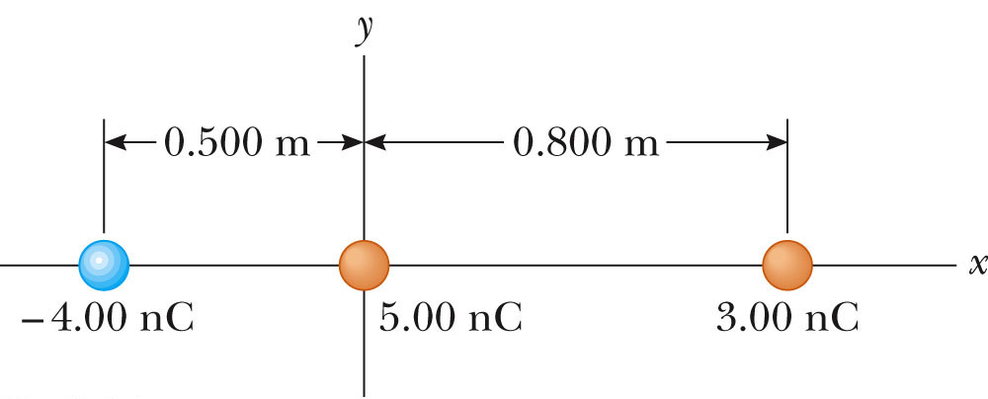
Problem: Coulomb’s Law I
Calculate the magnitude and direction of the electrostatic force on each of the three charges below.

Slide 13
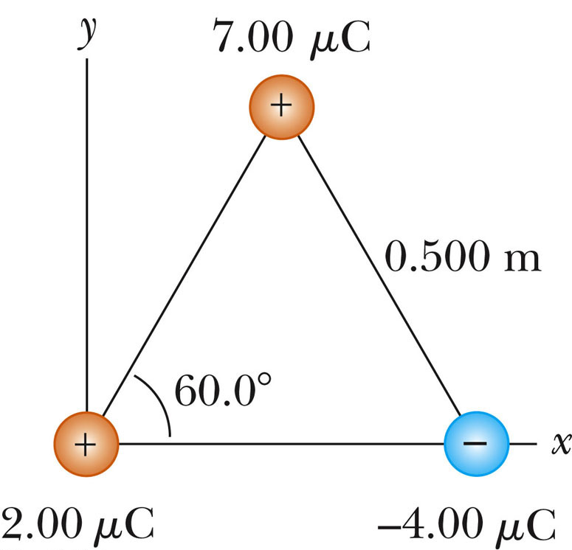
Problem: Coulomb’s Law II
Three point charges are located at the corners of an equilateral triangle, as shown below. Find the magnitude and direction of the net electric force on the 2.00 μ C charge.

Slide 14
Electric Field
Coulomb’s Law tells us there is a force between electric charges, even though the charges are never in contact.
What produces this force?
In the 1820s, the British scientist Michael Faraday introduced the concept of an electric field
Electric charge alters the space around it by setting up an electric field
Additional charges placed in this field will experience a force due to this electric field

Slide 15
Electric Field: Test Charge
It is possible to investigate an electric field. A test charge is a probe used to measure the electric force at a point due to other charged particles
In order not to disturb the distribution of the source charges, the test charge must be small in magnitude

Slide 16
Electric Field: Definition
The electric field that exists at a point is the electrostatic force experienced by a small test charge placed at that point divided by the charge itself:
Force on test charge placed at point
Electric field at point
Charge of test charge
SI Unit: Newton per coulomb (N/C)

Slide 17
Electric Field: Related to Electric Force
Once electric field is known at a point, one can determine the force on any charge placed at that point.

Slide 18
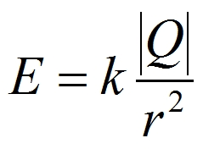
Electric Field: Point Charge
Magnitude of electric field due to point charge Q:
Note: electric field does not depend on the test charge
Direction of electric field due to point charge:
-> away from positive charge -> towards negative charge

Slide 19
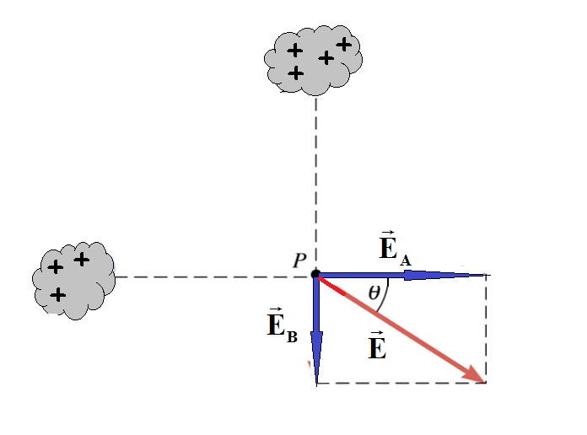
Electric Field: Multiple Charges
The electric field due to multiple sources is given by the principle of superposition:
B
Electric fields from different sources add as vectors
(look out for symmetry)
A
x

Slide 20
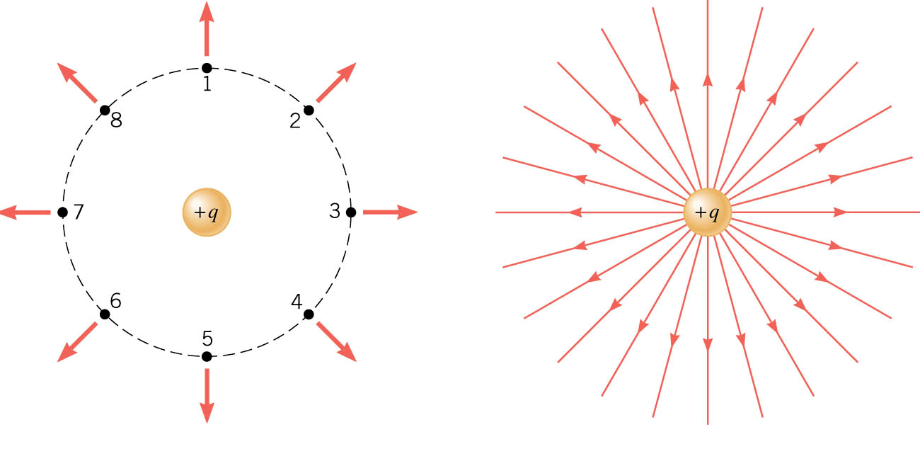
Electric Field: Representation
Electric field lines provide a map of the electric field in the space surrounding electric charges
+
-
Positive Point Charge

Slide 21
Electric Field Lines
Electric field lines provide a map of the electric field in the space surrounding electric charges
The electric field vector is tangent to the electric field lines at each point
The number of lines per unit area through a surface perpendicular to the lines is proportional to the strength of the electric field in a given region

Slide 22
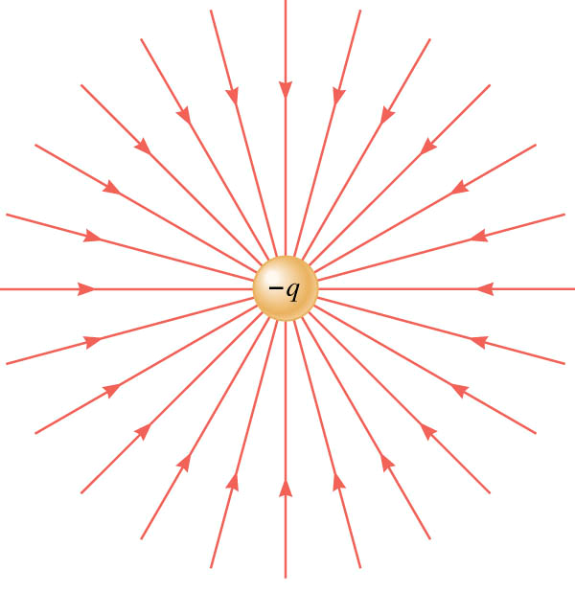
Electric Field Lines
Negative Point Charge
+
-
Electric field lines are always directed away from positive charges and toward negative charges

Slide 23
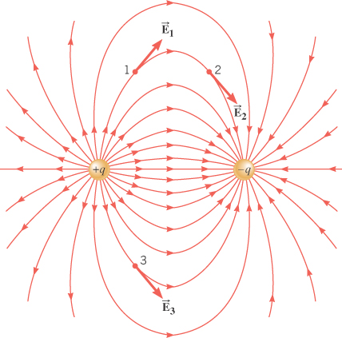
The number of lines leaving a positive charge or entering a negative charge is
proportional to the magnitude of the charge
Opposite Point Charges
Electric dipole
-
+

Slide 24
Electric Field Lines: Opposite Charges
Electric field lines are always directed away from positive charges and toward negative charges
Electric field lines never cross

Slide 25
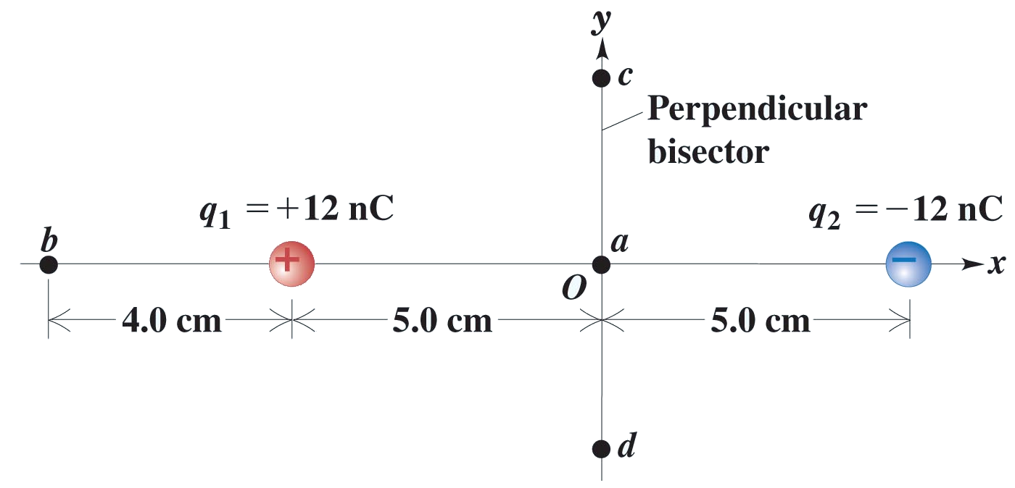
Problem: Electric Field
For the arrangement below, find the electric field (a vector!) at points a, b, c and d.
3.0 cm
3.0 cm

Slide 26
Chapter 17: Electric Potential
There is a huge amount of electrical potential energy stored in clouds. Lightening is the release of this energy through the movements of electrons and ions.

Slide 27
Electric Field Lines: Parallel Plates
Two parallel plates uniformly distributed with opposite charges produces a uniform electric field
Electric field lines always begin on a positive charge and end on a negative charge and do not stop in between

Slide 28
Electric Potential Energy
Since electric force is conservative, we can define an electric potential energy
Doing work against a conservative force produces an increase in potential energy

Slide 29
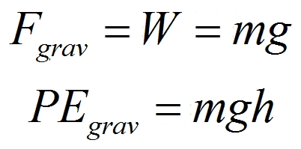
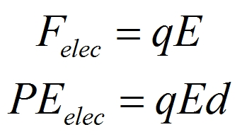
Electric Potential Energy
Electric potential energy is analogous to gravitational potential energy
The direction of the increase in PE depends on the direction of the electric field

Slide 30
Electric Potential Difference
Charge of object moving under
field’s influence
Difference in electrical
potential energy of charge q
Define the Electrical Potential Difference between two points in the field as the
“difference in electrical potential energy per unit charge”
Units: J/C or Volts

Slide 31
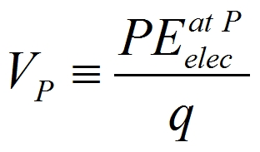
Electric Potential
To arrive at a property of the field, dependent only on the source charges setting up the field, we define the electrical potential at a point P in the field as …
… the electrical potential energy of a
small test charge placed at the point P divided by the charge on the test charge,
Unit: J/C or Volts

Slide 32
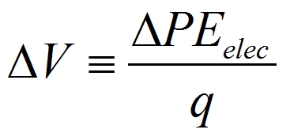
Electric Potential Difference
q₀
q₀
b
a
+
Evaluate the difference between the electrical potential energy of a test charge placed at the two points divided by the charge on the test charge

Slide 33
Electric Potential Difference
All charge will spontaneously move from points of high electrical potential energy to points of lower electrical potential energy (ΔPE_{elec} < 0)
Positive Charge
Negative Charge
moves spontaneously from points of high electric potential to points of lower electric potential (ΔV < 0)
moves spontaneously from points of low electric potential to points of higher electric potential (ΔV > 0)

Slide 34
2
V₂ = 800 V
e⁻
p
1
V₁ = 200 V

Slide 35
Capacitor
Parallel-Plate Capacitor consists of two conducting plates that do not touch. They are designed to store electric charge with the help of an electric field.

Slide 36
The Electrocardiogram (ECG or EKG)
The electrocardiogram detects heart defects by measuring changes in potential on the surface of the heart.

Slide 37
The Electrocardiogram (ECG or EKG)
Just like skeletal muscles, heart muscles are electrically stimulated to contract. This stimulation is also called activation or excitation. Cardiac muscles are electrically charged at rest. The inside of the cell is negatively charged relative to the outside (resting potential). If the cardiac muscle cells are electrically stimulated, they depolarize (the resting potential changes from negative to positive) and contract. The depolarization spreads across the cell and the entire muscle; the muscle then repolarizes to its original state.

Slide 38
The Electrocardiogram (ECG or EKG)
As the electrical impulse spreads through the heart, the electrical field changes continually in size and direction. The ECG is a graph of these electrical cardiac signals.

Slide 39
Chapter 18: Electric Currents
The glow of a light bulb filament is caused by the electric current passing through it. The electric energy is transformed into thermal energy, the wire’s temperature increasing until it starts to glow

Slide 40
Electric Circuit
An electric circuit consists of energy sources and energy-consuming devices connected by conducting wires through which charges move

Slide 41
The Electric Battery (EMF Source)
A battery produces electricity by transforming chemical energy into electrical energy.
symbol
Such devices provide a potential difference across the circuit, increasing the potential energy of the charges circulating in the circuit every time they enter the device (“charge pump”)

Slide 42
The Electric Battery (EMF Source)
“Voltage Pump” Boosts Potential Energy of Charges
High potential
Demand
12 V
Supply
Low potential
E.g. a 12 V battery gives every 1 C of charge passing through it 12 J of potential energy which is lost in passing through the bulb

Slide 43
Electric Current: Charge Flow
In order for charge to flow, there has to be
a supply of mobile charge
a potential difference / electric field
Then, positive charges will flow…
…from the higher to the lower potential
or alternatively
…in the direction of the electric field
while, negative charges will flow…
…from the lower to the higher potential
or alternatively
…in the opposite direction to the electric field

Slide 44
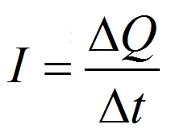
Electric Current: Equation
Current is the rate at which charge flows through a perpendicular surface
Unit: C/s or A (ampere)

Slide 45
Electric Current: Direction
The direction of current is defined as the direction of flow of positive charge, even if it is not the positive charges that move.
Moving charges (charge carriers) can be positive, negative or both…
In metals the charge carriers are negative electrons…

Slide 46
Electric Resistance: Ohm’s Law
The resistance of many materials is constant over a wide range of ΔV and I
Ohm’s Law:
The current in an ohmic resistor is directly proportional to the potential difference applied across it

Slide 47
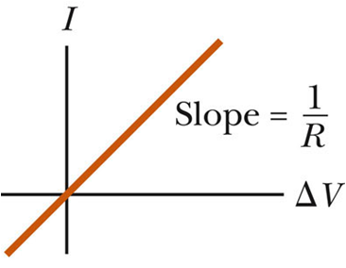
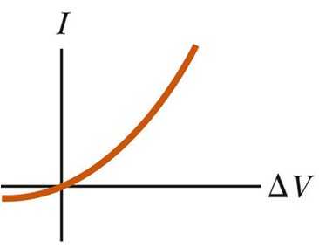
Electric Resistance: Ohm’s Law
Ohmic device:
Non-ohmic device:

Slide 48
Electric Resistance: Equation
Moving charges in a conductor collide with ionized atoms, thus experiencing resistance
Resistance
Resistance is high when a small current results from a large potential difference

Slide 49
Electric Resistance: Equation
Units: V/A or ohm (Ω)
symbol
A resistor is any device that offers a specified resistance to the flow of charge
An ideal conductor offers NO resistance to the flow of charge

Slide 50
Electric Circuits: Closed Loop
In addition to a energy source (battery) and an energy-consuming device (resistor), we need a complete path or closed loop for the current to flow.

Slide 51
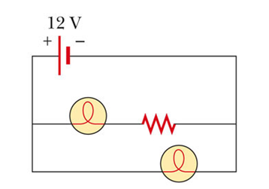
Circuit Diagrams
A circuit diagram is a stylized figure representing an actual circuit
Circuit Diagram

Slide 52
Potential Difference Across Resistor
High Potential
R
a
b
Lower Potential
I
An electrical potential decrease, as from point a to point b, is often called a potential drop or voltage drop

Slide 53
Electric Circuits: Example
b
+
Conventional
Current
a
V_{a} − V_{d} = 12 V
12 V
V_{b} − V_{c} = 12 V
−
d
c
Actual Electron Current (low to high potential)

Slide 54
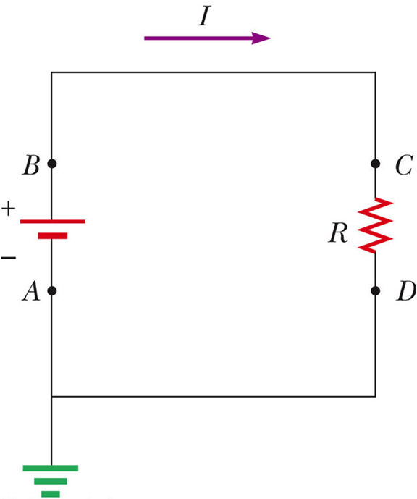
Electrical Energy & Power
High potential
Electrical potential energy of charge ΔQ increases by ΔQ ΔV, while chemical potential energy of battery decreases by this amount
Charge loses electrical potential energy ΔQ ΔV which is transformed to internal energy in the resistor
Chemical Energy in Battery
Kinetic Energy of Charge Carriers
Thermal Energy
Ground:
Zero potential

Slide 55
Electrical Energy & Power
Rate of electrical potential energy loss in resistor:
Rate at which energy is delivered to resistor (power):
Unit: J/s or watt (W)
Ohmic devices

Slide 56
Problem: Electric Power
You buy a 75-W light bulb in Europe, where electricity is delivered to homes at 240 V. If you use the light bulb in the United States at 120 V (assume its resistance does not change), how bright will it be relative to 75-W 120-V bulbs?

Slide 57
Electric Power
What you pay for on your electric bill is not power, but energy – the power consumption multiplied by the time.
We have been measuring energy in joules, but the electric company measures it in kilowatt-hours, kWh.

Slide 58
Problem: Electric Power
At R1.20 per kWh, what does it cost to leave a 40-W porch light on day and night for a year?

Slide 59
The Human Nervous System
The human nervous system depends on the flow of electric charge.
The basic elements of the nervous system are cells called neurons.
Neurons have a main cell body, small attachments called dendrites, and a long tail called the axon.
Signals are received by the dendrites, propagated along the axon, and transmitted through a connection called a synapse.

Slide 60
The Human Nervous System
The propagation of signal through the nervous system depends on the net negative charge on the inside of the nerve cells, like the cardiac muscle cells.
This applies to most cells in the body. Neurons can respond to a stimulus and conduct an electrical signal. This signal is in the form of an action potential.

Slide 61
The Human Nervous System
The action potential propagates along the axon membrane. It lasts for about 1 ms and can travel up to 150 m/s.

Slide 62
Chapter 19: DC Circuits
Electric circuits are a basic part of all electronic devices.
One of the simplest examples of an electric circuit is Christmas lights.

Slide 63
Direct vs. Alternating Current
Direct current (DC): Uni-directional flow of charge (as in circuit with battery)
Alternating currents (AC): varying direction of current flow (as produced by generators and power companies like ESKOM)

Slide 64
Electric Circuits: Two Ways to Connect
Series Parallel
One device dies and all die!
One device dies, others live on!
Resistors in series:
Current the same through resistors
Voltages across resistors add up
Resistors in parallel:
Voltage the same across resistors
Currents thorough resistors add up

Slide 65
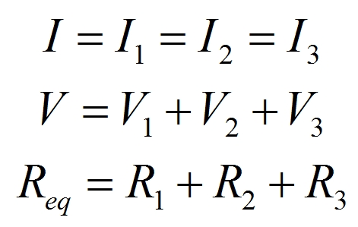
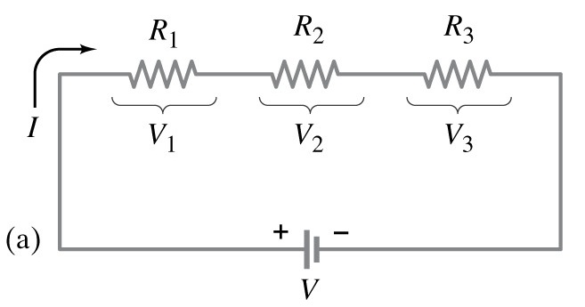
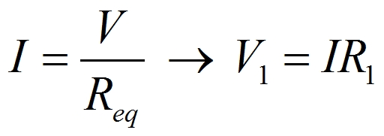
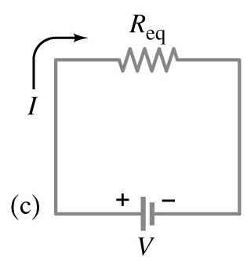
Electric Circuits: Series
Currents the same
Voltages add
Resistances add
Solving Circuit
1. Find Current
2. Find Voltages

Slide 66
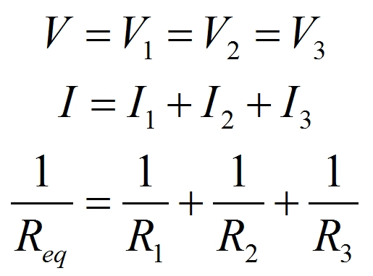
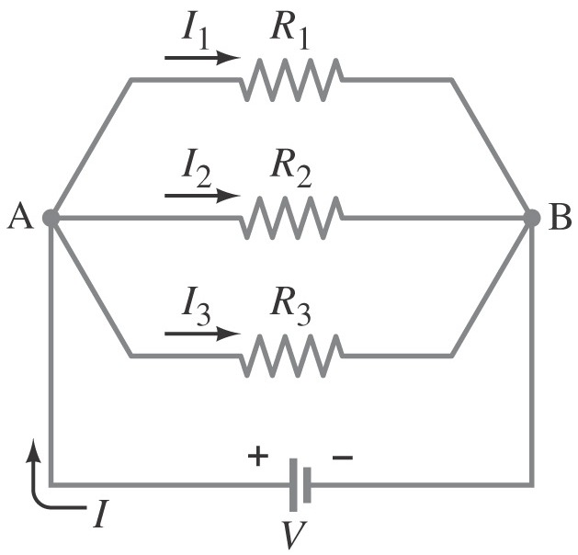
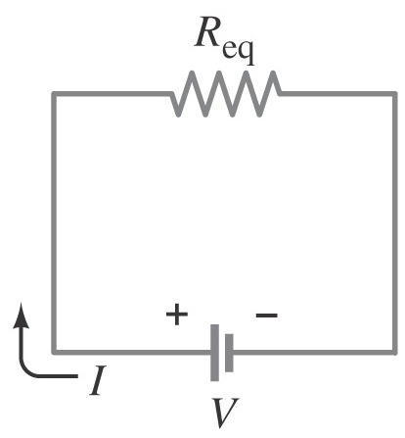
Electric Circuits: Parallel
Voltages the same
Currents add
Sum of inverses
Solving Circuit
1. Find Voltage
2. Find Currents

Slide 67
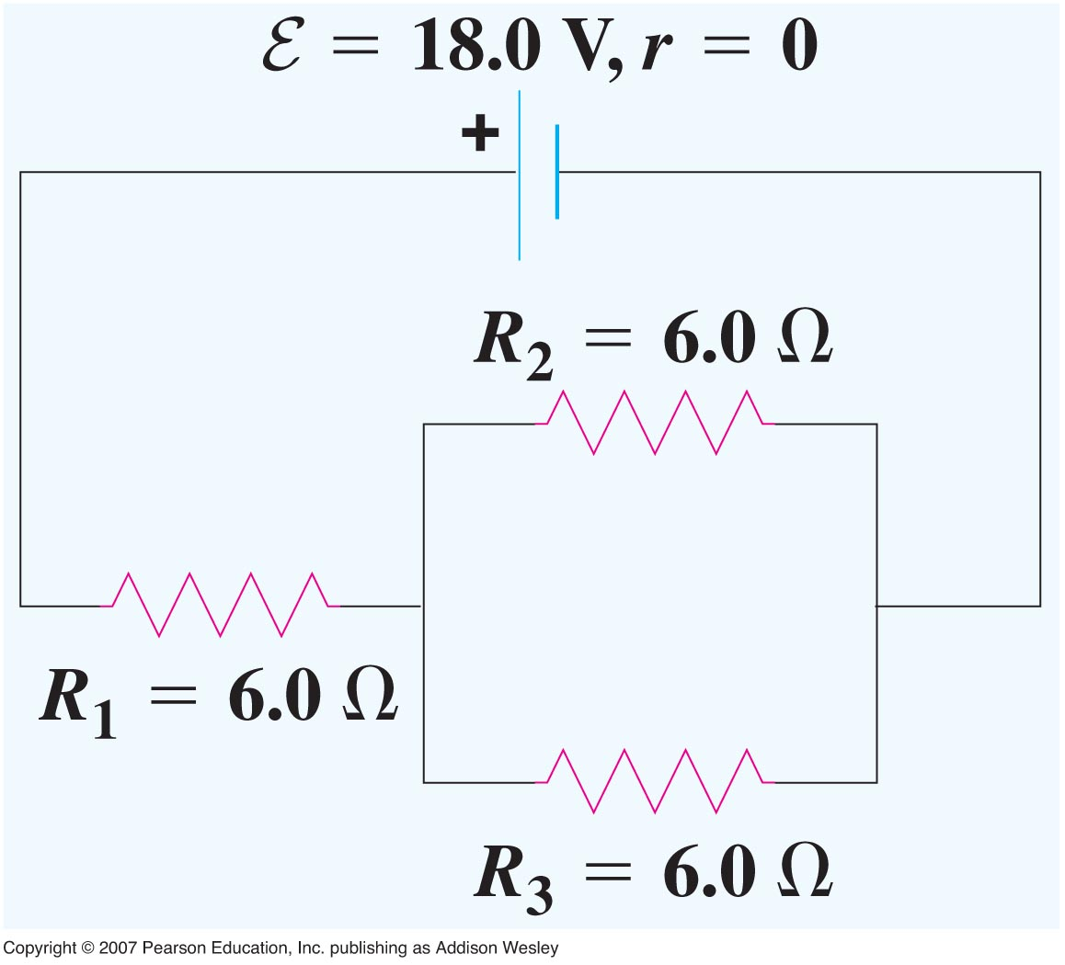
Problem: Electric Circuit I
For the circuit shown, (a) find the equivalent resistance of the resistor network; (b) find the current in each resistor and (c) find the voltage in each resistor.

Slide 68
Problem: Electric Circuit III
For the following circuit
(a) What is the equivalent resistance of the circuit shown?
(b) What is the current through the resistor R2?
(c) What is the power dissipation in resistor R5?

