Slide 1
PHY1013S ELECTROMAGNETIC INDUCTION
Gregor Leigh gregor.leigh@uct.ac.za

Slide 2
ELECTROMAGNETIC INDUCTION
Learning outcomes: At the end of this chapter you should be able to…
Calculate the magnetic flux through a current loop.
Use Lenz’s law and Faraday’s law to determine the direction and magnitude of induced emf’s and currents.
Explain the origin and speed of electromagnetic waves.

Slide 3
INDUCED CURRENTS
In 1831 Michael Faraday speculated that…
“good conductors of electricity, when placed within a sphere of magnetic action, should have current induced in them.”
?
!
N
S
G
An induced current can be produced by the relative movement between a magnetic field and a circuit.
G
“Yes, but of what possible use is this, Mr Faraday?”

Slide 4
MOTIONAL EMF
× × × × ×
× × × × ×
× × × × ×
× × × × ×
Charged particles in a wire which moves relative to a magnetic field experience a force, F_{mag} = qvB.
As +ve and –ve charges separate, an electric field develops in the wire…
× × × × ×
× × × × ×
× × × × ×
× × × × ×
…until F_{elec} = F_{mag}
i.e. qE = qvB
At which point: E = vB

Slide 5
MOTIONAL EMF
y
× × × × ×
× × × × ×
× × × × ×
× × × × ×
0
Thus the emf induced in a wire moving relative to a magnetic field (motional emf) is given by: E = vB

Slide 6
INDUCED CURRENT
× × × × × ×
× × × × × ×
× × × × × ×
× × × × × ×
Moving the wire along a pair of rails connected at one end, as shown, allows the motional emf to drive current through the loop.
But a current-carrying wire exper- iences a force in a magnetic field!
F_{mag} = IlB
So to keep a conductor moving in a magnetic field actually requires a force, F_{applied} = F_{mag}

Slide 7
INDUCTION AND ENERGY TRANSFER
× × × × × ×
× × × × × ×
× × × × × ×
× × × × × ×
The applied force does work on the wire at a rate:
P_{input} = F_{pull}v
This energy is then dissi-pated in the loop at a rate:
P_{dissipated} = I²R
Summary:
Moving a conductor in a magnetic field produces an emf and hence (in a closed loop) induced current.
Force is needed to move the conductor, and work is done.
The mechanical work done equals the electrical energy dissipated by the current as it passes through the circuit.

Slide 8
EDDY CURRENTS
Removing a loop from a magnetic field induces current in the loop, and the loop must be extracted by force.
S
N
S
If the single current loop is replaced by a sheet of conducting material, the induced electric field causes swirls of current, called eddy currents, in the material.
N
The power dissipation of eddy currents saps energy and can cause unwanted heating, but eddy currents also have uses, such as magnetic braking systems.
S
I
N

Slide 9
MAGNETIC FLUX
So far we have induced current by moving a conducting loop and a magnetic field relative to each other.
A more comprehensive perspective involves relating the induced current to magnetic flux through the loop.
The amount of magnetic flux, Φ_{m}, through the loop depends on:
the area of the surface, A;
the angle between and .
θ
(Φ is a maximum when θ = 0°; a minimum for θ = 90°.)
Hence: Φ = BAcosθ
or:
(Cf: )

Slide 10
MAGNETIC FLUX
In general, allowing for variations in the magnetic field, the magnetic flux through the surface bounded by a closed loop is determined by summing all the flux elements
…
…over the entire area to obtain:
Units: [T m² = weber, Wb]

Slide 11
FARADAY'S LAW OF INDUCTION
Whether we move the magnetic field and the conductor relative to each other, or we alter either the strength/ orientation of the magnetic field or the size/orientation of the conducting loop, according to Faraday’s law:
“The magnitude of the emf induced in a conducting loop is equal to the rate of change of the magnetic flux through that loop.”
Mathematically:
(Where the negative sign is indicative of the “opposition” we previously experienced as we induced emf in a wire.)

Slide 12
FARADAY'S LAW OF INDUCTION
We shall use Faraday’s law to determine only the magnitude of the emf induced.
For a coil of N turns:
The change in flux may result from…
a change in the loop’s size, orientation or position relative to the magnetic field;
a change in the magnetic field strength.
Hence:

Slide 13
LENZ'S LAW
The magnitude of the induced emf is given by Faraday’s law :
The direction of the induced emf is given by Lenz’s law:
“An induced current has a direction such that the magnetic field due to the current opposes the change in the magnetic flux which induces the current.”

Slide 14
LENZ'S LAW
Pushing the north pole of a magnet towards a coil induces counterclockwise current in the coil (as seen from the magnet) since this will produce a magnetic field which opposes the incoming flux.
N
S
N
S
S
N
When the magnet is retracted, the current is reversed, creating a field which tries to perpetuate the disappearing or diminishing flux.

Slide 15
INDUCED CURRENT REVISITED
From another perspective, pulling the slide wire to the right tends to increase the flux through the loop.
× × × × × ×
× × × × × ×
× × × × × ×
x
The induced current is directed so as to diminish this change – that is, anticlockwise.
= v B
And hence:
…in agreement with what we proved from first principles.

Slide 16
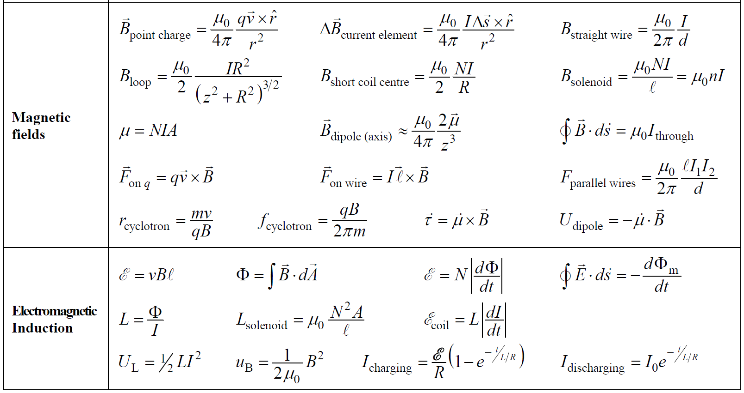
Formula sheet (new)

Slide 17
INDUCED ELECTRIC FIELDS
An induced current in a conducting loop implies the presence of an induced electric field E in the wire.
increasing
× × × × ×
× × × × ×
× × × × ×
× × × × ×
This non-Coulomb electric field is just as real as the Coulomb field produced by a static distribution of charges, and exists regardless of
whether any conducting material is present or not!
Both “types” of field cause a force F = qE on a charge; both create current in a conductor (if present), but they differ significantly in other, crucial aspects …

Slide 18
COULOMB vs NON-COULOMB FIELDS
Electric field lines in Coulomb fields originate on positive charges and end on negative charges.
The lines point in the direction of decreasing potential, V.
Field lines in induced electric fields form closed loops.
decreasing
× × × × ×
× × × × ×
× × × × ×
× × × × ×
A consequence of this is that the concept of potential has no meaning in non-Coulomb fields.
(Consider a charged particle moving around a circular field line.)

Slide 19
FARADAY’S LAW REVISITED
For a charged particle moving around a closed loop in the electric field, the work done is:
decreasing
× × × × ×
× × × × ×
× × × × ×
× × × × ×
and since E = W/q…
We can thus reformulate Faraday's law as:
“A changing magnetic field causes an electric field.”

Slide 20
MAXWELL’S THEORY
increasing
Faraday’s law of induction is restated as:
× × × ×
× × × ×
× × × ×
× × × ×
“A changing magnetic field produces an electric field.”
In 1855, prompted by consider-ations of symmetry, James Clerk Maxwell proposed that the converse should also be true:
increasing
× × × ×
× × × ×
× × × ×
× × × ×
“A changing electric field induces a magnetic field.”

Slide 21
ELECTROMAGNETIC WAVES
Maxwell realised that, in the absence of material, self-sustaining changing electric and magnetic fields would be able to propagate themselves through empty space as electromagnetic waves.
y
v_{em wave}
Conversely:
z
x
Hence:
(!!)
= 3 × 10⁸ m/s

Slide 22
ELECTROMAGNETIC SPECTRUM
Wavelength
7 × 10^{–7} m
10⁴ m
6 × 10^{–7} m
1 m
10^{–4} m
5 × 10^{–7} m
10^{–8} m
10^{–12} m
4 × 10^{–7} m
radio
infrared
ultraviolet
microwaves
gamma rays
cell phones
AM
FM/TV
X-rays
10⁴ Hz
10⁸ Hz
10¹² Hz
10¹⁶ Hz
10²⁰ Hz
Frequency
v = fλ
E_{photon} = hf (Einstein)

