Slide 1
PHY1013S CHARGE
Gregor Leigh gregor.leigh@uct.ac.za

Slide 2
ELECTRIC CHARGES and FORCES
Learning outcomes: At the end of this chapter you should be able to…
Describe and explain basic electrical phenomena in terms of the charge model.
Use Coulomb’s Law to calculate the force between charges.

Slide 3
ELECTRICITY
ηλεκτρων – elektron (amber), a substance which attracts other bodies when rubbed.
JJ Thomson (in the 1890’s) used a similar word (electron) to name the sub-atomic particle whose existence he had proved.
But what is electricity??!

Slide 4
WHAT IS ELECTRICITY?
Actually…
There is no such thing as electricity!

Slide 5
To light up cities, run machines, warm houses, requires energy. That is, energy must be transported from places where it’s available to places where it’s needed…
Notes:
5

Slide 6
THE NATURE OF AN ELECTRIC CHARGE
The Penguin Dictionary of Science states:
“Science is unable to offer any explanation regarding the nature of an electric charge…”
! ! !
“… however it is able to describe the properties of matter that is so charged.”

Slide 7
MATTER CONSISTS OF …
particle | symbol | charge | mass
proton
p
+e
1.6 ×10^{–27} kg
neutron
n
0
1.6 ×10^{–27} kg
electron
e
–e
9.1 ×10^{–31} kg
where the elementary charge, e = 1.60 × 10^{–19} C
Why did it take so long to detect the presence of charge in matter?

Slide 8
CLASSES OF MATERIAL
Conductors –
Materials in which a significant number of charged particles are free to move.
E.g. metals (mobile valence electrons);
electrolytes (ions in solution).
Insulators –
Materials in which charged particles are not free to move.
E.g. glass, plastic, rubber, water, air and other gases.

Slide 9
CLASSES OF MATERIAL
Semiconductors –
Materials whose conductivity can be (usefully) controlled .
E.g. silicon, germanium.
Superconductors –
Materials which offer no resistance at all to the movement of charged particles.
E.g. mercury below 4 K.

Slide 10
CHARGED OBJECTS
A charged object is simply an object with an imbalance of charge. The amount of charge on it is q = N_{p}e – N_{e}e ,
or q = (N_{p} –N_{e})e
If…
N_{p} < N_{e} the object has had extra electrons added to it;
N_{p} > N_{e} the object has had electrons removed from it;
N_{p} = N_{e} the object is said to be electrically neutral.
Notes:
Atoms and molecules which have had electrons added or removed are said to be ionised.
Objects can be discharged by being earthed.
Charge is quantised.

Slide 11
CHARGED OBJECTS
PHY1013S
ELECTRIC CHARGES and FORCES
Darn! I lost an electron.
Are you sure?
I’m positive!
Notes:
11

Slide 12
CHARGE POLARISATION (CONDUCTORS)
A charged object (irrespective of whether it is positively or negatively charged) will attract a conductor.
–
–
–
+
+
+
+
+
+
In the example shown, some mobile electrons in the brass rod move towards the positively charged stick, leaving positive ion cores at the further end.
The rod has been (charge) polarised.
Because electric force decreases with distance (qv), the stick attracts the nearby charges more strongly than it repels the opposite charges which are further away.

Slide 13
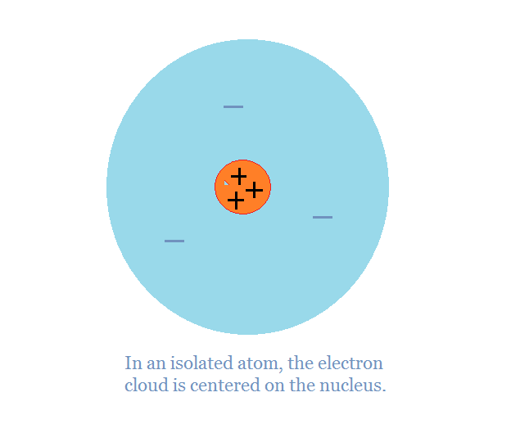
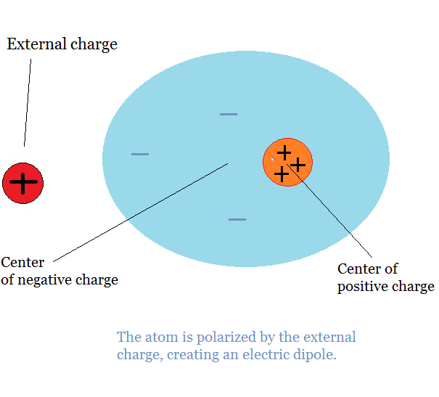
CHARGE POLARISATION (INSULATORS)
In an isolated atom, the electron cloud is centred on the nucleus.
An external charge brought near an isolated atom separates the atom’s electron cloud and centre of positive charge slightly.
An electric dipole is produced which is attracted to the external charge regardless of its sign.
(Why?)

Slide 14
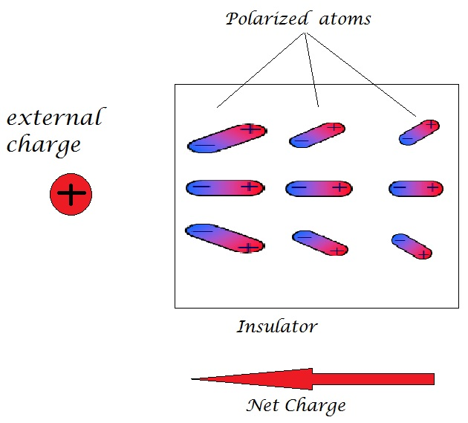
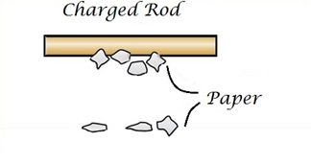
CHARGE POLARISATION (INSULATORS)
Unlike in conductors, where electrons are able to move through the material under the influence of an external charge, in insulating materials the electrons are bound inside the atoms, and it’s the atoms which become individually polarised.
Polarisation explains why uncharged tissue paper is attracted to charged objects.

Slide 15
LAW OF CONSERVATION OF CHARGE
In an isolated system the net amount of charge produced in any process is zero.
Charge cannot be created or destroyed.
Charge can be transferred from one object to another, but the total amount of charge remains constant.
This principle should also be reflected in the drawing of charge diagrams…

Slide 16
CHARGE DIAGRAMS
Draw a simplified two-dimensional cross section of the object.
Draw surface charges very close to the object’s surface.
Draw interior charges uniformly within the interior of the object.
Show only the net charge. A neutral object should show no charges, not a lot of plusses and minuses.
Conserve charge from one diagram to the next if you use a series of diagrams to explain a process.

Slide 17
WAYS OF CHARGING AN OBJECT
Friction (i.e. by doing work / converting energy)
Conduction
Induction
+
+
+
+
+
+
+
+
–
–
–
–
electrons
+
+
+
+
+
+
+
+
+
+
+
+
+
+
+
+
+
+
–
–
–
–
–
–
–
–
electrons
–
–
+
+
–
+
+
–
Note: Charge is transferred only during direct contact.

Slide 18
DISCHARGING and EARTHING / GROUNDING
If an uncharged person touches a charged object, the object’s charge is shared between them.
If the object is much smaller than the person, it is practically discharged.
If the person is replaced by the Earth (i.e. the object is connected to the Earth through a conductor), the object is said to be earthed, or grounded.
By sharing its excess charge with the entire Earth, the object is now completely discharged.

Slide 19
COULOMB’S LAW
F
+
+
F
–
–
F
F
+
–
F
F
cf Newton’s Law of Universal Gravitation:

Slide 20
COULOMB’S LAW
Notes:
The nature of F_{e} (i.e. whether it is attractive or repulsive) is determined by inspection.
F_{g}, however, is always attractive…
The electrostatic constant K = 8.99 × 10⁹ N m²/C². (cf G = 6.67 × 10^{–11} N m²/kg².)
The permittivity constant (for free space), ε₀:
(Why?)
= 8.85 × 10^{–12} C²/(N m²).

Slide 21
SI UNITS
The coulomb –
e = 1.60 × 10^{–19} C
One coulomb is the amount of charge which passes through the cross-section of a conductor in one second when the current in the conductor is one ampere.
The ampere –
Physically,
This is NOT a formal definition!
1 ampere = 1 coulomb per second

Slide 22
COULOMB’S LAW
As usual, the principle of superposition of forces applies:
F ?
+
+
+
1
j
j
2
–

Slide 23
COULOMB’S LAW
Theoretically… | In practice…
the law applies only to point charges
it holds for extended objects, provided the separation is much larger than the objects themselves
the law applies only to electrostatics
it holds, provided the relative speed of the objects is much less than the speed of light

Slide 24
SHELL THEOREMS
When dealing with extended spherical distributions of charge, the following theorems are useful:
A uniform spherical shell of charge acts on all charges outside it as if all its charge were concentrated at its centre.
A uniform spherical shell of charge exerts no force on a charged particle located inside it.
(A similar pair of theorems applies to the gravitational forces exerted by uniform spherical distributions of mass.)

Slide 25
PHY1013S
ELECTRIC CHARGES and FORCES
Two small conducting spheres of identical size and mass attract each other with an electrostatic force of 5.40 N when their centres are 10.0 cm apart.
If the spheres are now brought together and made to touch (and then returned to their original positions, 10.0 cm apart) they exert a force of 0.225 N on each other.
Calculate the initial charges on the spheres.
25
Notes:
25

