Slide 1
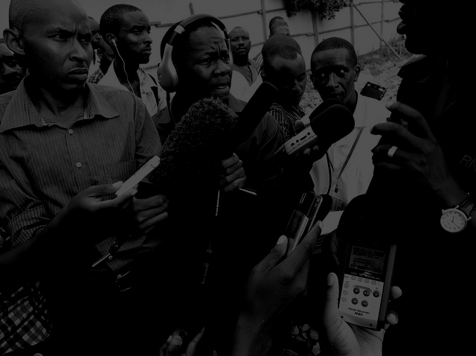
Media and National Development Policy
DR. Ibrahim Saleh
Image by : Graham Holliday

Slide 2
Public Journalism
The US journalistic reform movement known as "public " (or " civic ") journalism that inspired like-minded initiatives in other parts of the world, including Africa (Malawi, Senegal, Swaziland).
News organizations committed to public journalism have made efforts to focus their reporting on topics of concern to citizens rather than on the campaign agendas of candidates for office.
The focus on the topics of concern to citizens, report on political problems of particular concern to citizens from their perspectives rather than those of politicians, experts, and other elite actors, and even to reform their routine information-gathering, reporting, and evaluation practices.

Slide 3
New movements express a "silent revolution" in values and attitudes – a shift from the old politics of social and economic security to the new politics of participation, quality of life, individual self-realization and human rights. They seek no material compensation from the welfare state but have to do with 'the grammar of forms of life' (Habermas, 1987: 392).

Slide 4
Thesis Statement
There is gap between academic scholarship on the public sphere and journalistic work in the public sphere.
Media scholars have extensively critiqued the democratic deficits inherent in a corporate-dominated, highly commercialized media system – its inequalities of access, representation and political/ideological power, its economic and structural integration with globalizing capitalism and consumer culture.

Slide 5
The problem
The tragedy facing African journalism is that the continent’s journalists have closely imitated the professional norms of the North (Kasoma, 1996).
Afriethics as a basis for African journalism practice, was criticized by colleagues from all over the continent who claimed that his ideology was based on a romantic reconstruction of the pre-colonial (Nyamnjoh, 2005) and that it assumed a static and exceptionalistic understanding of African culture (Banda, 2009; Tomaselli, 2009).

Slide 6
African journalists are called upon ‘to operate in a world where everything has been pre-defined for them by others, where they are meant to implement and hardly ever to think or rethink, where what is expected of them is respect for canons, not to question how or why canons are forged, or the extent to which canons are forged, or the extent to which canons are inclusive of the creative diversity of the universe that is purportedly of interest to the journalism of the One-Best-Way (Nyamnjoh, 2005b: 3).

Slide 7
Development journalism, which became the buzz word in promoting good governance in the 1970s and 1980s, was forged out of a compromise between 'nation building' and 'a free and unfettered press'.
Media became a tool for enhancing positive social change by encouraging and promoting development initiatives sponsored by local and foreign governments and international organisations. But this situation has overshadowed the role of the press as government watchdog by its role for development efforts’ in areas such as health, agriculture and education, steering clear of politics (Romano, 2005).
Much academic writing on Africa focused (functionistically) on development concerns with only a small body of writing emerged which theorized the "democratization decade" in ways outside the liberal pluralist paradigm, although still drawing on concepts ready-made from Western theory (Berger, 2002).

Slide 8
Key Questions
Should journalists encourage citizens to transcend inequalities among social groups, or should citizens be encouraged to attend to social inequalities;
Should journalists help create a single, unifying public sphere, or should the goal be to strengthen a public sphere composed of multiple discursive domains;
Should journalists maintain sharp distinctions between issues of public interest and matters of private concern, or should the public/private dichotomy be challenged;
Should journalists’ goal be to engage citizens in public opinion-formation, or should they also try to involve citizens in political decision-making.

Slide 9
The Westley-MacLean model proposes that journalists act as gatekeepers in the mass communication process and, because of their privileged role, they ought to report the news objectively and check their own political convictions at the door as they enter the newsroom. They ought to be impartial referees as competing advocates of this or that cause struggle to promote their particular interpretations or spins to the public.
Other views perceive the purpose of journalism goes beyond impartial refereeing and news people ought to become active players in the political process--not as one-sided spokespersons for this or that cause, but as involved facilitators of the information flow within the society. In short, they ought to become gate-opener (Manca, 1999).

Slide 10
Media reform comprises efforts to change any aspect of the media
‘its structures and processes, media employment, the financing of media, content, media law, media ownership, access to media . . . ’ (Media Development, 2004: 2).
Media reform has been undertaken by governments and business, and has focused upon state policies towards the communication industries; but groups within civil society have increasingly turned their attention to media as a sphere of political action leading to the re-emergence of media activism – organized ‘grassroots’ efforts directed to creating or influencing media practices and strategies, whether as a primary objective, or as a by-product of other campaigns such as efforts to change public opinion on environmental issues.

Slide 11
Media Democratization
Media democratization comprises efforts to change media messages, practices, institutions and contexts (including state communication policies) to enhance democratic values and subjectivity, as well as equal participation in public discourse and societal decision-making (Hackett, 2000: 64).
The concept of media democratization, emphasizing the process, avoids hypostatizing ‘democracy’ as a fixed and final state of affairs. It also connotes the connection between processes of progressive change in the media and those in other social spheres.
But democratization through the media emphasizes the use of media, whether by governments or civil society actors, to promote democratic goals and processes elsewhere in society), which is different from the democratization of the media themselves.

Slide 12
Media activism & the concentric circles
Journalists/Media Personnel/Researchers: Groups within and around the media industries, groups whose working life or professional specialization may stimulate awareness of the alienation, exploitation and/or constraints on creativity and public information rights.
Subordinate social groups: lack of social, cultural, economic or political capital is paralleled in the mass mediated machinery of representation, and whose interests sometimes bring them into conflict with the social order – particularly when they are organized in the form of social movements.
Diffuse sectors: communication policy and practices are not a central concern, but who may occasionally mobilize around perceived threats that commercialized media may pose to humane, non-commodifiable, democratic values. For example, parents concerned with media impact on the socialization of the young.

Slide 13
Resource mobilization approach (RMT)
How movements form and engage in collective action; new social movement formulations focus primarily on why specific forms of collective identity and action appeared and on their socio-political significance (Melucci, 1989).
Asymmetrical dependency: movements rely on the media for access to publics much more than media rely on movements for copy.

Slide 14
new social movements (NSMs).
What is integral to contemporary movements is the construction of collective identity, an interactive process that addresses ‘the question of how a collective becomes a collective’ (Melucci , 1996:84).
The unity of collective action now depends on the collective actor’s ability to locate itself within a system of relations; yet this process of identity construction cannot occur independently of the recognition provided by other actors (Melucci, 1996:73).

Slide 15
Bring about change
(1) influencing content and practices of mainstream media , by finding openings for oppositional voices, media monitoring, campaigns to change specific aspects of representation;
(2) advocating reform of government policy/regulation of media in order to change the structure and policies of media themselves such as the reform coalitions;
(3) building independent, democratic and participatory media, though we need to differentiate between self-management and counter-information traditions within such media (Downing et al., 2001), depending on whether they prioritize the democratic process or the counter hegemonic textual product of such media. We can also distinguish;
(4) changing the relationship between audiences and media, chiefly by empowering audiences to be more critical of hegemonic media through media education and culture jamming.

Slide 16
References
Banda, F. 2009. Kasoma's Afriethics A Reappraisal. International Communication Gazette, 71(4):227-242.
Berger, G. 2002. Theorizing the Media—Democracy Relationship in Southern Africa. International Communication Gazette. 64(1):21-45.
Habermas, J. 1987. The Philosophical Discoiirse of Modernity. Cambridge: Polity Press.
Hackett, R. 2000. Taking back the media: Notes on the potential for a communicative democracy movement. Studies in political economy, 63.
Kasoma, F.P. 1996. The Foundations of African Ethics (Afriethics) and the Professional Practice of Journalism: The Case of Society-Centered Media Morality. Africa Media Review. 10(3): 93–116.
Manca, L.U. 1999. Journalists: Gatekeepers or Gate-openers? In A Reinterpretation of the Westley-MacLean Model Based on MacLean’s Unpublished Papers.

Slide 17
References
Media Development. 2004 ‘Editorial’. Media Development 51(1): 2.
Melucci, A. 1989. Nomads of the present: Social movements and individual needs in contemporary society. Vintage.
Melucci, A. 1996. Challenging codes: Collective action in the information age. Cambridge University Press. http://www.mcs.anl.gov/~pieper/manca-paper.html.
Nyamnjoh, F. B. 2005. Africa's media: Democracy and the politics of belonging. Zed Books.
Nyamnjoh, F.B. 2005b. Journalism in Africa: Modernity, Africanity. Rhodes Journalism Review 25 (November): 3–6.
Romano, A. 2005. Asian journalism. Journalism and democracy in Asia. 1.
Tomaselli, K. G. 2009. Repositioning African media studies: thoughts and provocations. Journal of African media studies. 1(1):9-21.

