Slide 1
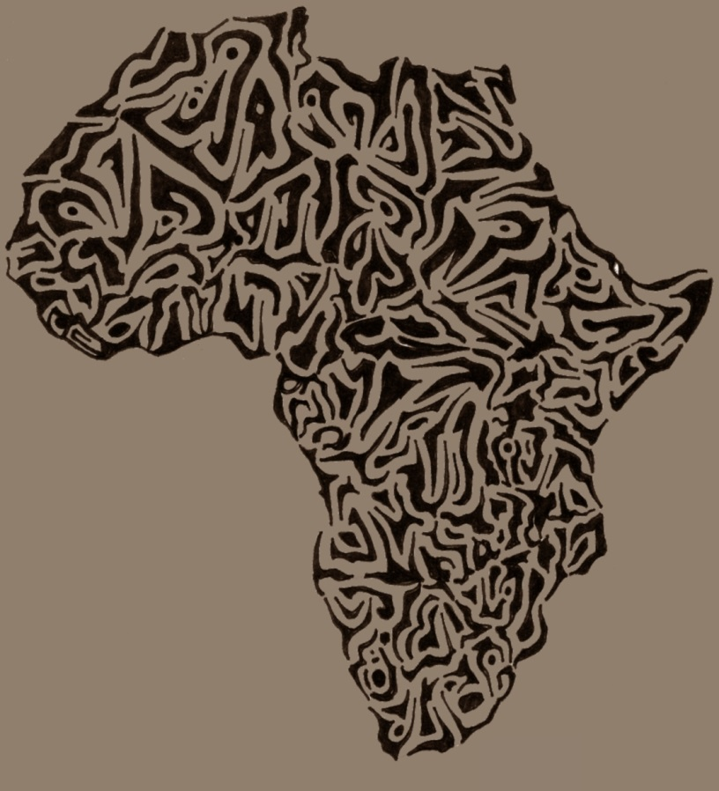
Media and National Development Policy
Dr. Ibrahim Saleh
Image by Scallop Holden

Slide 2
Suggested Readings
Brown, D. (2001). "National Belonging and Cultural Difference: South Africa and the Global Imaginary," Journal of Southern African Studies, 27(4), (December 2001):757-769.
Ojala, M. (2010). "Narrating Global Politics Social Imaginaries in European Journalism, " Paper prepared for the conference 'Communication and Citizenship' of the International Association for Media and Communication Research, (Braga, Portugal, July 18–22, 2010), pp. 1-28.

Slide 3
The problem
South African universities’ emphasis on the 'African renaissance' that makes policies continue to direct themselves towards the so-called 'hard' sciences at the expense of humanities and social sciences.

Slide 4
Whatever Africans share, we do not have a common traditional culture, common languages, a common religious or conceptual vocabulary … Africans share too many problems to be distracted by a bogus basis for solidarity (Appiah, 1992 )

Slide 5
Thesis statement
South Africa requires a common commitment and a sense of shared responsibility in rebuilding its society.
It is important to explore the possibilities of reconciling the demands of difference and national belonging that are based on the actions of imagined unity, but on a shared problematic: a mutual implication in a history of difference, which acknowledges local as well as global affiliations.

Slide 6
Global politics demonstrate the interdependencies of national economies; social and natural phenomena such as migration and the climate change are increasingly interpreted through transnational cultural prisms.
Important questions must be addressed here:
How can these processes be publicly controlled, where should these issues be discussed?
Who should be able to participate in the decision-making?

Slide 7
Double Role of Social imaginary(Appadurai 2000)
1. A tool for political discipline and control of the citizens.
2. A possibility to come up with alternative ways of designing collective life.
The collective imaginary has a central part in the reproduction of social practices and the expression of political objectives, which makes the public definition of the imaginary certainly can be seen as an essential form of power.

Slide 8
Journalism and the Social Imaginary (Ojala, 2010)
Linking journalism to the broader cultural practices in
which social imaginaries and world culture are reproduced.
Examining journalism as a cultural practice that shapes social imaginaries and collective identities by mediating shared narratives, values and world-views.
Considering ideological struggles to both legitimize and challenge the dominant ideas and structures of global governance.
Perceiving journalistic narratives of global politics as articulations of the political possibilities and guiding ideological principles in the conditions of different crises and threats.

Slide 9
Political ideologies have transformed from setting out principally national political projects into the definition of universal values, practices and policies to regulate global relations.
Social imaginary refers to "deep-seated modes of understanding that provide the most general parameters within which people imagine their communal existence" (Steger 2009). And Charles Taylor (2002) defines social imaginary as shared conceptions of social reality, everyday understandings that make sense of social action, and normative assumptions about the state of things.
Social imaginary is not synonym to explicitly expressed theories or political programs, but rather social practices as well as texts, narratives and symbols (Gaonkar 2002; Taylor 2002) that merge the shared myths and cultural symbols into collective self-understanding and experience of a common cause.

Slide 10
World culture Theory
Institutional theory of a global political community that explains that the relationships between different actors are interpreted by analysing established cultural practices or institutions.
These practices define the actors' understandings of themselves, the social reality and the principles, aims and rationality of social action.
According to Lechner and Boli (2005), world culture manifests itself in the common knowledge and shared norms that travel across national boundaries.
World culture can be analysed both as concrete globally organized communities and as abstract assumptions of the universality of cultural values, norms and practices.

Slide 11
Key Issues to Remember
media politics: the power of the media lies not in its institutional influence as a political actor, but in the space of power-making as the gatekeeper and agenda setter, and as producer and distributor of messages that serve certain political actors and interests.
political contest model: the role of the news media in influencing policy is shaped by a wider political conflict between "the authorities" and "the challengers". The battle is fought over the access to the news media and over the dominant media frames (Wolfsfeld, 2003).

Slide 12
South Africa
People living together under conditions of nationhood do sothrough 'consent' and commitment to a common future. However, this consent is based as much on 'forgetting' as it is o remembering.
In South Africa, forgetting is undesirable and irresponsible because the degree of failure admitted by the Truth and Reconciliation Commission arises from too little remembering !
What do you think?

Slide 13
“[T]he political unity of the nation consists in a continual displacement of its irredeemably plural modern space, bounded by different, even hostile nations, into a signifying space that is archaic and mythical, paradoxically representing the nation’s modern territoriality, in the patriotic, atavistic temporality of Traditionalism. Quite simply, the difference of space returns as the Sameness of time, turning Territory into Tradition, turning the People into One. The liminal point of this ideological displacement is the turning of the differentiated spatial boundary, the ‘outside’, into the united temporal territory of Tradition” (Bhabha, 1990).

Slide 14
Partha Chatterjee has argued that the most powerful as well as the most creative results of the nationalist imagination in Asia and Africa are posited not on an identity but rather on a difference with the "modular" forms of the national society propagated by the modern West.

Slide 15
In the South African context, the political weight given to difference, the atrocities committed in its name, and the very powerful and evident effects of the racialisation of culture make multicultural metaphors, including those of the 'rainbow nation' seem facile in the extreme.
Apartheid’s attempts to reinvent itself under a seemingly endless set of synonyms: 'separate development', 'democratic pluralism', 'constellation of nations', 'multicameralism' has meant that the language of multiplicity has been the language of 'false endings', and 'multi-'becomes a 'kiss-of-death.'
Instead of 'multiculturalism', it might be more relevant to seek a more complex and dynamic understanding of the ways in which cultures construct themselves in relation to each other.

Slide 16
References
Appadurai, A. 2000. Grassroots globalization and the research imagination. Public culture. 12(1):1-19.
Appiah, K. A. 1992. In my father's house: Africa in the philosophy of culture. Oxford University Press.
Bhabha, H. 1990. DissemiNation: time, narrative, and the margins of modern nation. Nation and Narration, ed. London: Routledge.
Boli, J. 2005. Contemporary developments in world culture. International Journal of Comparative Sociology. 46(5-6):383-404.
Gaonkar, D. P. 2002. Toward new imaginaries: An introduction. Public Culture. 14(1):1-19.
Lechner, F. J. 2005. World culture. Blackwell Publishing Ltd.
Steger, M. 2009. Globalisation and social imaginaries: the changing ideological landscape of the twenty-first century. Journal of Critical Globalisation Studies. 1(1):9-30.
Taylor, C. 2002. Modern social imaginaries. Public culture. 14(1):91-124.
Wolfsfeld, G. 2003. The political contest model. News, public relations and power, 81-95.

