Slide 1
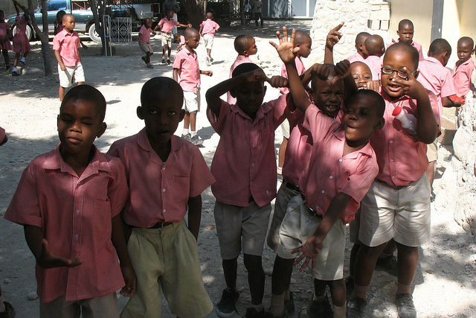
Media & National Development Policy
Dr. Ibrahim Saleh
Image by James Emiry

Slide 2
"Knowledge has been at the heart of economic growth and the gradual rise in levels of social well-being since time immemorial. The ability to invent and innovate, that is to create new knowledge and new ideas that are then embodied in products, processes and organizations, has always served to fuel development".
(David & Foray, 2002)
Image by Rusty Sheriff

Slide 3
Values at the heart of change
Images sourced from: http://www.humanosphere.org

Slide 4
Media and Development
Cultural diversity - plurality in all social spheres of activity.
Governance for inclusion and poverty reduction.
Education contributing to well-being and choice.
Dignity, equal and inalienable rights & entitlements.
Participatory media – what does this really mean?

Slide 5
Media and Democratization Models
Media as distribution channels
Media as actors and agents
Agenda setting
Framing
Supportive or critical

Slide 6
Media as agent of change
What is the role of the media in stimulating national debate and creating a demand for change?
How can media form part of national information strategies? (provide communities with health, livelihoods and education)
How should the media in developing countries be strengthened to enable it to play a more effective role?

Slide 7
Media research
Media &
Professional
Education
Media & Cultural
Diversity
Media &
Governance
Human Rights, Media and Communication
Access and Literacy
Participatory Media and Communication
Representation by Media
Strategic Media Policies and Action Plans
Monitoring Media for Development

Slide 8
How to Measure Media and development?
Formative research to identify the parameters of viable media interventions
Qualitative research methods to pre-test media and communication materials
Continuous feedback research to monitor the audience reception to media outputs
Audience-based qualitative and quantitative methods to measure reach and impact of media interventions

Slide 9
Research and Evaluation Cycle
Formative
Impact Evaluation:
Quantitative Surveys and
Qualitative Studies
Pilots
Pre-Testing
Audience
Feedback
Mechanisms of Effectiveness
Primary &
Secondary Data
Values,
Tastes
Habits,
Rationales
Context
Epidemiological,
Behavioural
Situation,
Context
Analysis
Media Consumption
Ethnography
Focus Groups
Community-Based ‘Rapid Feedback’
In-Depth Interviews
Formats
Content
Scripts
Characters
Attributes
Production Quality
Branding
Message Clarity
Accurate Targeting
Cultural Suitability
Letters, Texts, Follow-Up Studies, Panels, Contests
Reactions
Interpretation
Message
Delivery
Viewing/
Listening
Context
Characters,
Presenters
Story Lines
Update /
Reformat
Extension
New Developments
Focus Groups, in-Depth Interviews,
Statistical Analysis
Intensity of
Exposure
Combinations of Outputs, Multiple Platforms
Use of Animation
Humour
How Audience
Relates to
characters
Branding
Predispositions
Profiling
Shared,
Associated
Attributes
Surveys, Skills Assessment, Pre/Post Tests, Indices
Knowledge, Attitude,
Practices/Behaviours Baseline
Barriers, Facilitators Midline
Refine Objectives Tracking
Set Priorities Stages of Change
Identify, Profile Target
Endline Audiences, Partners, Participants
Content Analysis, Pre/Post Tests
Follow Up Interviews,
Policy Analysis
Journalistic Principles
Scenario Exercises
Professional Norms, Standards
Statistical Analysis
Trends
Relationships between
Exposure and Outcomes

Slide 10
What’s our No. 1 Problem?
Aids?
Digital divide?
Corruption?
Women/child abuse?
War and strife?
Fundamentalism?
Despotism?

Slide 11
However, it all depends how we look at it but in any problem, we need value-driven journalism work in order to tackle it.

Slide 12
Poverty
Form of deprivation
Deprivation of what?
From whose perspective?
These influence measurement approaches
Common definitions are:
Inability to meet basic necessities of life – money-metric measures;
Failure of some capabilities -lack of opportunities and choices to lead a dignified life – "capabilities" & "functioning" approach
Inability to participate in one’s community: Social exclusion

Slide 13
Transient poverty
Poverty is dynamic - nature & characteristics change over time
Movements – poverty resulting from shocks such droughts, floods, pests infestation of crops, etc.
Understanding factors contributing to Poverty
Helps develop interventions linked specific risks
Lack of data poses a challenge
Measuring impacts of shocks on livelihoods using participatory approaches

Slide 14
South Africa
Human Development Report focuses on provision of public services: introduces service deprivation index (SDI)
Indicators-housing type, energy type (for cooking, heating & lighting), water, sanitation & refuse removal.
SDI measures the distribution of progress in reducing deprivation in basic services
Limitation
shaped around commodity evaluation

Slide 15
Social Exclusion
Intended to capture structural features of poverty.
Inability to participate in ones community
Exclusion from political, cultural & economic processes
Human poverty-location specific
Nature of deprivation vary with social & economic conditions

Slide 16
Key Questions:
Why Poverty is Public Enemy no. 1
The journalism of poverty
The poverty of journalism
What’s to be done?

Slide 17
whose problem it is
the poor?
government?
civil society?
business?
individuals?
media?

Slide 18
Poverty reflects deep structural problems within societies. Media isn’t a solution, but perhaps the way it is practiced is a part of the problem?
Let’s be realistic: the media can’t end poverty. But if we in journalism don’t cover it intelligently (with attachment and outrage) the media will be an obstacle in poverty alleviation.

Slide 19
Media Challenges to report poverty
Hard to link the different aspects: In SA, the one-dimensional focus is more common than the multidimensional one. The reporting on one angle, more-or-less in isolation of others, are in land and housing/homeless stories (Burger, 2007).
Poverty is often hidden under other frames – crime, gender, Aids, strikes, unemployment. But poverty coverage often hides aspects like gender, and power. The challenge is to cover a condition with many causes

Slide 20
Journalism of poverty: Charity angle
Dichotomy:
Stories of people who are poor
Stories of "poverty" (often policy promises)
Reports of manifestations of poverty, do not ID these "exhibits" as constituting "poverty".
Yet, linkage is necessary to grasp poverty as a generalised condition with inter-dependent and mutually reinforcing dimensions.

Slide 21
Journalism of poverty: political spectacle
Examples
President promises relief
Opposition accuses President of neglect.
Little independent follow-up.
Glorification of the correspondent
Sympathy is created with the journalist, not poor people

Slide 22
Who should address poverty?
Solving poverty seldom painted as some-thing where all stakeholders play a part:
- poor people (they are not "objects" to be pitied and uplifted through pure charity),
- government (elected bodies supposed to deal with it),
- civil society (NGO's, scholars, students, churches, etc.),
- employers/business/educational institutions,
- individuals.

Slide 23
References
Burger, D. (ed). 2007. South African Year Book 2006/2007. Pretoria: Government Communication and Information System. http://www.gcis.gov.za/content/resource-centre/sa-info/yearbook/2006-07
David, P.A. & Foray, D. 2002. An introduction to the economy of the knowledge society. International Social Science Journal. 54(171):9-23. http://onlinelibrary.wiley.com/doi/10.1111/issj.2002.54.issue-171/issuetoc

