Slide 1
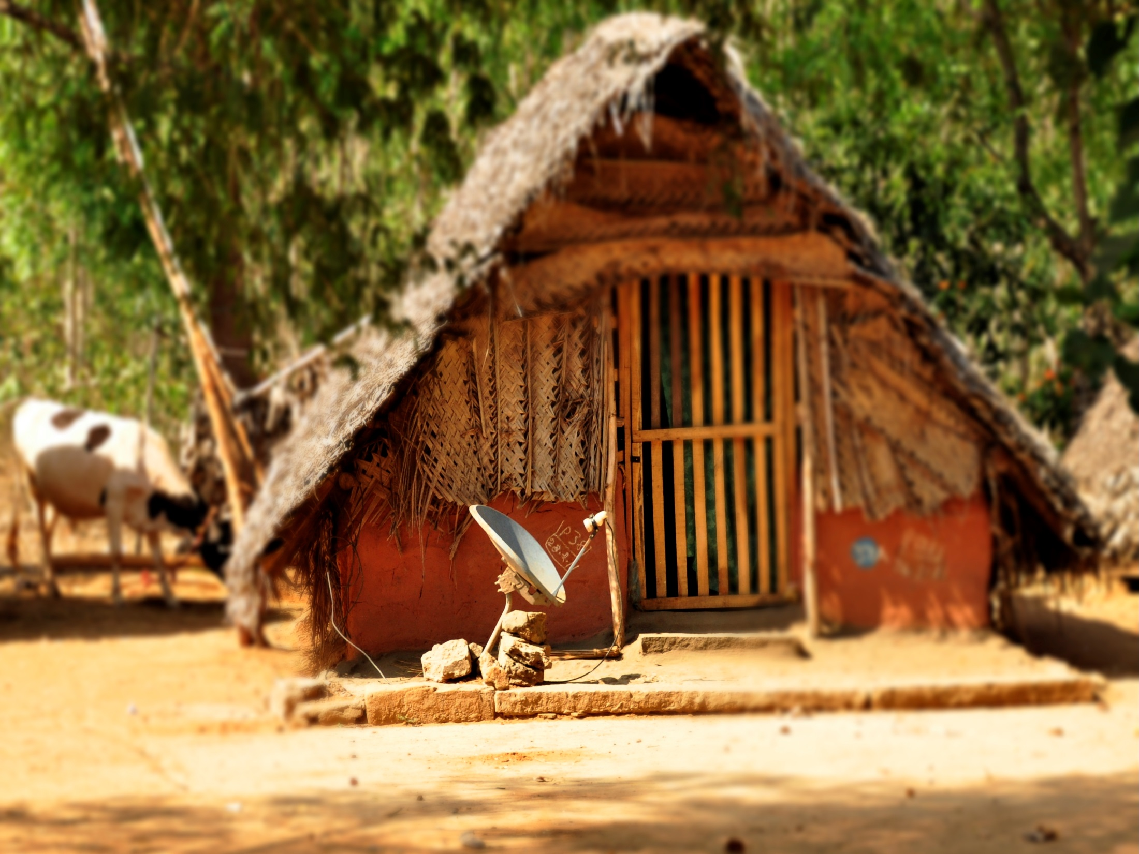
Media & National Development Policy
Image from: Wikimedia
Dr. Ibrahim Saleh

Slide 2
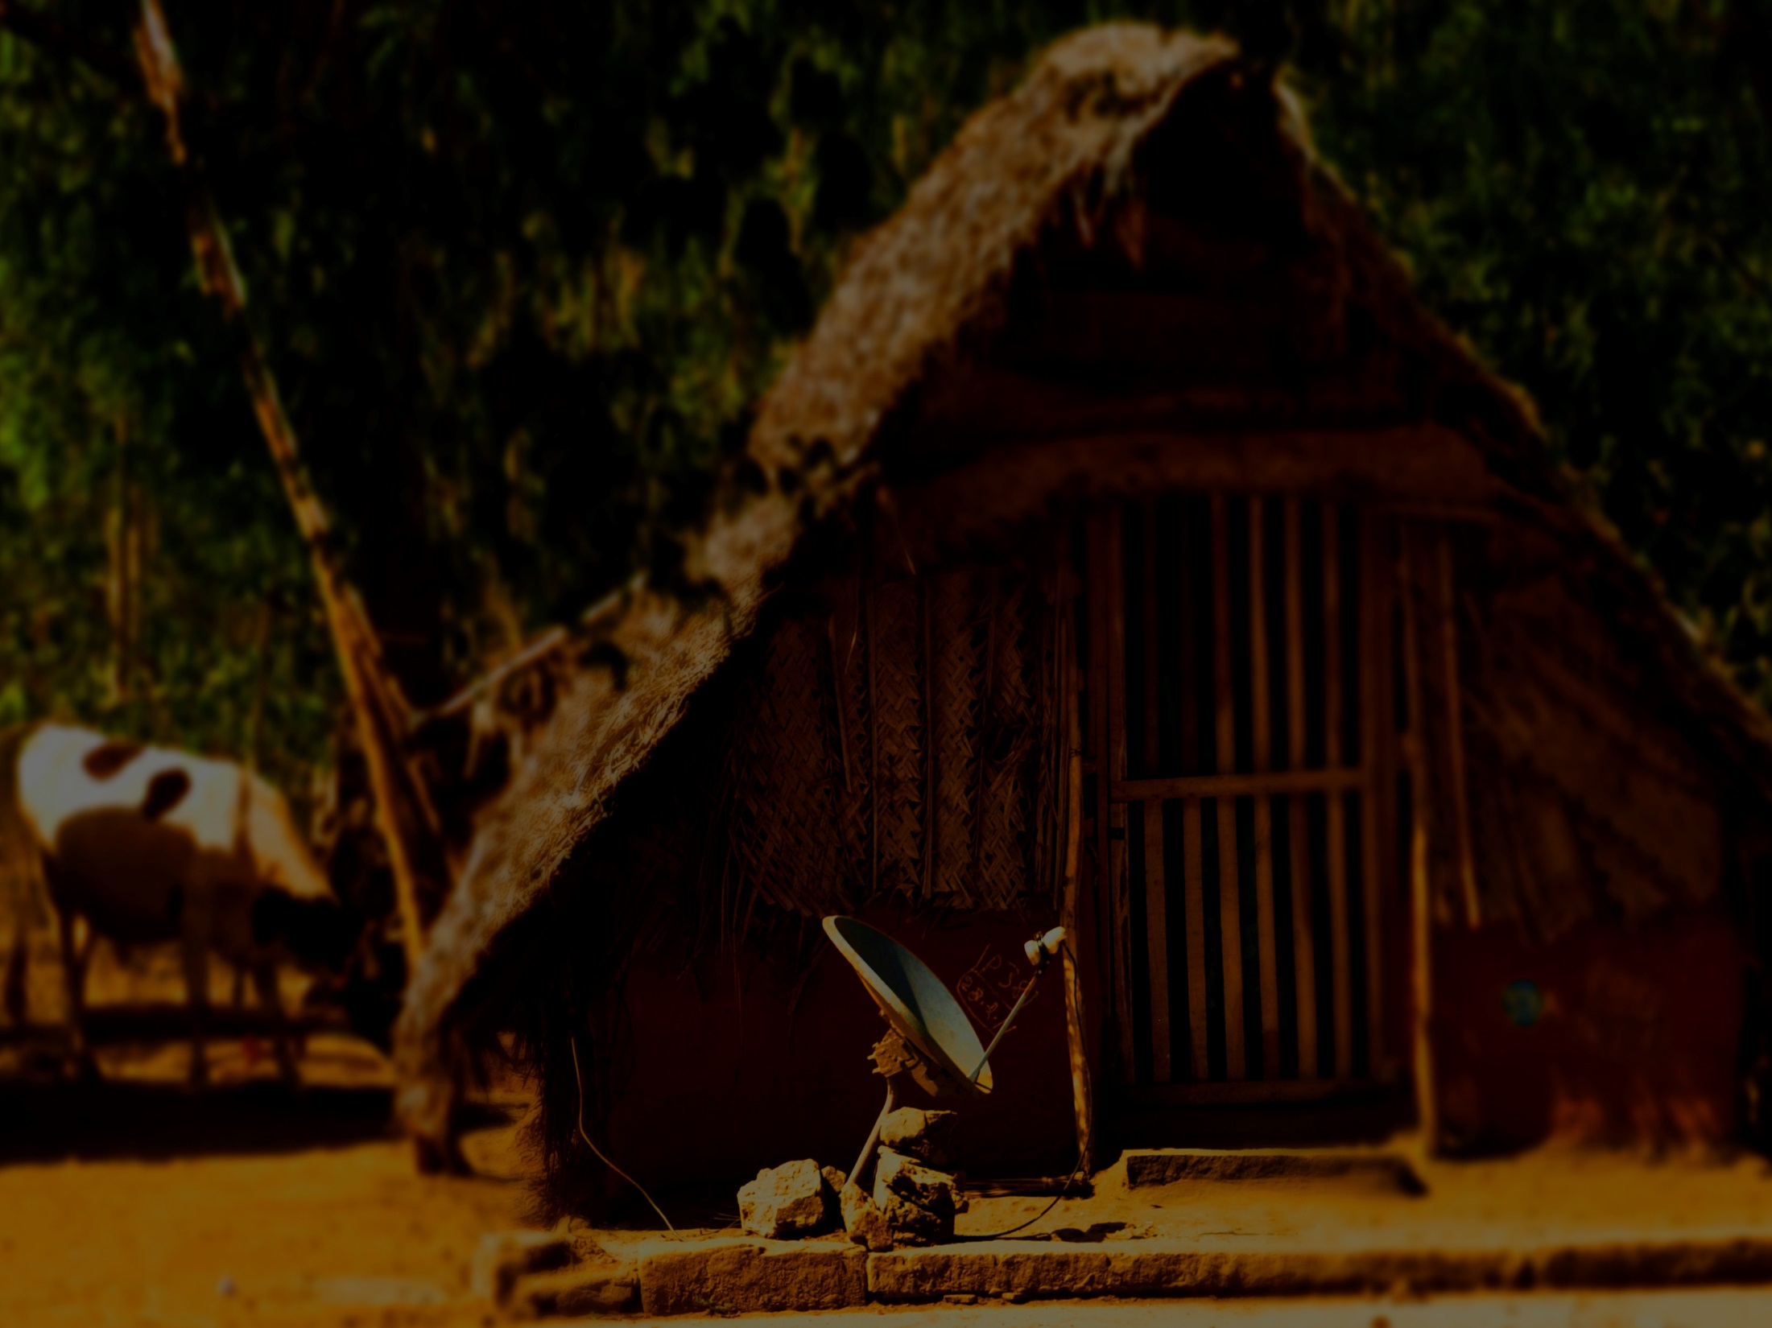
Thesis Statement
The creation of a new 'window of opportunity,' the 'demonstration effect' of other democratic transitions, and a broader target group conducive to 'development for all', helped to prepare the way for a new communication approach when communicating with communities in South Africa.
The effective communication with communities depend on three interrelated aspects. Firstly, the viability of the current theoretical trends or approaches in development communication. Second, the methods or media to apply at the various stages of communication to reach the different target audiences. Thirdly, the integrated approach to the application of development communication methods and media in development communication programmes or strategies.

Slide 3
Thabo Mbeki, Parliament in June 1999
"Steadily, the dark clouds of despair are lifting, giving way to our season of hope. At the dawn of a new life, our practical actions must ensure that none can challenge us when we say: we are a nation at work to build a better life. " (Mbeki, 2000)

Slide 4
Statement of the problem
In contrast to the conventional wisdom stated by various authors that 'we are living in the information age,' there is growing realisation that it is still difficult to reach and communicate with rural communities in South Africa (Baker, 2001).
According to Mersham et al (1995:78), most communication programmes are built upon first world assumptions that are in most cases unsuitable for implementation in the South African context.

Slide 5
Development efforts are not delivering the results the world’s poor need and the global community promised in the Millennium Declaration that ended with two out of every five people are living on less than US$2 a day.
The World Bank forecasts predict that by 2015 more than 600 million people will still be living on US$1 a day, and without measures that accelerate change, many countries may fall short of the [Millennium Development Goal] targets.

Slide 6
Why is progress so slow?
Open, inclusive, participatory communication and information processes are prerequisites for successful, sustainable development.
Communication processes form the lifeblood of politics: they are central to the creation of a healthy, vibrant civil society and efficient, more equitable economies; they are also a critical element of social adaptation.
People must be their own agents of change: to act individually and collectively, using their own ingenuity and accessing ideas, practices and knowledge in the search for ways to fulfil their potential.
Economist Amartya Sen calls 'real freedoms' (human welfare): the capacity for people to participate in a diverse range of decisions that affect them, and to enjoy specific ' functional' (not only economic, but also health and education) aspects that constitute a healthy life.

Slide 7
Key Terms and Concepts
Development is improving the quality of all human lives, by raising people's living standards through economic growth; improving the self-esteem of people by establishing the relevant social, economical and political systems and institutions that will promote human dignity and respect; and increasing people's freedom to choose and their range of choices (Todaro, 1989:620).
Development Communication is the process by which people become leading actors in their own development which allows people to go from being recipients of external development interventions to generators of their own development (Bessette 1996:1).

Slide 8
Sustainable Development (Panos, 2007)
People participate in the debates and decisions that affect their lives, however they need to be able to receive information, but also to make their voices heard.
The poor are often excluded from these processes by geography and lack of resources or skills; and many groups – including women – are also kept silent by social structures and cultural traditions.
Inclusive political processes, through which citizens can shape political agendas and hold their governments to account, are an essential foundation of successful development.
Political processes are communication processes – not only through formal elections, but also the ongoing dialogue between people and their governments and the shaping of public agendas.
Mobile phones are increasingly used to strengthen the integrity and credibility of elections; while the media play a crucial role in political debate. Healthy political processes need open communication environment.

Slide 9
Development communication theory
Information dissemination models
Grassroots awareness-raising models
Development support communication
(DSC) models
Innovation dissemination models
Participatory models

Slide 10
Information dissemination models use communication mainly to distribute information to make people understand the 'benefits' promised by developments. This approach relies on the mass media to persuade and transmit information.
Innovation dissemination models focus on the stimulation of the potential for change within a community. It involves the transmission of information to communities, by including the target group of the innovation, the innovation to be transmitted and the sources and communication channel.

Slide 11
Grassroots awareness-raising models emphasize the importance of grassroots access to the communication process to promote social justice and democracy. However, access may vary from access to small media at the local level to the promotion of cultural expression and the search for ways of taking control of the mass media.
Development support communication (DSC) models focus on the promotion of dialogue and the sharing of messages on an equal footing to achieve recipients' participation.
Participatory models define development as a global process for which societies are responsible and the key concept is grassroots participation in the development process. Other concepts of development include notions of social equality, liberty, revenue distribution, interactivity, etc. Participatory development communication' emphasizes two-way communication (not one-way communication) to disseminate messages and to transmit information or persuade people to change their behaviour. Accordingly, they allow for 'horizontal' communication among people rather than the traditional 'vertical' transmission from an expert to his audience.

Slide 12
Marchant's Triangulate Model
Marchant (1988:58) argues that communication practitioners conceptualise communication in a limited way, by seeing it as the transmission of information from sender to receiver, that is, as a one-way flow. He argues that communication should be seen as a two-way process with emphasis on the user's needs.
Understanding user groups is more important than technical expertise and hardware resources and that an analysis of all the key participants in the communication process is vital to understand how they communicate.

Slide 13
Application of the development models
According to Mersham et al (1995:52), the most fundamental adjustment to communicators in South Africa will have to occur in their approach to the communication context and their understanding of development.
Skinner (1992:44) emphasises that in development situations, the effectiveness of communicators depend to a great extent on their concern and on gaining respect and trust.
Mersham et al (1995:52) argues that it is important to identify the needs of the community and to build mutual and trusting relationships.

Slide 14
Traditional folk media and oramedia
Traditional folk media are cultural resources that accumulate indigenous knowledge; experiences and expressions passed down from generation to generation. Woven into proverbs and poems, songs and dances, puppet plays and stories, rhythms and beats, they are embedded with a strong sense of cultural identity that can be used creatively to communicate important messages. (Knowledge and information for food security ... 1998:4.)
Oramedia has been used effectively in facilitating the process of reflection in many communities. Members of the community or local theatre group prepare and present a play to the community about a fictitious place where conditions are similar to those in the village. The play usually has no ending and members of the community are asked to act out or suggest the end of the play. This method is successful because it is entertaining, easy to participate in, nonthreatening and the event is conducted in an indigenous art form.

Slide 15
References
Baker, H. A. 2001. Turning south again: re-thinking modernism/re-reading Booker T. Duke University Press.
Bessette, G. 1996. Development communication in West and Central Africa: toward a research and intervention agenda. IDRC. Canada.
FAO. 1998. Knowledge and information for food security in Africa: from traditional media to the Internet. Available at: http://www.fao.org/waicent/faoinfo/sustdev/CDdirect/CDan0017.htm .
Mbeki, T 2000. Speech at the launch of the presidential strategic leadership development programme. Pretoria. Available: http://www.unisa.ac.za/contents/colleges/docs/tm2000/tm072300.pdf
Mersham, G. M., Rensburg, R., & Skinner, C. 1995. Public relations, development and social investment: A southern African perspective. Pretoria: Van Schaik.

Slide 16
References
Panos. 2007. The case for communication in sustainable development. London: Panos London.
Todaro, M. P. 1989. Economic Development in the Third World. New York: Longman.
Skinner, E. A. 1992. Perceived control: Motivation, coping, and development. In R. Schwarzer (Ed.),Self-efficacy: Thought control of action (pp. 91 - 106). London: Hemisphere Publishing Corporation.

