Slide 1
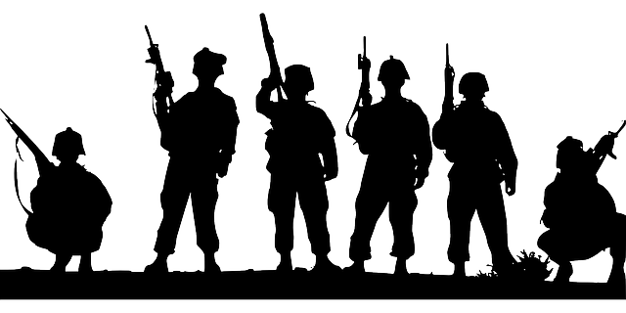
FAM 4018S: Crisis communication in Africa Media & Conflict
Dr. Ibrahim Saleh
Ibrahim.Saleh@uct.ac.za
A130

Slide 2
Thesis Statement
Tensions frequently escalate in situations where information is scarce. Offering a variety of information that contains a range of facts, perspectives and opinions would therefore be a de-escalating measure.
The ‘‘tale of war’’ is always constructed differently by the different international media.

Slide 3
Media and Conflict
The media in conflict-ridden countries often play a significant role in creating and furthering both facilitating factors and triggering factors, for example by utilising 'oppositional metaphors' ('us' vs. 'them') linked to internal and external issues or 'threats' facing the nation (Jager & Link 1993; Van Dijk 1997).
Minorities are often identified as the official representatives of the external 'enemy' regardless of the weakness of the ties between them, while everyday discrimination against them, on the one hand, and their contribution to economic, political and cultural diversity, on the other, are rarely mentioned in the media.

Slide 4
Facts about media and conflict
News reporting on and about a certain conflict can drastically affect the audience’s perception of the situation and thus may influence further developments.
Media institutions are deeply rooted in the socio-political environment in which they operate (McQuail, 1994).
Media often act as a mouthpiece for power circles. Thus a deliberate distortion of news coverage for particular interests easily exacerbates the tension between opposed factions and becomes a main trigger of violent conflict (Terzis 2000).
The differences in the tone of coverage could be dominant journalistic values.
Research indicates that differences in media metaphors, or frames, alter viewers’ reasoning and beliefs about events (McCombs & Ghanem, 2003).

Slide 5
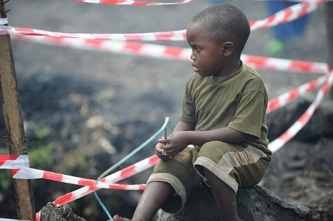
Notes:
Photo source: https://www.flickr.com/photos/julien_harneis/3027390989/in/photostream/

Slide 6
Media framing of issues such as war is influenced not only by the dominant political environment and national history and culture, but also by journalistic values and routines that may to some extent transcend national borders.
Through the use of different frames and different tone of war coverage, media essentially construct different wars in order to appeal to the their local audiences.
McCombs and Ghanem (2003) suggested, exposure to specific frames can have effects on the evaluations of events made by recipients of those frames, although much reporting rely on similar newswire sources (Legard & Lemon, 2003). It might be explained that there were radically different news choices in terms of framing and tone.

Slide 7
Digitally networked activism fails to generate committed collective action when the going gets tough. Social media activism has weak ties and horizontal decentralized organization in contrast with the strong ties and centralized hierarchical organization which marked key junctures in the Civil Rights Movement. Digitally networked action is ill-equipped to bring about systemic change
(Gladwell, 2010).

Slide 8
Images of Wars
War news exhibits a turn to the visual side of information relay, by which news organizations readily turn over column-inches and airtime to accommodate an increased and more central presence of pictures in the news
(Zelizer, 2005).

Slide 9
How images are used to depict death in wartime has long been a troublesome practice for those who cover war.
Ever since journalists gradually began to accommodate the inclusion of images as part of war’s coverage, which gradually made the fundamental question of whether, how, and in which fashion to include images of death has never been sufficiently clarified.
The topic of death frequently becomes the focus of news images. While pictures of war combine the cool mechanics of the camera with the hot passions of the battlefield to address the proximity and inevitability of death, they also force an address to the fundamental question of what news images are for.

Slide 12
Value of images
Images as "eyewitness " authority in a sort of "having been there."
Images compel public attention, especially after large-scale crises.
Images justifying policy in wartime.
Images emphasize that the world is manageable, reliable, and readily understandable fashion.

Slide 13
Seeing is preferred only under certain circumstances. As one writer for the Toronto Star phrased it,
If the victims are not one of us, if they live far away or have no names or cultural commonalities, they’re fair game. Hence, it’s perfectly acceptable, if not mundane, to show piles of skulls in Rwanda or a skeletal and swollen-bellied African baby on the verge of death

Slide 14
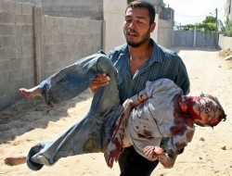
Photographs are incorporated to invoke more than just the photograph itself with negotiations over selection, placement, prominence, and size.
In accommodating the visual, war facilitates a turn to the memorable image over the newsworthy one, showing a preference for images that appear in frequent and prominent displays, resemble non-journalistic depictions .
Notes:
Photo Source: http://wilpf.org/SnyderLtrToUNreGazaDec2008

Slide 15
What Images and Their Absence Tell Us about the News
Images were used in a way that showed less of the war itself and more of the assumptions about the war held in ways that upheld larger strategic aims.
Images of the executions portraying numerous instances of the same phenomenon in different localities and captured by different photographers. Though these photos constituted a small sample of all of the photos that appeared, they nonetheless occupied a central place in the larger corpus of still images by which publics saw the war unfolding, reveal

Slide 16
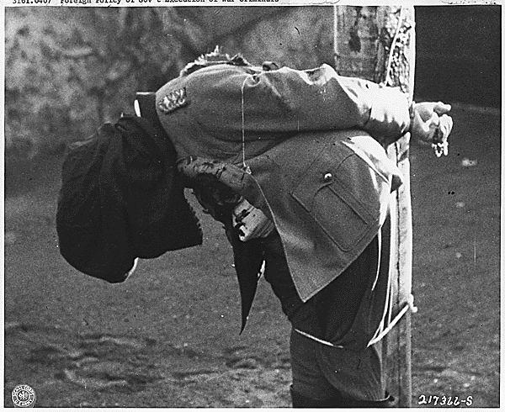
Notes:
Photo Source: via pignews - https://www.flickr.com/photos/pingnews/442011770/#

Slide 17
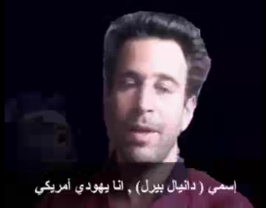
The kidnapping and murder of Wall Street Journal reporter Daniel Pearl offered a useful contrast case of about-to-die coverage about-to-die-moment.
These images were shown repeatedly, across newspapers, and with full supporting verbal documentation,
Images of Pearl held by his captors, rather than the graphic pictures of his actual execution, became, in a sense, one of the memorable images of the war in Afghanistan, pushing aside other depictions of his murder, even when instances of its photographic display became available.
Moreover, the early pictures of a captive Pearl, about to be killed by his abductors, continued to illustrate the story long after he was already dead.
Notes:
Photo Source: http://en.wikipedia.org/wiki/Daniel_Pearl

Slide 18
This presentation is licenced under the Creative Commons Attribution 2.5 South Africa License. To view a copy of this licence, visit http://creativecommons.org/licenses/by-sa/2.5/za/
Or
send a letter to Creative Commons, 171 Second Street, Suite 300, San Francisco, California 94105, USA.

