Slide 1
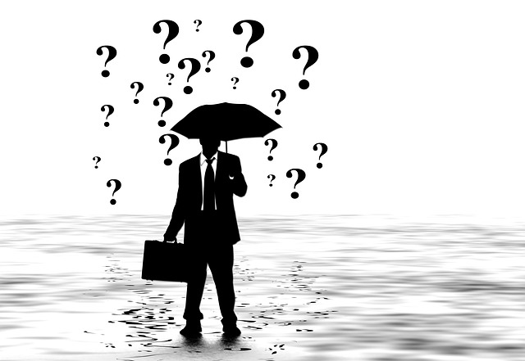
Crisis Communication in Africa
Crisis Theory
Dr. Ibrahim Saleh
Ibrahim.Saleh@uct.ac.za
A130
Ext: 4837
Notes:
Photo Source: http://pixabay.com/en/man-silhouette-briefcase-umbrella-96587/

Slide 2
“There were very poor communications at the time. We weren't able to get clear, accurate information out to the media and the public. ... And at that point the media went to other sources for their information." Tom Kauffman

Slide 3
What is a crisis?
Crisis: an unstable or crucial time or state of affairs whose outcome will make a decisive difference for better or worse (Webster's New Collegiate).
Crisis management: a systematic response to unexpected events that threaten the people, property and operating continuity of the organization.
The role of the media: (should be) provide balanced views to allow the public to shape informed opinions and make informed decisions.

Slide 4
Stages of a Crisis
1. Crisis build-up – hints or cracks appear
2. Break-out – triggering event causes the crisis to erupt
3. Lessening (abatement)-linger for years
4. Termination- when the crisis is no longer a threat or has caused the demise of the entity involved
Strategic media communications are essential at every stage.

Slide 5
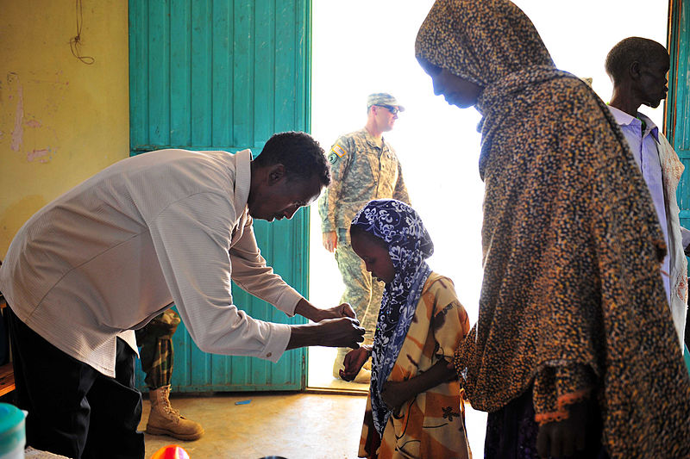
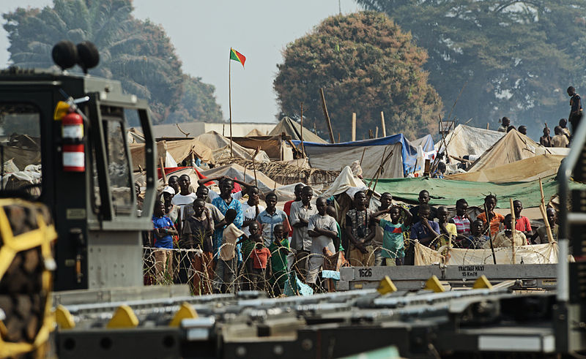
An evolution in approach
To Risk Reduction
From Response and Relief
5
Notes:
5
Photo (right) source: http://en.wikipedia.org/wiki/File:Medical_Civic_Action_Program_in_Shinile_Woreda,_Ethiopia,_2010_(5119873865).jpg
Photo (left) source: http://en.wikipedia.org/wiki/File:Refugees_of_the_fighting_in_the_Central_African_Republic_observe_Rwandan_soldiers_being_dropped_off_at_Bangui_M%27Poko_International_Airport_in_the_Central_African_Republic_Jan._19,_2014_140119-F-RN211-760.jpg

Slide 6
What is Disaster Risk Reduction?
The conceptual framework of elements with possibilities to minimize:
Hazards
Vulnerabilities
and therefore disaster risks to:
Avoid (prevent) or
Limit (mitigate and prepare for)
The adverse impacts of hazards within the broad context of sustainable development

Slide 7
Risk management
What is risk?
The probability of suffering damage (to life, property, economic disruptions and environment) from a hazard for a given area and reference period.
Risk is the product of hazard and vulnerability

Slide 8
Disaster Risk management
The process of identifying, analyzing and quantifying the probability of losses in order to undertake preventive or corrective actions
This involves two types of activities ;
Planning actions to reduce vulnerability in areas where risk can be controlled, and
Establishing protective mechanisms against the potential economic losses from uncontrollable factors of natural hazards

Slide 9
Risk Management
Entails efforts and measures put in place to reduce risk in case of a disaster happening
Commitments related to disaster and vulnerability reduction and improved early warning

Slide 10
Shared Risk (Aldoorya, Kimb &Tindall, 2010)
Perceived shared experience with a media portrayal could inﬂuence various cognitions—such as concern, sense of personal involvement, and desire to learn more—that are important for behavior change.

Slide 11
The Situational Theory of Publics
Factors; including problem recognition, level of involvement, and constraint recognition inﬂuence the individuals’ infnormation process about a problem and the cognitive need to seek out more information about a problem.
"Perceived similarity" is the extent to which an audience member believes a media portrayal reﬂects their own personal characteristics (Andsager, Bemker, Choi, & Torwel, 2006; Austin & Meili, 1994).
Findings (agenda setting and cultivation) emphasized a close link between the perceived similarity to characters portrayed in mediated campaigns and the more likely that identiﬁcation and modeling will occur, which then lead to greater intent to change behavior (Andsager et al., 2006).

Slide 12
Information-seeking behavior is what characterizes the active players in a public opinion issue (Slater, Chipman, Auld, Keefe, & Kendall, 1992, p. 190). But with information processing, members of a public do discover or recognize a message although the message is not necessarily acted upon (Aldoory, 2001; Grunig, 1989; Slater et al., 1992).
But in almost all cases, individuals lack direct experience (obtrusive) with the risks associated with major crises, they rely on others to interpret technical jargon and threat, and then they negotiate the boundaries between the scientiﬁc and their everyday world.
Without the ability to directly assess the risks and beneﬁts (unobtrusive),the public rely on information provided by experts (Siegrist & Cvetkovich, 2000, p. 714).
As Berger (2003) argued, the ways in which the news media present stories about potentially threatening phenomena “may be among the more inﬂuential cause of “distorted risk perceptions (p. 251).

Slide 13
Media Effects
Research assess systematically how people perceive crisis situations and crisis response strategies (Coombs & Holladay, 2009). Print and video differ as channels. Video messages have the ability to deliver relational, nonverbal, and verbal cues as well as to create a "face" for the message.
Drawing on Meyrowitz’s (1985) work, Pfau and Wan (2006) suggest televised (video) messages lead viewers to focus on the message source while print leads readers to focus on the message content.
The Elaboration Likelihood Model suggests televised messages would be more likely to be processed on the peripheral route because it requires minimal involvement while print messages would be more likely to be processed on the central route (Pfau & Wan, 2006).
Crises are largely a mediated experience for the vast majority of stakeholders, especially non-victims.

Slide 14
Mistakes in Crisis Communication
If media does not provide comprehensive information
If the representative/ spokesperson did not go to the crash site quickly enough
If authorities fail to deal with circulating conspiracy theories fuelled suspicions
If not using the Golden hour and taking too long to respond to the public and complete investigation

Slide 15
Planning for a crisis
Prepare contingency plans in advance
Crisis management team members should be the only the people who speak to the media
Give accurate and correct information because manipulating information can backfire
Action plans should consider both the short term and long term

Slide 16
The Crisis Game
An opportunity for change
Transparent message of integrity
Effective strategy to improve/instil values
Make the media your friend, not your enemy
BUT… how you start is how you’ll end

Slide 17
"A good reputation is more valuable than money. "
Publilius Syrus, Roman author
1st century BC

Slide 18
This presentation is licenced under the Creative Commons Attribution 2.5 South Africa License. To view a copy of this licence, visit http://creativecommons.org/licenses/by-sa/2.5/za/
Or
send a letter to Creative Commons, 171 Second Street, Suite 300, San Francisco, California 94105, USA.

