Slide 1
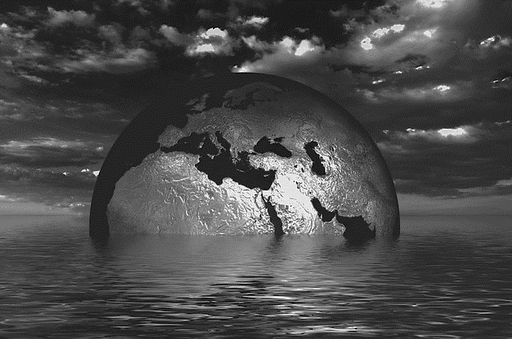
FAM 4018S: Crisis Communication in Africa: Climate Change
Dr. Ibrahim Saleh
Ibrahim. Saleh@uct.ac.za
Notes:
Photo source: http://pixabay.com/en/earth-globe-water-wave-sea-see-216833/

Slide 2
The challenge of climate change provides an opportunity to rethink the meaning of development and economic growth in ways that promote redistribution of power and wealth while simultaneously protecting the environment?
We do not need the military to fight these battles. Instead they should take place in public, democratic, civilian spaces at all levels of politics and governance.

Slide 3
Thesis Statement
Some climate activists and analysts appeal to martial language, emphasizing the seriousness of the problem by calling for a "war " against climate change.
The implications of the rhetoric of eco-justice and the norms of such rhetoric runs the risk of inspiring authoritarian, divisive solutions that distract from the genuine conflicts caused by climate change and the long-term changes required in response. It is thus more desirable to encourage action on this issue with metaphors that are more empowering and inclusive than war.

Slide 4
Metaphors and narratives
The Climate War, and emphasized that he was writing "about people who went to war, and learned what war costs" (Pooley 2010: x).
Baroness Barbara Young, then chief executive of the United Kingdom’s Environmental Agency, boldly asserted in 2007 that, "This is World War Three"—this is the biggest challenge to face the globe for many, many years.
We need the sorts of concerted, fast, integrated and above all huge efforts that went into many actions at times of war." She went on to criticize existing approaches to the problem: "We’re dealing with [climate change] as if it is peacetime, but the time for peace on climate change is gone—we need to be seeing this as a crisis and emergency" (Quoted in Clover, 2007).

Slide 5
War may well be the most serious and attention-grabbing collective activity, and to compare the response to climate change to a war is to immediately communicate a great deal about how serious the problem is and how important it is that human beings respond with haste, with concerted effort, and with a willingness to make sacrifices as necessary.
Organizing metaphor for a movement is particularly significant and worthy of careful reflection: "an ambiguous or uncertain situation," and notes that "for many members of the public, climate change is likely to be the ultimate ambiguous situation, given its complexity and perceived uncertainty" (Nisbet 2009).

Slide 6
Climate refugees & Climate Conﬂict
It locates the ideological roots of these concepts in development theories and policy narratives about demographically induced migration, environmental refugees and environmental security.
While alarmist rhetoric around climate refugees and conﬂict has been deployed by a variety of actors, it raises the question of how the portrayal of climate change as a security threat could further militarise the provision of development assistance and distort climate policy.

Slide 7
In the United States, the defence think tank, CNA, produced a reportNational Security and the Threat of Climate Change, which argued that global warming could help trigger widespread political instability in poor regions and large refugee movements to the United States and Europe (CNA, 2007).
Toward the end of the year, the Norwegian Nobel committee (2007) warned that climate-induced migration and resource scarcity could cause violent conﬂict and war within and between states when it awarded the Nobel Peace Prize to Al Gore, Jr. and the Intergovernmental Panel on Climate Change (IPCC).

Slide 8
how should we portray dangerous climate change?
There are different ways in which the idea of dangerous climates can be communicated and this paper identifies three: through pictures, through scenarios and through probabilities.
Although the use of pictures and scenario narratives are influenced by the emergent probabilities that science, or scientists, places on them, these forms of communication often transform the emergent scientific insights and endow them with much greater certainty than is warranted (Hulm2, 2004).

Slide 9
Subliminal focus on "danger-as-threshold"- the dramatic, the unprecedented - draws attention away from the other dimension of danger, " danger-as-extreme ", which is the more everyday experience of dangerous weather which most people have, year in, year out.
And here there is a cultural difference also. The majority of the world’s population are exposed routinely to dangerous weather and the challenges it brings. It is doubtful whether for such communities the portrayals of climate change as dangerous, whether through pictures, scenarios or probabilities, is as meaningful as for communities in more developed or highly protected societies.

Slide 10
Each selected icon would be highly visual (allowing communication through pictures), the vulnerability of each icon to different levels of climate change could be communicated through narratives (scenarios), and the use of formal probabilistic prediction techniques would allow communication and analysis of danger using riskbased methods.
Different constituencies – media, public and policy - could be served by this approach and the icon-based approach would relate notions of danger to phenomena or assets which had immediate saliency with everyday experience.

Slide 11
This presentation is licenced under the Creative Commons Attribution 2.5 South Africa License. To view a copy of this licence, visit http://creativecommons.org/licenses/by-sa/2.5/za/
Or
send a letter to Creative Commons, 171 Second Street, Suite 300, San Francisco, California 94105, USA.

