Slide 1
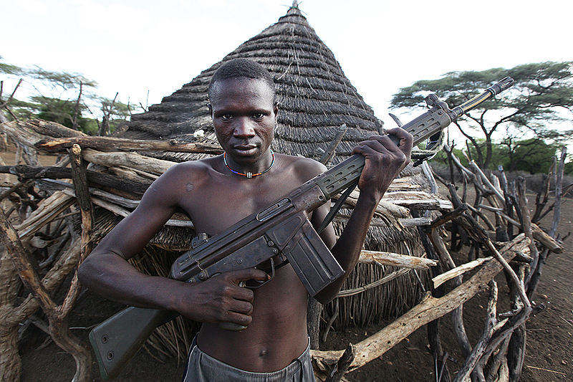
Crisis Communication in Africa Crisis Response & Strategies
Ibrahim Saleh, PhD
Ibrahim.Saleh@uct.ac.za
Notes:
Photo source: Steve Evans http://www.flickr.com/photos/64749744@N00/5786070092

Slide 2
"There cannot be a crisis next
week…My schedule is already full."
-Henry Kissinger

Slide 3
"Providing the right amount of accurate information at the right time is a fundamentally strategic issue." – Gerald Baron

Slide 4
Close scrutiny will show that most "crisis situations" are opportunities to either advance, or stay where you are….
-Maxwell Malt

Slide 5
Readings
Week 3:
Hale, J. E. & Dulek, R. E. (2005). "Crisis Response Communication Challenges: Building Theory From Qualitative Data," Journal of Business Communication, 42(2), (April 2005):112-134.
Law, A. & McNeish W. (2007). "Contesting the New Irrational Actor Model: A Case Study of Mobile Phone Mast Protest, " Journal of Sociology, 41(3): 439–456.

Slide 6
Nine Steps of Crisis Response
Conduct assessment (activate crisis plan)
Organize assignments
Prepare information and obtain approvals
3
4
Conduct notification
5
Release information to media, public, partners through arranged channels
2
6
Verify situation
1
Crisis Occurs
7
Obtain feedback and conduct crisis evaluation
8
Conduct public education
9
Monitor events

Slide 7
The "Golden Hour"
If you have a crisis communications plan, activate it
Holding statement
Statements should be 75 – 100 words.
'This is what we know now – but we’re continuing to investigate and will keep you informed'
'No comment ' isn’t an option
Your job is to:
Get correct information out simultaneously;
Let them know what you know and can say;
Get critical public safety messages out;
Correct rumors;
Educate and calm the public; and
Gain support
Notes:
The first hour after something happens is called the “golden hour.” Most initial reports will come out from this hour – and more importantly subsequent stories will follow the way stories frame the event in the first hour.
While we understand that your job as an official in your community may be to handle the situation, it is also to keep the public informed. This stage is all about FACT FINDING.
First, if you have a crisis communications plan, activate it.
Next it is critical to provide a holding statement of what you know to be the facts at that time. Most people can retain and repeat 75 – 100 words. Your initial statement should be short – this is what we know now – we will keep you informed” and by keeping it short you will also be scripting your staff. SHARE THIS STATEMENT as simultaneously as possible with staff/other key audiences.
As far as picking a spokesperson – that could be a whole presentation on it’s own – for today we’ll assume you, as the leader, are the spokesperson.
It is key to remember that no comment isn’t an option – the story will go on with or without your involvement. It’s key to provide any information that you have and can release as soon as possible – through a holding statement at least.
Your role in the communications is to put a human face on what is going on – remembering that your first priority should be to victims and families. If this is an event where injuries/deaths occurred, put that into your holding statement – such as “What we know right now - additional information will be forthcoming - right now our focus is on the victims and their families - we will get back to you at …” Pick a time and stick with it.
At this point you may not know a lot about what is going on but you should not be afraid to say if you don’t know something or if information is confidential.
Schedule your next briefing and stick to it – even if you don’t have additional information at that time, you can be there to get questions and know what they are looking for in the future.

Slide 8
Surviving the First 48 Hours
48
Requires quick assessment
Collection of facts
Actions to secure resources
Media and public response
Rehearsal
Alert key partners, as appropriate

Slide 9
Key Messages
Prepare to address these questions:
Who: is responsible, is affected, will benefit
What: happened, is the impact, is the cost, is the solution
When: did it happened, will it be resolved, will you have more information
Where: did it happen, are people going to be relocated
Why: didn’t you know about this, didn’t you do something sooner, is this taking so long
"Why " questions tempt you to speculate - don’t do it!
Notes:
These are the types of questions you should be prepared to answer at your first interview/briefing.
Who: is responsible, is affected, will benefit
What: happened, is the impact, is the cost, is the solution
When: did it happened, will it be resolved, will you have more information
Where: did it happen, are people going to be relocated
Why: didn’t you know about this, didn’t you do something sooner, is this taking so long
Why questions – are a trap – to get you to speculate. Don’t do it. More on that later.
Focus on procedure if necessary – procedure doesn’t necessarily relate to specifics of current crisis but helps give reporter something to go back with. VDSS example of violations at assisted living facilities, example.

Slide 10
Delivering Bad News
Getting out your message puts you on offense, not defense.
Answer honestly – can’t play gotcha if you tell the truth
Take responsibility
Show humility
Couple concern with commitment to action
Address rumors
Make sure your body language corresponds to your message
Notes:
When delivering bad news be on the offense – not defense.
Be honest – they can’t play gotcha if you tell them the truth.
Take responsibility if you can – and get sign off from attorneys
Show humility
Show a commitment to action and ensuring it doesn’t happen again
Address rumors
Make sure your body language corresponds to your message – no smiley face with victims.

Slide 11
Instances of Crisis
How would you report on cases reflected in the following images?

Slide 12
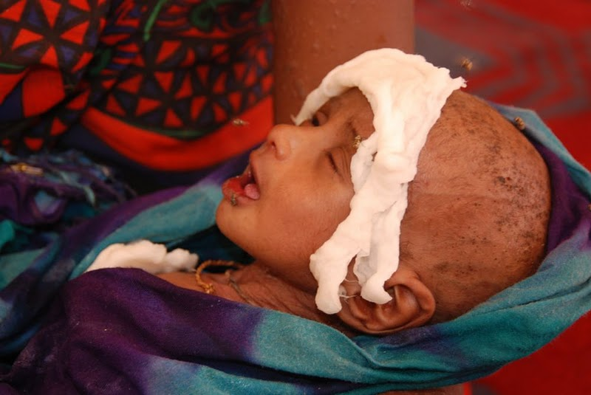

Slide 13
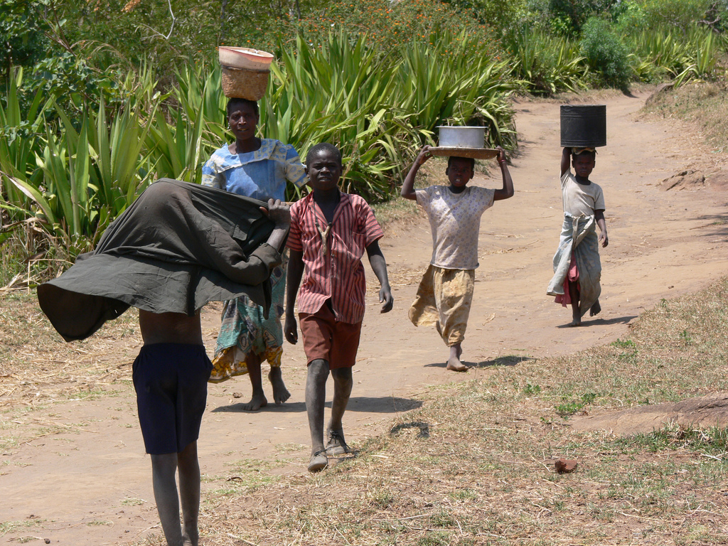
Notes:
Photo by: Lars Plougmann https://www.flickr.com/photos/criminalintent/63336602/in/set-1366816

Slide 14
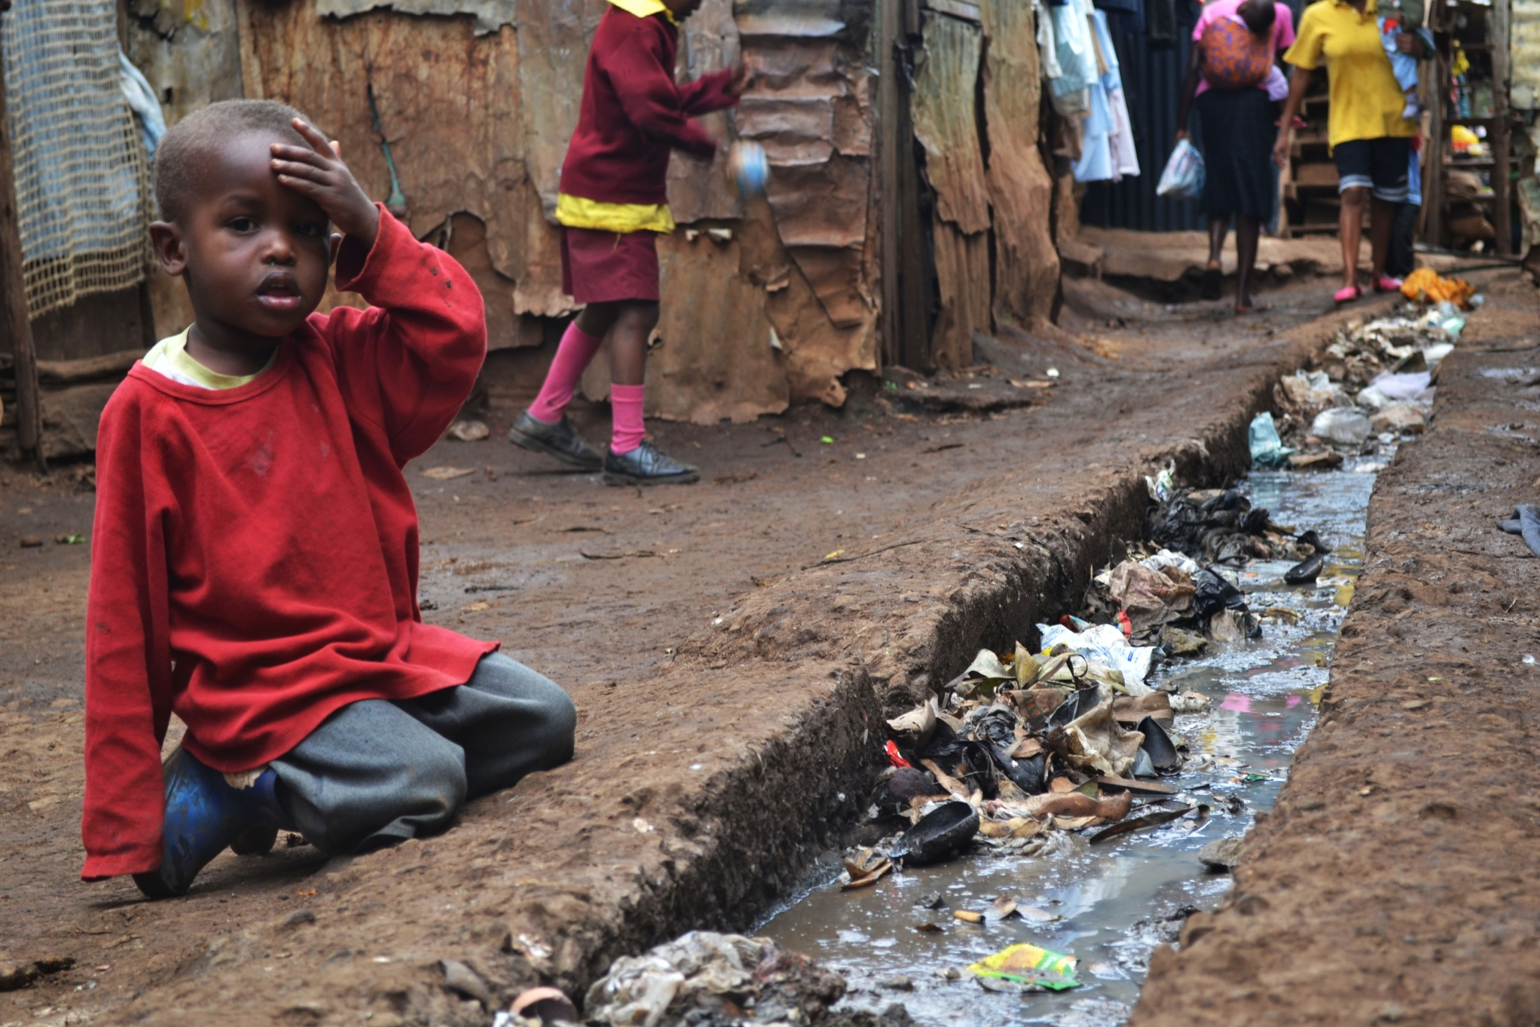
Notes:
Photo Source: http://en.wikipedia.org/wiki/File:A_young_boy_sits_over_an_open_sewer_in_the_Kibera_slum,_Nairobi.jpg

Slide 15
Thesis statement
The attribution of whatever has caused a crisis not only affects how the crisis is perceived and also how communicating the crisis is shaped.
Public response tend to be dependent on the cause of the risk, even though the consequence is the same.

Slide 16
Communicating Crisis
How to best communicate to different audiences during a crisis seems to be high on the political agenda.
Information released in times of crises often needs to be timely, accurate and should provide relevant information to those affected.
The content of crisis communication is influenced by the type of crisis is at hand; ranging from public apologies when the reputation of an organization is at stake, to emergency behaviour in case of a major natural disaster.

Slide 17
Crisis Communication: Past to Present
In the past, crisis communication focused on causes and who or what that is to be blamed, as a way of reducing threat and uncertainty (Seeger, 2002).
In the present, the causes leading to a crisis are unclear or unknown, communicating uncertainty and ambiguity is focused on the best practice of crisis communication.

Slide 18
In the past, authorities have been reluctant to share information concerning different risks and crises out of concern that the public, or groups of people, might react with protests, irrational behaviour or even panic (Perry & Lindell, 2003; Sandman, 2006).
In the present, communication acknowledges or attributes the cause of the risk or crisis, because it provides the context for the situation (Coombs & Holladay, 1996).

Slide 19
Risk-managing process
Providing people with detailed information concerning the events leading up to a crisis can cause them to believe that the risk could have been better managed or that the crisis could have been altogether avoided (Coombs, 1999).
However, many risk managers don’t disclose the risk assessment process to a larger scrutiny, as it may invite discussions of overall risks rather than those controlled by the individual company, leading to delays or costly processes (Gouldson, Lidskog, & WesterHerber, 2007; Wise´en & Wester-Herber, 2007)

Slide 20
Psychometric Paradigm (Fischhoff, Slovic, Lichtenstein, Read, & Combs, 1978).
The level, the intensity and the direction of perceived shared risk depend to a large extent on the degree of 'dread' it invokes (Sjo¨berg, 2002), it can be agreed upon that risk perception is more inﬂuenced by possible consequences, rather than the estimated probability (Sjo¨berg, 2002).
Risk is a multi-dimensional concept that is not primarily focused on the probabilities and technical estimates, but also on the level of 'outrage' factor that include cognitive and affective components in emergency situations (Lachlan & Spence, 2007)

Slide 21
Organizational crises
Events characterized by high consequence, low probability, ambiguity, and decision-making time pressure (Pearson & Clair, 1998).
Crisis management consists of three distinct phases: crisis prevention, crisis response, and recovery from the crisis.
Fink (1986) subdivided crisis prevention (i.e., avoiding and averting potential crises) into three stages (mitigation, planning, and warning), thus developing his five-stage interdependent model consisting of crisis mitigation, planning, warning, response, and
recovery.
The response stage is entered when avoidance efforts fail and events trigger a crisis, which makes the shift in resources and efforts to minimizing damage to the environment, facilities, and people.
Crisis response communication includes conveying ongoing crisis events to stakeholders, decision making within the crisis management team, and organizational decisions regarding whether and what amount of information to share

Slide 22
The Spiral Crisis Response Communication Model
The crisis response communication spiral is activated when a triggering event occurs and rapid, decisive action is needed. At this point, the organization goes into "crisis mode" and proceeds to enter the crisis response stage.
The process progresses forward through the loop from (1)observation through (2) dissemination, which in turn triggers another response (3) iteration. At other times, however, analysis shows that progress ceases and the crisis teams retrace the communication activities by moving backward.
Information is made sense of is determined by concrete environmental and social conditions that people find themselves in

Slide 23
The perception and the Reality
The controversy and related protests surrounding the sitting of mobile telecommunications base stations are understood primarily in terms of perceptions of health risks associated with radiation emissions then they rest on an apparent paradox. However, scientific evidence, radiation from base station masts could be considerably lower than emissions from mobile handsets (Stewart, 2000)

Slide 24
The New Irrational Actor Model
Current research tends to prioritize professional and expert definitions and calculations of risk over public perceptions (Bennett and Calman, 1999; Kammen and Hassenzahl, 1999).
Public concerns and campaigns are variously attributed to the failure of elites to communicate scientific knowledge effectively to the public (Covello, 1998), or their collective cognitive failure to acquire accurate knowledge (Hester, 1998).

Slide 25
The 'established mental model' of deficient public knowledge and risk perceptions often assumes the public’s numerous misconceptions and misperceptions, as well as deductions from inaccurate media information (Szmigielski and Sobiczewska, 2000: 364).
Studies for the International Commission on Non-Ionizing Radiation (ICNIR) and the World Health Organization (WHO) (Matthes et al., 1998; Repacholi and Muc, 1999) propose to resolve the clash between science and public perceptions by a more efficiently designed process for communicating scientific knowledge appropriate to the existing 'mental models' of lay people.

Slide 26
The Explicit Irrationality Thesis
Risk-denial perspective, constantly hostile to environmentalism and related social movements and discourses that seek to challenge the hegemony of dominant conceptions of scientific endeavour, economic modernization and technological development (Burgess, 2002, 2004, 2005a, 2005b).
Contemporary society is increasingly losing confidence in scientific authority, the benefits of corporate governance and the progressive potential for human advancement have led to the model of 'march of unreason'(Burgess, 2004; Furedi, 1997)

Slide 27
Media and the Irrational Model
Media play a decisive role as the catalyst of fear, and state elites engage in a collusive 'politics of fear', something that is illustrated in the way that scientific authority is routinely either under used or over used by state elites depending on the sensitivity of the political issue at stake (Brown, 2005).
Media with agenda setting has a tendency to transform through cumulative effects fear into a cultural perspective through which society makes sense of itself (Furedi, 2004: 3).

Slide 28
The precautionary principle
Represents for the campaigners the most substantively rational response to unknown and unseen risks rather than an irrational 'gamble' on 'irreversible' consequences.
Activists therefore seek for the precautionary approach to be moved from the level of rhetoric to real implementation by the government and planning authorities.

Slide 29
This presentation is licenced under the Creative Commons Attribution 2.5 South Africa License. To view a copy of this licence, visit http://creativecommons.org/licenses/by-sa/2.5/za/
Or
send a letter to Creative Commons, 171 Second Street, Suite 300, San Francisco, California 94105, USA.

