Slide 1
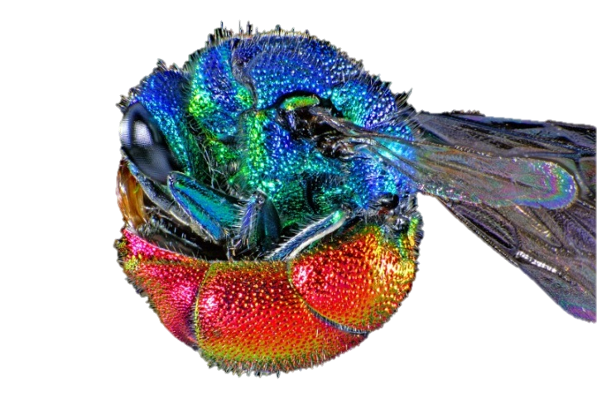
Funding at the Wellcome Trust
29 July 2016 S
Mary De Silva
Head of Population, Environment & Health
m.desilva@wellcome.ac.uk
Alexina Weekes
Grants Advisor
a.weekes@wellcome.ac.uk
Notes:
1

Slide 2
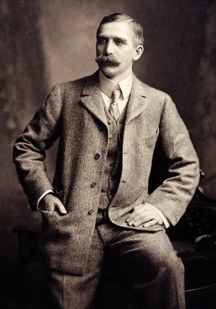
The Wellcome Trust
Wellcome exists to improve health for everyone by helping great ideas to thrive
Global charitable foundation
World’s second largest private funder of medical research
Supports over 3000 researchers in more than 50 countries
£740 million total annual spend
£103 million for international activities
Established in 1936 to administer the endowment of pharmaceutical businessman and philanthropist Sir Henry Wellcome
Notes:
Supports over 3000 researchers in more than 50 countries
£740 million total annual spend
£103 million for international activities
Annual report- 2013/14 spent 727.7 on ‘charitable activities’

Slide 3
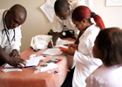
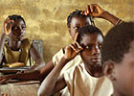
Wellcome and UCT
2nd most successful in LMIC for Wellcome Trust funding in population health
21st most successful institution globally
Most funding has been in infectious diseases
BUT
We have many eligible schemes that UCT researchers rarely apply for
Notes:
Our funding has three focuses:
First, the individual. We want to support the brightest researchers with the best ideas at all stages of their careers.
We are also committed to maximising the application of research to improve health
Finally, for our third focus - because biomedical science by its nature challenges cultural norms and personal beliefs and choices - we will aim to understand the social, political and historical contexts of biomedical science and its application so that we can help deliver its full potential for health improvement.

Slide 4
Schemes for LMIC
Personal support for researchers
Support for teams
Support for research resources
Themed initiatives in population health

Slide 5
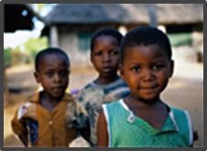
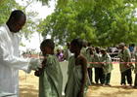
Personal support for researchers
Fellowships
Investigator Awards
Seeds

Slide 6
Fellowship – key features
To attract, train and retain the best researchers
Schemes designed for each stage of the research career
Salary of the fellow provided
Plus research costs – including the salaries of the fellow’s research team, consumables, equipment and other expenses
Research should be aimed at understanding and improving public health and tropical medicine of local, national and global relevance
You must be based primarily in a low- or middle- income country

Slide 7
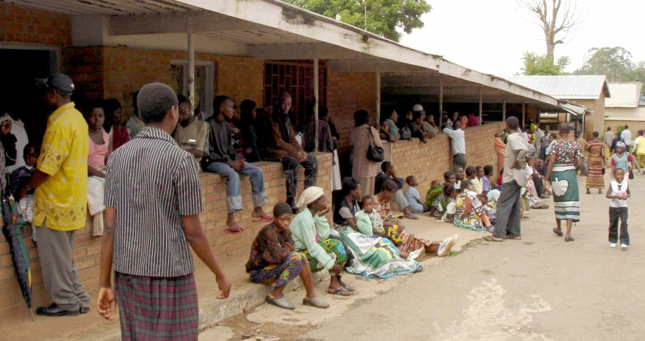
Public Health and Tropical Medicine Remit
The PH&TM remit covers research on infectious and non-communicable diseases (either human or animal) of relevance to local, national or global health.
Can include laboratory based molecular analysis of field or clinical samples
Projects focused solely on studies in vitro or using animal models will not normally be considered under this scheme.
Measurements of infectious and chronic disease burden
Clinical trials*
Demographic, social science and health economic studies
Health care systems and policy research
Population studies
Studies of disease mechanisms, immunity or resistance in the natural host or vectors
* Clinical trials must be achievable in the time frame & appropriate to career stage
Notes:
For all these fellowships the proposed research projects should be in the Public Health and Tropical Medicine Remit. Which is research on infectious and non-communicable diseases (either human or animal) of relevance to local, national or global health.
The fellowships should be Primarily based in a LMIC and periods of training may be done internationally

Slide 8
PUBLIC HEALTH & TROPICAL MEDICINE
Personal support for researchers based in a low- and middle- income country
Masters Fellowships
Training Fellowships
Intermediate Fellowships
PhD
Senior Fellowships
Investigator Awards
EARLY
INTERMEDIATE
SENIOR

Slide 9
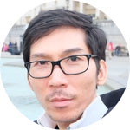
Masters Fellowship in Public Health and Tropical Medicine
Anne Amulele
KEMRI-Wellcome Trust Research Programme, Kenya
‘Virulence characteristics of Shigella species isolated from children hospitalised at Kilifi County Hospital’
For junior researchers to provide them with the opportunity to gain research experience and training at a Master’s degree level
Flexible support for 30 months (12 month Masters course, and an 18 month research project).
Training and your Master’s degree may be undertaken in centres of excellence regionally or internationally
Applications considered twice a year (next application deadline 30 August 2016)
Ngure Kagia
KEMRI-Wellcome Trust Research Programme, Kenya
‘Molecular epidemiology of ESBL-carrying Enterobacteriaceae among neonates at Kilifi County Hospital’
Patpong Rongkard
University of Oxford
‘The cross-reactivity of human humoral and cellular immune responses to Burkholderia pseudomallei and avirulent Burkholderia species’

Slide 10
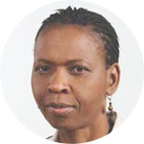
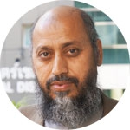
Training Fellowship in Public Health and Tropical Medicine
Dr Mutsawashe Bwakura-Dangarembizi
University of Zimbabwe
‘Long-term clinical and nutritional outcomes of HIV-infected children surviving inpatient management of severe acute malnutrition’
For researchers who are at an early stage in their careers (no more than 3 years postdoctoral experience)
Flexible support for three years to provide opportunities for research experience and high-quality research training relevant to health in low- and middle-income countries.
Training may be undertaken in centres of excellence regionally or internationally
Applications considered twice a year (next preliminary application deadline 28 November 2016)
Dr Ghulam Rahim Awab
Nangarhar University, Afghanistan
‘Bridging the critical policy-practice gap in radical treatment of vivax malaria in Afghanistan’
Dr Eleanor Ochodo
Stellenbosch University, South Africa
‘Developing a framework for design of clinical trials to measure the impact of TB diagnostic tests on patient outcomes’

Slide 11
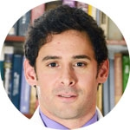
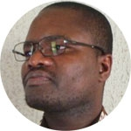
Intermediate Fellowship in Public Health and Tropical Medicine
Dr Maria Adelaida Gomez
Centro Internacional de Entrenamiento e Investigaciones Medicas (CIDEIM), Colombia
‘The inflammatory response as a targetable pharmacodynamic parameter of antileishmanial drugs’
For high-calibre, mid-career researchers to establish an independent research programme (have between 3 to 6 years postdoctoral experience)
Flexible support for five years
Candidates must have a relevant high-quality publication record and show potential to become a future scientific leader.
Applications considered twice a year (next preliminary application deadline 28 November 2016)
Dr Francisco Villafuerte
Universidad Peruana Cayetano Heredia, Peru
‘Mechanisms, cardiometabolic consequences and treatment strategies for high-altitude excessive ertythrocytosis and chronic mountain sickness in the Andes’
Dr Luc Djogbenou
Institute Regional de Sante Publique, Benin
‘The impact of insecticide resistance and exposure on Plasmodium infection level and prevalence in the malaria vector Anopheles gambiae’

Slide 12
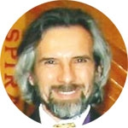
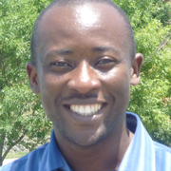
Senior Fellowship in Public Health and Tropical Medicine
Dr Hector (Hugo) Garcia
Universidad Peruana Cayetano Heredia, Peru
‘Definition and characterisation of the contribution of neurocysticercosis to seizure burden in endemic areas’
For high-calibre researchers to establish themselves as internationally recognised leaders in their field (have between 5 to 12 years postdoctoral experience)
Flexible support for five years
Candidates must have a relevant high-quality publication record and show potential to become a future scientific leader.
Applications considered twice a year (next preliminary application deadline 28 November 2016)
Dr Christophe Antonio-Nkondjio
OCEAC, Yaoundé, Cameroon
‘Assessment of larviciding efficacy for integrated vector control in the city of Yaoundé, Cameroon’

Slide 13
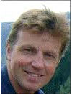
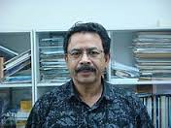
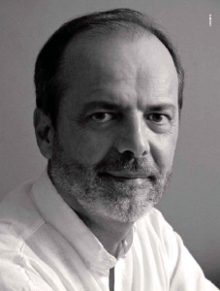
Investigator Awards
Investigator Award are for researchers at any stage in their independent research career.
Early-stage researcher, you should be able to show that you can innovate and drive advances in your field of study and demonstrate considerable promise for the future
Mid-career or senior researcher, you should have achieved more in terms of originality and impact of your research, your track record of gaining research grant support and your success in training and mentoring others.
Flexible support for five years
Applications considered three times a year (next application deadline 21 November 2016)
Professor Guy Thwaites,
Oxford University Clinical Research Unit, Vietnam
Dr Shah Faruque
International Centre for Diarrhoeal Disease Research, Bangladesh
Professor César Victora
Federal University of Pelotas, Brazil

Slide 14
Seed Awards
Responsive, flexible funding, enabling researchers to develop a novel idea.
To generate resources, tools and/or preliminary data leading to a larger research application
Applicants must hold an appointment at an eligible institution in the UK, Republic of Ireland or a low- or middle-income country
Up to £100,000 over 2 years
Not for researchers with a current personal award or other substantive funding
Considered 3 times per year
(next application deadline 3 October 2016)
Notes:
FYI- standard LMIC rules apply to both schemes, for now (some LMIC applicants can propose both PHATM and basic science, others can only propose PHATM projects). When our international strategy is reviewed later on this year this may change. It’s not a level of detail worth having on the slide, but might be something to bear in mind in case the audience ask any questions about it.

Slide 15
Support for teams
Collaborative Awards

Slide 16
Collaborative Awards
Collaborative research projects that can only be achieved by teams working together
Single or cross-discipline (but cross-discipline encouraged)
Teams can be multinational, but we expect that at least one applicant will be based in the UK, ROI or LMIC
Members of the team must have proven experience in collaborative research and consist of independent research groups
Up to £4 million for up to 5 years
Applications considered 3 times per year (next preliminary application deadline 17 November 2016)
Notes:
FYI - standard LMIC rules apply to both schemes, for now (some LMIC applicants can propose both PHATM and basic science, others can only propose PHATM projects). When our international strategy is reviewed later on this year this may change. It’s not a level of detail worth having on the slide, but might be something to bear in mind in case the audience ask any questions about it.

Slide 17
Support for research resources
Biomedical Resources
Technology Development Grant
Multi-user Equipment Grant

Slide 18
Biomedical Resource / Technology Development Grants
These grants are for researchers who want to establish or maintain resources or technology for the benefit of the wider scientific community
Examples include databases, biobanks, cohorts
Flexible funding of up to £1.5 million
Applications considered once a year (next deadline approx Nov 2016)
Multi-user Equipment Grants
These grants provide support for multi-user items of equipment
Examples include FACS, electron microscopes, mass spectrometer
Flexible funding of up to £1 million
Applications considered once a year (next deadline approx Nov 2016)

Slide 19
Population health specific schemes

Slide 20
Wellcome’s mission: to improve health for everyone

Slide 21
Direction of travel for population health – towards health impact
Definitive RCTs with clear pathway to implementation
Health systems research
Transition to scale - Implementation Science to understand how to scale up interventions and their impact at scale

Slide 22
Joint Global Health Trials
Late stage trials of interventions that will provide evidence to improve health in LMIC
Frequency of calls | Annual
Next deadline | 15th September 2016
Development grants | Up to £150,000 for 2 years. To do pilot work to develop aspects of a trial protocol NOT a small stand alone project grant.
Full grants | ~£19 million to fund several trials for up for 5 years
What we want | Rigorous methodology All intervention types Likely to produce results that are implementable Focus this round on NCDs including mental health, and reproductive, maternal and newborn health

Slide 23
Joint Health Systems Research Initiative
Providing evidence to strengthen health systems to improve health outcomes in low- and middle-income countries
Frequency of calls | Annual
Next deadline | Call opens Nov 2016, deadline Jan 2017
Development grants | Up to £100,000 for 18 months. To do formative work towards a full proposal, NOT a small stand alone project grant.
Full grants | ~£4 million to fund 5 to 10 grants, up to 3 years
What we want | A step change in understanding how to optimise health systems in LMIC
What we don’t want | Evaluations of specific interventions

Slide 24
Research into Health in Humanitarian Crises
Support for research institutes and humanitarian organisations that work in partnership to improve health outcomes in humanitarian crises
Frequency of calls | Annual
Next deadline | Closed for 2016. Next call: July 2017
Rapid response grants | Funding is ‘pre-approved’ and triggered later when the foreseen rapid-onset crisis occurs
Full grants | ~£4 million to fund 8 to 10 grants, up to 2 years each
What we want | Improve health outcomes by strengthening the evidence base for public health interventions in humanitarian crises Bridge the gap between research and practice Partnership between a research institution and an operational humanitarian organisation

Slide 25
Direction of travel for population health – towards health impact
Definitive RCTs with clear pathway to implementation
Health systems research
Transition to scale - Implementation Science to understand how to scale up interventions and their impact at scale

Slide 26
Direction of travel for population health – towards health impact
Definitive RCTs with clear pathway to implementation
Health systems research
Transition to scale - Implementation Science to understand how to scale up interventions and their impact at scale

Slide 27
Direction of travel for population health – towards health impact
Definitive RCTs with clear pathway to implementation
Health systems research
Transition to scale - Implementation Science to understand how to scale up interventions and their impact at scale
Collaborative awards

Slide 28
Questions?

